Slide 1



Slide 2
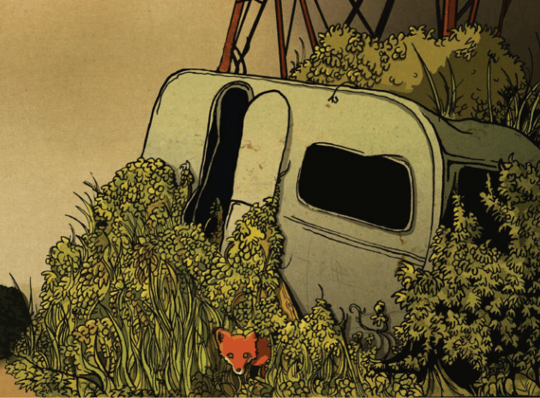
The Caravan

Slide 3
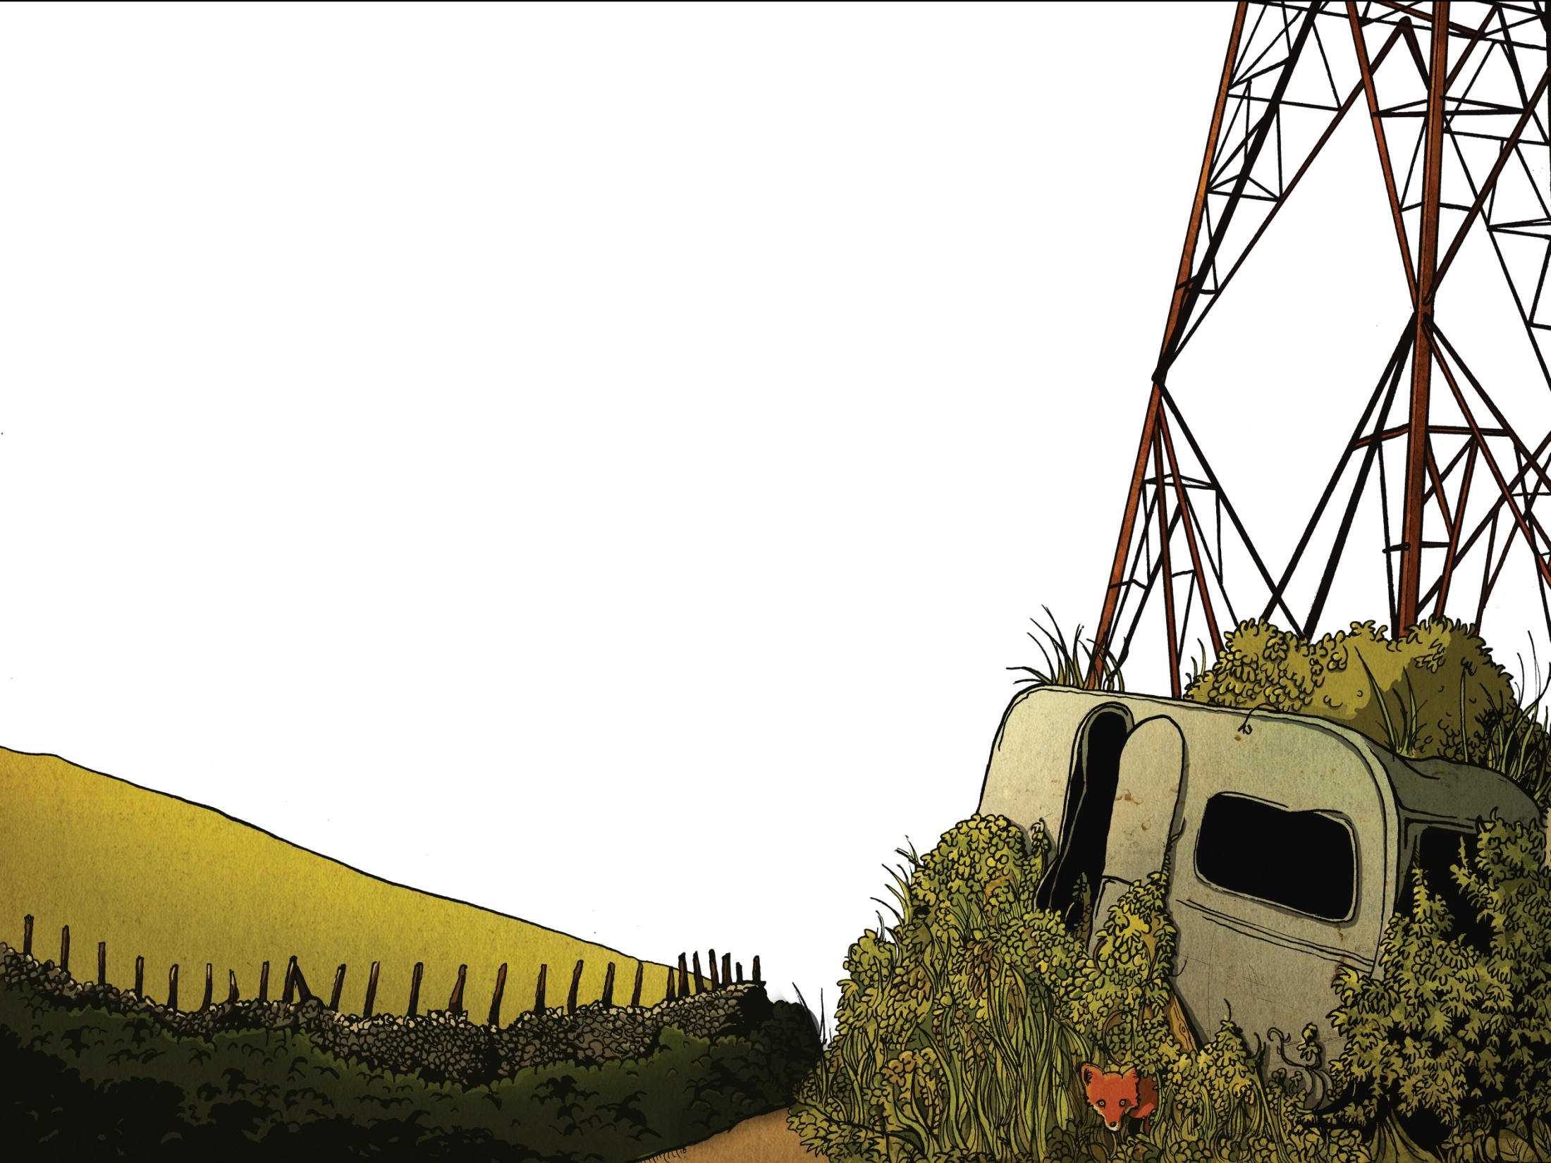
“Now Mitch, don’t go playing up by the pylon,” my Mum had warned me often enough. “It’s dangerous. You’ll get yourself electrocuted.” Did I listen? Of course I didn’t. Most days after school that was exactly where I went. Daft really, but she actually thought that I was doing my homework with Connor.

Slide 4
Mum worries too much. I’ve still not forgotten how she used to tell me not to play under Hanger Bridge by the railway in case the troll snatched me. Of course, I was younger then.

Slide 5
The pylon she was talking about stood at the end of Muggie Moss Road. Red and brown rust fluttered from its lean body and it made odd creaking sounds when the wind blew. It was there we found the caravan.

Slide 6
It had been empty for years. If you go past, you’ll just see a small patch of overgrown land under the pylon, a mess of brambles and nettles that smothered the van.

Slide 7
It was damp inside and the windows were smeared with green grime. Moss clung to its wheels. It was a place of dead spiders and dust but it was our special place. Most days after school we went straight there. Just to muck about.

Slide 8
That afternoon, a storm raged. It had been brewing all morning. The trees were like crazed zombies thrashing wildly. Rain lashed down, drumming on the metal roof. Inside the caravan it felt safe, almost cosy really. We shoved newspaper into any cracks to keep out the wind.

Slide 9
I’d found a bit of old carpet and Connor had brought along some cushions that his Mum had thrown out. He’d also found a candle and in the semi-gloom its flame flickered with a cheerful glow. Outside dusk shadowed the bushes. Soon the streetlights would come on, casting orange pools of light.

Slide 10
We were arguing over whether the last goal in the Man United game was the best yet when we heard it: a clap of thunder so close that it sounded like an explosion. Connor wiped the condensation from the window and we peered out.

Slide 11
At that very moment, there was another tremendous crack, and lightning struck the pylon. Sparks flew, the pylon shuddered and, as if in slow motion, it crashed down towards the caravan roof.

Slide 12
Instinctively, we both ducked down fast. There was an enormous crash and the caravan roof crumpled. The air prickled with electricity and rain lashed through the opening in the roof. For a moment, I was certain that I was about to be fried alive.

Slide 13
In the half-light, I could see Connor’s face. His eyes were wide with fright and he gulped like a fish. “Come on,” he hissed. We slithered like snakes across the floor with the rusted pylon creaking dangerously above us.

Slide 14
Luckily, the door had flown open when the pylon had struck. We slipped out onto the muddy ground and lay there with the thunder grumbling above us and the rain beating down. Then Connor started to laugh. He curled up into a ball and laughed so much that I thought he was crying.

Slide 15
I couldn’t help myself. The next thing I knew, I was laughing too. Inside, I just felt relief. On the outside, I was laughing crazily. Then we ran, through the brambles and out onto Muggie Moss Road.

Slide 16
Of course, Mum was furious. “I’m not made of money,” she said, eyeing the state of my school clothes. “Still, maybe a good wash will sort them out.” She glared at me suspiciously. “So, a tree nearly hit you?” I nodded, avoiding her icy stare. “You could have been killed,” she said. Shamefaced, I nodded. She was right. She’d been right from the start.

Slide 17
Warning Stories

Slide 18
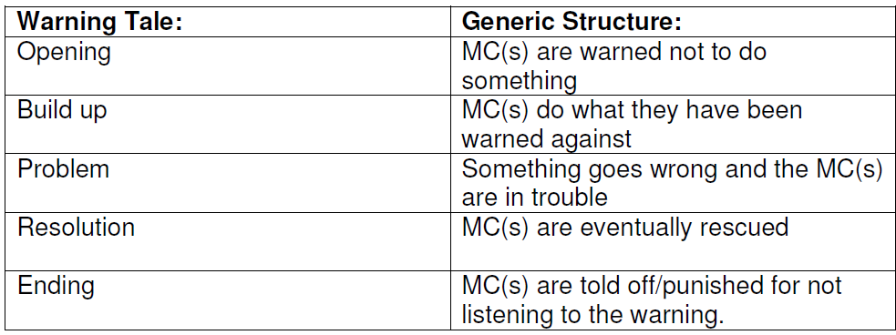

Slide 19
Can you link the events of the story to the structure?

Slide 20
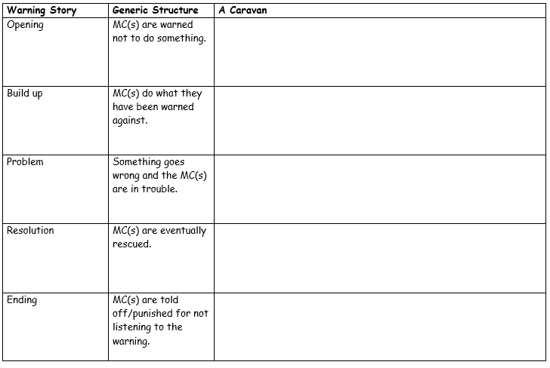
Activity
Write the events of the Caravan story next to the matching part of a warning story structure.
Red Pen: Draw a graph showing the ups and downs of Mitch’s feelings during the story – label with quotes from the text.

Slide 21
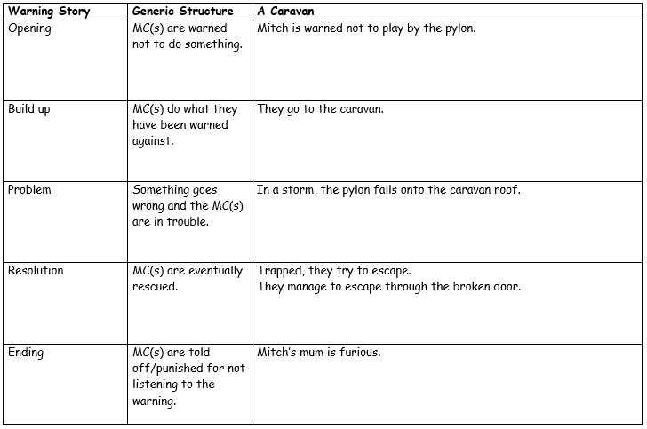
ANSWERS

