Slide 1


Friday 22nd January 2021
L.O: understand that differences and conflicts sometimes happen among family members.
C: Celebrating Differences!

Slide 3
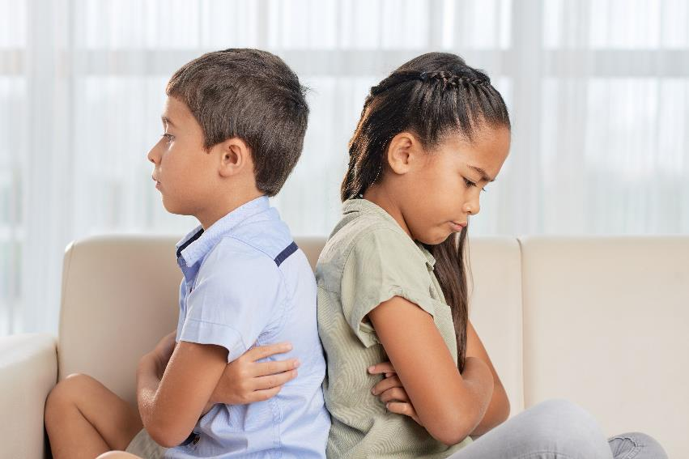

Slide 4

Let’s think about this scenario!
Nova has an older brother Caleb who is at senior school. Caleb is always on his phone or tablet. Nova’s Mum gets cross with Caleb and asks him to get off his phone because she says it is unhealthy to spend so much time looking at screens. There is always an argument about it because Caleb doesn’t agree. Nova gets her tablet taken away too, even though it’s not her fault.

Slide 5
Now use the “Solve it together” Technique to try and work out a solution to the problem!

Slide 6
Now use the “Solve it together” Technique to try and work out a solution to the problem!
Try the technique with some of the scenario cards!

