Slide 1
PSHCE

Slide 2
Memories
Think of something you have at home that is a reminder of a special event: perhaps a holiday, trip or visit, or a special experience of some kind. The reminder could be a photograph or a souvenir object, item of clothing…
We like to remember both occasions and people that have been special to us, and photos, souvenirs and mementos help us to do this.

Slide 3
Think of some reasons why you might not see a person they once knew e.g. family members who live abroad, friends who moved away, people who have died, family members falling out and splitting up…

Slide 4

Jaz is feeling sad today because one of Jaz’s friends has lost a very special pet dog called “Tammy’.
Tammy was very old and had a wonderful life, and she died of old age. Tammy used to enjoy playing by the seaside and going for long walks with her owner. Jaz wants to remember Tammy by putting something special in a memory box.

Slide 5
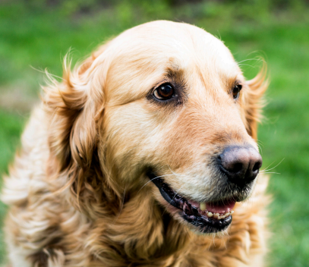
This could be a picture or a poem, or maybe something special to Tammy e.g. her favourite toy/collar.
Draw some items to go in Jaz’s memory box to remind him of Tammy.

Slide 6
Although Jaz and Tammy’s owner are feeling sad today, they are now also able to remember all the special things about Tammy, so she will always be close to them.

