Slide 1
Monday 17th May 2021
LO: To understand electrical circuits.
C: Electricity.

Slide 2
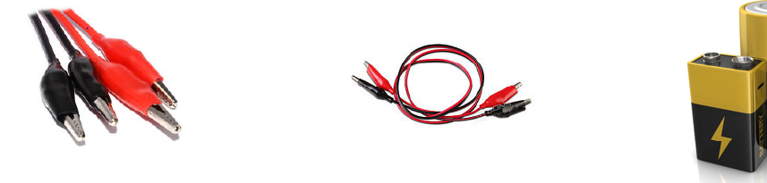

Recap:
What is needed to make a bulb light up or a buzzer sound?
Challenge:
Using the website below, can you make a simple circuit which includes a bulb, buzzer or motor?
https://phet.colorado.edu/sims/html/circuit-construction-kit-dc/latest/circuit-construction-kit-dc_en.html (click ‘lab’)

Slide 3
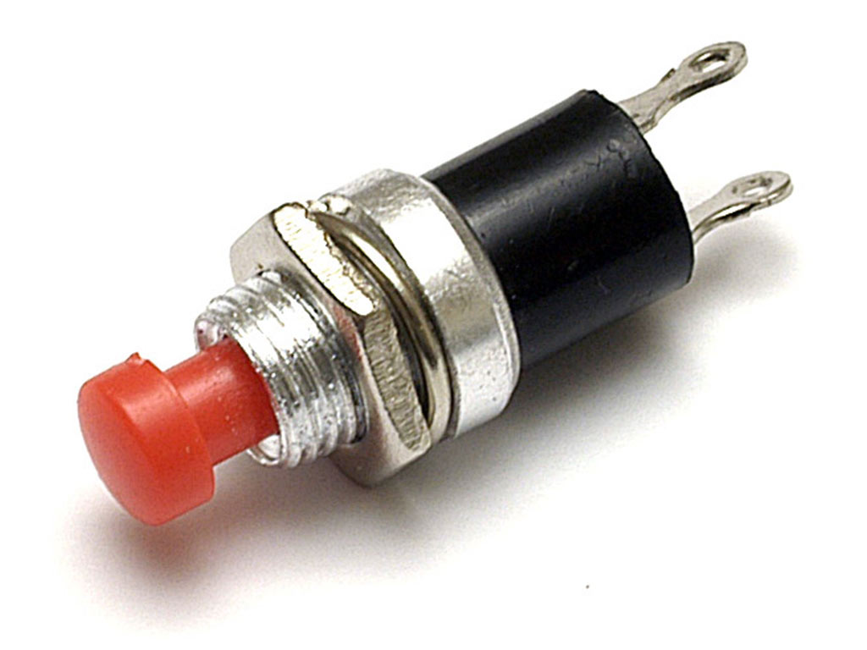
What do you think this is?
What do you think it does in the circuit?
Switch!
Using the same website again, can your add the switch into your circuit and see if it works?
The switch opens and closes a circuit.

Slide 4

Why aren’t wires made from wood?
Should I make a crocodile clip from margarine?
Why is plastic used to coat the outside of wires?

Slide 5

We know from our electricity safety lesson that your should NEVER put a knife into a toaster.
Why is this?
Watch: https://www.bbc.co.uk/bitesize/clips/zyxd7ty
(click ‘lab’)
Metal is a very good conductor of electricity, so the electrical current will pass down the knife to your hand.

Slide 6
Electrical insulators and conductors
Watch: https://www.bbc.co.uk/bitesize/topics/z2882hv/articles/zxv482p
Electrical insulators = materials that prevent electrical energy passing through them.
Electrical conductors = materials which allow electrical energy to pass through them.
SAFETY REMINDER:
People and water can conduct electricity so materials must be used to keep us safe.
Sockets are not allowed to be put in bathrooms, covers are put over wires.

Slide 7

Which materials are electrical insulators and which are electrical conductors?
Today you will test different materials to see whether they are electrical insulators or conductors.
You will make a prediction of what you think will happen FIRST and then record what actually happened.
How could you record this information?

Slide 8
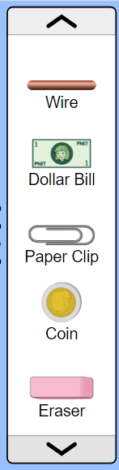
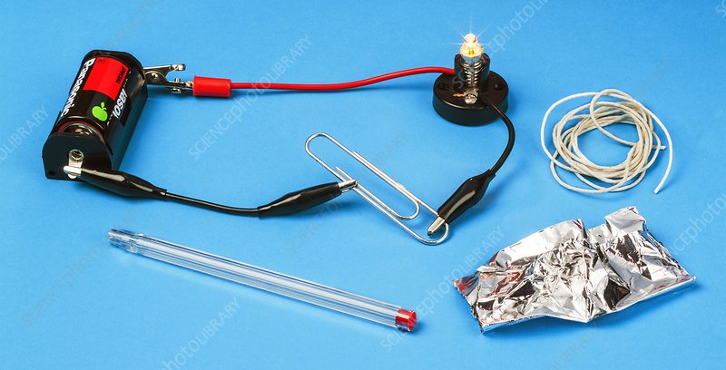
Over to you…
Go to the following website: https://phet.colorado.edu/sims/html/circuit-construction-kit-dc/latest/circuit-construction-kit-dc_en.html
Click ‘lab’.
Choose a material (from the left hand menu – you may need to scroll down) and record your prediction as to whether it will be a conductor (allows electrical energy to pass through) or an insulator (prevents electrical energy passing through).
Place the chosen material in the break of your circuit, so completing the circuit again. Does the material allow the electrical energy to pass through it and therefore light up the bulb?
Record your result in your table.
REPEAT with all the materials.
Sort the materials into those that do and those that do not allow electrical energy to pass through.
Red Pen: Do you think the position of a switch in a circuit makes a difference? Explain your thinking.

Slide 9


