Slide 1
Tuesday 18th May
LO: to understand beliefs
To understand practices and lifestyles
To understand values
C: Buddhism

Slide 2

What do you think this wheel represents?

Slide 3
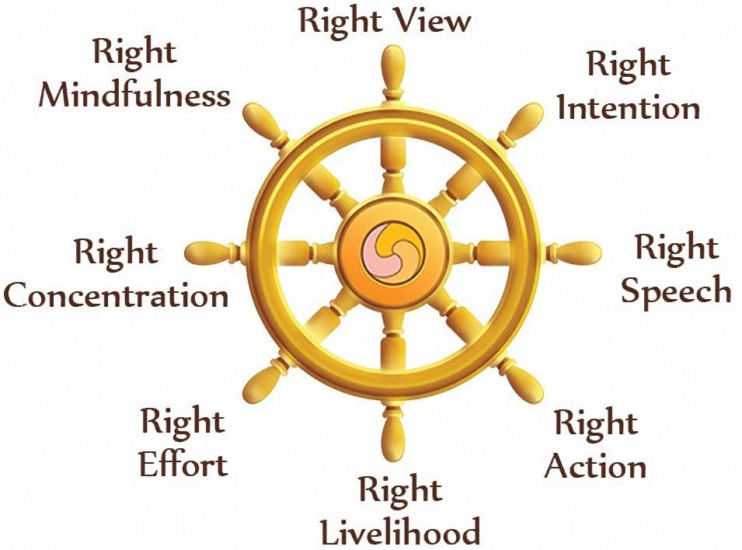
The wheel represents the eight-fold path because it has eight spokes.
The Buddha’s teaching goes round and round like a great wheel that never stops, leading to the central point of the wheel, the only point which is fixed, Nirvana (enlightenment).
The eight spokes on the wheel represent the eight parts of the eight-fold path.
Just as every spoke is needed for the wheel to keep turning, Buddhists need to follow each step of the path.

Slide 4

What can you remember about the eight-fold path and the eight stages from last week?

Slide 5
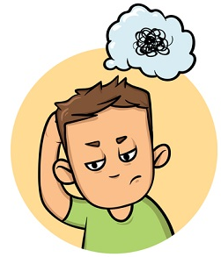
This is how I remember the eight-fold path:
1. Point to your eyes (Right View)
2. Put the palm of your right hand on your heart (Right Intention/Thought).
3. Point to your mouth (Right Speech)
4. Raise your hands in front of you and move your fingers in and out (Right Action).
5. Lower one of your hands to your side and pretend you are carrying a briefcase (Right Livelihood).
6. Move both hands over your head and lower them all the way down (Right Effort – whole mind and body effort).
7. Point to your head (Right Mindfulness).
8. Place your hands in front of you with your palms up (Right Concentration)

Slide 6
Right View
Right means complete or correct.
View is the way we look at things or the way we understand things.
So, Right View is the correct way of understanding the world.
When we use the Right View, we understand the way that the world works so that we can make the best decisions.
When we have a good understanding, we will make the right choices and avoid the bad choices. If we don't make bad choices, we will be happier.

Slide 7
Right Intention
Right means correct or wholesome (good).
Intention means that something is done on purpose; it's not an accident.
Right Intention means purposely making good decisions using Right View (what we know of the world).
People with Right Intention always try to make wholesome, harmless decisions.
What are some things that people with Right Intention do?
1. They refuse to make violent decisions.
2. They always use good will (make wholesome decisions).
3. They are selfless (they think about others first; they are not selfish).
4. They are always harmless to other living things.
When we have Right Intention, we plan to do wholesome actions. We purposely do things to make life better.

Slide 8
Right Speech
Right Speech is choosing and using your words wisely when you say them.
Right Speech is also speaking without unwise or bad speech.
There are four major types of speech that you should avoid:
1. Do not lie.
2. Do not say things that will cause others to disagree or fight.
3. Do not say anything insulting or rude.
4. Do not chatter about unimportant things.
There are four major right types of speech that you should use:
1. Always tell the truth
2. Say things to try and help people work together.
3. Always speak kindly, politely, and friendly.
4. Always speak with reason and purpose.
When we have right speech, we do not harm the others around us. With good speech, we can help people, and make everything around us better.

Slide 9
Right Action
Right Action is doing things that will not harm yourself or others.
1. Do not physically harm any living thing with your actions.
2. Do not steal from any living thing with your actions.
3. Do not emotionally or mentally harm any living thing with your actions.
There are good actions to do with Right Action:
1. Be helpful
2. Be generous
3. Be kind
Using Right Action helps everyone around you, including yourself. You will not harm anyone, you will only help them. By using Right Action, you are making life better for everyone around you. So, always try to do the good actions that are listed above, and always avoid doing any bad actions. Remember, if you accidentally do something wrong, it's okay. Just learn from your mistakes, and always try to do good.

Slide 10
Right Livelihood
Right Livelihood is living your life so that will not harm yourself or others. It's similar to Right Action.
Just think, "How can I make my life meaningful and kind?" You can do this by practicing Right Livelihood. Never lie, cheat, or steal.
Everything you do must use these to have Right Livelihood:
1. Be honest
2. Be moral
3. Be meaningful
Everything you do in life should be done selflessly - think about others when you do them. Whenever you practice Right Livelihood, you can get a better understanding of the world because you are open-minded and kind. Everyday will feel better when you practice good skills in Right Livelihood. Remember, it's okay if you accidentally make a few mistakes. Just make sure that you learn from them and try hard not to do them again!

Slide 11
Right Effort
Right Effort is trying your best to give up all your harmful ways and trying your best to be wholesome.
With Right Effort, the goal is to become a wholesome person. You have to put in a lot of effort to do this. This is called being persistent to do the right thing. You are putting in your best effort be kind, generous, and understanding.
These are the four steps to practicing Right Effort:
1. Prevent unwholesomeness (harmful actions) in you.
2. Remove the unwholesomeness in you.
3. Try to bring wholesomeness to you.
4. Always keep that wholesomeness in you.

Slide 12
Right Mindfulness
Right Mindfulness means being aware and mindful of what is happening in your life. By staying mindful, you can be focused and aware of everything that is happening around you.
Here's how to use Right Mindfulness:
1. Focus on the body.
2. Focus on feelings.
3. Focus on the mind.
4. Focus on mental qualities.
Right Mindfulness is all about focus. Pay attention to your surroundings and live in the present, not the past or future. When you observe something, you watch without judging or thinking greedily. Take a few minutes and check to make sure you're living in the present. Just sit back, breathe, and just watch everything. Take in all of your life without making any judgment. A good way to do this is through meditation. You'll see that you will have a greater understanding about life that way.

Slide 13
Right Concentration
Right Concentration means being focused and mindful of what is happening in your life. By staying concentrated on something, you can fully understand it. By staying concentrated on what is happening around you, you can fully understand life.
Here's how to use Right Concentration:
1. Do not work hard to get dukkha (suffering).
2. Do not work hard to get complete happiness (bliss).
3. Work hard to have neither bliss nor dukkha (suffering).
It seems obvious that you shouldn't try to have suffering in your life. What is surprising is to not try to have bliss in your life, right? But being the happiest person in the world is not that great. Having too much happiness is hard to keep, and you will quickly return to dukkha again. That's why the best place to be is right in the middle. There, you are neither too happy nor too sad - you are mindful. In this place, you have complete wisdom and open-mindedness to understand life.

Slide 14


Now we have learned some more about the eight-fold path:
Do you think it is easier or harder to follow than the 10 Commandments?

Slide 15
Activity
Buddhists use the Dharma wheel to represent the eight-fold path.
Your job today is to create your own way of remembering the eight-fold path.
Annotate your work to show how it represents the eight-fold path.
Remember the symbolism of the wheel – every spoke is needed for the wheel to keep turning.
Challenge: create a presentation that is equally symbolic.
You could:
represent the eight-fold path along an actual path.
draw a series of pictures as visual clues to the folds.
order the rules in order of importance.

Slide 16

Red Pen
Paddling: Which stage of the eight-fold path do you think is the most important? Why?
Snorkelling: Which stage of the eight-fold path would make the biggest difference to your life? Why? Would this difference be positive? Why/why not?
Diving: if you had to follow the eight-fold path in your life, what changes would you have to make? Do you think these changes would all be positive? Explain your thinking.

