Slide 1
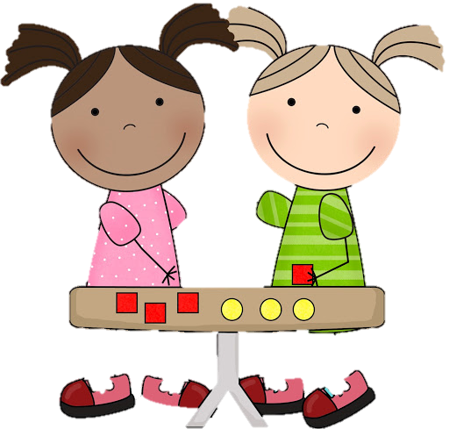

22.1.2021
L.O: Multiplication and Division
C: Dividing by 2.

Slide 3
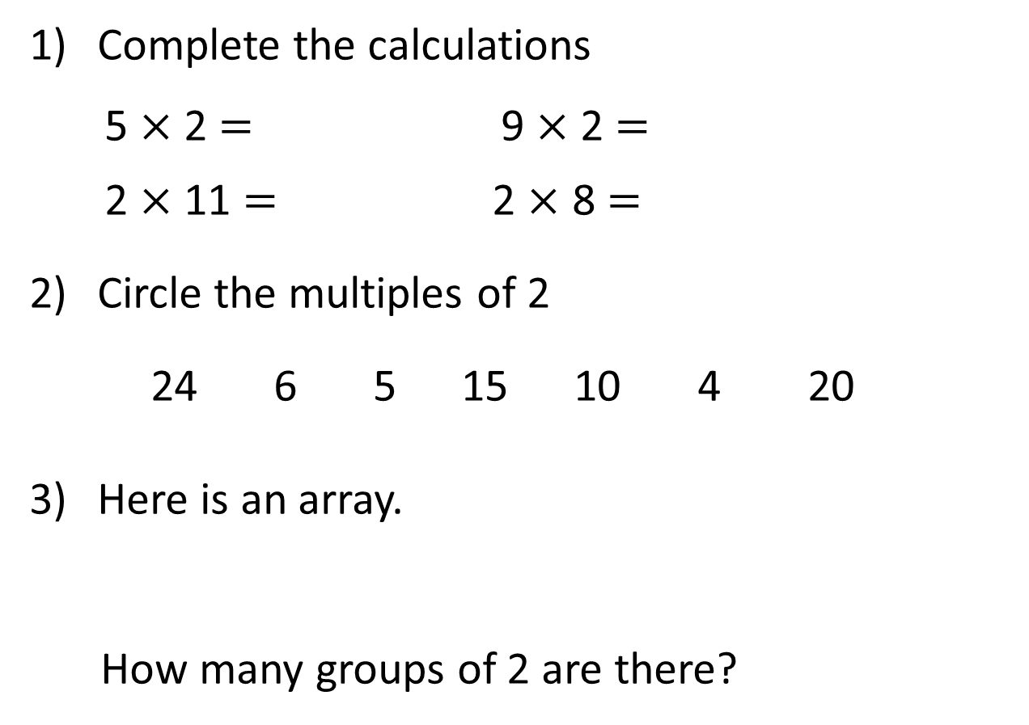
Complete the calculations
5 $×$ 2 $=$ 9 $×$ 2 $=$
2 $×$ 11 $=$ 2 $×$ 8 $=$
Circle the multiples of 2
24 6 5 15 10 4 20
Here is an array.
How many groups of 2 are there?

Slide 4
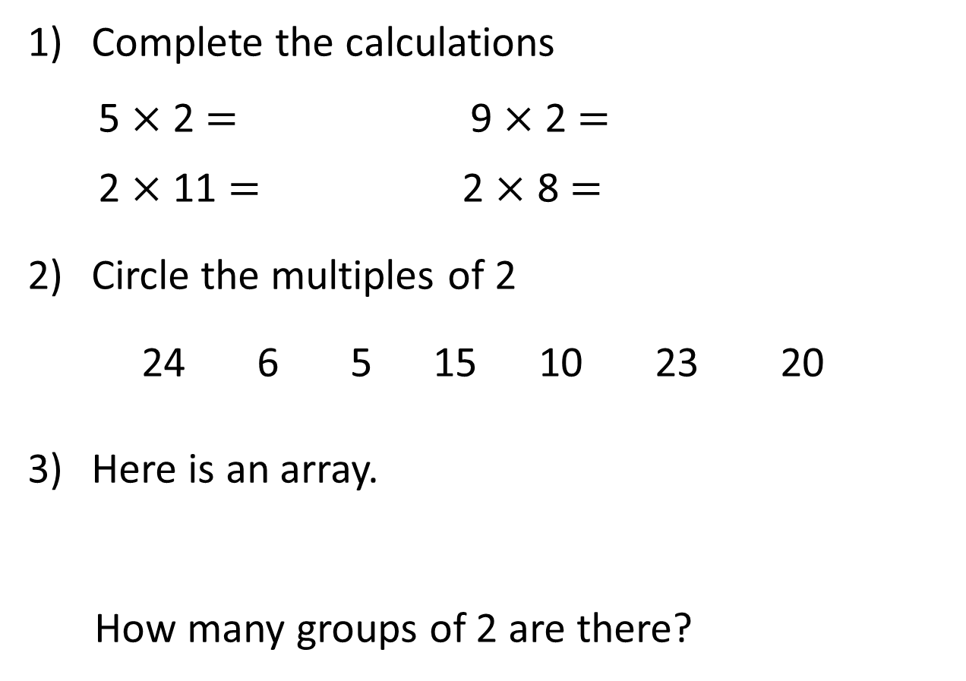
Complete the calculations
5 $×$ 2 $=$ 9 $×$ 2 $=$
2 $×$ 11 $=$ 2 $×$ 8 $=$
Circle the multiples of 2
24 6 5 15 10 23 20
Here is an array.
How many groups of 2 are there?
10
18
22
16
5

Slide 6








The children are playing a game.
They need to get into two equal teams.
How many will be in each team?
There will be 4 children in each team.

Slide 7


The children are playing a game.
They need to get into twos.
How many pairs will there be?
There will be 4 pairs of children.

Slide 8

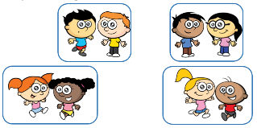
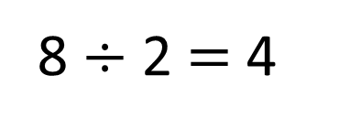
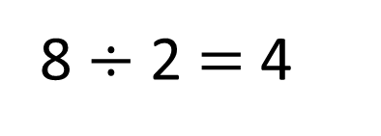
Sharing
There are 4 children in each team.
8 $÷$ 2 $=$ 4
Grouping
There are 4 pairs of children.
8 $÷$ 2 $=$ 4

Slide 9




Here are 12 flowers.
The flowers are shared equally
between 2 pots.
The flowers are grouped into
pots of 2
Have a think

Slide 10
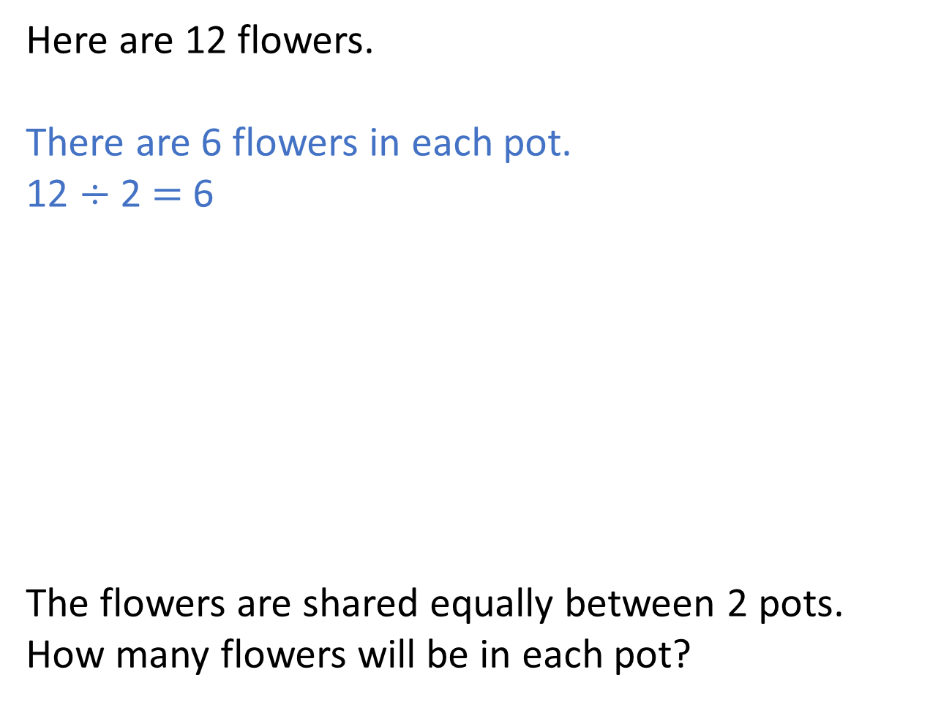
Here are 12 flowers.
There are 6 flowers in each pot.
12 $÷$ 2 $=$ 6
The flowers are shared equally between 2 pots.
How many flowers will be in each pot?

Slide 11
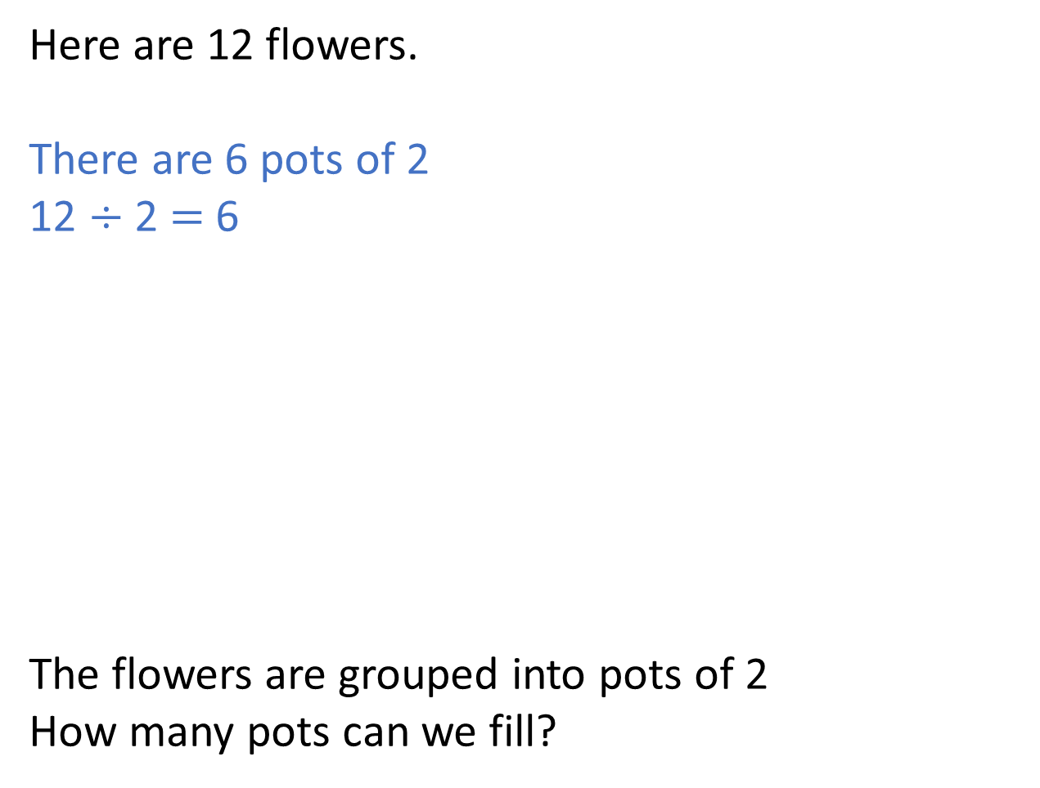
Here are 12 flowers.
There are 6 pots of 2
12 $÷$ 2 $=$ 6
The flowers are grouped into pots of 2
How many pots can we fill?

Slide 12
What if we had 13 flowers?
The flowers are shared equally
between 2 pots.
The flowers are grouped into
pots of 2
Have a think

Slide 13
What if we had 13 flowers?
There are 2 pots of 6 flowers.
There is one flower left over.

Slide 14
What if we had 13 flowers?
There are 6 pots of 2 flowers.
There is one flower left over.

Slide 15
Which groups can be divided by 2 with no flowers
left over?
Have a think

Slide 16
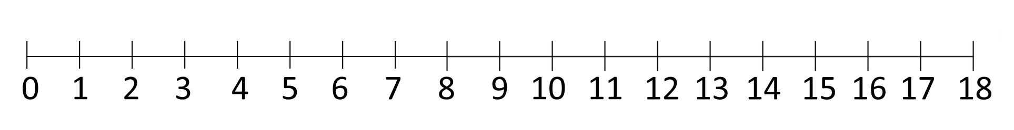
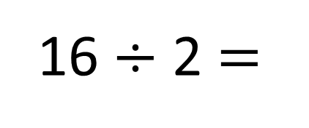
16 $÷$ 2 $=$
8

Slide 17
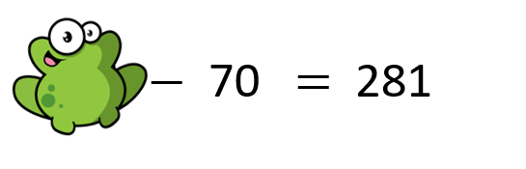
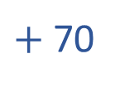
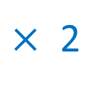
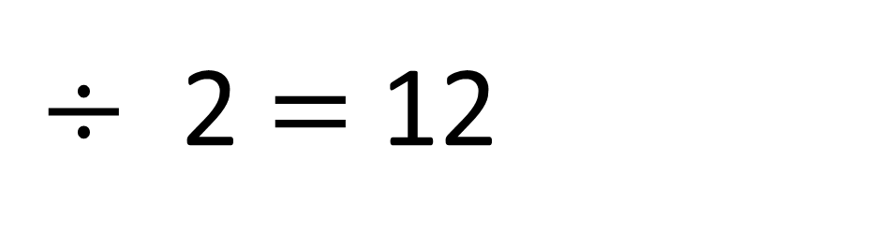
24
$÷$ 2 $=$ 12
$×$ 2
$+$ 70

Slide 18
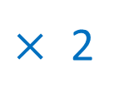
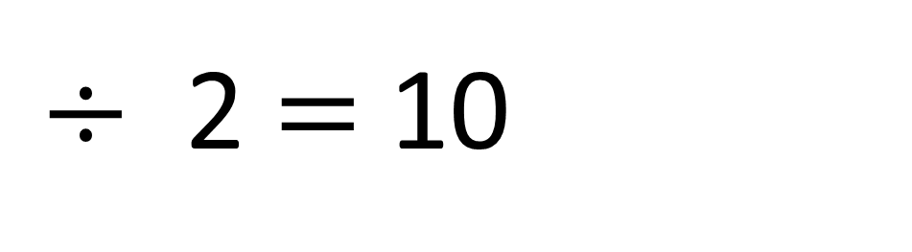
20
$÷$ 2 $=$ 10
$×$ 2
Have a think

Slide 19

Your turn!
Have a go at a sheet!

