Slide 1
Monday 17th May 2021
LO: To write with purpose
To organise writing appropriately
To use sentences appropriately
C: Non-Chronological Reports

Slide 2
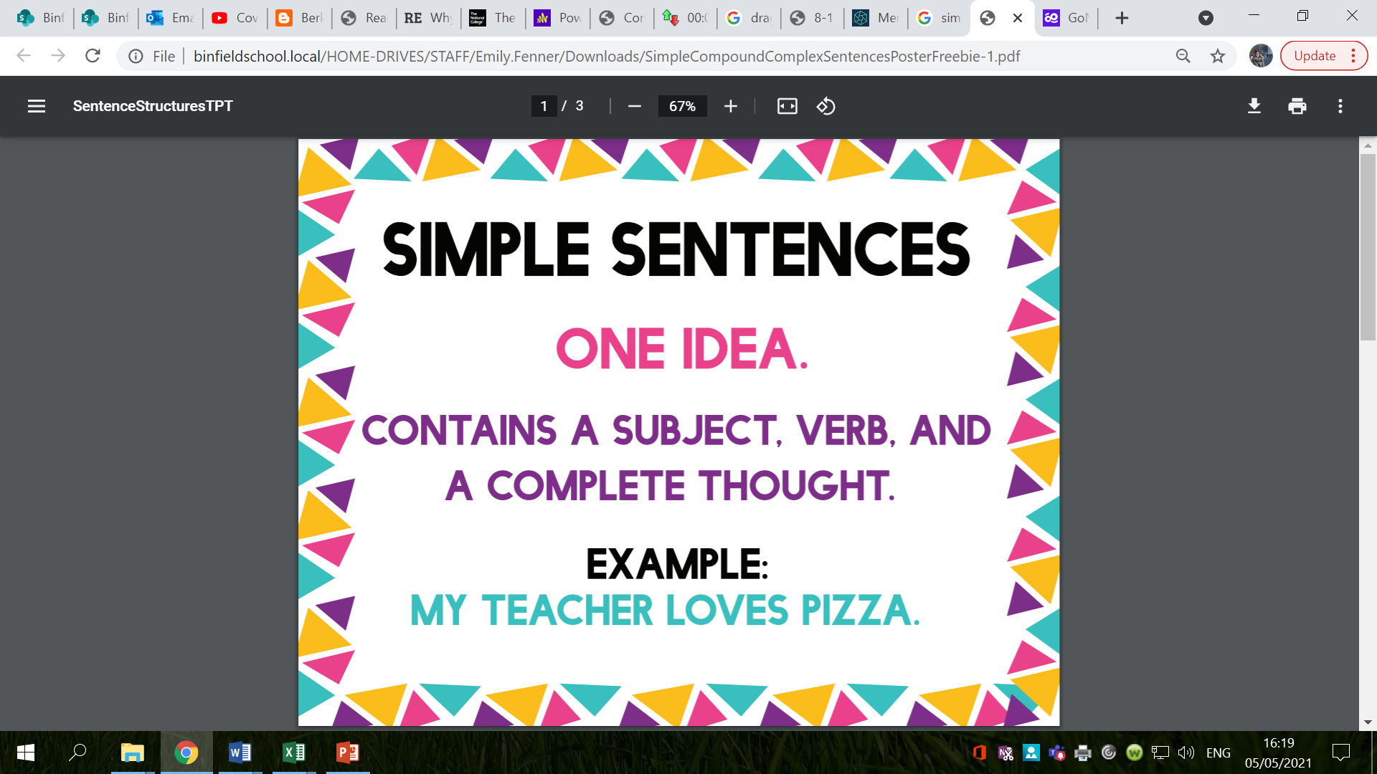

Slide 3
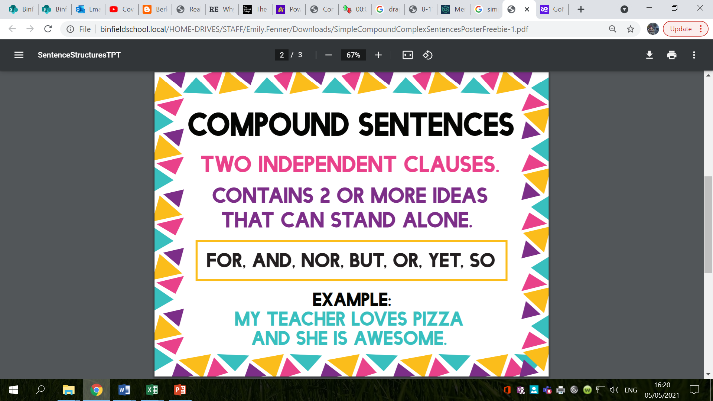

Slide 4
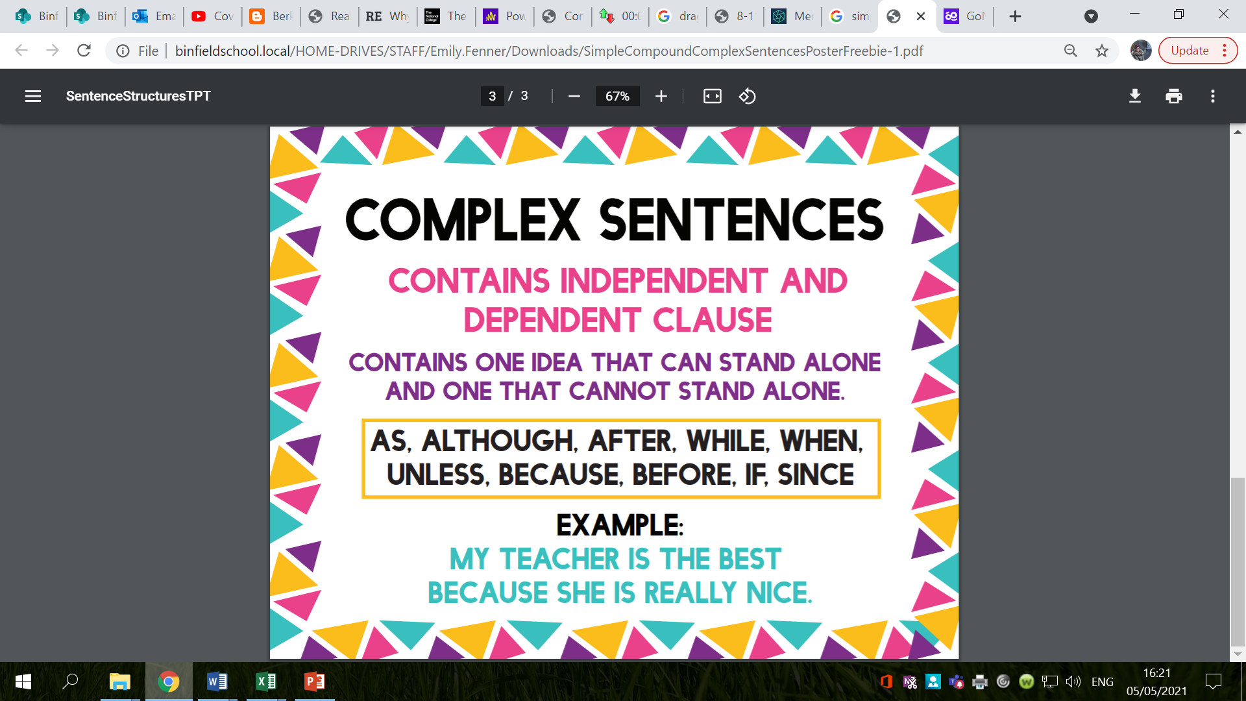

Slide 5
Look at the simple sentences below.
Can you turn it into a compound sentence?
A complex sentence?
The bright, burning sun was shining,
I clumsily fell over.
My miniscule, timid cat was meowing loudly.

Slide 6
Challenge
Can you identify the simple sentence (independent clause) in these compound and complex sentences?
The boisterous, playful dog came rushing in, so the nervous, slim cat ran quickly upstairs.
My thoughtful, generous friend kindly gave me a lift, because it was raining heavily.
When the delicious, chocolate cake is brown, remove it from the hot oven.
You will definitely lose, if you don’t try.
Although it was hard work, I enjoyed volunteering at the library.

Slide 7
Look back at your sub-heading bubble maps from last week.
What sub-headings are you going to use in your non-chronological reports?
What information are you going to include in these paragraphs?

Slide 8
Today you are going to be writing some simple, compound and complex sentences that you can use in your non-chronological reports this week.
What could your first sub-heading be?
What simple, compound and complex sentences could you write for this sub-heading?
Remember, the sentences you write must link to the sub-heading we have chosen.
Challenge: use different conjunctions in your writing today!
Diving Challenge: start your sentences with subordinating conjunctions.
Make sure you are using impressive vocabulary in your sentences!

Slide 9
Activity
Write simple, compound and complex sentences for your sub-headings which you can use in your writing later this week.
You are not writing your paragraphs today!
You are just going to write some sentences which you can use.
Challenge: use different conjunctions in your writing today!
Diving Challenge: start your sentences with subordinating conjunctions.
Red Pen: add in impressive vocabulary to your sentences. You might like to use a thesaurus to help you!

Slide 10
Tuesday 18th May 2021
LO: To write with purpose
To use imaginative description
To organise writing appropriately
To use paragraphs
C: Non-Chronological Reports

Slide 11
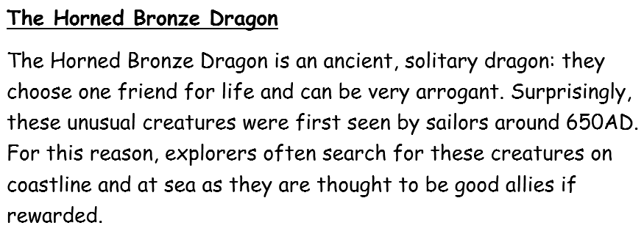
Starter
Do you know what these are?
What are the features of introductions?

Slide 12
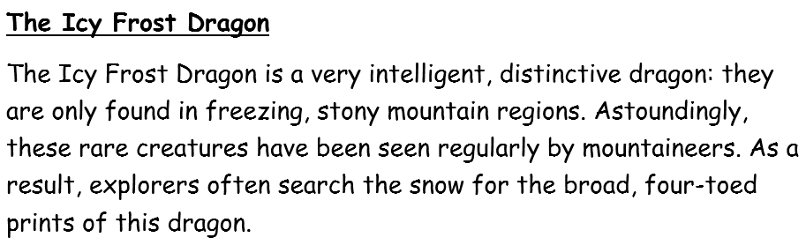
Starter
Do you know what these are?
What are the features of introductions?

Slide 13
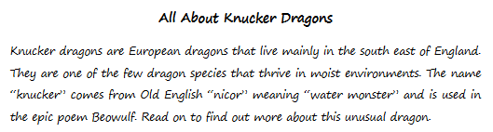
Starter
Do you know what these are?
What are the features of introductions?

Slide 14
You are going to start writing your dragon non-chronological reports today!
You are just going to write your introduction and first sub-heading paragraph.

Slide 15
Example
Habitat
Forest Dragons are found in the depths of the Forest of Dean in West England, for they feel safest deep in the forest. Male Forest Dragons silently build their vast, leaf-lined nests in towering, fir trees, while female Forest Dragons protect their fragile, defenceless eggs. Although they love to roam around the dense, overgrown forest, most of their comfortable, cumbersome nest is found high in the tree tops. Because Forest Dragons only fly in the dead of night, they are rarely sighted. During the spring and summer months, they can often be found feeding on the open, green grass with their young. However, they hibernate during the colder months by digging a deep, underground burrow similar to that of a rabbit.
What features do you notice?
What words, phrases or ideas would you like to magpie for your own writing today?

Slide 16

Look back at your bubble maps and work from last lesson – you can use the sentences you wrote yesterday to help you!

Slide 17
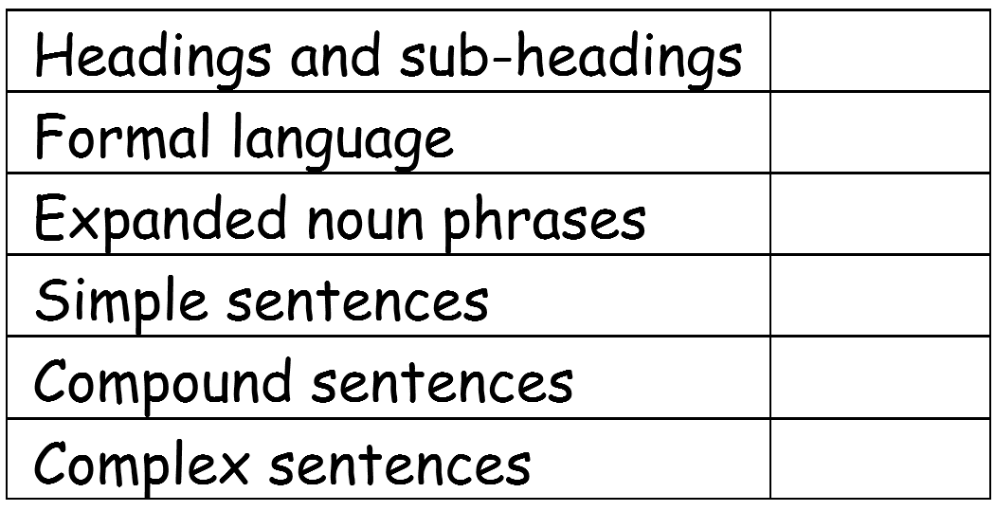
Non-Chronological Report Checklist

Slide 18
Activity
1. Write the introduction for your non-chronological report.
Use the sentence starters to help you.
The … dragon is a ….
Surprisingly, …
For this reason …
Read on to …
2. Write the first paragraph for your non-chronological report.
Red Pen: look at the non-chronological report checklist – have you included all of the features you need to? If not, see if you can add them in or write some additional sentences to tick off any missing features.

Slide 19
Wednesday 19th May 2021
LO: To write with purpose
To use imaginative description
To organise writing appropriately
To use paragraphs
C: Non-Chronological Reports

Slide 20
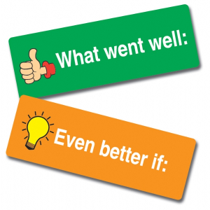
Starter
You have 10 minutes to look back at your work from last lesson.
What went well?
What could you do to improve?
What features have been highlighted on your checklist?
What features do you need to include in your writing today?
*You are not red pen editing today!*

Slide 21
We should be writing formally in our non-chronological reports.
What does this mean?
What vocabulary should we be using?
What should we not be using?

Slide 22

What is Formal and Informal Language?
Do you know what the difference between formal and informal language is?
Formal Language
Formal language is used for more official and serious purposes.
The correct grammar and standard English should always
be used.
Informal Language
Informal language is used for more casual and less
serious purposes. Slang words and chatty language
can be used.

Slide 23

What is Formal and Informal Language?
formal
informal
uses a serious tone
uses a ‘chatty’ tone
uses correct grammar
and punctuation
can use ‘text’
language and slang
uses correct vocabulary
can use contractions and
abbreviations e.g. ‘it’s’ or ‘TV’

Slide 24
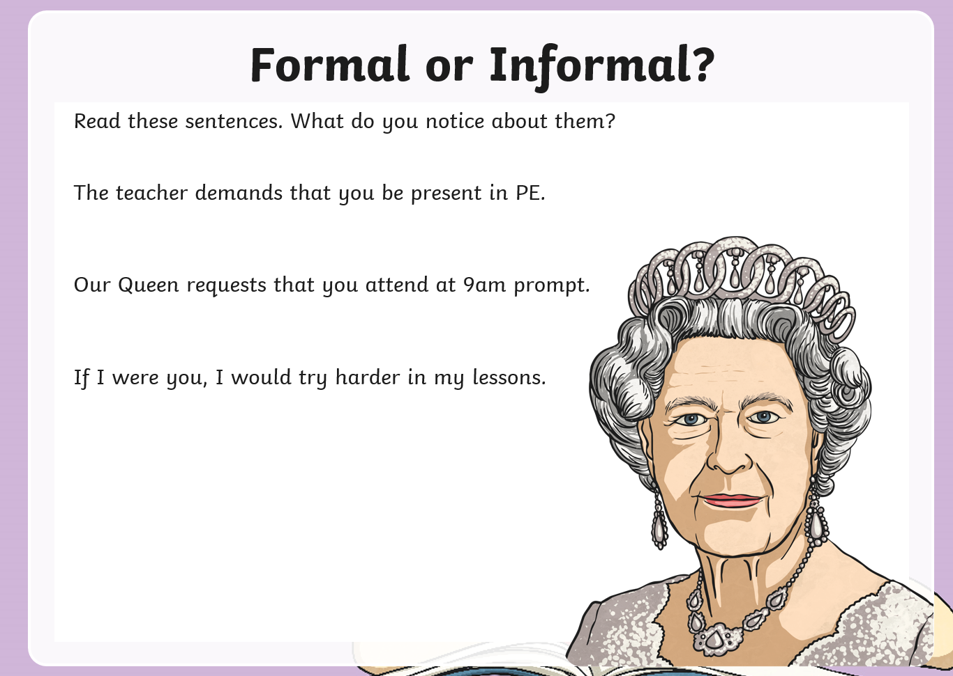

Slide 25


Slide 26
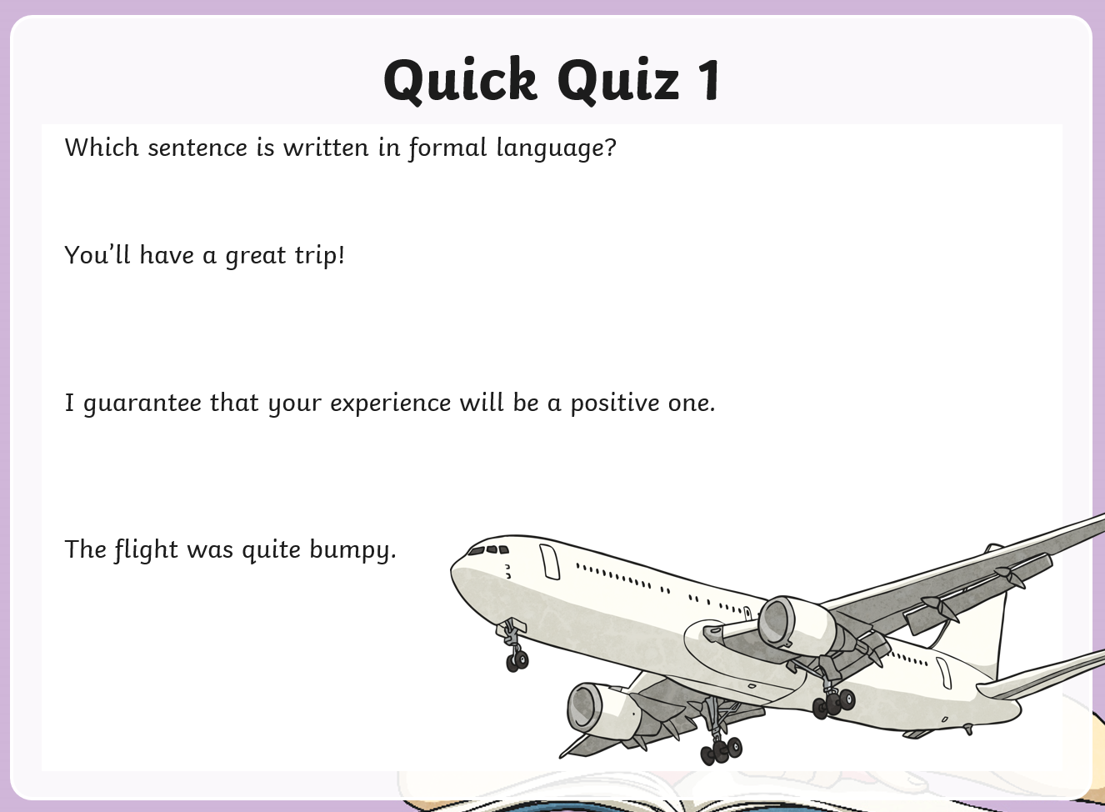

Slide 27
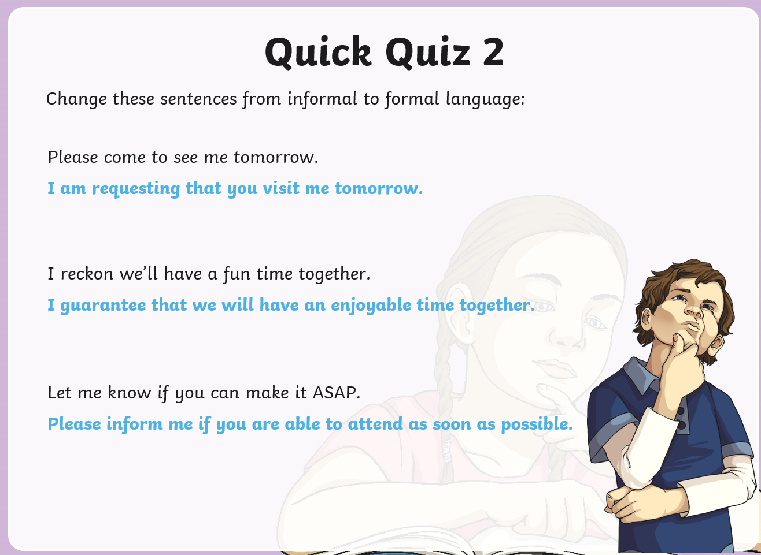

Slide 29
You are going to finish writing your reports today!
You have two more paragraphs to write.
Look back at your bubble maps from last week and your sentences from Monday.

Slide 30
Activity
Write your second two paragraphs for your non-chronological report.
Red Pen: look at your non-chronological report checklist – have you included all of the features you need to? If not, see if you can add them in or write some additional sentences to tick off any missing features.

Slide 31
Thursday 20th May 2021
LO: To write with purpose
To use imaginative description
To organise writing appropriately
To use paragraphs
C: Non-Chronological Reports

Slide 32
Starter
You have 10 minutes to look back at your work from last lesson.
What went well?
What could you do to improve?
What features have been highlighted on your checklist?
What features do you need to include in your writing today?
*You are not red pen editing now!*

Slide 33
Example
Diet
These shy, gentel creatures are vegetarians. They usually feed on flowrs, shrubs and grass. Interestingly, there breath is warm, but thay do’nt breathe fire. Forest Dragons do not pose any thret to hoomans, and have been nown to be tamed as howsehold pets.
What do you think about this paragraph?
What is missing?
How could we improve this paragraph?

Slide 34

You are going to be editing your work today!
You should use the margin marking to edit and improve your work first.
You can then write sentences to meet any features from the checklist you haven’t included.
Ask for help if you are unsure!

Slide 35
Activity
Use the margin marking to edit and improve your work first.
Then write sentences to meet any features from the checklist you have not included.
Red Pen: improve the vocabulary you have used in your writing. You may like to use a thesaurus to help you! Could you use alliteration, metaphors or similes to add detail?

