Slide 1
Monday 28th June 2021
LO: to investigate materials
C: States of Matter

Slide 2
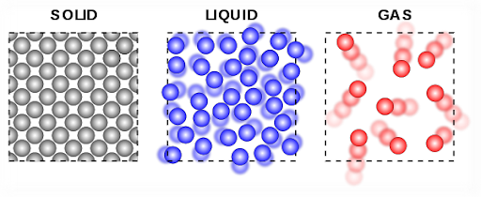
Solid, Liquid or Gas? Why?

Slide 3
Each circle represents a molecule.
Solids have a rigid structure of particles vibrating at fixed points.
Liquid has no fixed shape and particles moving around.
Gas particles move randomly and rapidly to fill spaces.

Slide 4
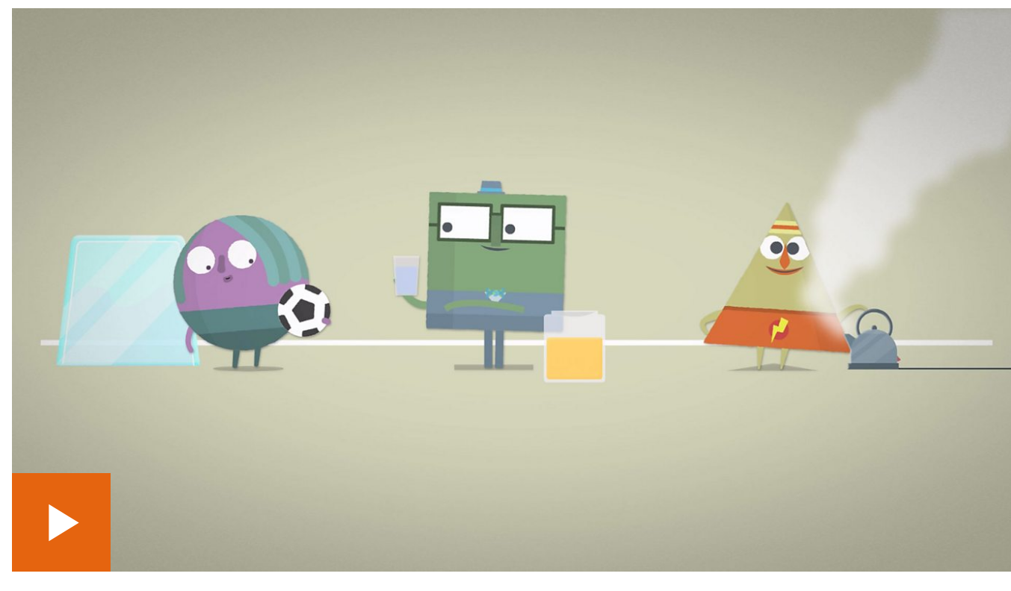
https://www.bbc.co.uk/bitesize/topics/zkgg87h/articles/zsgwwxs

Slide 5

Gases surround us, but how many gases can you name?
Which ones make up the air around us?
Which gases are important for human or plant life?

Slide 6
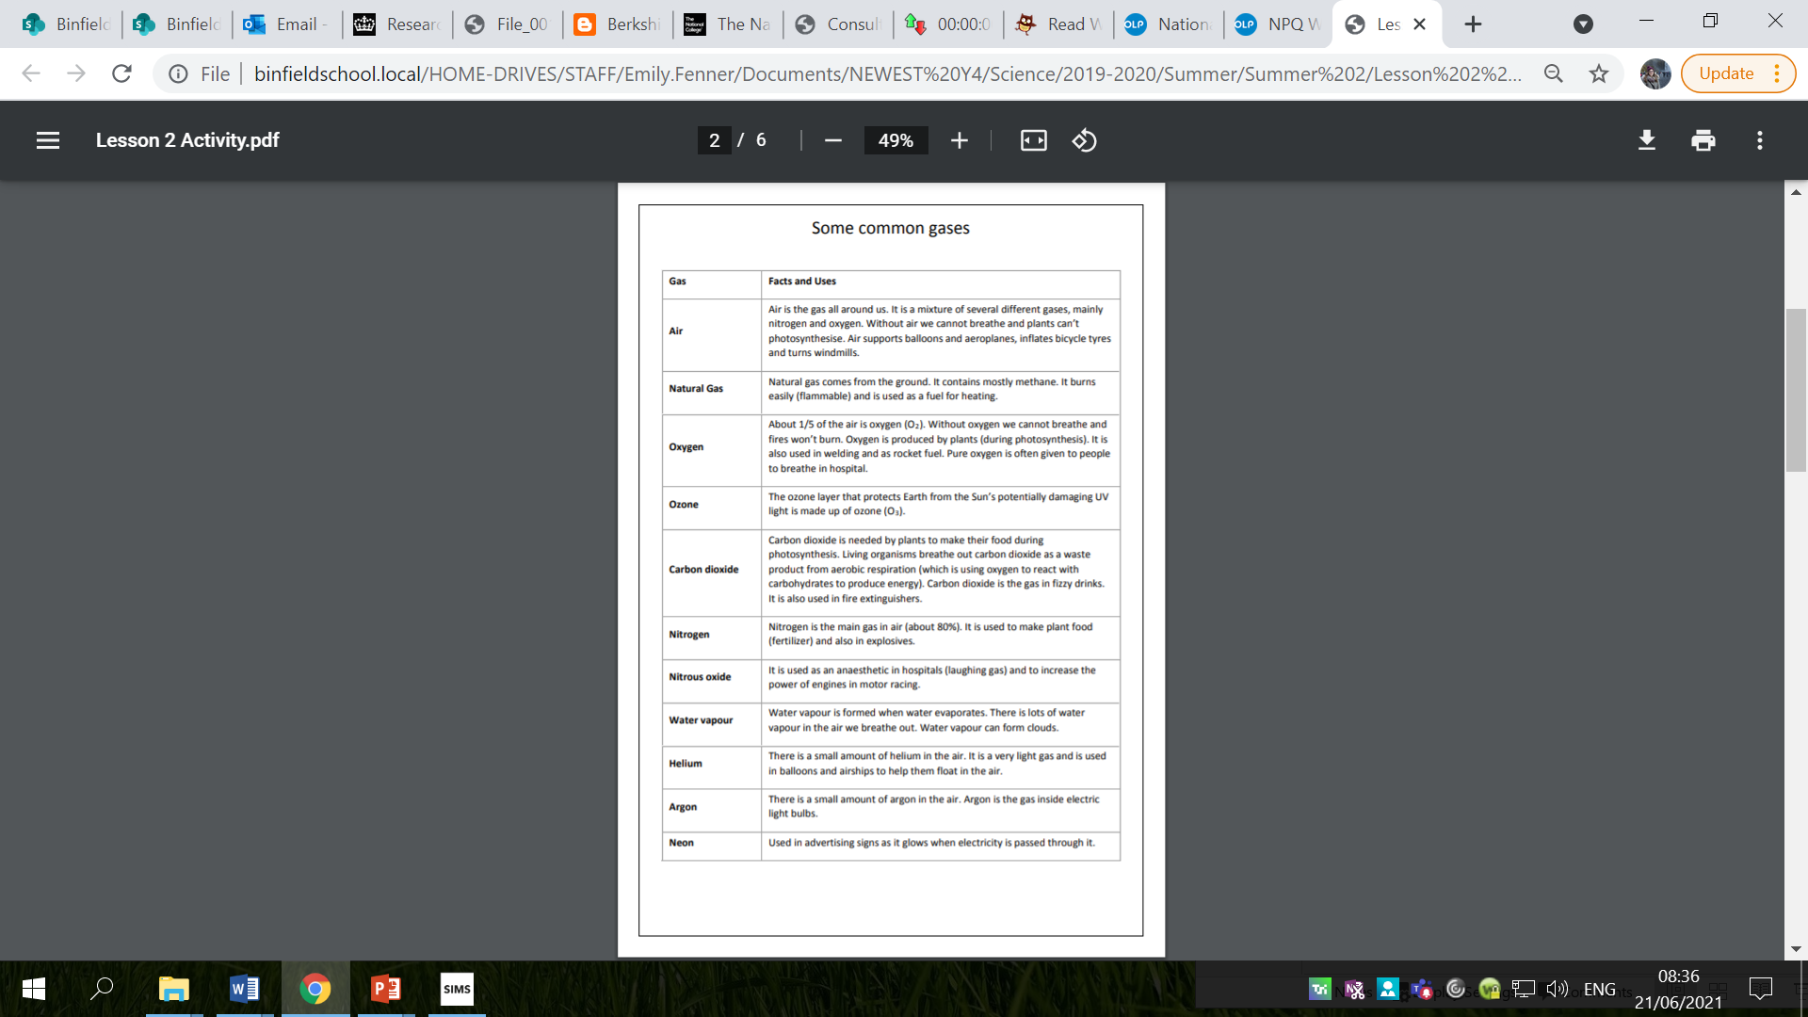
How many of these gases have you heard of?

Slide 7
How many of these gases have you heard of?

Slide 8

https://www.bbc.co.uk/bitesize/clips/zxgvr82
How many gases can you spot?

Slide 9
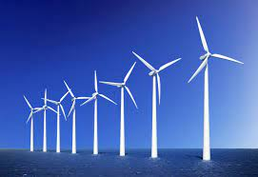


Moving air can be very useful: turning wind turbines, blowing washing on a washing line or filling the sail of a boat, but it can also be damaging.

Slide 10
Remember, all materials are made up of particles – solids, liquids and gases!
Even though many gases are not visible, they are there and they are matter!

Slide 11
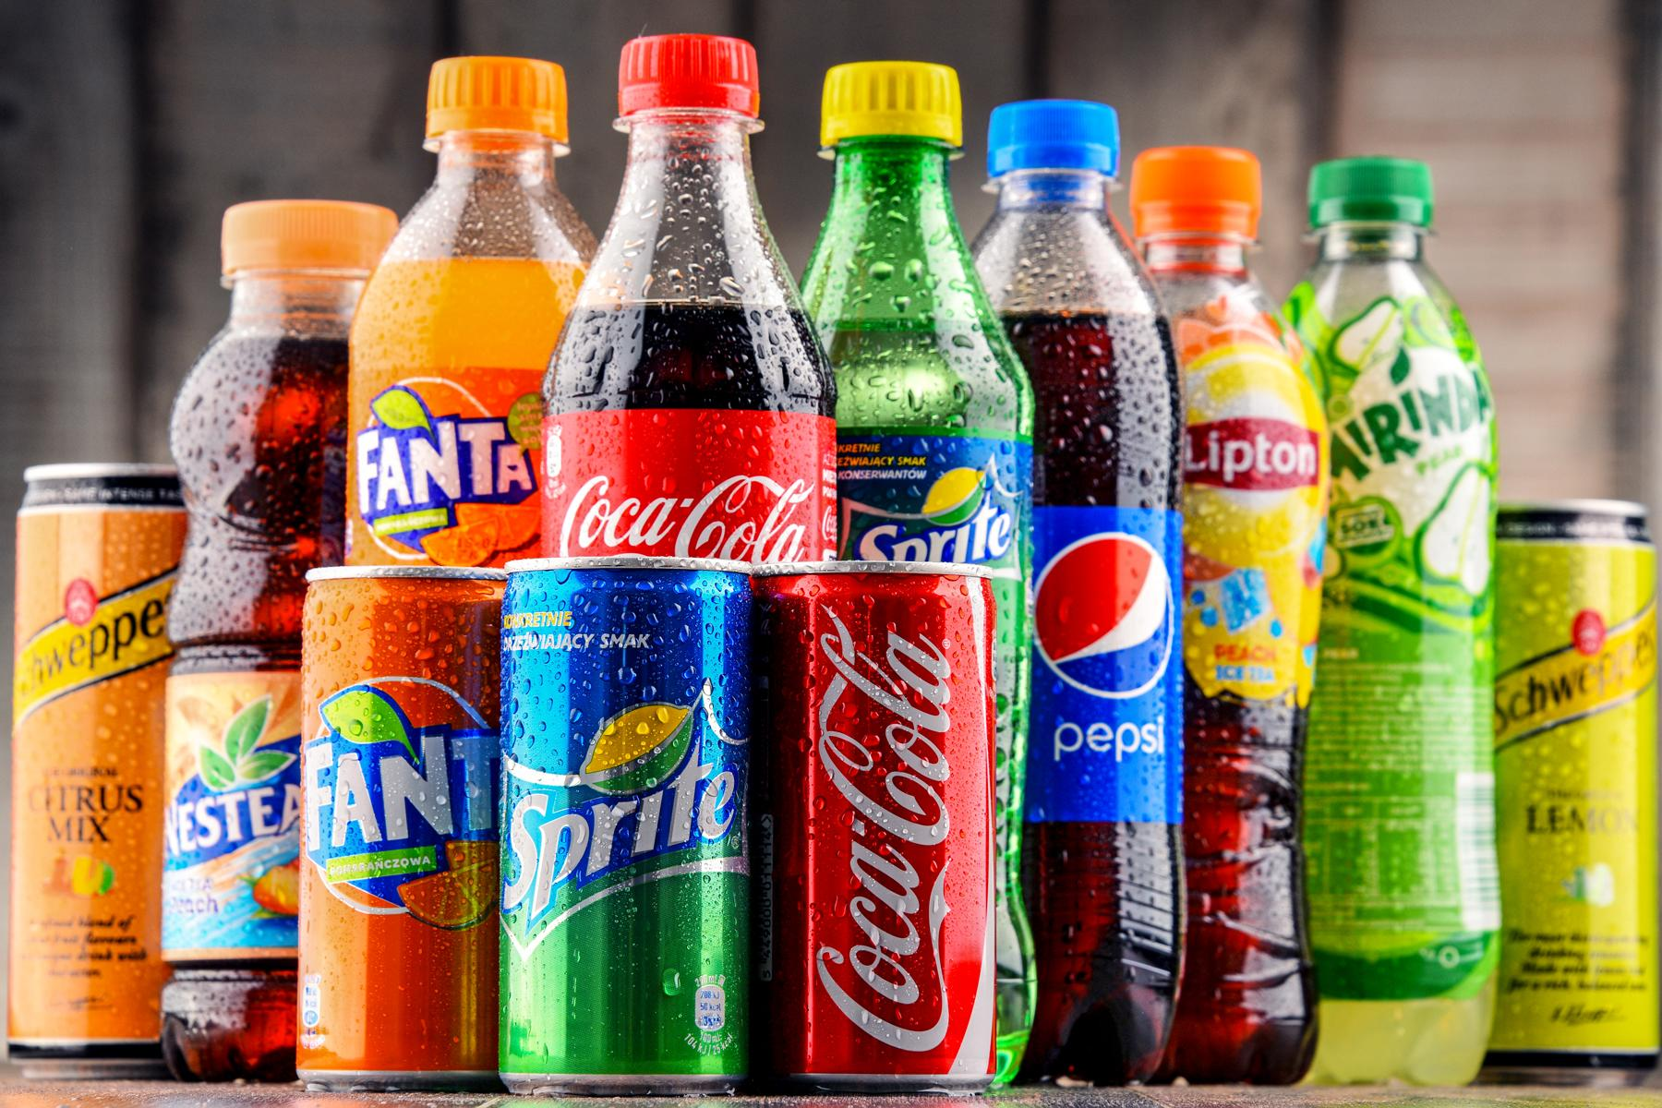
Think about fizzy drinks.
Have you ever seen bubbles in fizzy drinks?
What are the bubbles in fizzy drinks made of?
Why are there bubbles in fizzy drinks?
How are fizzy drinks made?

Slide 12
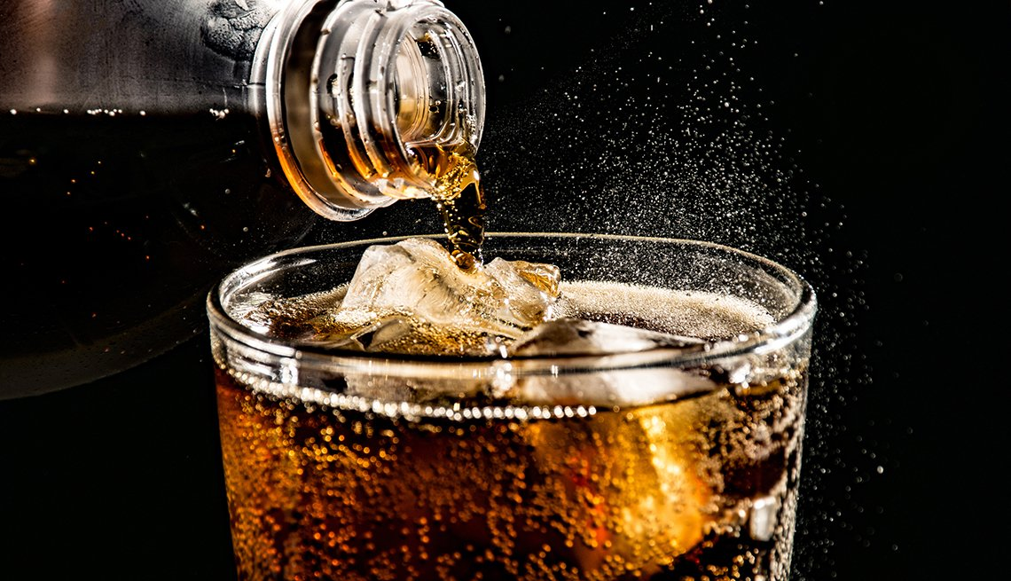
Bubbles in fizzy drinks are made from a gas called carbon dioxide.
Carbon dioxide is a gas that is all around us.
It makes up only about 0.04% of the Earth's atmosphere.

Slide 13




Do Gases Weigh Anything?
These children are talking about the weight of gas.
Who do you agree with? Why?
Gases are lighter than air, so they do not weigh anything.
Gas has no weight because it is invisible.
A gas does have weight because it is a material.

Slide 14
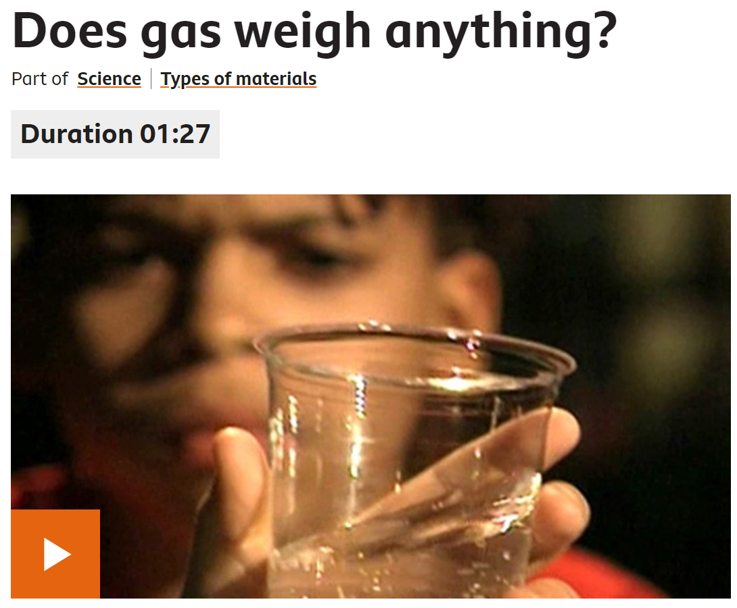
https://www.bbc.co.uk/bitesize/clips/zt3fb9q

Slide 15

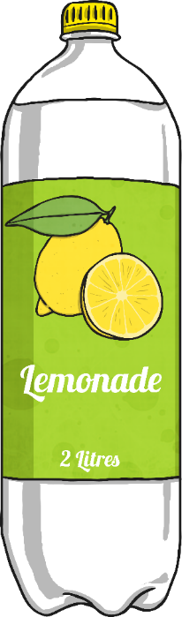


Do Gases Weigh Anything?
This is Maya. She weighed a glass of fizzy lemonade. It weighed 173.1g. Gently, she swirled the glass around to make the liquid flat, in other words, to remove the carbon dioxide. She weighed the glass again and this time it weighed 172.6g. The drink was lighter after the gas had been removed.
This shows that the gas in the fizzy drink, carbon dioxide, does have a weight.

Slide 16
Do Gases Weigh Anything?
The glass of fizzy lemonade was heavier than the flat drink because it contained carbon dioxide. Some gases are lighter than air and some are heavier. Carbon dioxide is heavier than air.

Slide 17
Activity
Create a poster which answers the question ‘Do gases weigh anything?’ using your learning from this lesson.

Slide 18
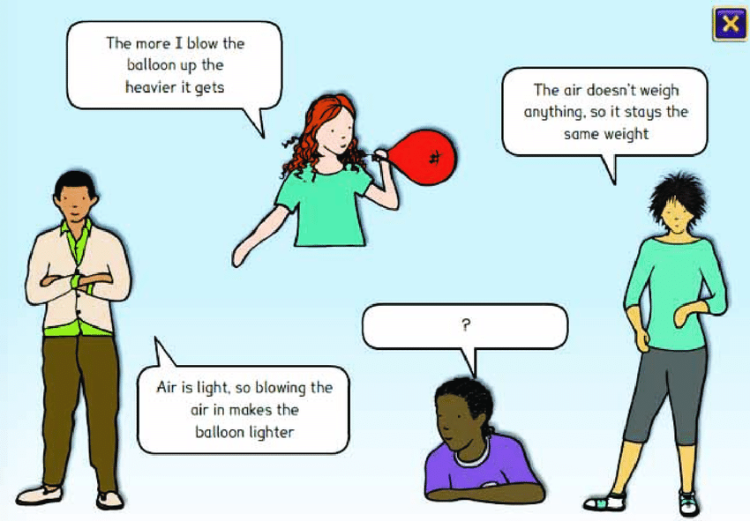
Paddling and Snorkelling Red Pen
Which child do you agree with?
Explain your reasoning.

Slide 19
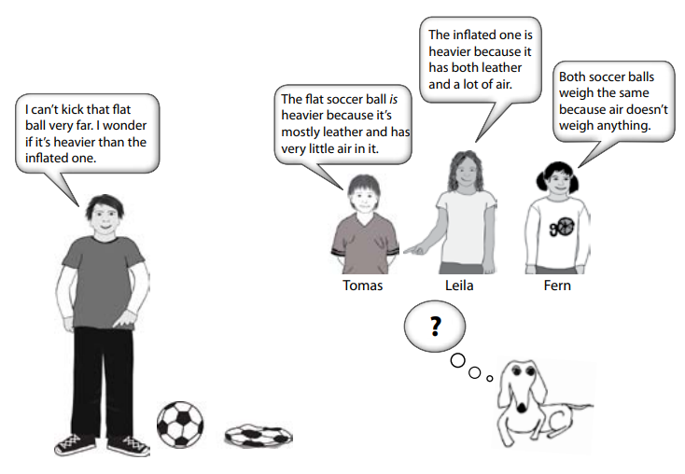
Diving Red Pen
Which child do you agree with?
Explain your reasoning.

Slide 20
Plenary: True or False?
Carbon dioxide is a gas at room temperature.
Gases keep
their shape.
Carbon dioxide
is useful.
The bubbles in
fizzy drinks are bubbles of gas.
Gases that are lighter than air weigh nothing.
You can find the weight of gases.

Slide 21
True or False?
How did you do?
True.
Carbon dioxide is a gas at room temperature.
Gases keep
their shape.
False.
Carbon dioxide
is useful.
True.
The bubbles in
fizzy drinks are bubbles of gas.
True.
Gases that are lighter than air weigh nothing.
False.
You can find the weight of gases.
True.

