Slide 1
Tuesday 29th June 2021
LO: to understand beliefs and teachings
to understand lifestyles and practices
to understand values
C: Buddhism

Slide 2

Right Living or Livelihood
The final fold of the Eight-Fold Path left to look at is ‘Right Living’
Can you remember what ‘Right Living’ means?

Slide 3
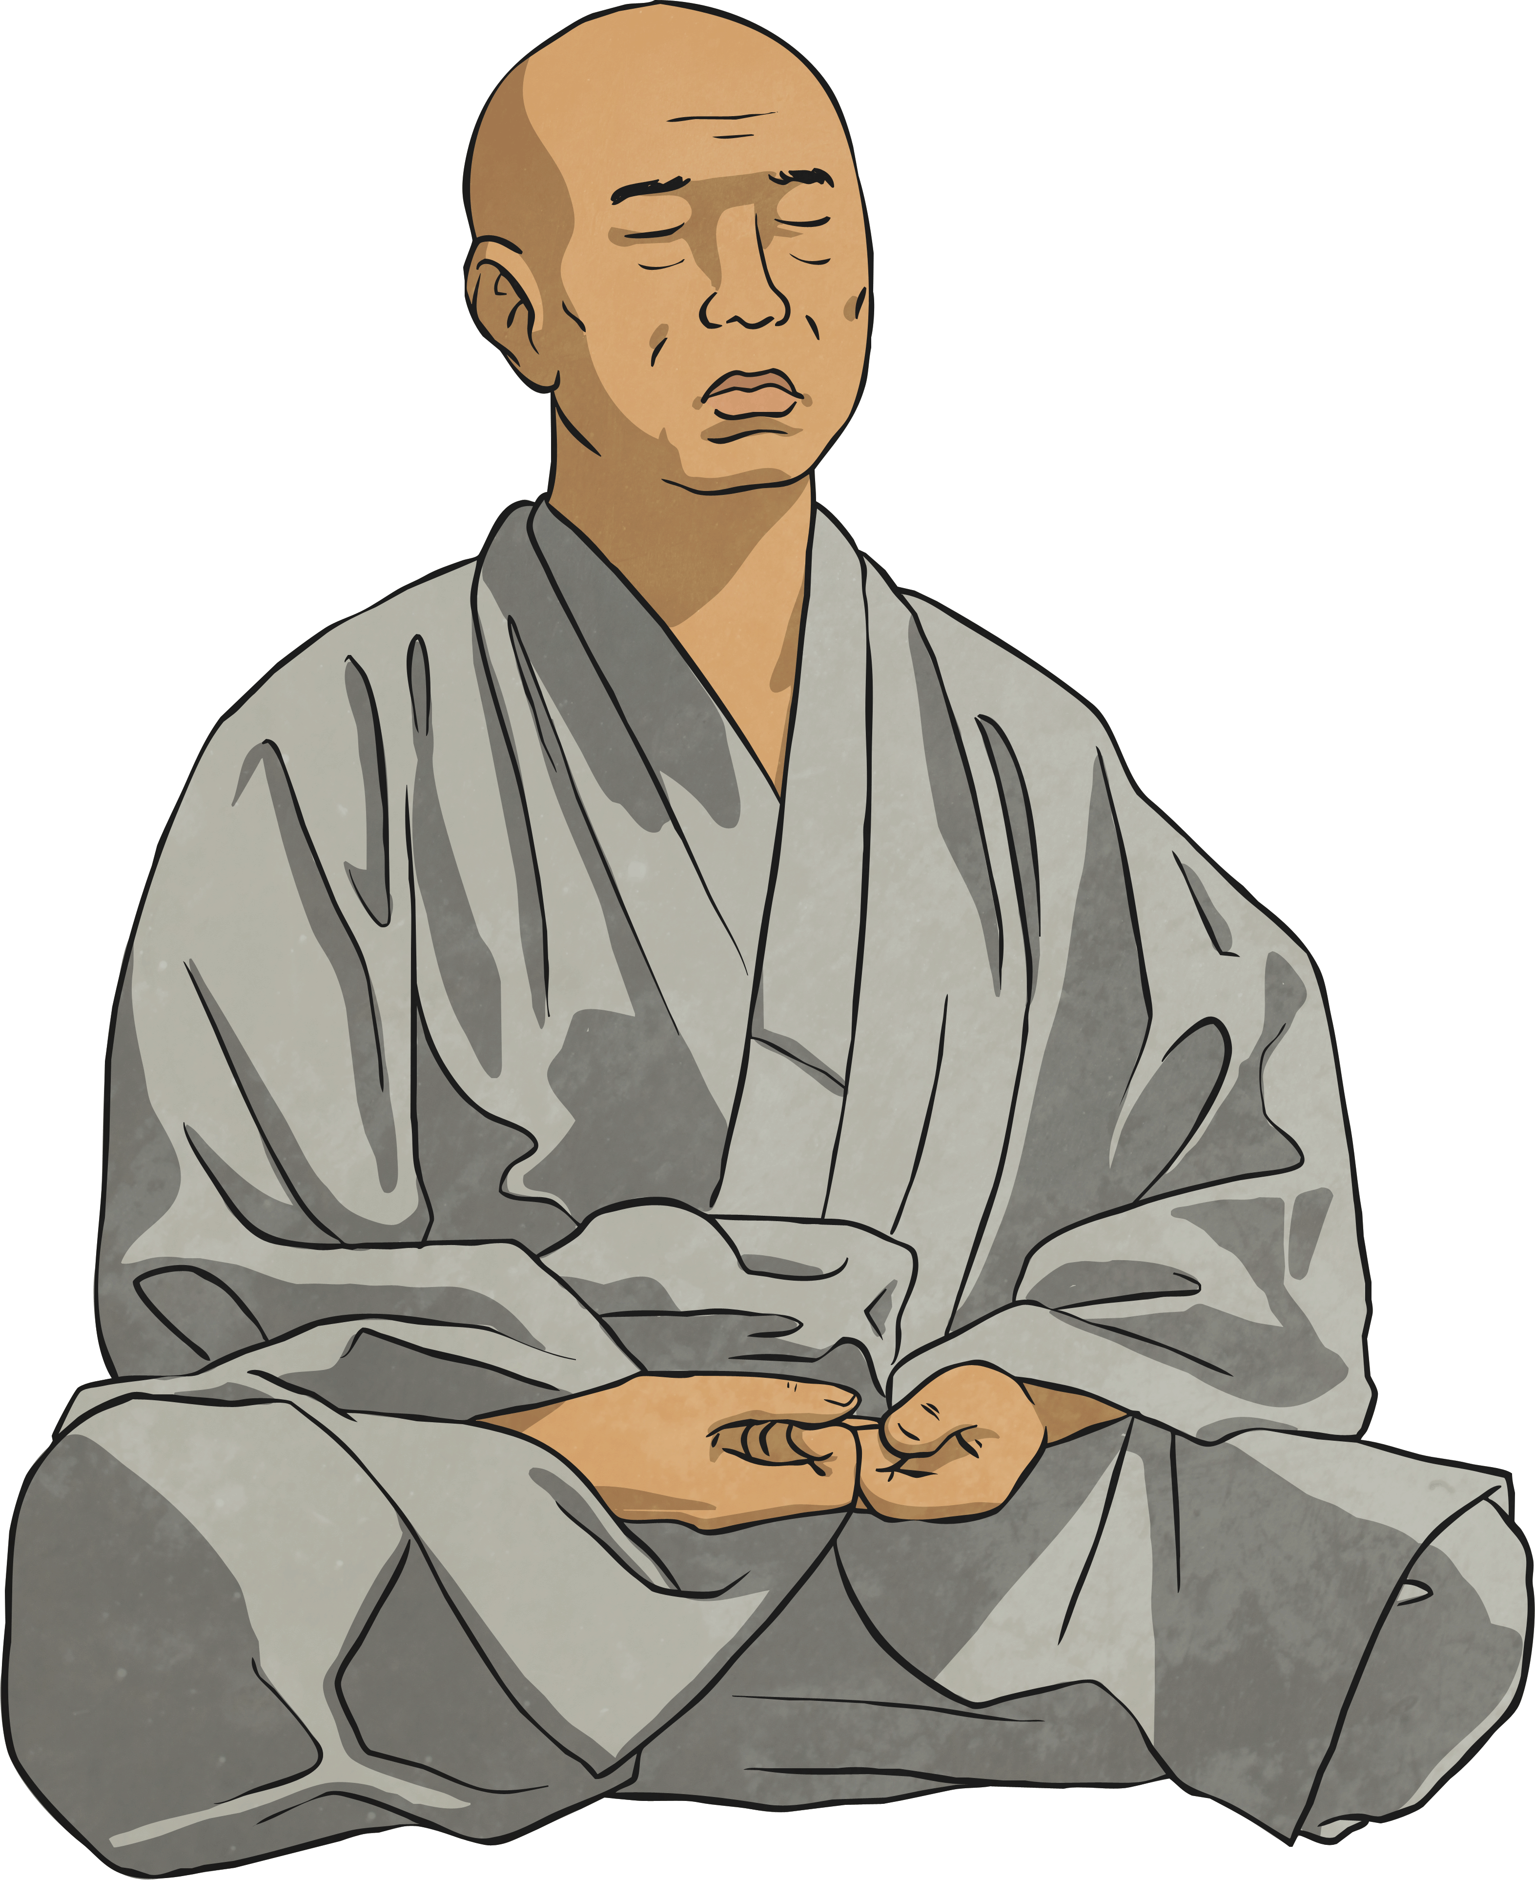
Right Livelihood
Our livelihood, how we choose to work and earn money, can have an effect on the world at large. Buddhists do not agree that people should work in a job that might cause harm to others. They would not agree with being a gun seller, butcher or any job that involved harming animals. They believe that we should work for the good of the community and benefit the world as a whole.
What job would you like to do in the future? Is it something that will help someone or will it harm them?

Slide 4
Right Living
Earning a living in a way that does not harm others, for example not doing work that harms people or animals.
To work in a way that encourages kindness and compassion.
If your work has a lack of respect for life, then it will be a barrier to progress on the spiritual path.
Buddhism promotes the principle of equality of all living beings and respect for all life.
Certain types of work were discouraged by the Buddha, in particular those where you sell alcohol, those dealing in weapons, and those harmful to animal or human life.
A dedicated Buddhist would not be recommended to have a store which sells alcohol, own a gun shop, or be a butcher.

Slide 5
Buddhist Quote
We try to avoid any kind of work that might increase suffering in the world. We don’t want to harm the environment, animals or humans. So we avoid work involving weapons, tobacco or alcohol. Instead, I want to find work that can help the world. I like to work with other Buddhists because it keeps me on my toes. It’s not easy to forget the Noble Eightfold path when your friends are practising it too.
What actions do Buddhists take to make sure they follow this fold?

Slide 6
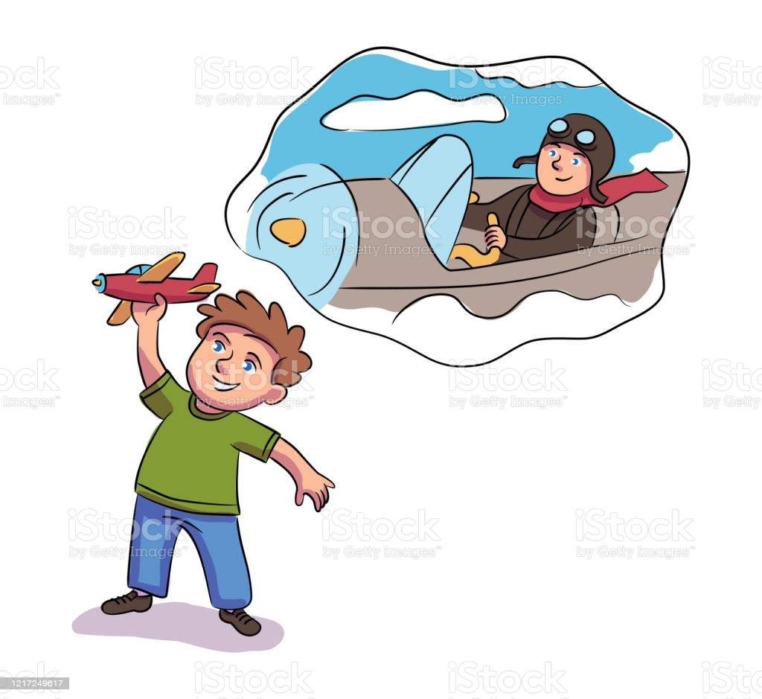
Create a bubble map of your dream job.
Which of these jobs might a Buddhist choose to do in order to help others? Would they be following any other of the folds in this job?
Which of those jobs would a Buddhist need to avoid if they were to work without harming others? Would these jobs stop Buddhists from following any other of the folds?

Slide 7
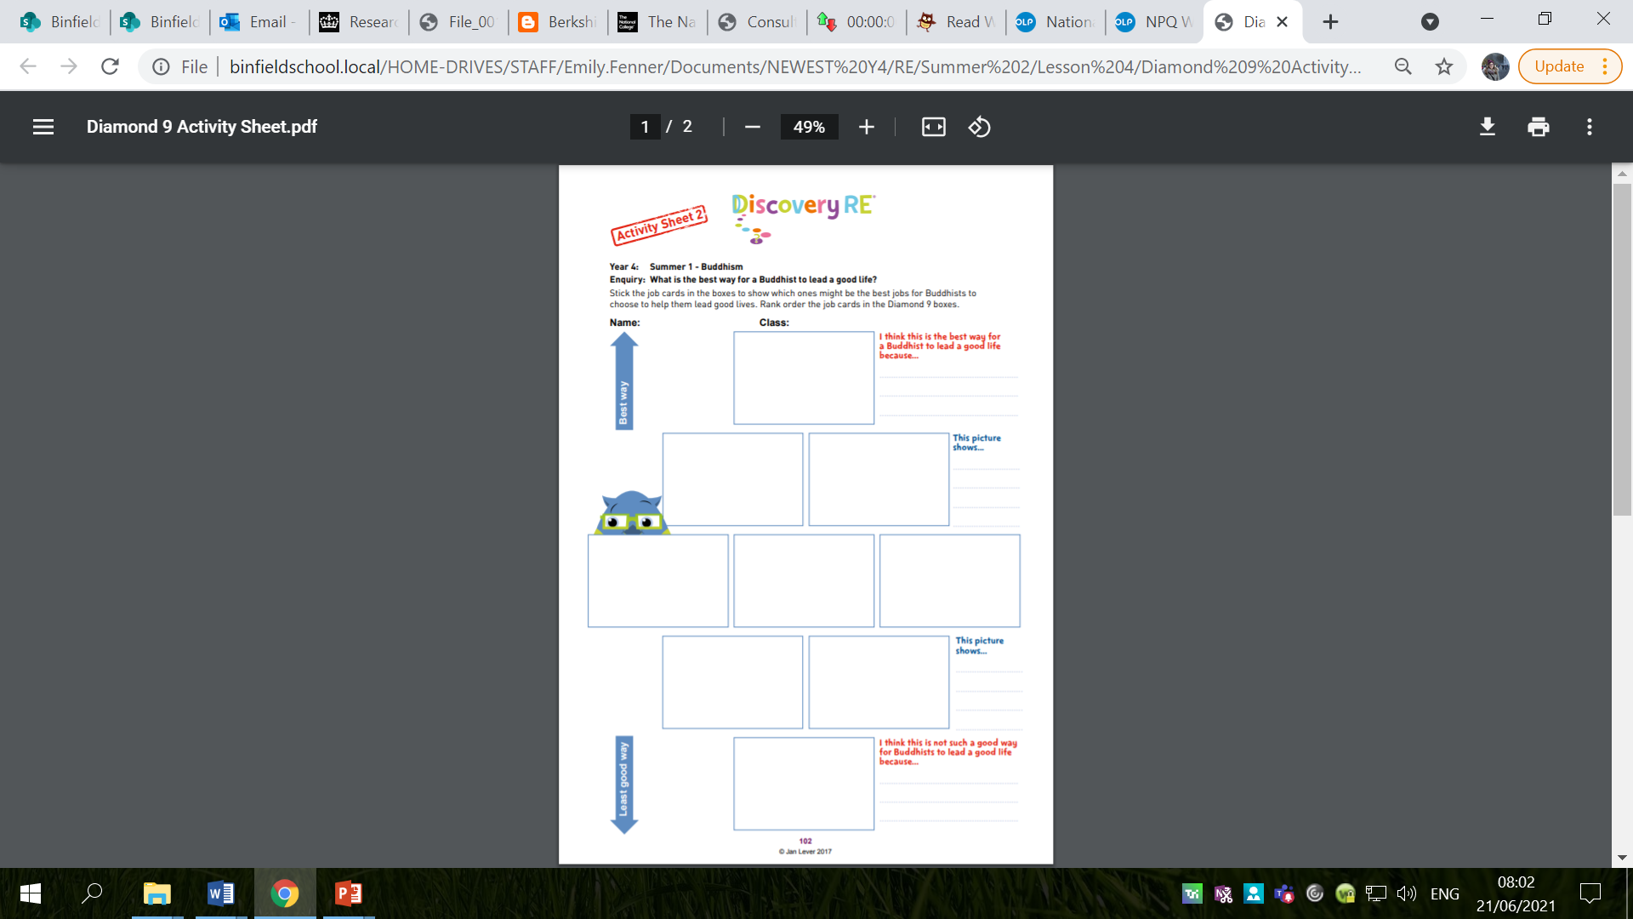
Activity
Complete the sheet: Diamond 9 the job cards to show which ones might be the best jobs for Buddhists to choose to help them lead good lives.
Explain the reasoning behind your decisions.
Snorkelling and Diving – try to refer to the other folds of the Eight-Fold Path in your explanation; not just Right Living/Livelihood.

Slide 8
Red Pen
Paddling Red Pen: Do you think it would be easy for you to follow the Eight-Fold Path? Why/why not?
Snorkelling and Diving Red Pen: What do you think about following the Eight-Fold Path as a way to live? Give reasons for your answer.

