Slide 1


Instructions with Miss Watton!

Slide 2



Slide 3
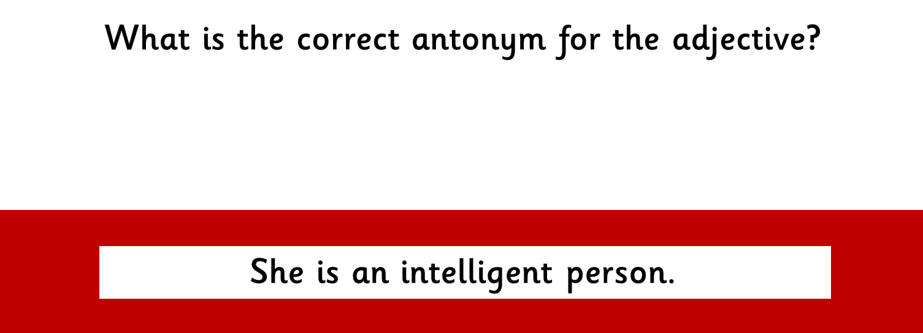






Slide 4
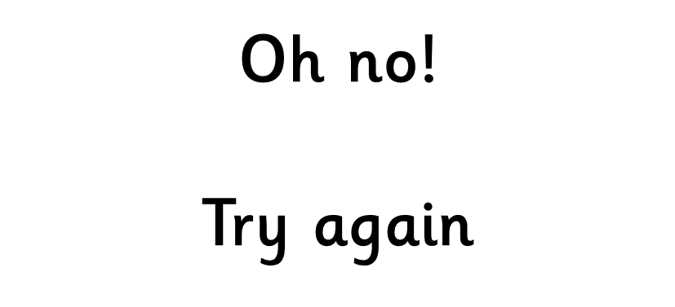

Slide 5


Slide 6
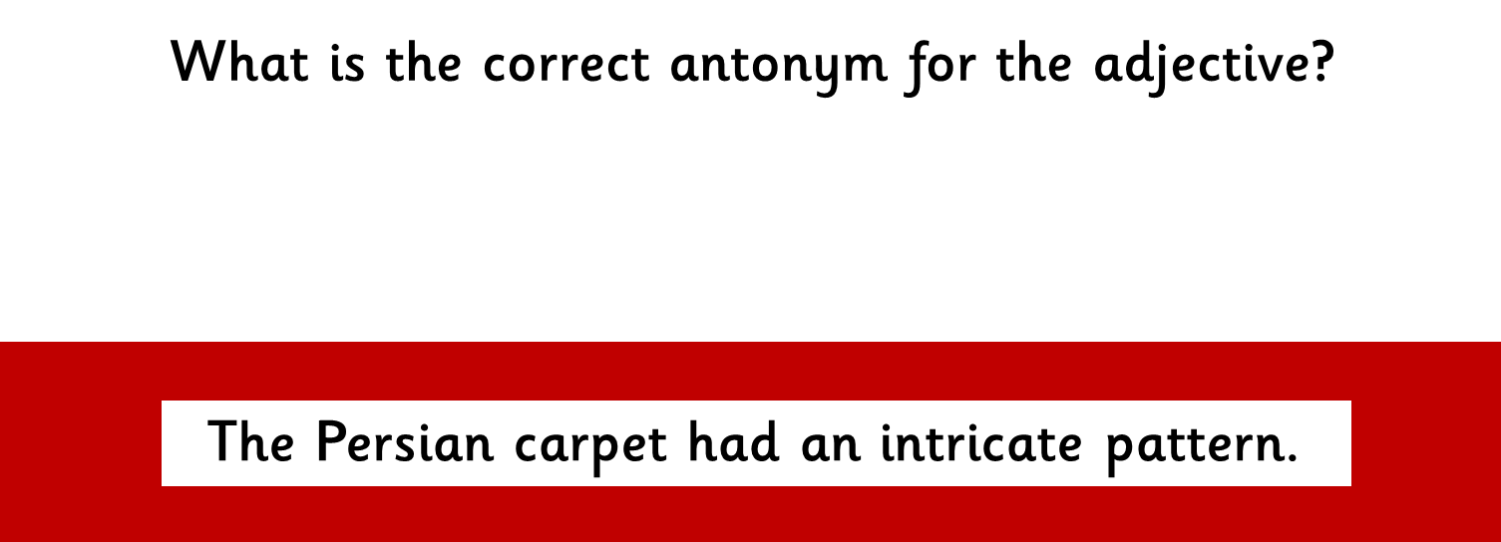






Slide 9
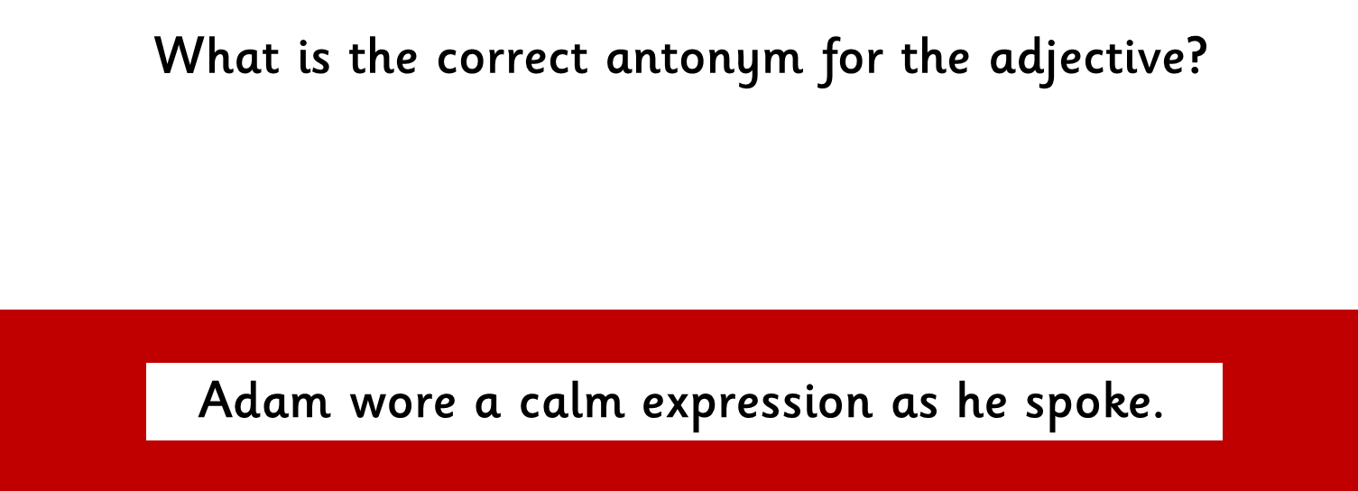






Slide 12

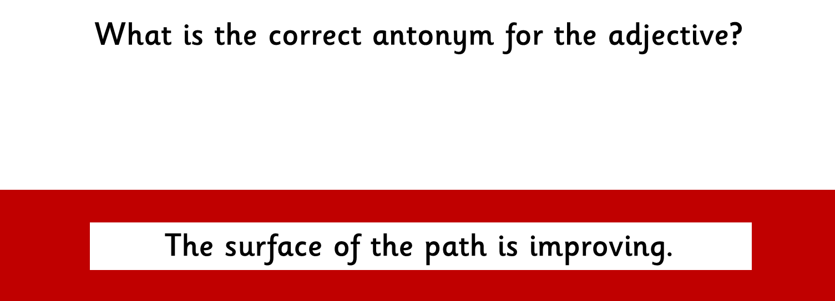
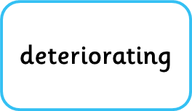





Slide 15







Slide 18
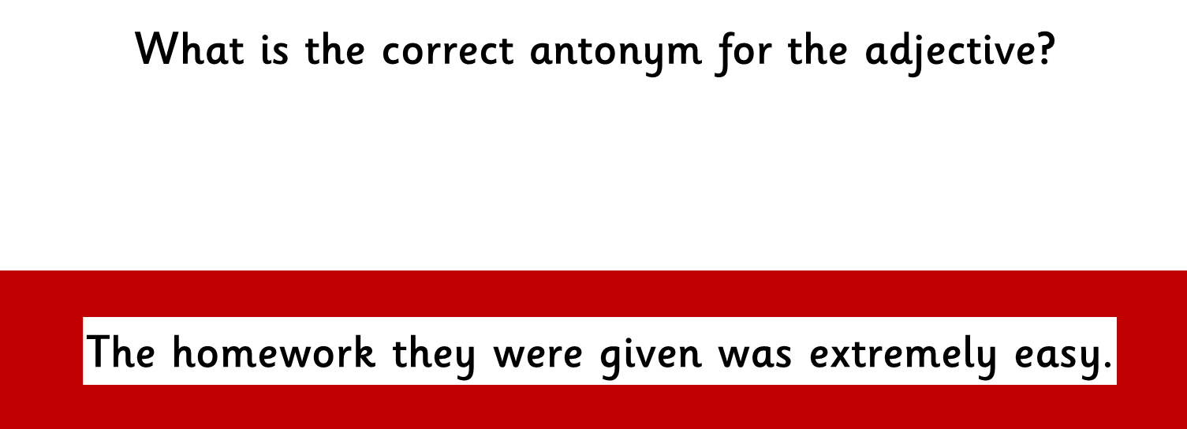






Slide 21
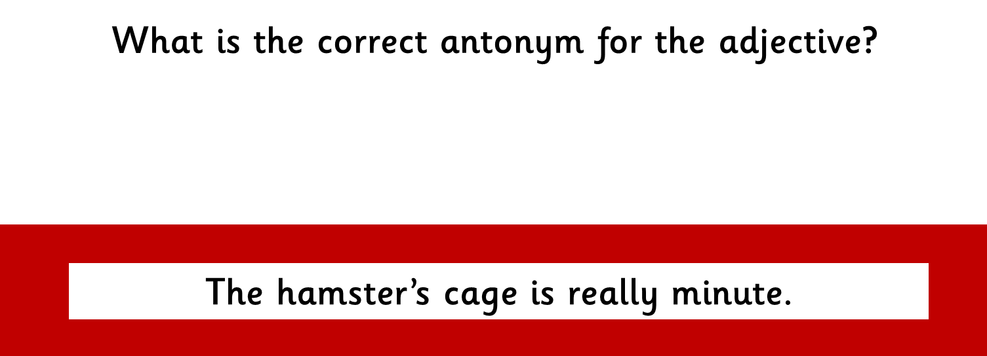






Slide 24
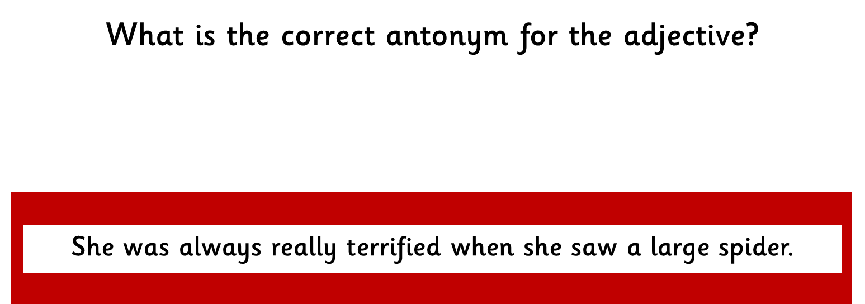






Slide 27
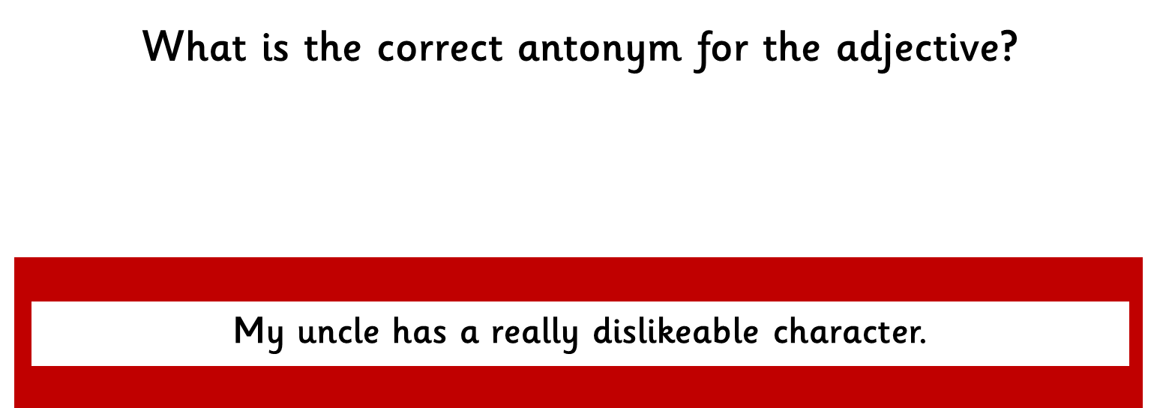





Slide 30
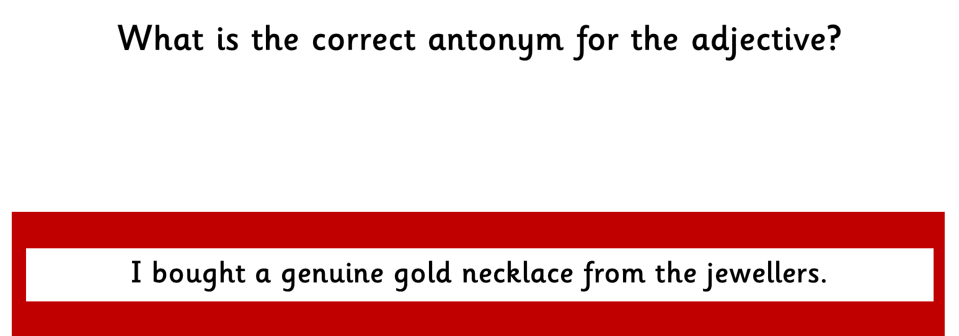






Slide 33

THE END

