Slide 1
Monday 28th June 2021
LO: to write with purpose
C: Persuasive Writing

Slide 2
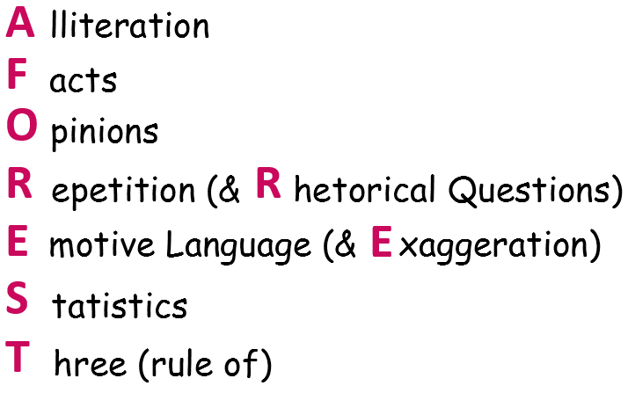

You are going to finish looking at the final few features of persuasive writing!
What features do you have left to look at?

Slide 3

Emotive
What does this word mean?
Can you spot a word (or part of a word) which may help you?

Slide 4
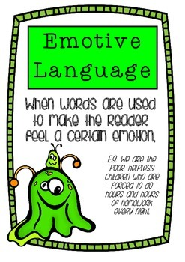
Emotive Language
Emotive language is the deliberate choice of words to elicit emotion.

Slide 5
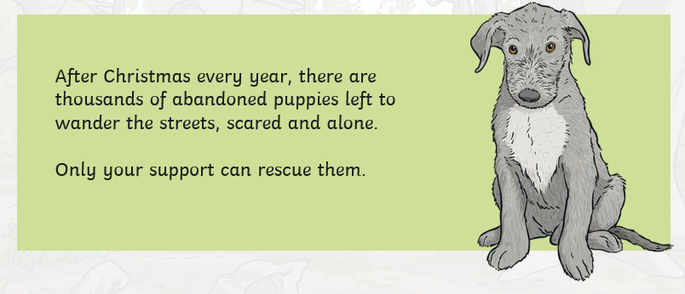
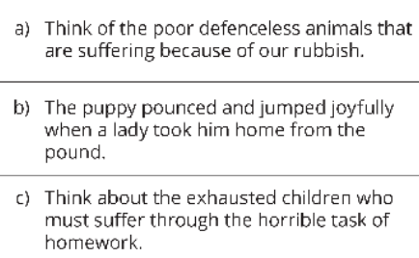
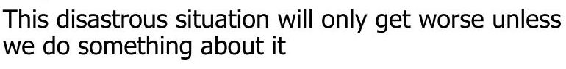

Slide 6
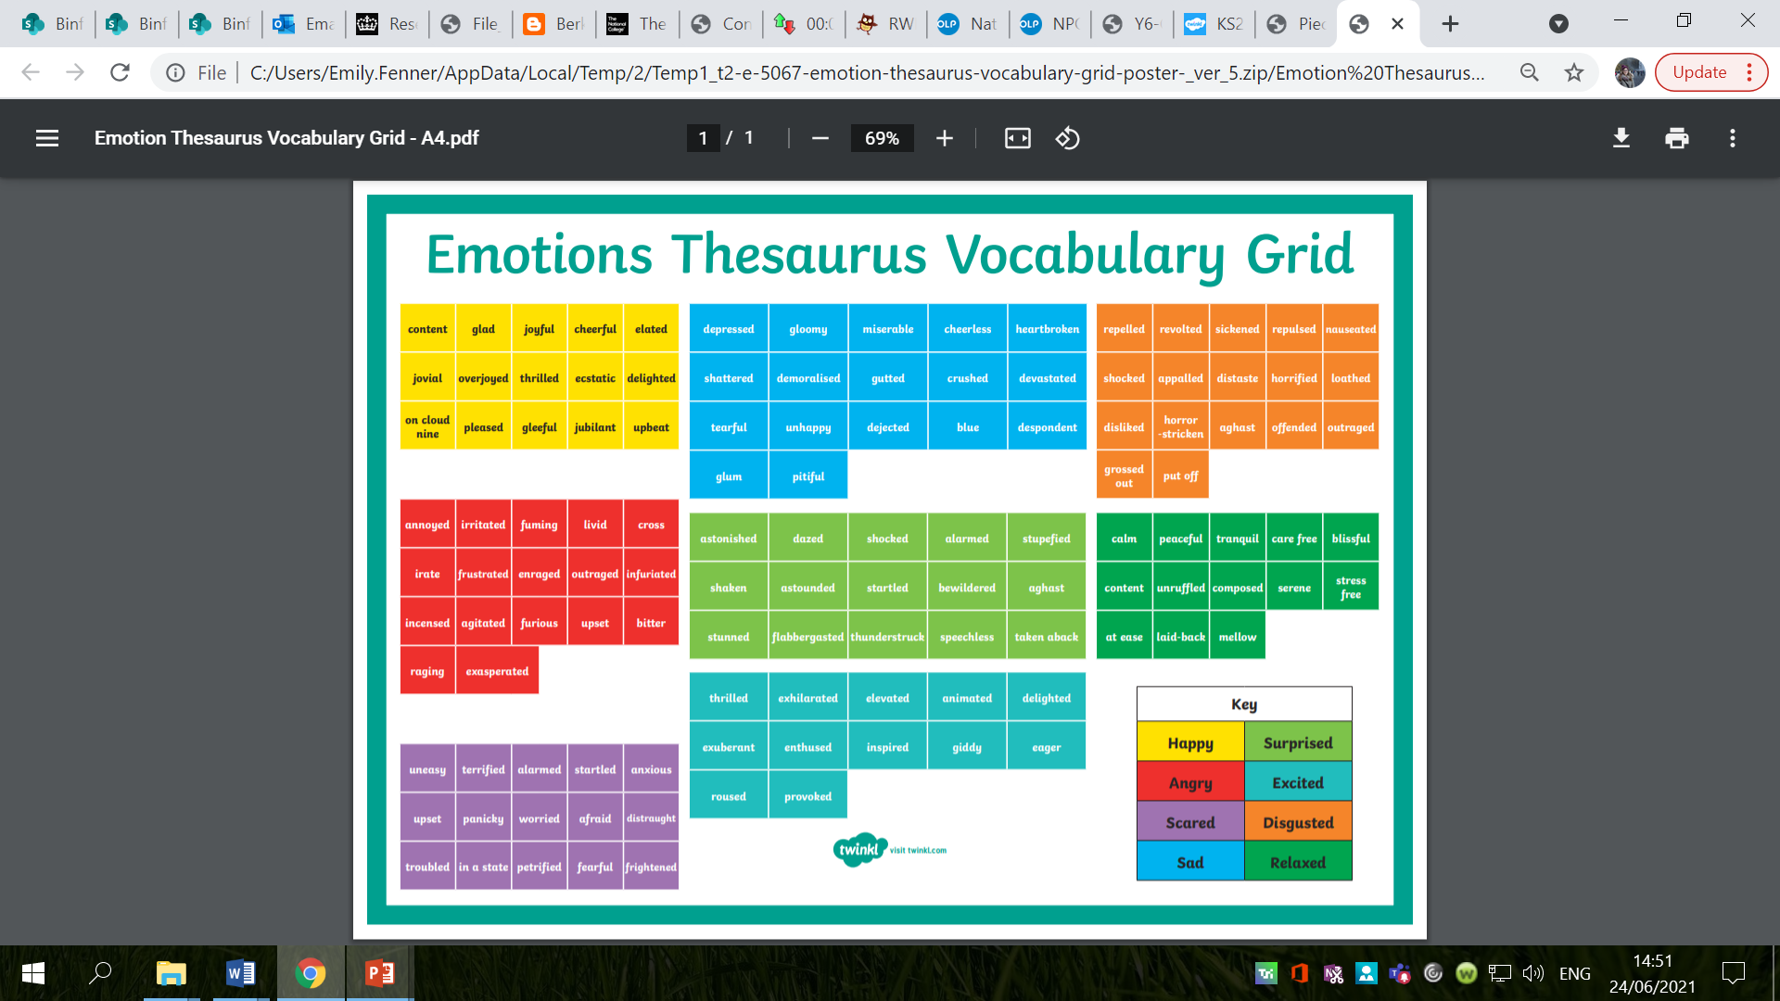

Slide 7
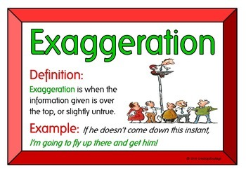
Exaggeration
What does this mean?
A statement that represents something as better or worse than it actually is.
Do you want to make your product sound better or worse than it actually is?

Slide 8
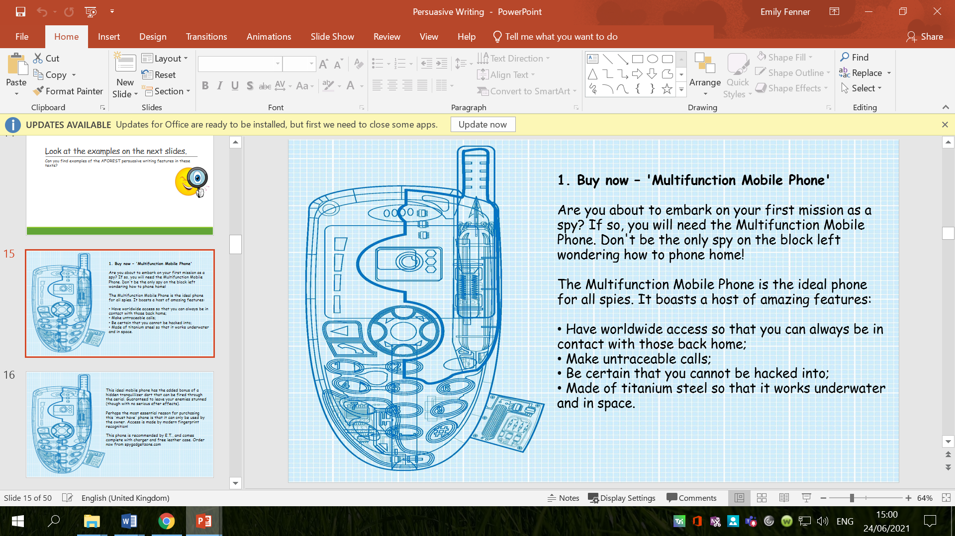
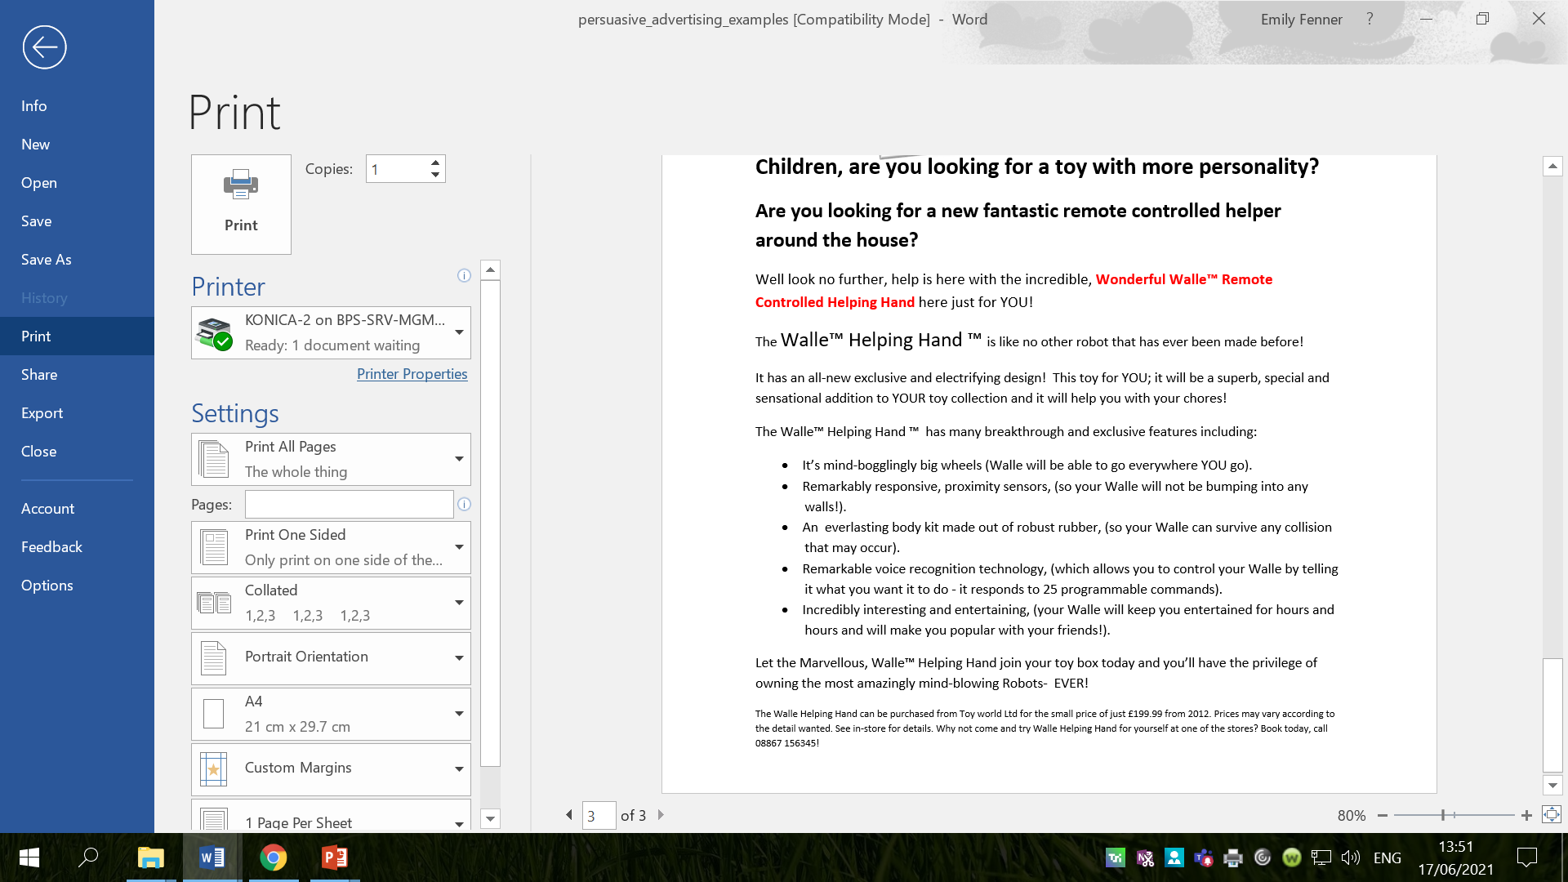
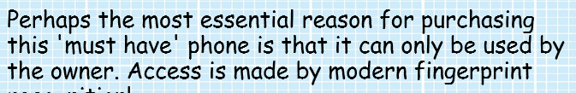

Slide 9



Why is this number important?
It is believed that a person is more likely to remember things if they are grouped in three.
Every Little Helps (Tesco)
Just Do It (Nike)
Finger Lickin’ Good (KFC)
I’m Lovin’ It (McDonalds)
Taste the Rainbow (Skittles)
Snap, Crackle Pop (Rice Crispies)

Slide 10
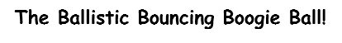
When using the rule of 3 in persuasive writing, you need to choose the word order carefully, so the word having the biggest impact is at the end.

Slide 11
Activity
Experiment with using emotive language, exaggeration and rule of 3 for your invention.
Think carefully about your vocabulary choices – try to increase the effect on the reader! Different words can be more powerful, effective or emotive.
Red Pen: read your work to an adult. Have you persuaded them to buy their product? Why/why not? What do you need to do to persuade them? Are there better, more effective word choices you could have used?

Slide 12
Tuesday 29th June 2021
LO: to write with purpose
to plan, write, edit and improve
C: Persuasive Writing

Slide 13

You are going to be creating your persuasive writing posters this week!
The first thing you need to do is plan your ideas.

Slide 14
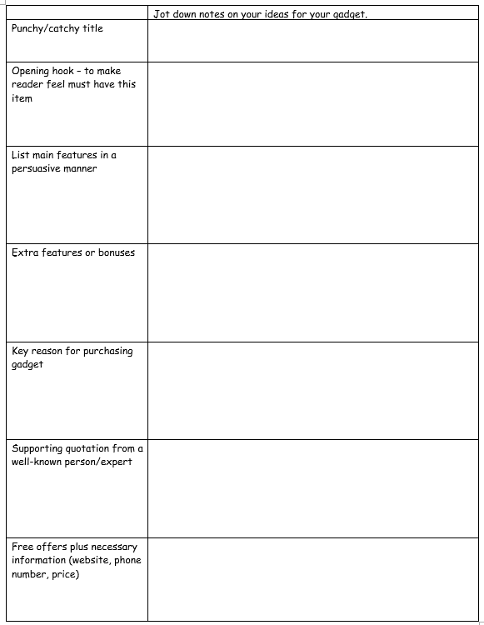
Planning Template
You will be looking back at your work from last week and choosing some of your best ideas to include in our plan and final poster.

Slide 15
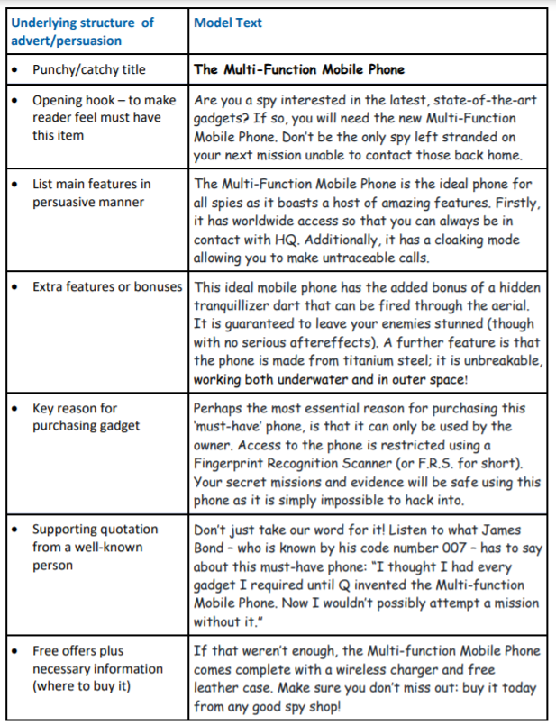
Example:

Slide 16
Activity
Complete the planning template for your own invention using your ideas from the last few lessons.
Red Pen: think carefully about the vocabulary you have used in your plan. Remember you want to persuade the reader to buy it! Try to boast about your product, e.g.
‘It is the ideal gadget.’
‘This essential gadget.’
‘This gadget will transform your life.’

Slide 17
Wednesday 30th June 2021
LO: to write with purpose
to use imaginative description
to use sentences appropriately
C: Persuasive Writing

Slide 18
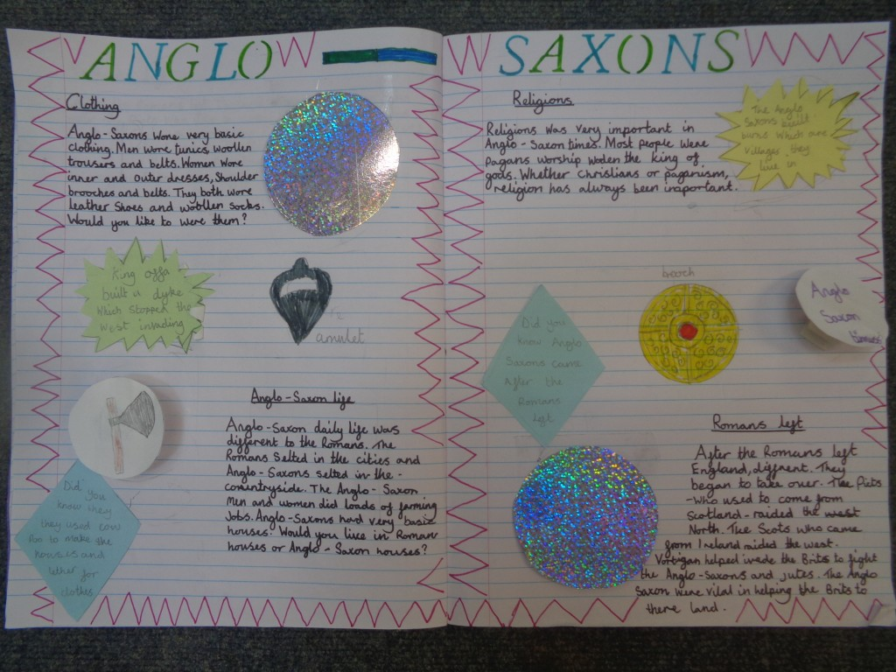
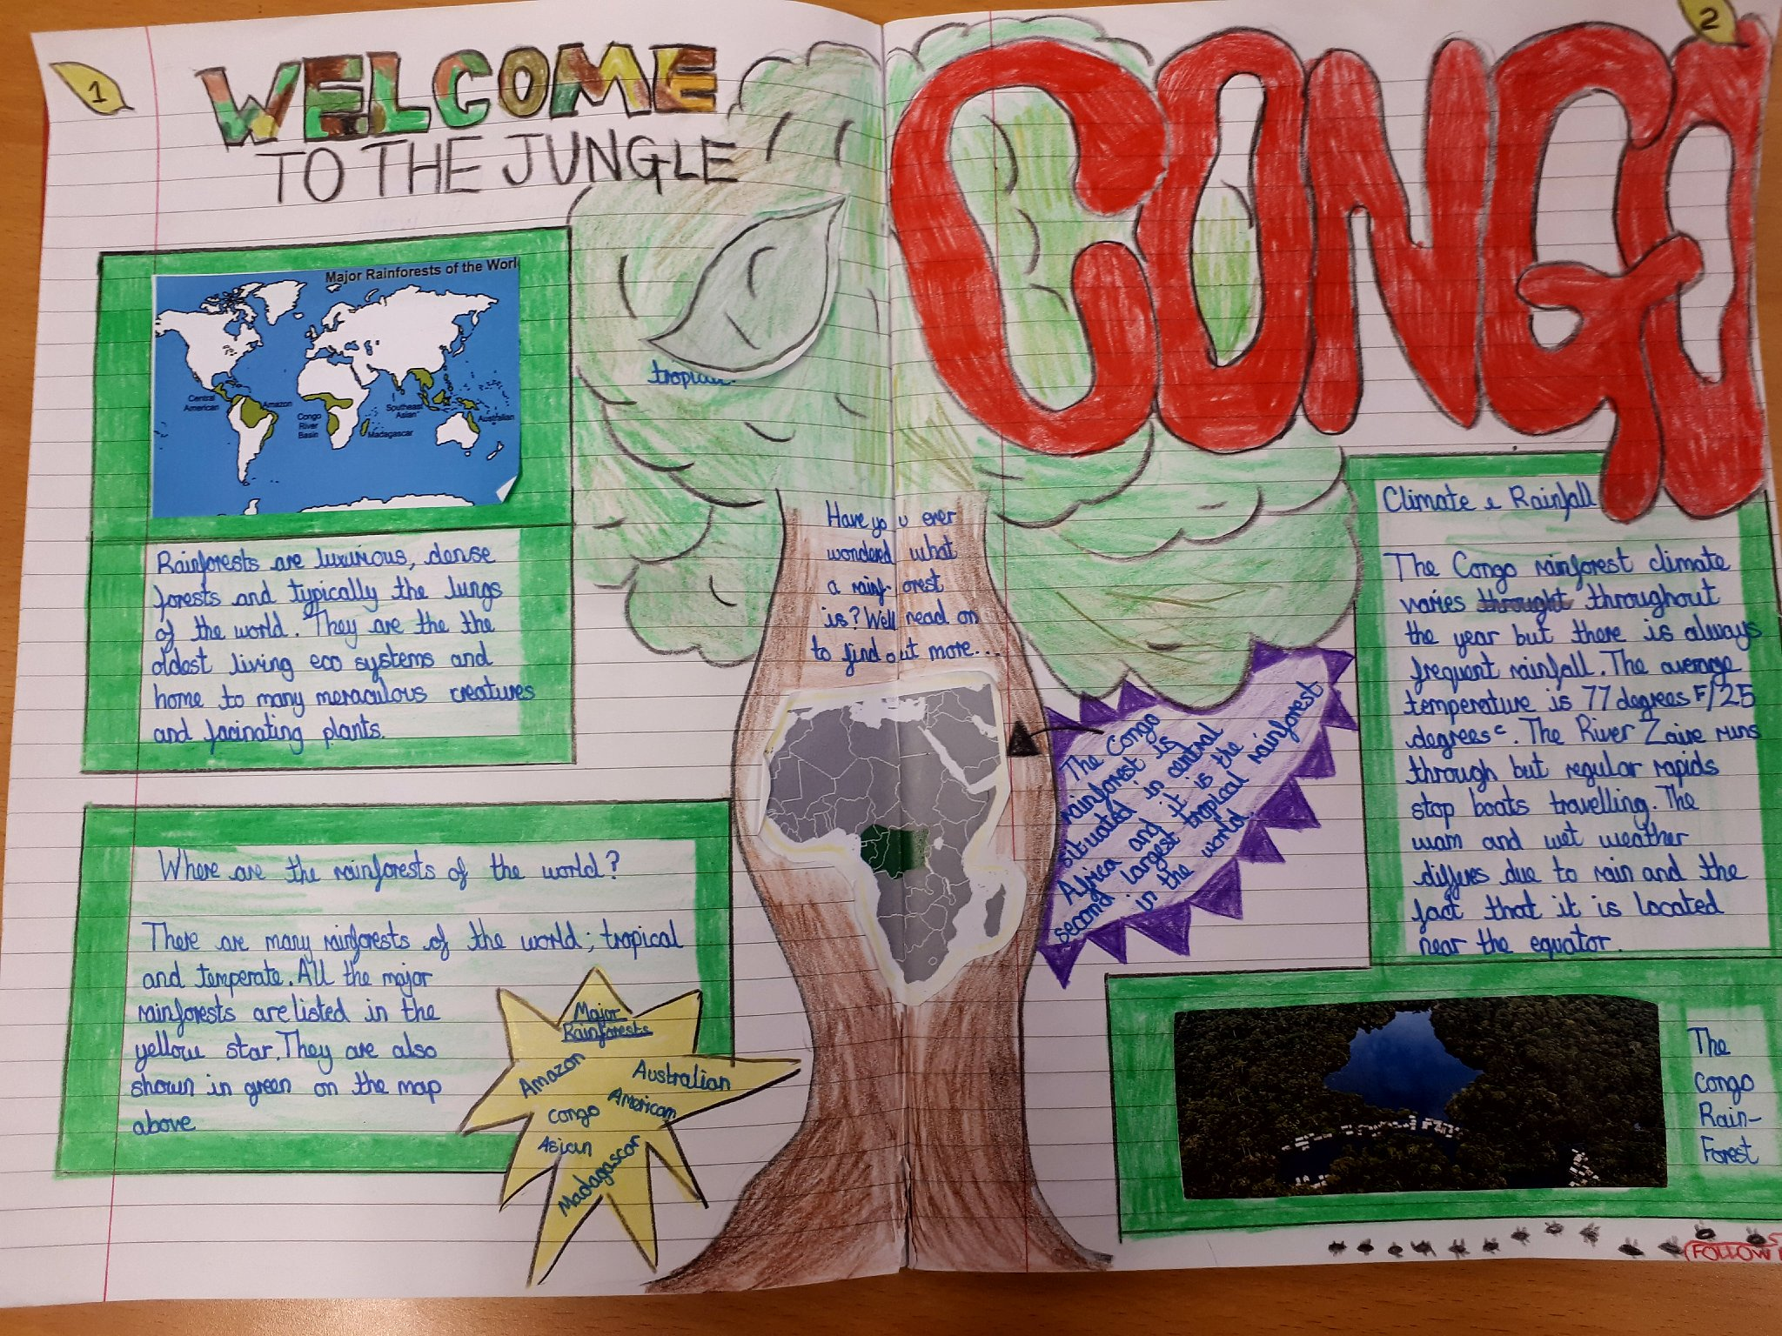
You will be creating your persuasive writing poster over the next 2 lessons.
You will be doing this over a double page spread, just like we have been doing in Geography!

Slide 19

My Example
What features of persuasive writing can you identify?
What do you like about my poster? What could I do to improve?
Are there any words or phrases you want to magpie?
Jot them down!

Slide 20
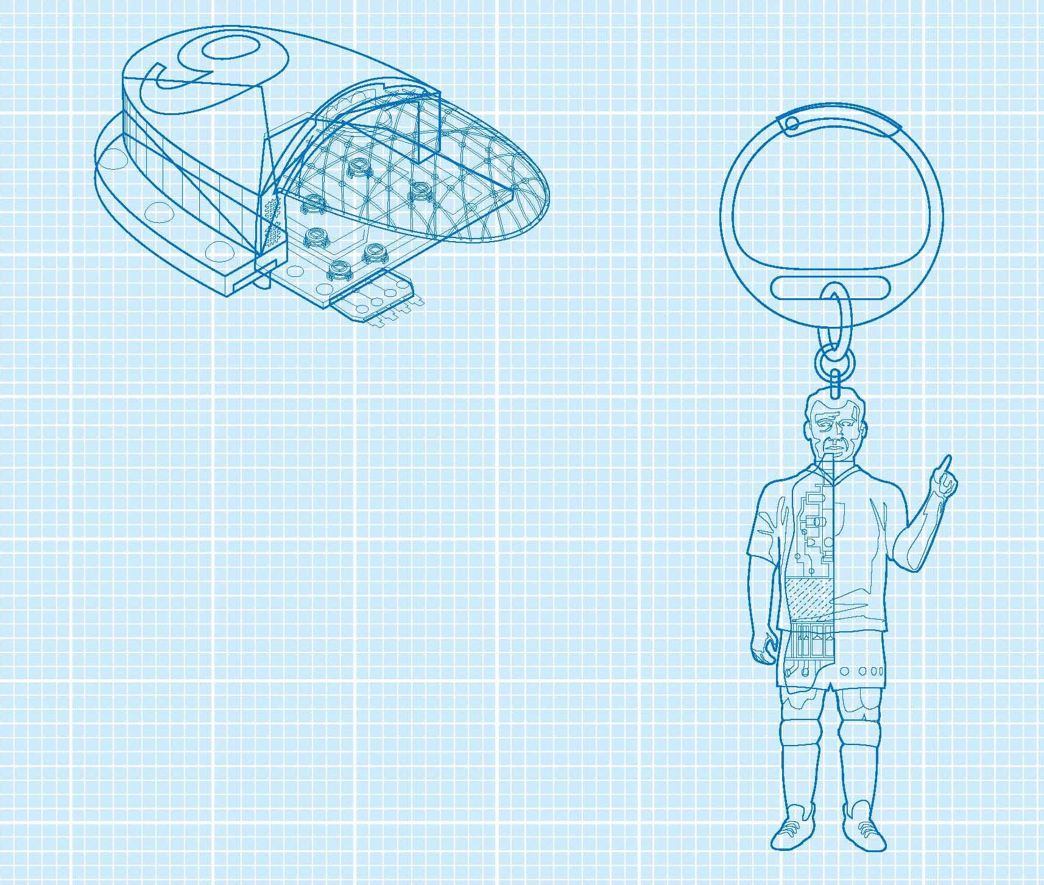
Buy now – the new 'Multi-purpose Spy Key Ring'
Have you ever been captured whilst spying? Do you run the risk of your enemies finding you out? Are you a spy in need of a helping hand? If so, buy this Multi-purpose Spy Key Ring and all your troubles will be left behind.
Notes:
20
20

Slide 21
The Multi-purpose Spy Key Ring is the latest gadget created by Smithers at the Covert Weapons Section of MI6. This is the updated version of the famous Stun Grenade Key Ring as used by Alex Rider, the spy that even James Bond feared. This new version has been fully upgraded to include:
explosive light burst that will stun but never kill;
laser light that cuts through all known metals;
bug finder to check that you are not being spied upon;
an amazing listening device;
plus the latest smoke bomb technology.
Notes:
21
21

Slide 22
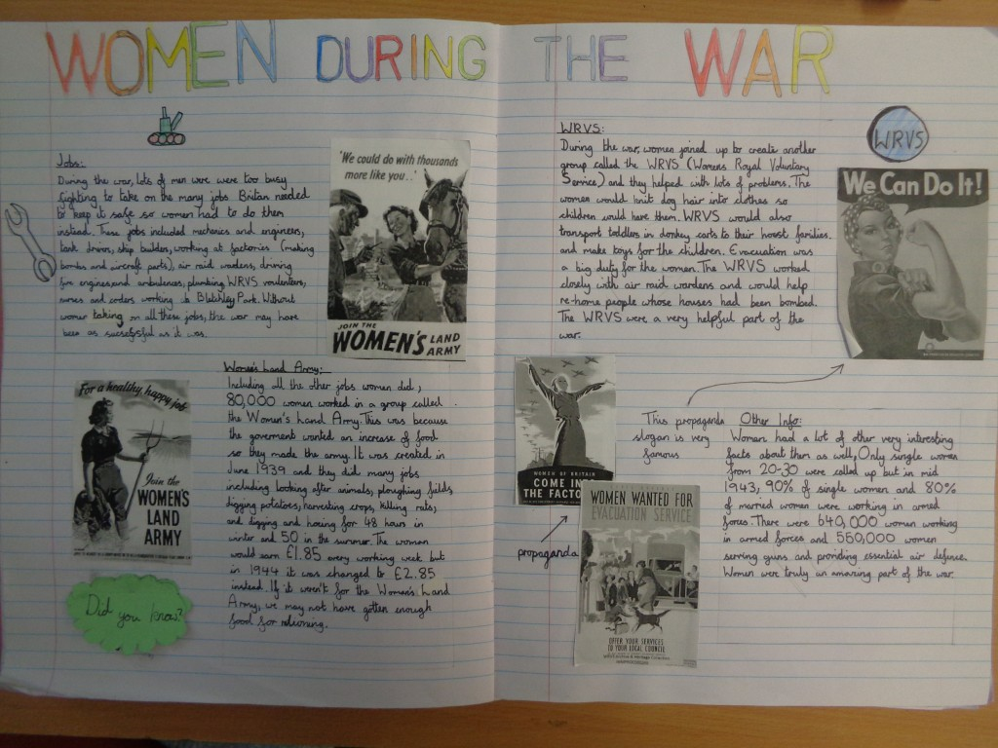
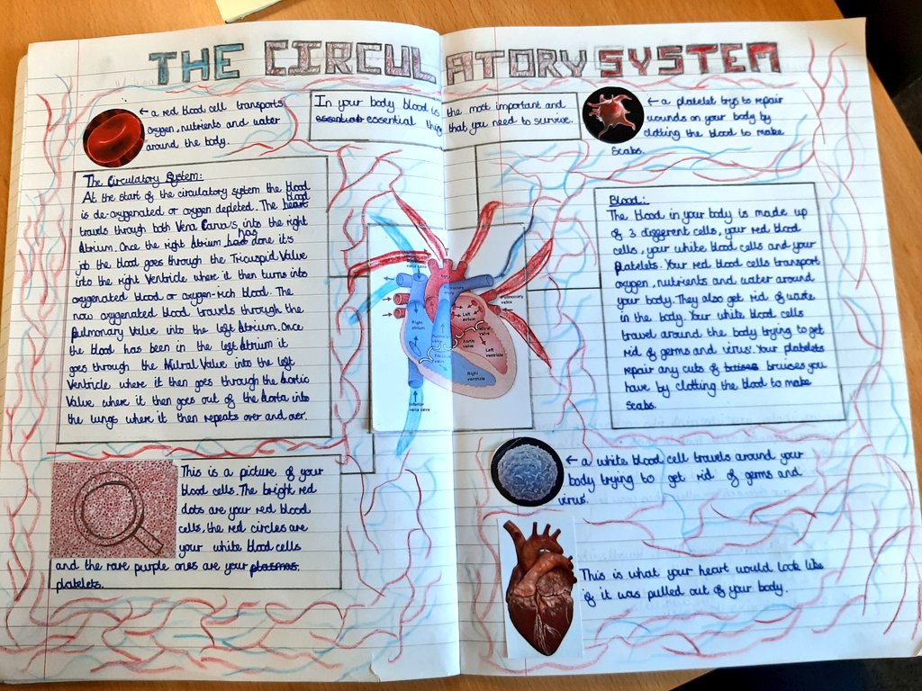
You will have the rest of this lesson and some of tomorrow’s lesson to complete your posters so there is no need to rush!
Your priority is the writing, but you are allowed to draw diagrams and pictures! You can also split the writing into boxes etc.

Slide 23
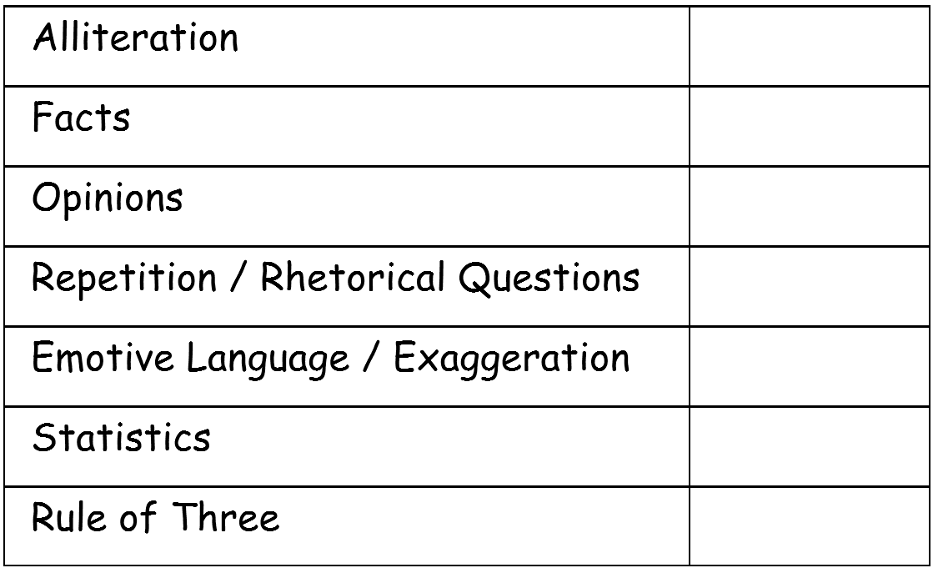
Checklist

Slide 24
Activity
Start creating your persuasive writing poster!
Red Pen: look back at the checklist; have you included everything on the checklist? Is there anything else you need to include? Try to add it into your poster.

Slide 25
Thursday 1st June 2021
LO: to write with purpose
to use imaginative description
to use sentences appropriately
C: Persuasive Writing

Slide 26
Starter
Look back at your work from yesterday – look at the highlighting and checklist and read your marking comment.
What have you done well?
What do you need to improve?
Tell an adult what you are going to do to improve your work today!

Slide 27
Activity
Finish writing your persuasive posters today, using your marking feedback to help you improve.
Red Pen: look back at the checklist; have you included everything on the checklist? Is there anything else you need to include? Try to add it into your poster!
Read your work to an adult. Have you persuaded them to buy their product? Why/why not? What do you need to do to persuade them? Are there better, more effective word choices you could have used?

Slide 28

Plenary
Present your posters to an adult.
Ask them:
- would you buy this product?
- why?
- what persuaded you?

