Slide 1
Monday 15th March 2021
LO: to identify how sounds are made, associating some of them with something vibrating
to recognise that vibrations from sounds travel through a medium to the ear
C: Sound

Slide 2

Starter
Using an object on your table, make a quiet noise.
STOP.
Now, make a loud noise.
STOP.
What did you have to do differently to make a louder noise?

Slide 3
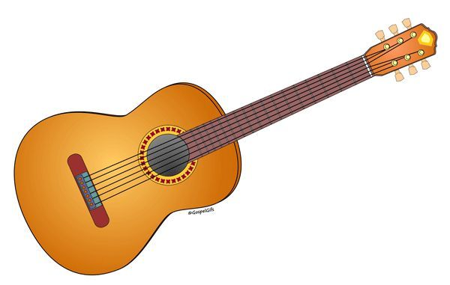
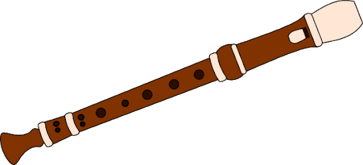

Starter:
What would you have to do to make a quiet noise with these instruments?
A loud noise?

Slide 4
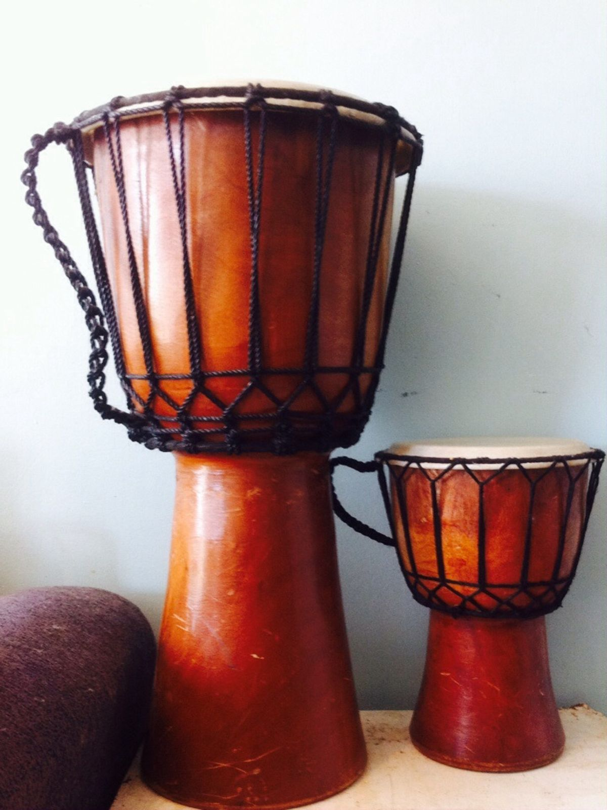
Sound is a form of energy, and if we put more energy into making the noise, then the noise will be louder.
The size of the object vibrating will also affect the volume – a large drum will be louder than a small drum.

Slide 5

How do we hear sounds?
Can you remember what we learned last lesson?

Slide 6
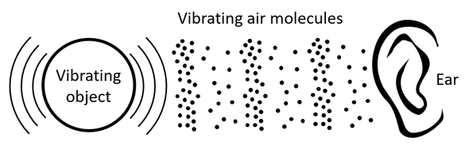
Vibrations in the air (sound wave) caused by vibrations of objects, travel into our ears.

Slide 7
Sound is caused by vibration.
When you pluck a guitar string or hit a drumskin, you can see the material vibrate.
This causes the air touching the string to vibrate, which causes air further away to vibrate, which causes the air near your ear to vibrate, which your brain experiences as a sound.
The moving vibration is called a sound wave.

Slide 8
How our ears work:
When a sound wave reaches our ear, our outer ear (the part that we can see on the side of our heads) funnels the sound into our heads, down the ear canal.
At the end of the ear canal, is the eardrum, which is waterproof and airtight.
Past the ear canal is the middle ear.
Inside the middle ear is the hammer, anvil and stirrup (the three smallest bones in the body), which vibrate and pass the sound waves to the inner each, which contains the cochlea, which turns the vibrations into electrical signals.
These signals travel down the auditory nerve to the brain, which experiences the signal as a sound.

Slide 9
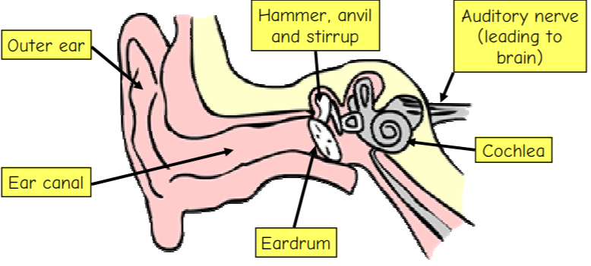

Slide 10
The structure of the ear:
When the vibrations in the air enter the ear, they cause the eardrum to vibrate, which in turn passes the vibrations to the small bones inside the ear.
The vibrations then cause the fluid inside the cochlea to move the small hairs inside, which send messages to the brain which are interpreted as sounds.
The fact that we have two ears helps us to decide which direction the sound is coming from, because the sound wave reaches one each before the other.
https://www.bbc.co.uk/bitesize/topics/zgffr82/articles/zx9hcj6

Slide 11
Activity:
Paddling | Snorkelling | Diving
Cut out the diagrams and descriptions to create an explanation text showing how we hear things. | Use the diagrams and descriptions to help you create your own explanation text showing how we hear things. Red Pen: How does the outer ear help us to hear better? | Create your own explanation text showing how we hear things. Draw your own diagrams and write your own descriptions. Red Pen: Sam says, ‘I don’t think we need an outer ear. As long as I have an ear canal, I will still be able to hear.’ Do you agree with Sam? Explain your reasoning.

Slide 12
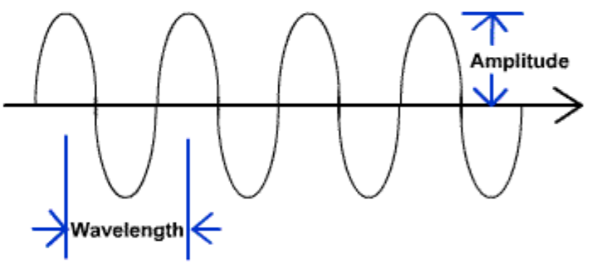
Plenary:
Look at the sound waves on the link below.
https://www.dkfindout.com/uk/science/sound/loudness/

Slide 13
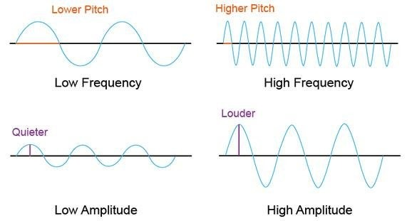
Scientific Vocabulary
Amplitude – the larger the amplitude, the louder the sound
Frequency – the number of waves per second
Pitch – how high or low the sound is
Wave length – the shorter the wave length, the higher the frequency of waves and the higher the pitch

Slide 14
If you were to make a louder sound of the same pitch, how would the sound wave change?
(The amplitude would be larger, but the wave length would remain the same).
Draw the sound wave.

Slide 15
If you were to make a sound with a lower pitch, how would the sound wave change?
Draw what you think the wave might look like.
Why have you drawn it like this?

Slide 16
If you were to make a quiet sound with a high pitch, how would the sound wave change?
Draw what you think the wave might look like.
Why have you drawn it like this?
Make sure you use scientific vocabulary in your explanation!

