Slide 1
Tuesday 16th March 2021
LO:
*to understand lifestyles and practices
C: Christianity

Slide 2
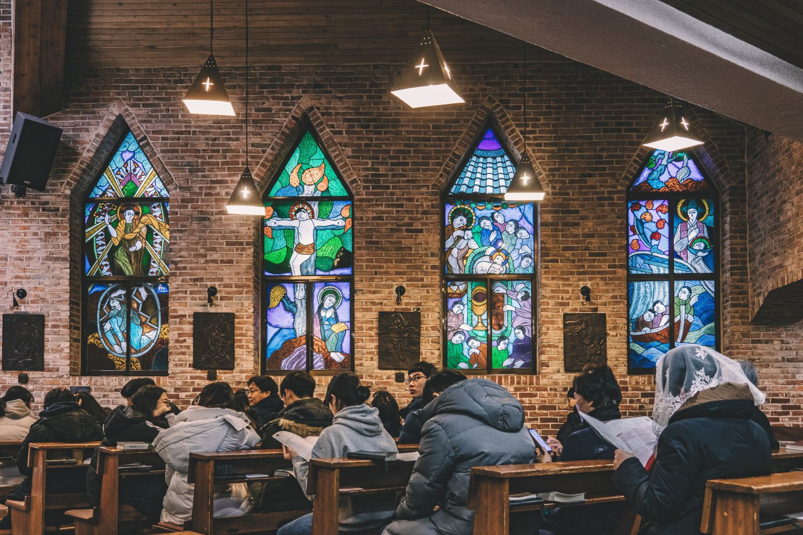
Many churches will have a special service on Maundy Thursday to remember the events of the Last Supper.
A Maundy Thursday service is a time when people meet together for a shared meal and have a communion service together.
In many Roman Catholic, and in some Church of England churches, services are held on Maundy Thursday that re-enact the things that Jesus did at the Last Supper.

Slide 3
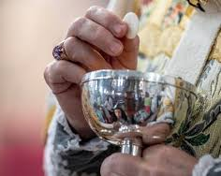
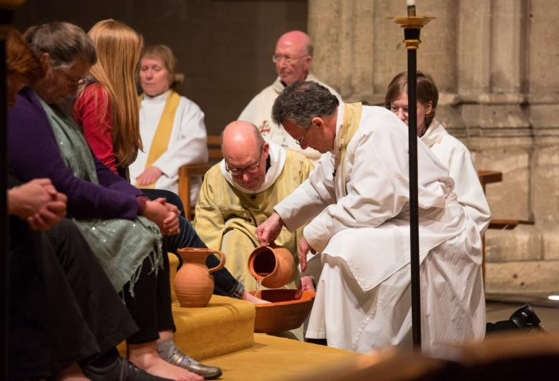
Three things happen:
The Ministers wash the feet of twelve members of the church, remembering that Jesus washed the feet of his twelve disciples.
Broken bread and wine are shared in Holy Communion to remember the meal that Jesus shared with his disciples.
The service ends with a “Prayer Watch” or “Prayer Vigil” to remember that Jesus asked his disciples to pray with him after the Last Supper.

Slide 4
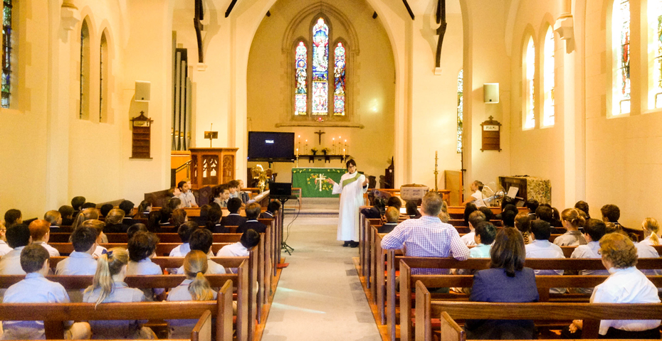
https://www.youtube.com/watch?v=XS4QkZQ-cug

Slide 5
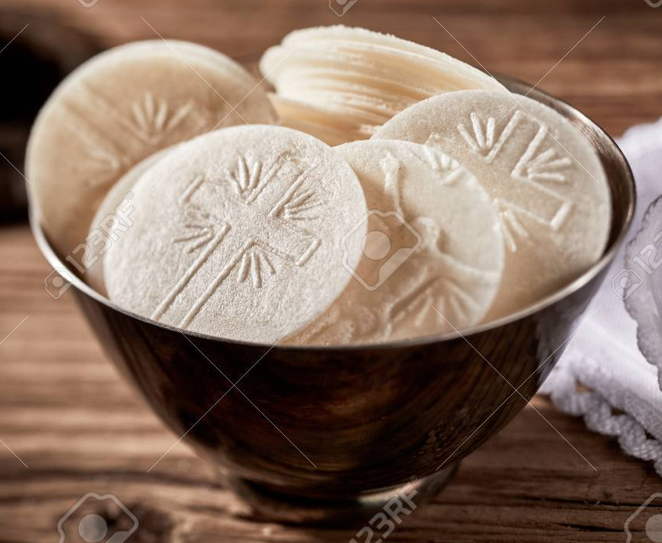
Words used during the service of Communion:
https://www.churchofengland.org/prayer-and-worship/worship-texts-and-resources/common-worship/holy-communion/additional-eucharistic-prayers/prayer-one
What do you notice about these words?
How do they link to the Last Supper?
What other Christian beliefs can we learn
from these words?

Slide 6

Activity:
Create a guide for 6-8 year olds to use in church to help them understand what is happening in the communion service at Maundy Thursday.
The guide should include:
The Last Supper
What Christians believe the bread and wine mean
Why Christians say sorry for what they have done wrong
What foot washing means
Ideas for how 6-8 year olds should behave during communion.
You should include pictures and annotations alongside your writing.

Slide 7
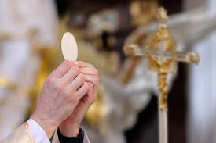
Red Pen:
Snorkelling Red Pen: Why do you think it is important for Christians to have communion on Maundy Thursday?
Diving Red Pen: Christians remember the Last Supper whenever they take communion. Do they really need a special service on Maundy Thursday to remember it too?

