Slide 1
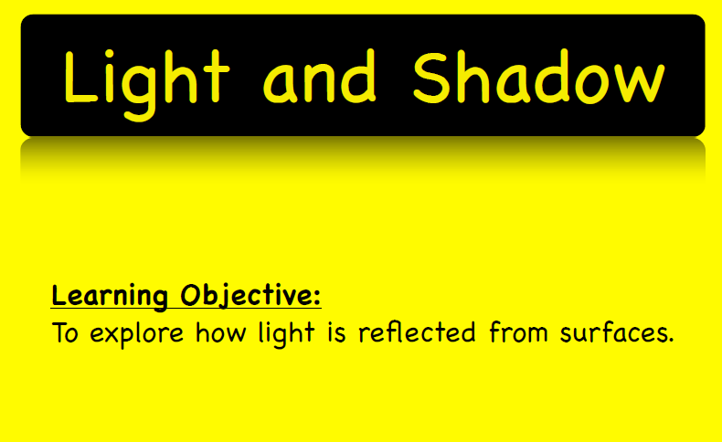
To work scientifically.

Slide 2
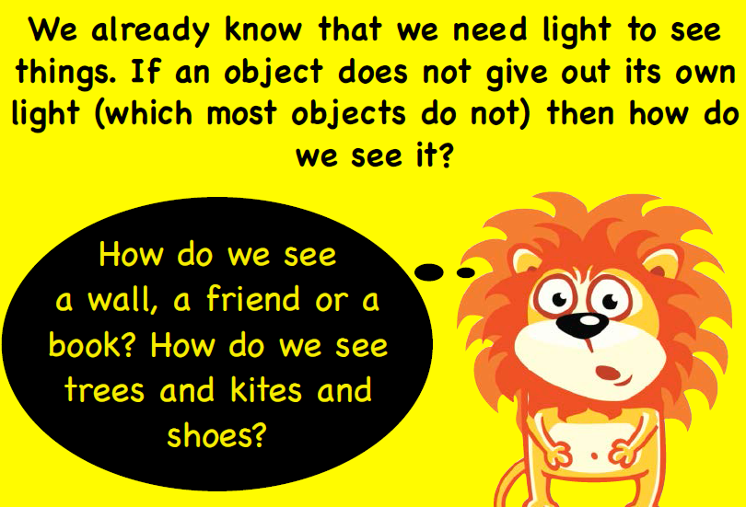

Slide 3
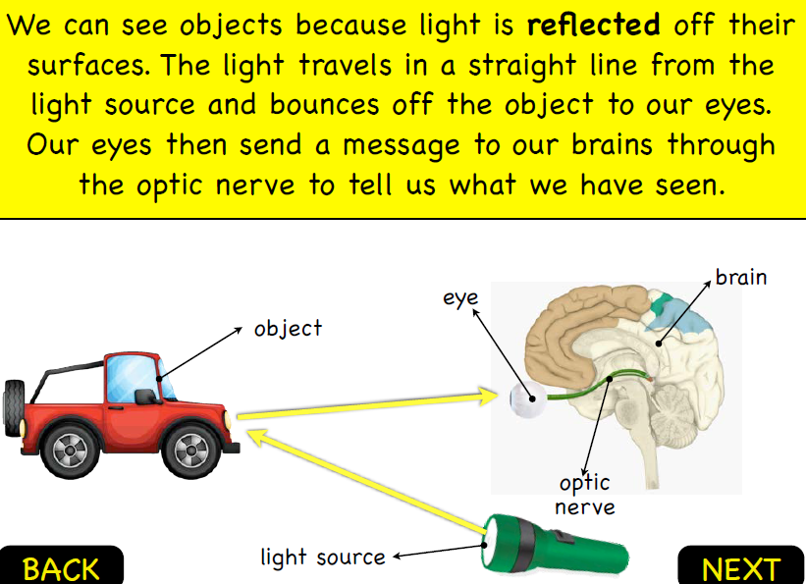

Slide 4
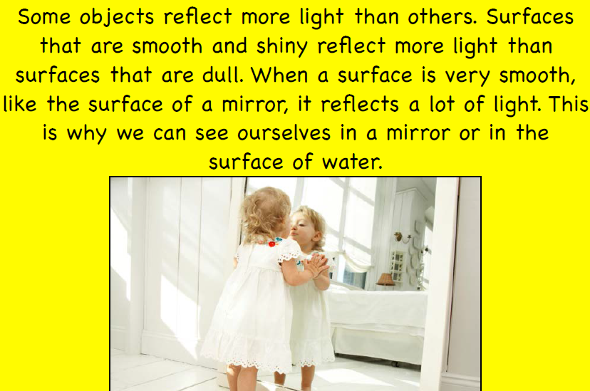

Slide 5
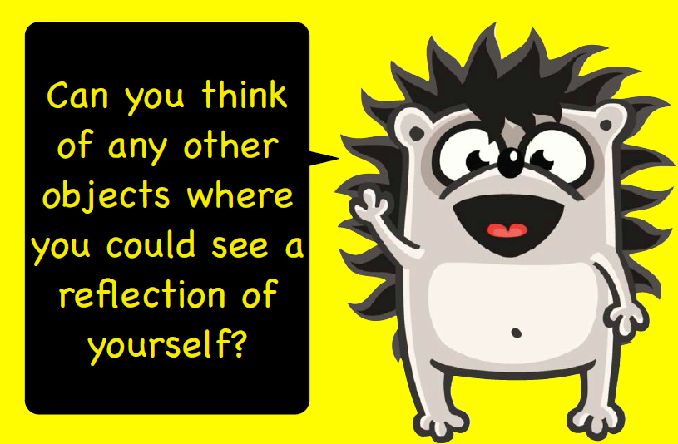
https://www.youtube.com/watch?v=7N7Wx5ClTGU

Slide 6
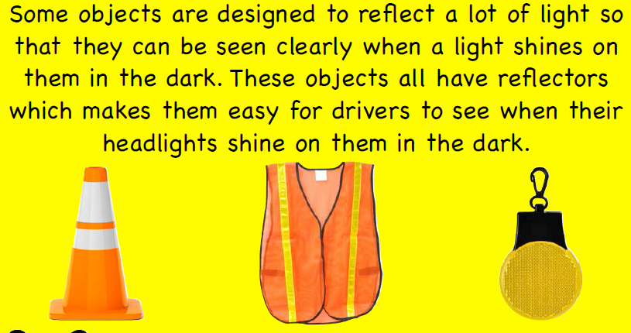

Slide 7
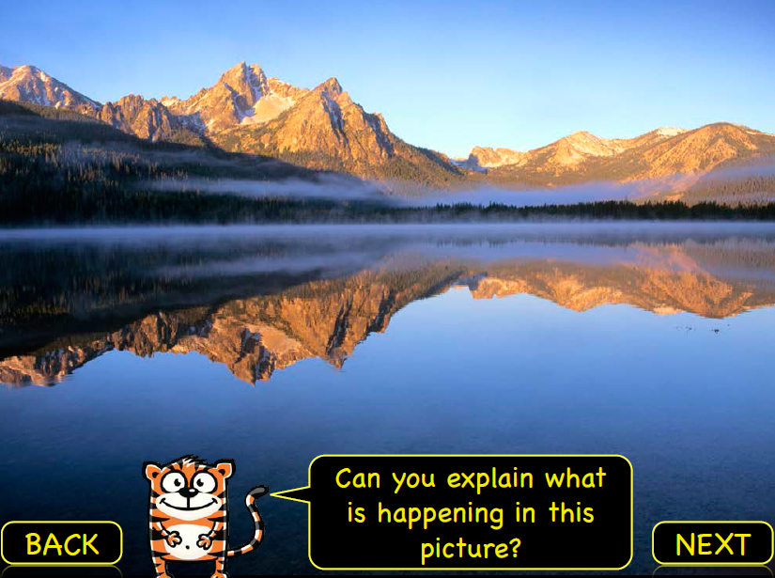

Slide 8
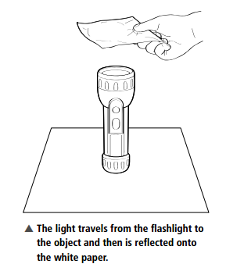
Your experiments today. By the end of the lesson, you need to have completed all 3:
Watch the Videos with Miss Watton!
What makes a good reflector? Look at the different materials on your table, you are going to see which ones are the best reflectors. Complete your sheet and stick it in your books. | Human reflections- Put a metre stick on the floor between you. One of you choose to be the object, and the other the reflected image. What happens when the object moves his/her left hand? Moves backwards and forwards? What do you notice about the image? Stick the picture in your book and complete the question. | Name writing- You need to work out how to write your name in the box so that when you put your mirror on the line, it is reflected back at you in a way that you can read your writing in the mirror. It’s harder than it looks!
Read in the mirror YOUR NAME
Write here:
YOUR NAME

