Slide 1
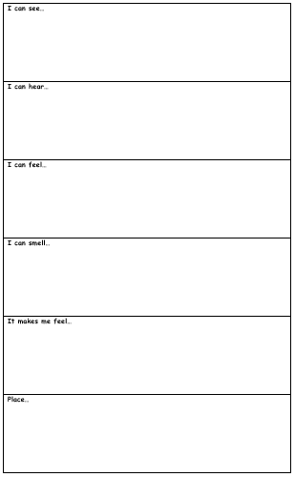

This week we are going to be writing some rainforest poems using photographs and our senses to help us.
On the sheet, you have the headings: I can see, I can hear, I can feel, I can smell, it makes me feel and place.
Red Pen: Use a thesaurus to improve your adjectives!

Slide 2
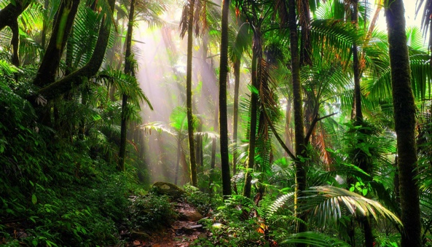

Slide 3
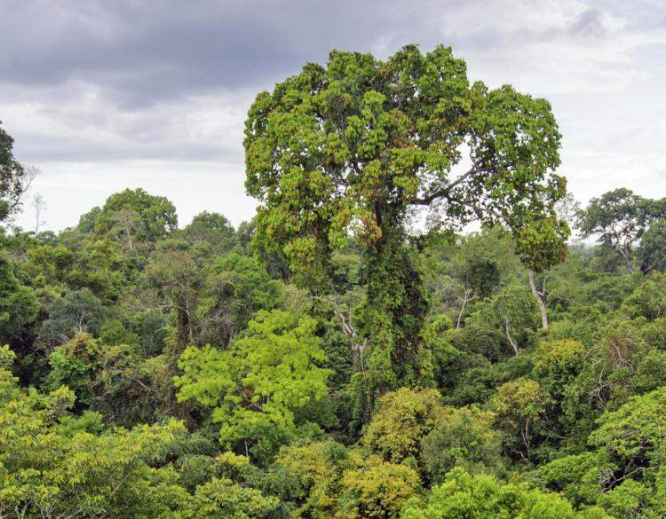

Slide 4
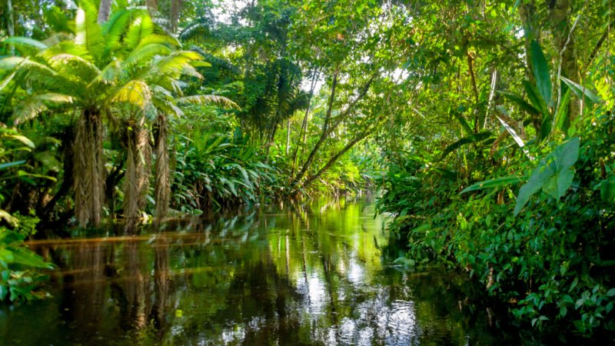

Slide 5
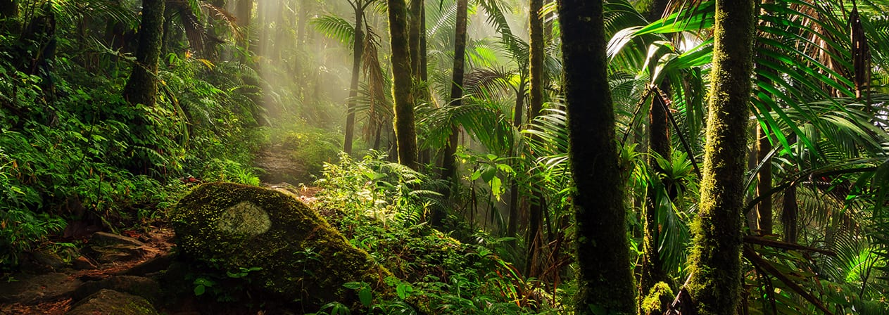

Slide 6
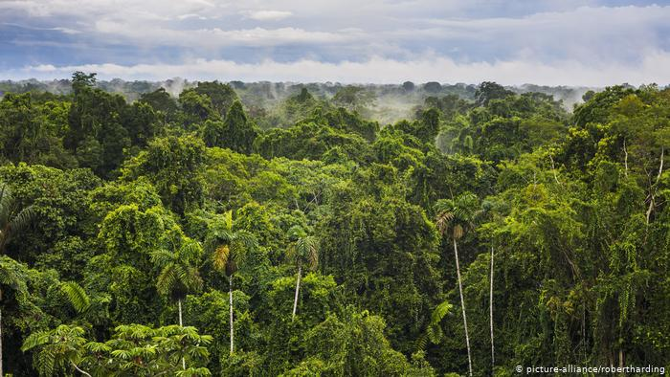

Slide 7
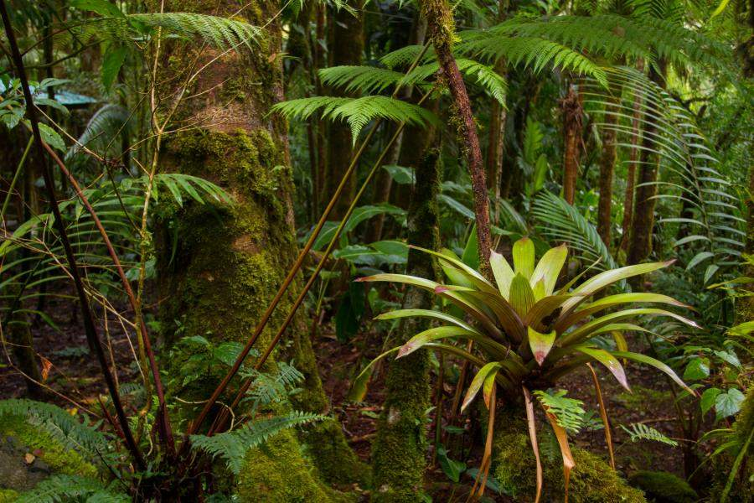

Slide 8
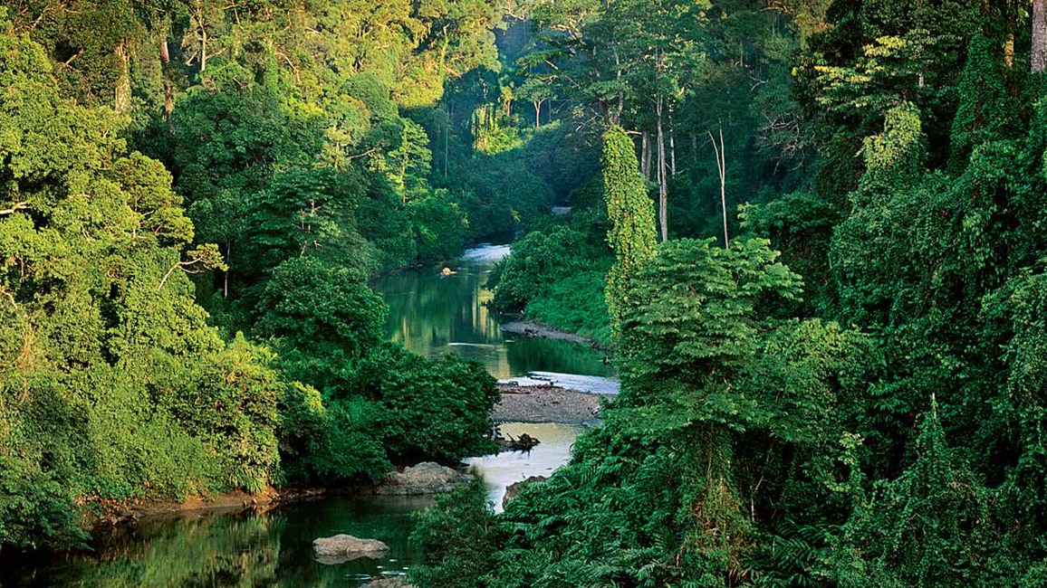

Slide 9
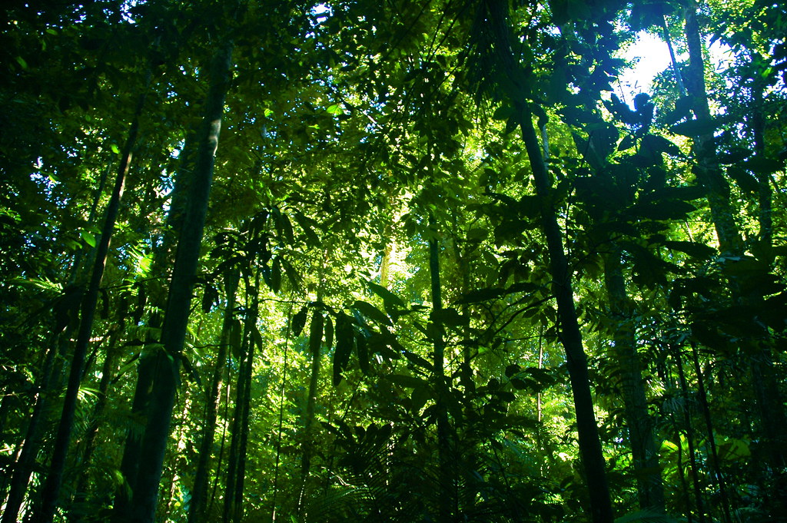

Slide 10
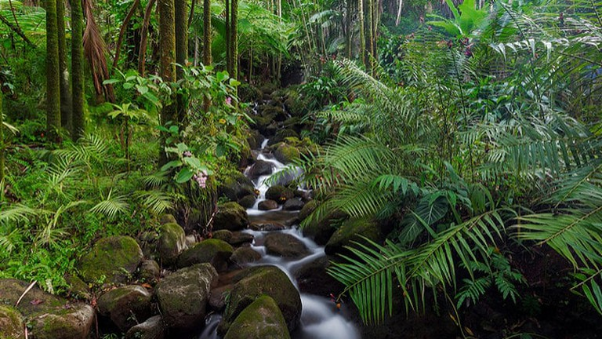

Slide 11
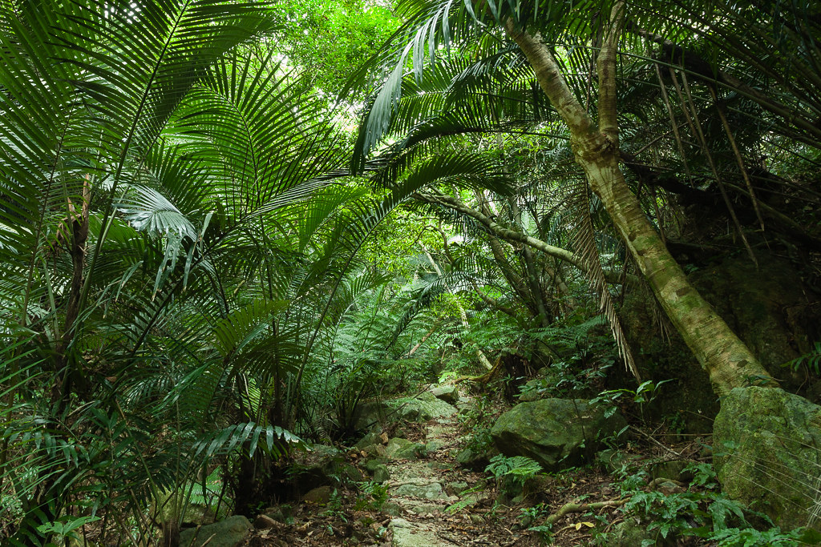

Slide 12
Activity:
Now, cross out the headings and choose an idea or two from each heading.
Read it out loud – you have made a poem!
Red Pen: Mix it up! Change the order of your headings to create a different poem. Could you repeat some of your lines? Which lines will you choose? Why?
Notes:
See the next slides for my examples.

Slide 13
Now, cross out the headings and choose an idea or two from each heading. Read it out loud – you have made a poem!
Fragments of sunlight illuminate the damp, dark forest floor,
Dense, green bushes rustle,
Soggy, slimy leaves slip beneath my feet,
The smell of damp, decaying vegetation fills the air,
A clearing in the rainforest.
I’m in awe.
A blanket of soft moss,
Distant echoing calls of birds in the canopy,
Jagged, hidden rocks scrape,
The earthy aroma of damp soil,
The centre of the rainforest,
Lost.
A sea of green,
Excited, exotic birds chirp loudly,
A warm, gentle breeze blows,
The heavenly scent of rain in the air,
The canopy,
On top of the world!
An umbrella of gargantuan, weighty leaves,
Quiet droplets of water drip,
Warm, calm water lapping gently,
Rainforest river,
Calm.

Slide 14
Red Pen: Mix it up! Change the order of your headings to create a different poem. Could you repeat some of your lines? Which lines will you choose? Why?
A clearing in the rainforest,
I’m in awe.
Fragments of sunlight illuminate the damp, dark forest floor,
I’m in awe.
Soggy, slimy leaves slip beneath my feet,
I’m in awe.
Dense, green bushes rustle,
I’m in awe.
The smell of damp, decaying vegetation fills the air,
I’m in awe.
Distant echoing calls of birds in the canopy,
The centre of the rainforest.
Jagged, hidden rocks scrape,
A blanket of soft moss,
The centre of the rainforest.
The earthy aroma of damp soil,
The centre of the rainforest,
Lost.
A sea of green,
Excited, exotic birds chirp loudly,
A warm, gentle breeze blows,
The heavenly scent of rain in the air,
The canopy,
A sea of green,
On top of the world!
An umbrella of gargantuan, weighty leaves,
Calm.
Quiet droplets of water drip,
Calm.
Warm, calm water lapping gently,
Calm.
Rainforest river,
Calm.

