Slide 1

What is a limerick?
What do all limericks need to have?
What ideas did you have for your own limericks?

Slide 2
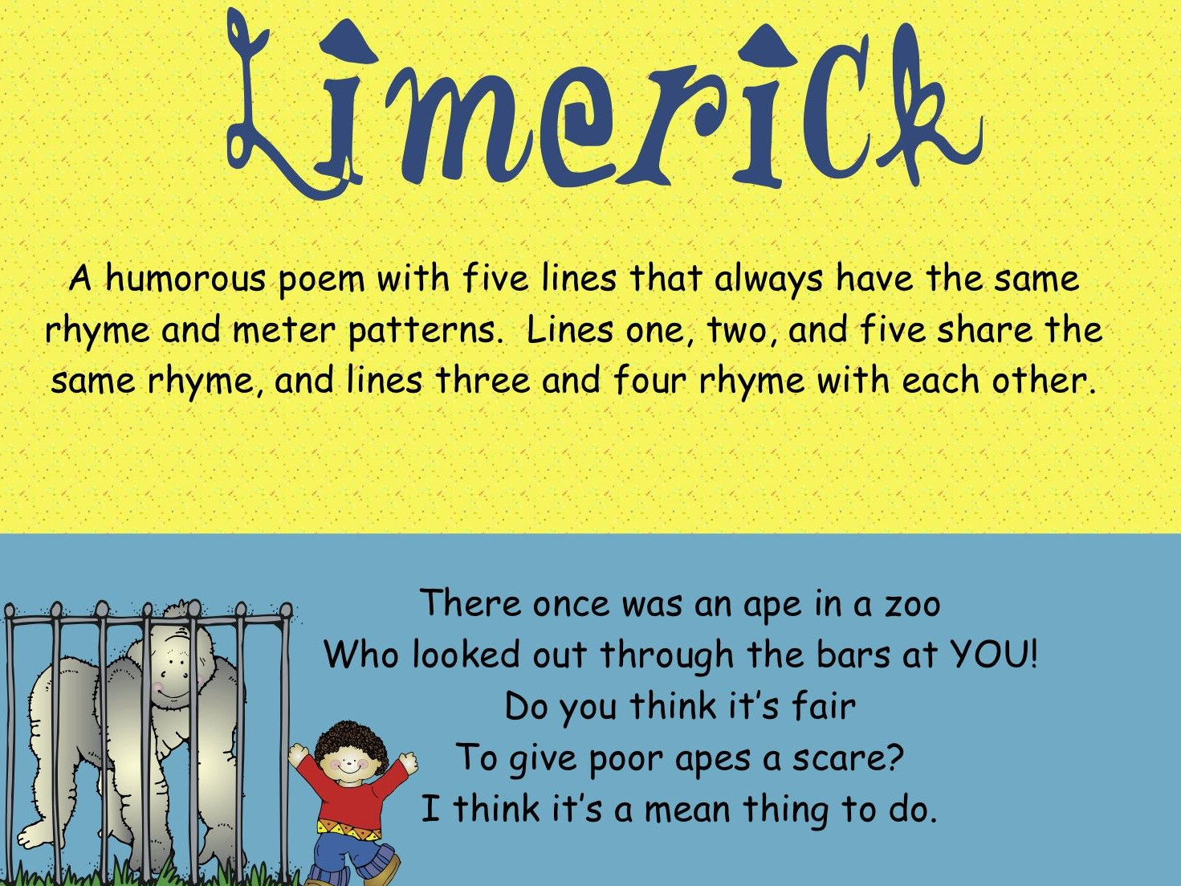
What is a limerick?

Slide 3
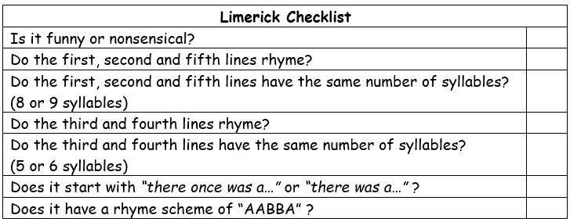
My Limericks
What do you think about them?
Do they have all the features of a limerick?
Can you identify them?
There once was a gargantuan tree,
As tall as a skyscraper can be,
His golden leaves fell down,
And blew around the town,
Blocking my view so I couldn’t see!
There was a sloth hanging upside down,
His tangled fur was chocolate brown,
He stretched his strong arm out,
But fell down with a shout,
Which left his mud brown face with a frown.

Slide 4
Write your own limericks about the rainforest / rainforest animals.
You may wish to jot down ideas on whiteboards while you are experimenting with syllables / rhyming, but I am expecting at least 1 limerick sent on Teams by the end of the day.
Make sure you are using impressive vocabulary!
If you have finished writing your limerick, use the checklist for writing limericks and red pen check that you have included all of the features.

Slide 5
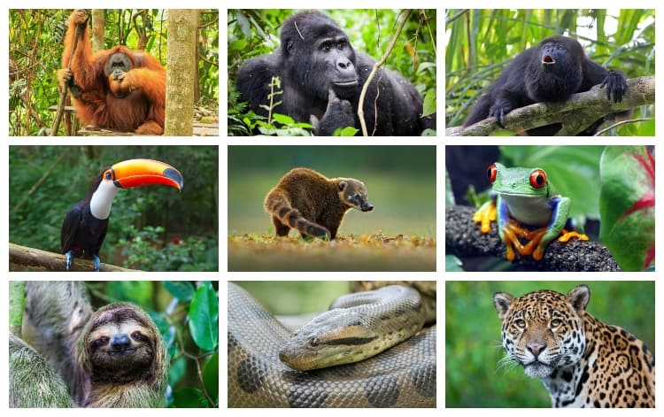

Slide 6


