Slide 1
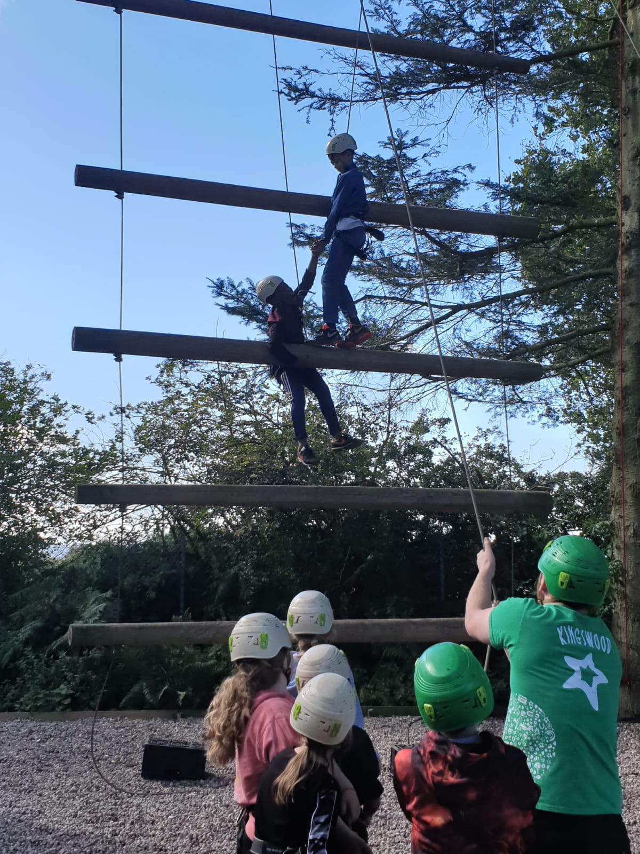
Year 6 Residential
Liddington, Swindon, Wiltshire

Slide 2
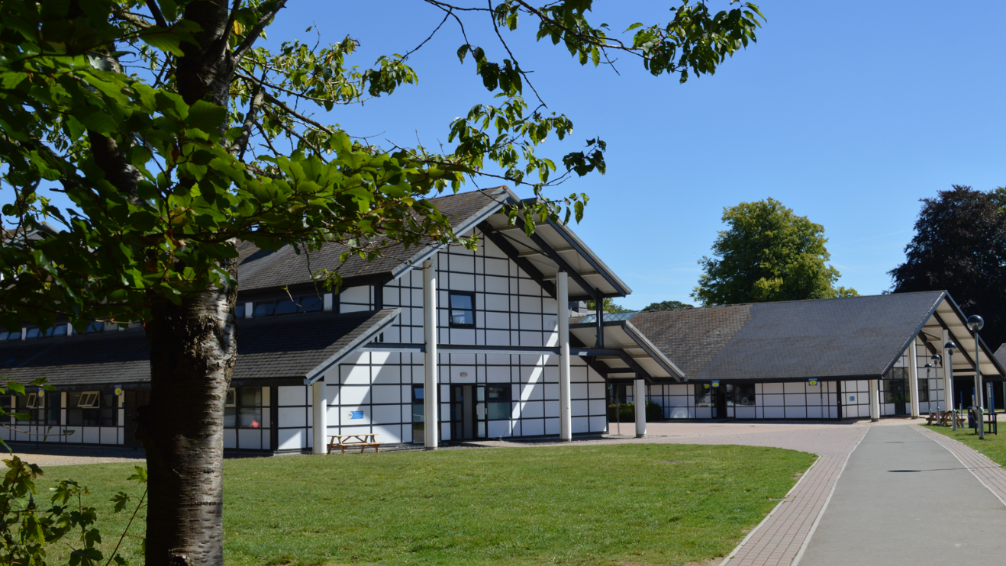
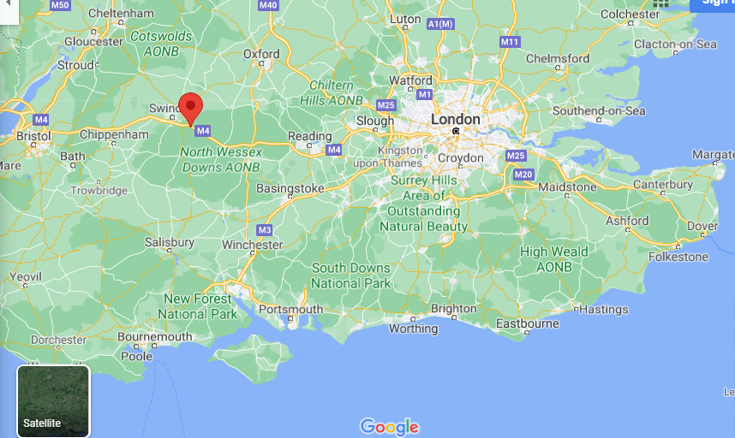

Slide 3
Dates:
Monday 10th June 2024
to
Friday 14th June 2024

Slide 4
Cost
The cost of 4 nights (including coach fare) is likely to be £423.81 (this may change if we don’t have the full year group or the coach cost is different)
Pay via Schoolcomms (£100 deposit due 21st April 2023 to secure your child’s space).
The balance of the trip can be paid in full or in 7 instalments. (£46.25 per month from September 2023 onwards).
If cost is an issue, please talk confidentially to our Finance Office, Nicol Doherty before making final decisions.

Slide 5
A day at PGL…
https://www.youtube.com/watch?v=lYs24HDhB9M

Slide 6
We go to...
Learn about each other and ourselves
Team build
Face new challenges
Try something new
Build resilience and a growth mindset
Fulfil some of the PE curriculum
Experience being away from home
Develop independence
Have lots of fun!

Slide 7
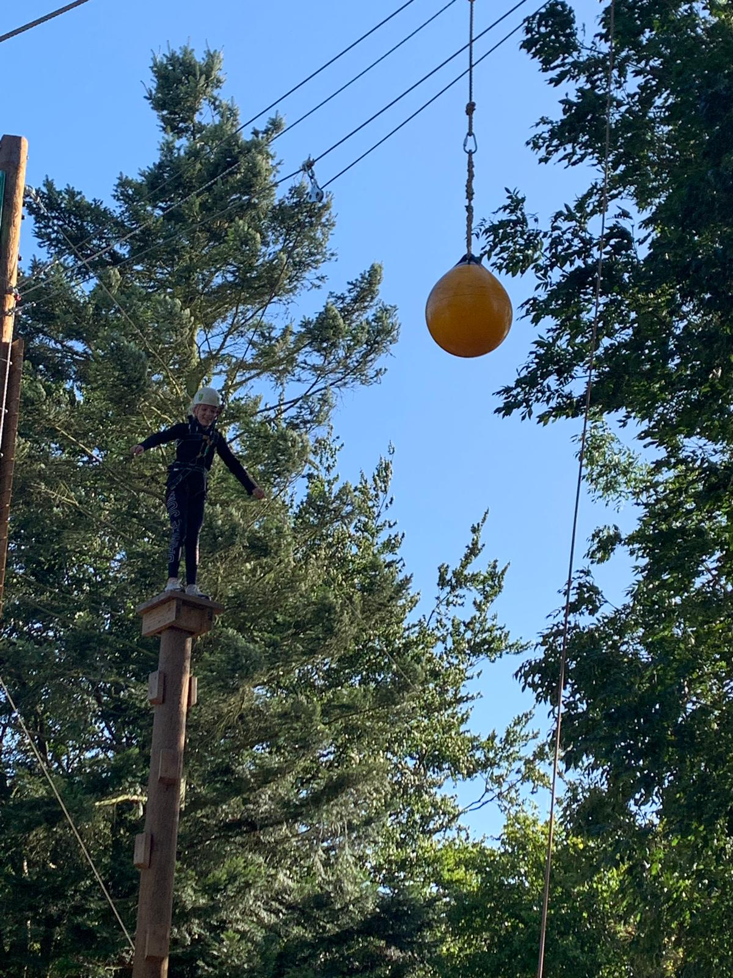
Challenges

Slide 8
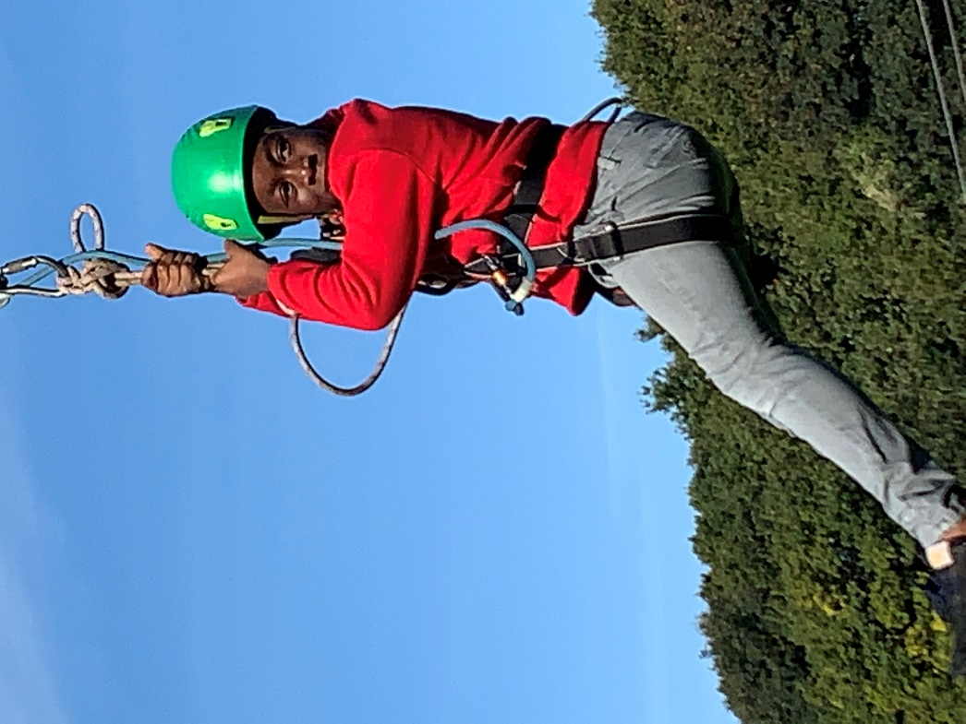
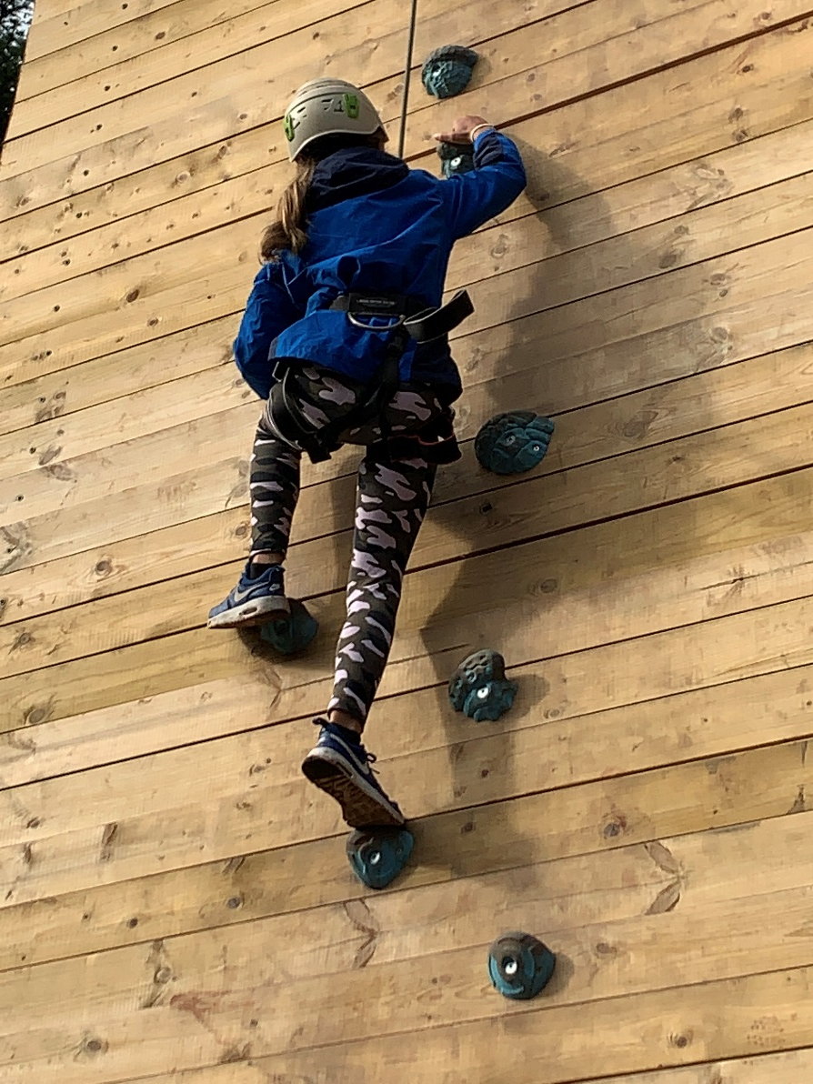
Confidence building

Slide 9
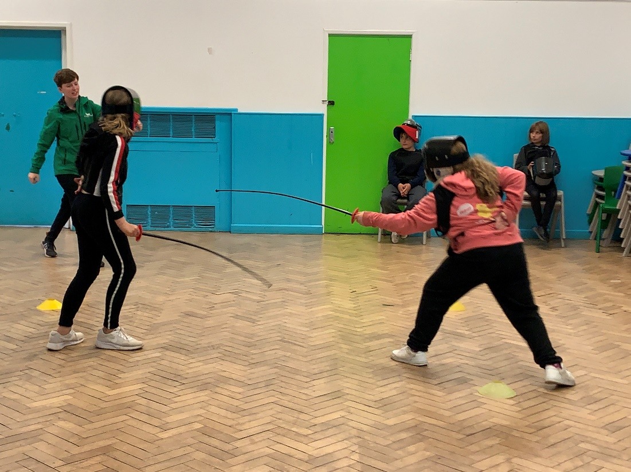
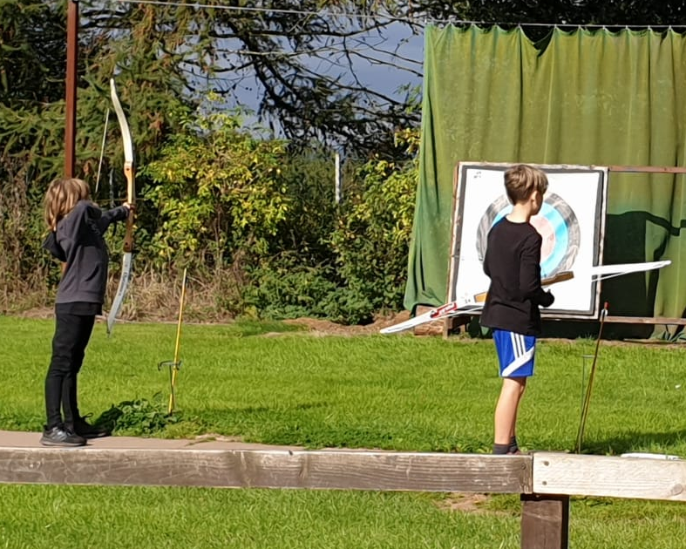
New skills
Notes:
Staff are well-trained and experienced
Safety is obviously key and inherent across the site
All activities are ‘challenge by choice’

Slide 10
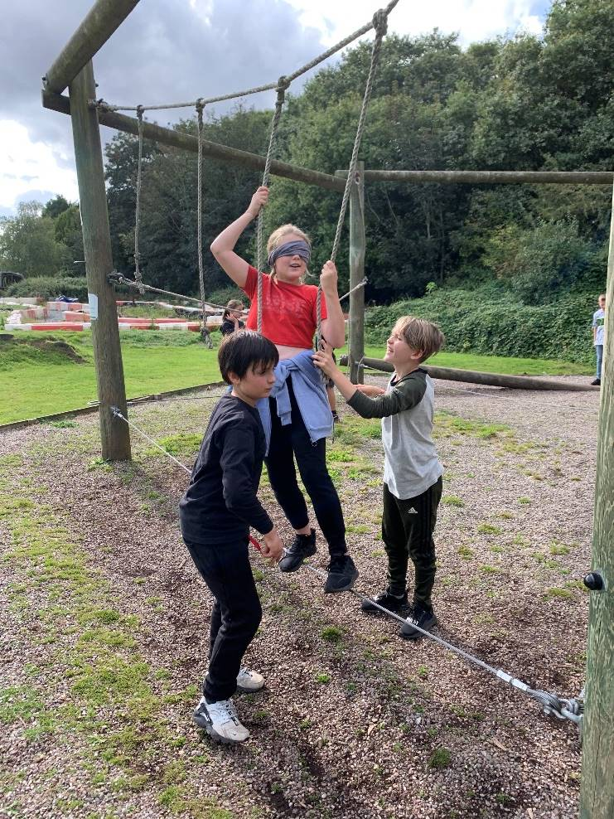
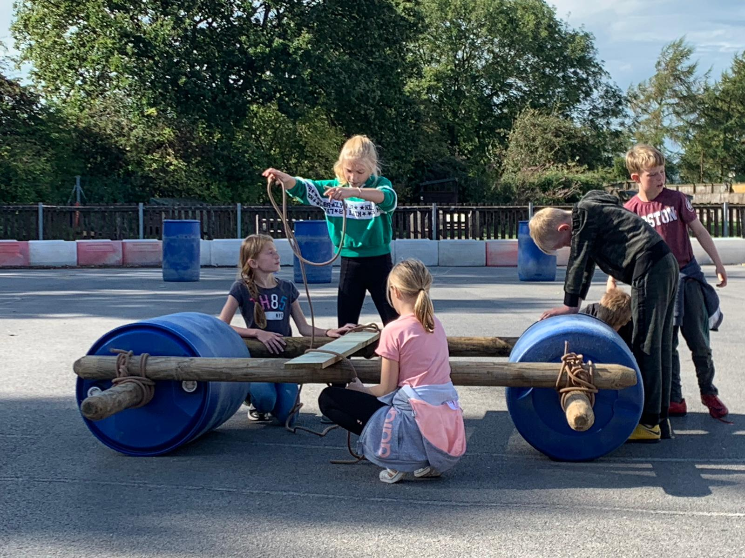
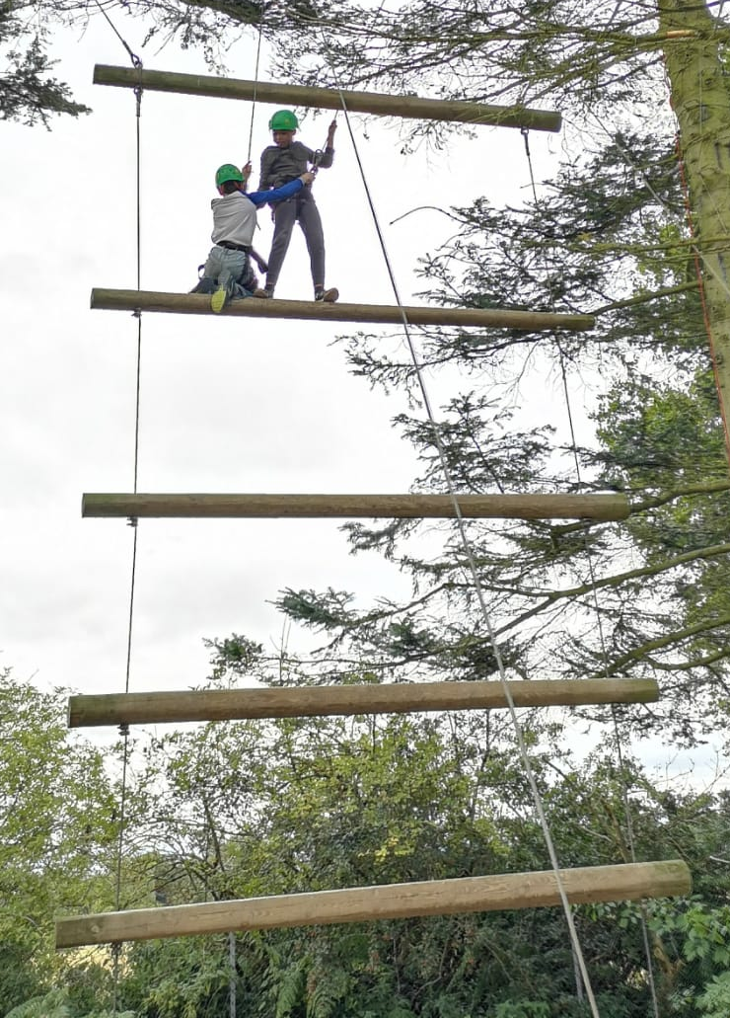
Team work

Slide 11
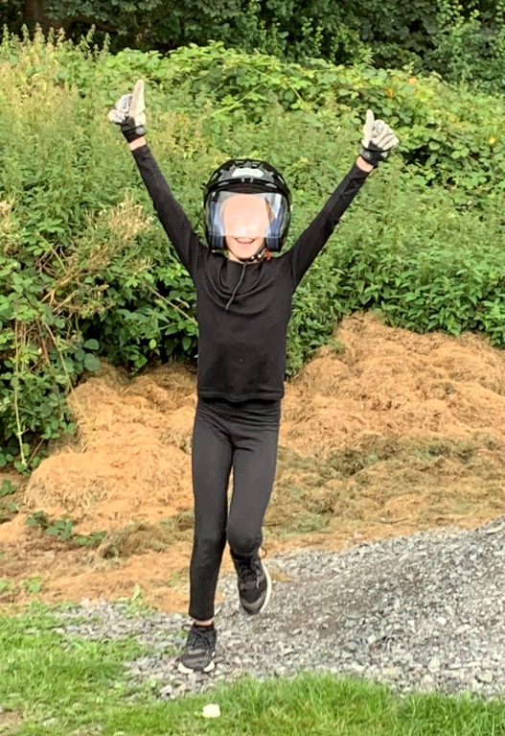
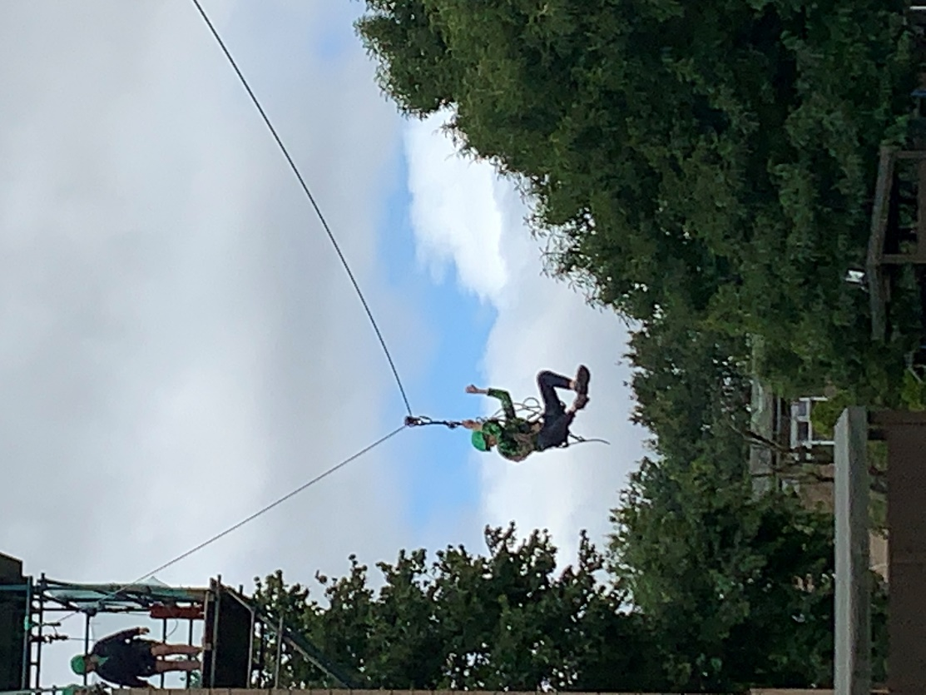
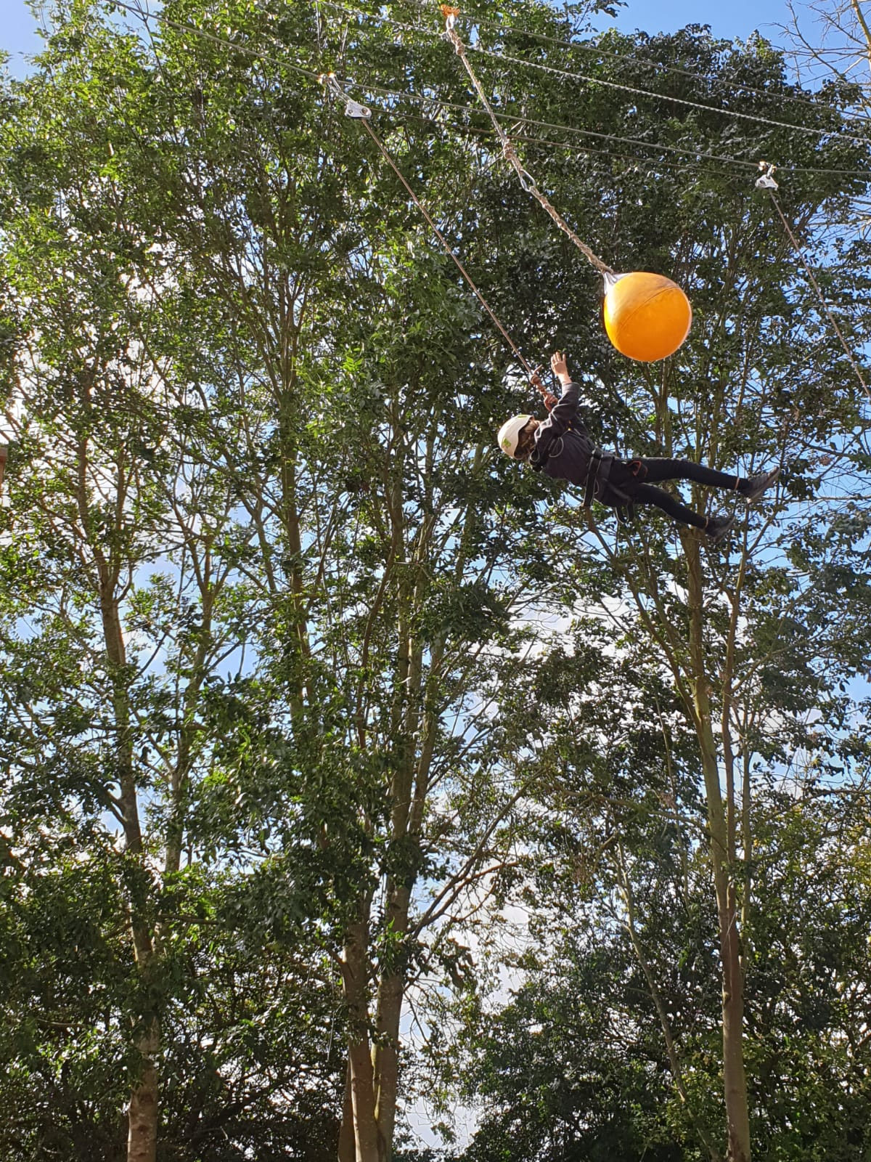

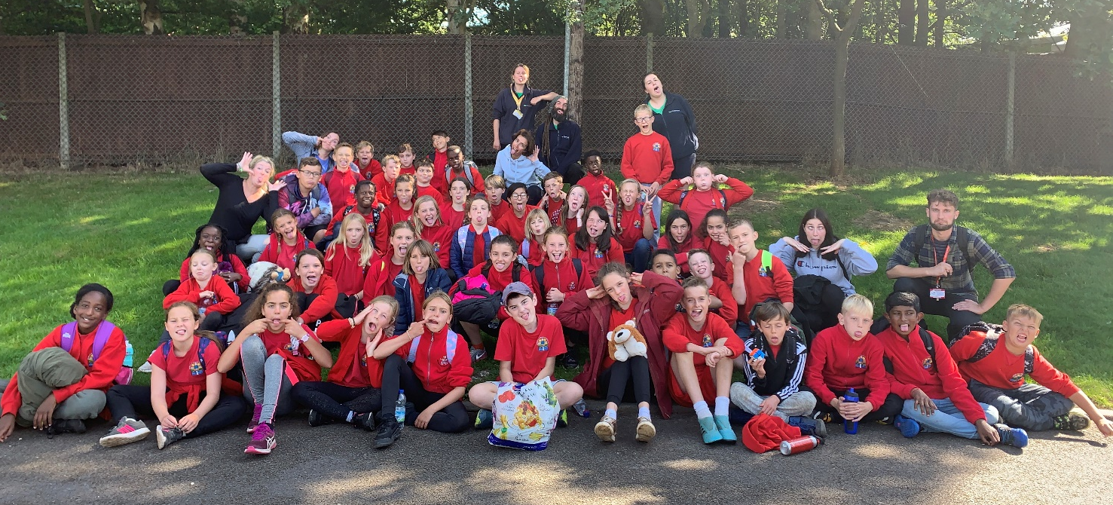
And lots and lots of fun…

Slide 12
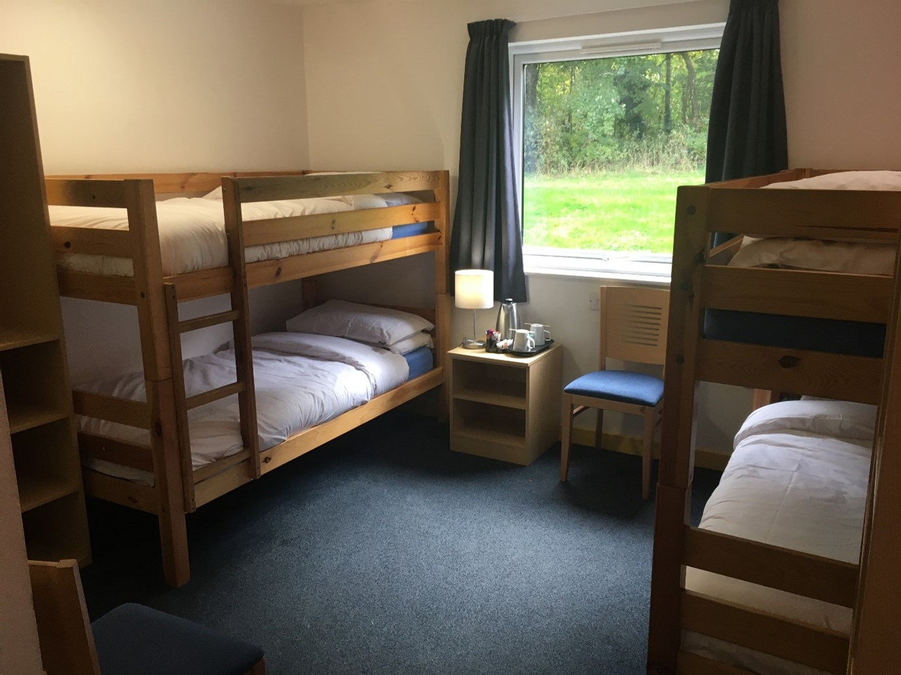
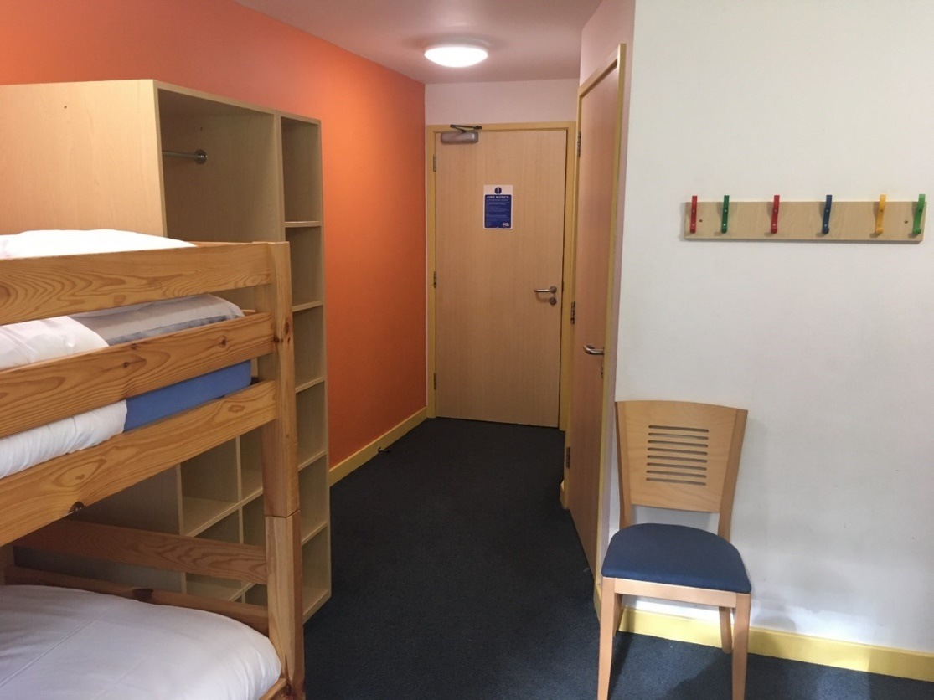
Accommodation
Notes:
Chalets – usually 4-6 – single sex
Choose friends, mixed for activity groups too
Bedwetting –not a problem

Slide 13
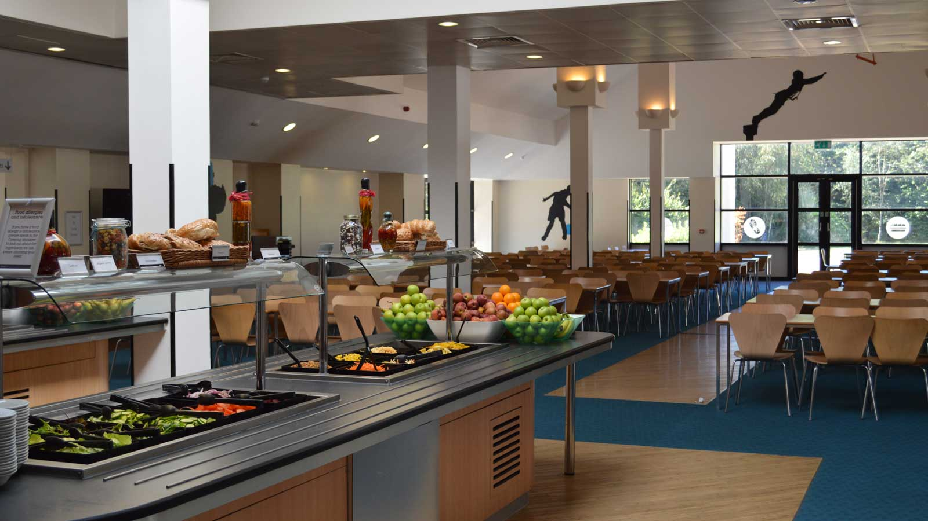
Food!
Notes:
Food is never an issue! All dietary requirements (and the fussiest of eaters!) are catered for.

Slide 14
A typical day
Breakfast
Activity 1 – Abseiling
Activity 2 – Jacob’s Ladder
Lunch
Activity 3 - Aeroball
Activity 4 - Trapeze
Dinner
Evening Activity - Disco
Each activity is 90 minutes

Slide 15
Next steps
Deposit to be paid by 21st April
Nearer the time of the trip, there will be another meeting.
This is for more specific information as well as detailed paperwork for collection.
Attendance at this evening is essential to review the detailed paperwork.
Notes:
Usually we have a brief meeting before the trip to confirm details eg arrive at school at xxx, we'll arrive home on the Friday at xxx
Medical details and hand out all the forms for medical stuff
Give out packing list and answer any questions
Not sure if you had a meeting before the last pgl or not?

Slide 16
Any questions…?

