Slide 1

What do you notice about these texts?
There once was a young girl on a tower
Who looked just as fresh as a flower.
Her hair was like silk.
Her skin smooth as milk,
But her breath made the strongest knight cower.
There was a young man from Leeds
Who ate a whole packet of seeds,
In less than an hour
His nose was a flower
And his head was a garden of weeds!

Slide 2
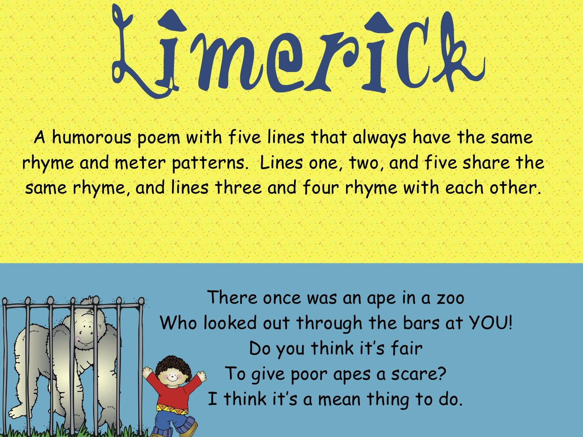
Limerick
A limerick is a silly poem with 5 lines.
They are often funny or nonsensical.

Slide 3
Look at these limericks – can you identify any of their features?
There once was a frog named Cog
who liked to sit on a log
one day he slipped off
because of his cough
and now he’s in the bog.
There once was a very small bug.
Every one liked to call him Doug.
He walked on the cement,
And ended up getting bent.
Now he looks just like a slug.

Slide 4
How to write a limerick…
The first, second and fifth lines rhyme with each other and have the same number of syllables (typically 8 or 9).
The third and fourth lines rhyme with each other and have the same number of syllables (typically 5 or 6).
Limericks often start with the line “There once was a…” or “There was a…”
The rhyme scheme of a limerick is known as “AABBA.”
This is because the last words in lines 1, 2 and 5 rhyme. Those are the “A’s” in the rhyme scheme.
The “B’s” are the last words of lines 3 and 4.

Slide 5
Syllable
What does this word mean?
A syllable is a single, unbroken sound of a spoken (or written) word.
Sometimes syllables are referred to as the ‘beats’ of spoken language.

Slide 6
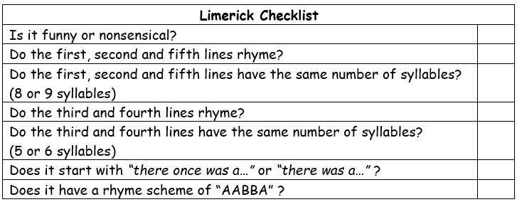
Do the limericks all follow this pattern?
There once was a young girl on a tower
Who looked just as fresh as a flower.
Her hair was like silk.
Her skin smooth as milk,
But her breath made the strongest knight cower.
There was a young man from Leeds
Who ate a whole packet of seeds,
In less than an hour
His nose was a flower
And his head was a garden of weeds!

Slide 7
Do the limericks all follow this pattern?
There once was a frog named Cog
who liked to sit on a log
one day he slipped off
because of his cough
and now he’s in the bog.
There once was a very small bug.
Every one liked to call him Doug.
He walked on the cement,
And ended up getting bent.
Now he looks just like a slug.

Slide 8
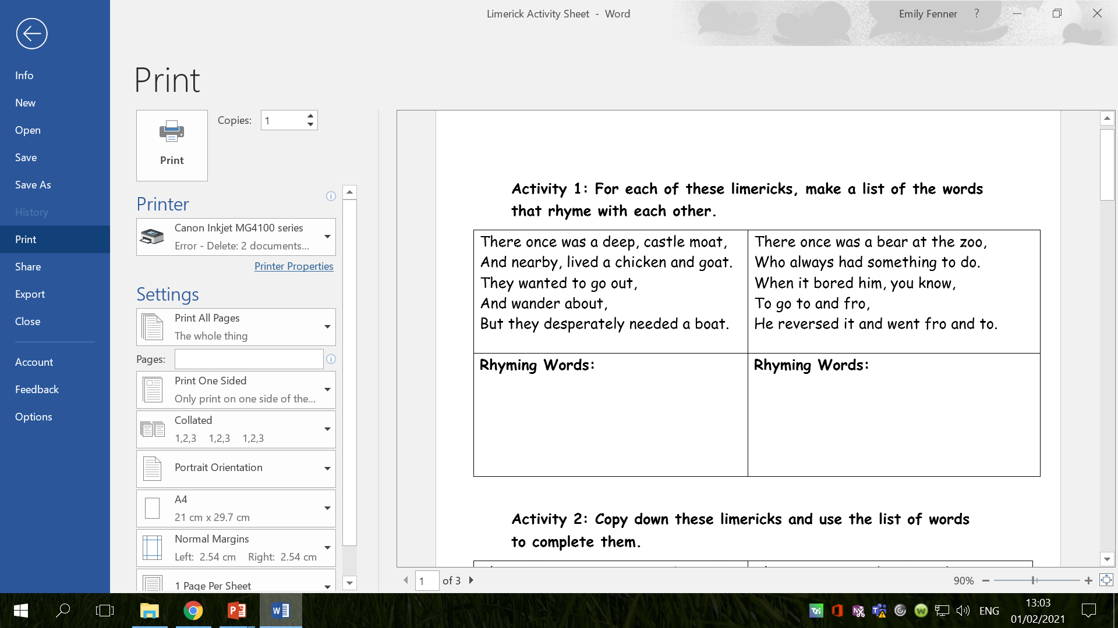
Activity 1:

Slide 9
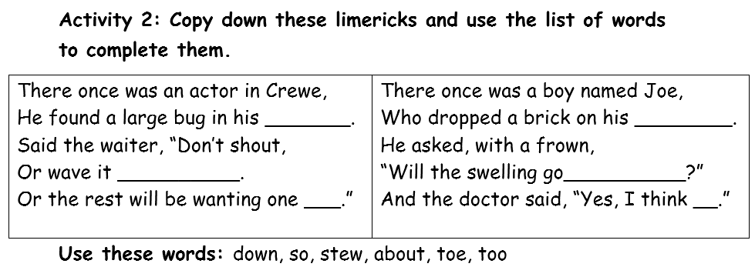
Activity 2:

Slide 10
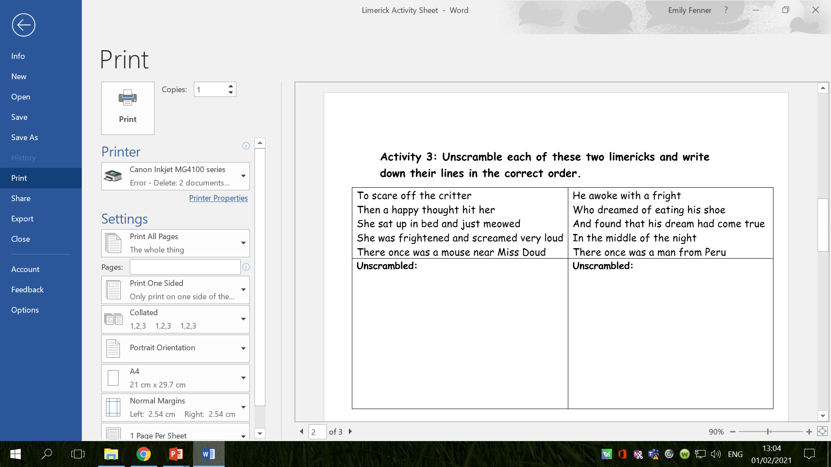
Activity 3:

Slide 11
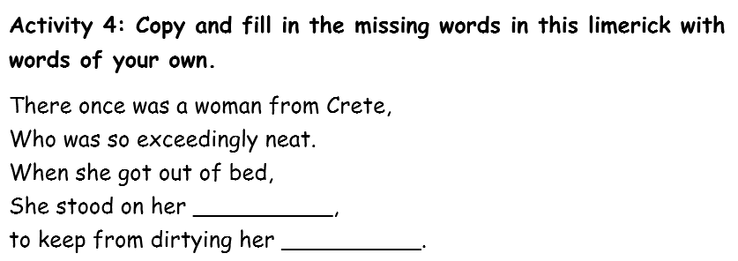
Activity 4:

Slide 12
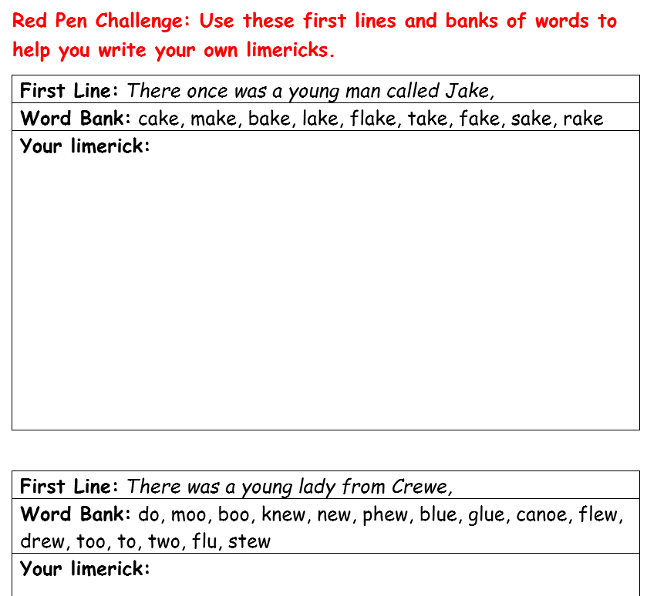
Red Pen Challenge:

