Slide 1
Monday 12th July 2021
LO: to investigate materials
C: States of Matter

Slide 2
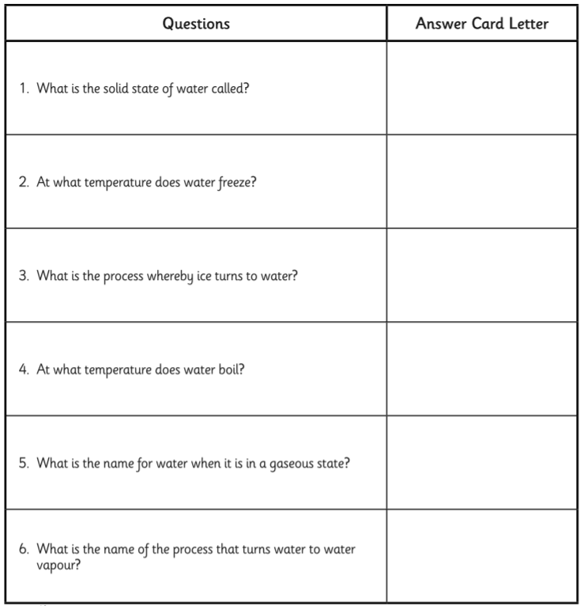
Starter
Find the answers to the questions on the sheet using the cards on the next slide to help you.

Slide 3
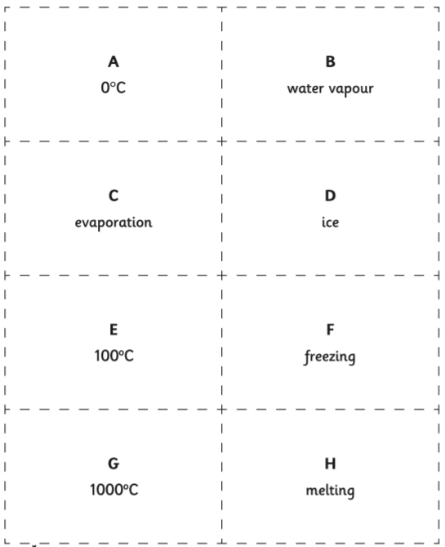

Slide 4
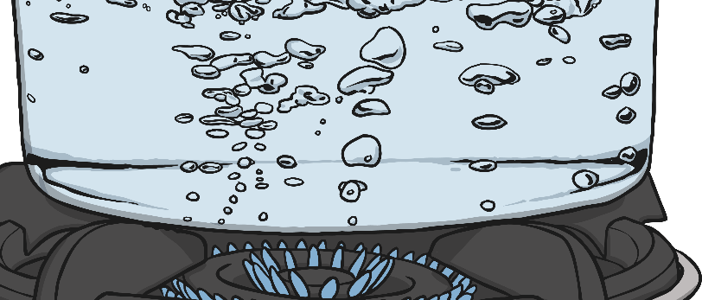
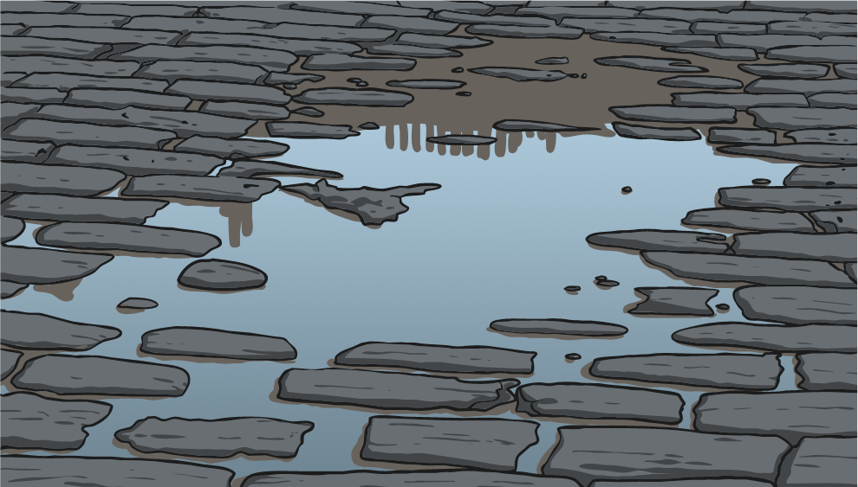
Exploring the Processes
Evaporation is when water turns into water vapour (a liquid turning to a gas).
Evaporation happens very easily when water reaches its boiling point of 100˚C.
However, evaporation can happen more
slowly at much lower temperatures. For example, when water in a puddle warms up, water from the surface of the puddle slowly changes to water vapour.

Slide 5
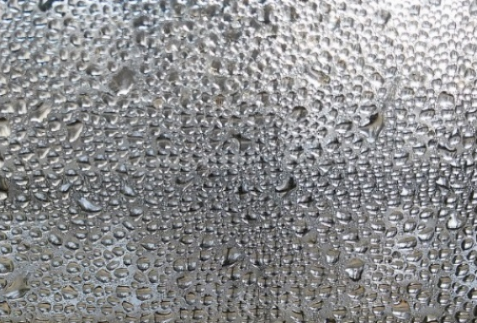
Exploring the Processes
Condensation is when water vapour is cooled down and turns to water (a gas turning to a liquid).
You can see that condensation has happened when you see droplets of water on a window or mirror in a warm room. The water vapour in the air has been cooled by touching the cold surface and this causes it to change to water.

Slide 6
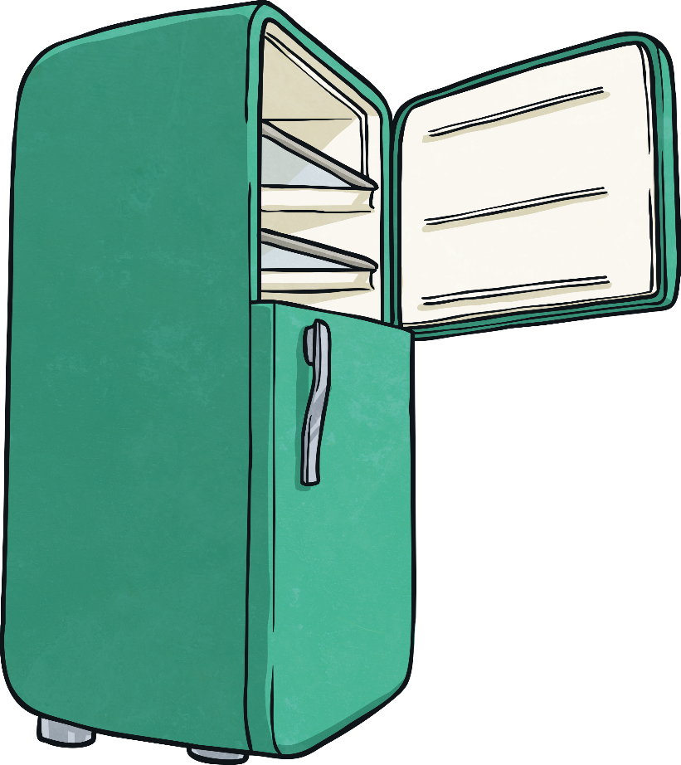
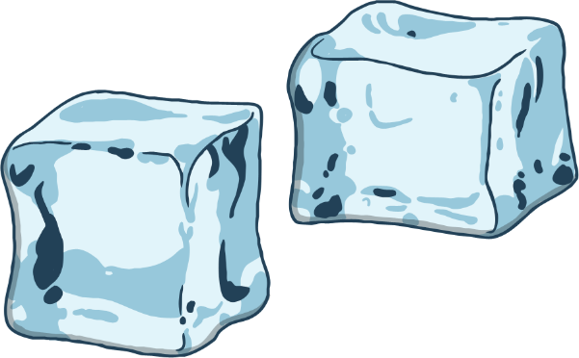
Exploring the Processes
Freezing occurs when water is made very cold. When water reaches 0˚C it turns to ice. (Freezing is a liquid turning to a solid.)

Slide 7
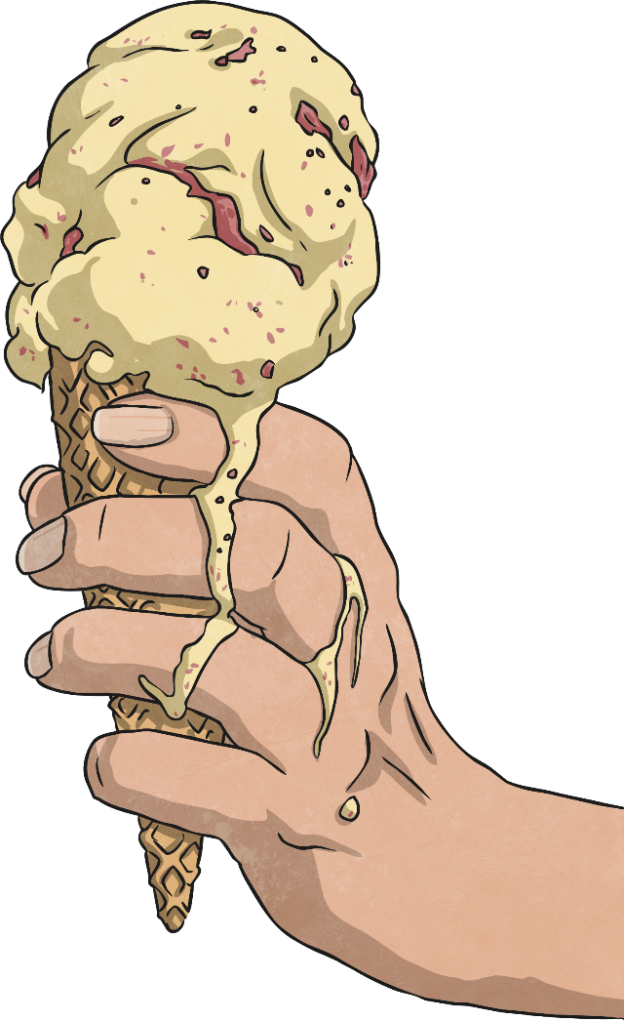
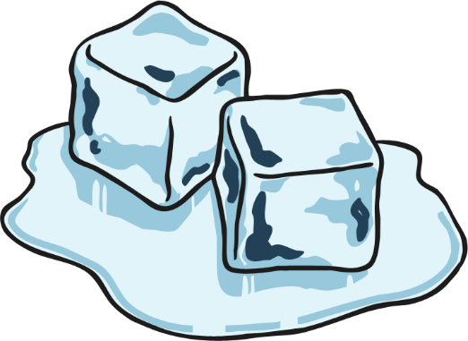
Exploring the Processes
Melting occurs when ice warms up and changes to water (a solid changing to a liquid).
At temperatures above 0˚C, ice will melt.

Slide 8
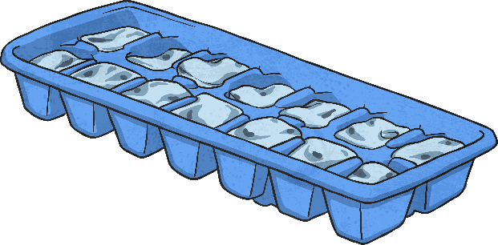

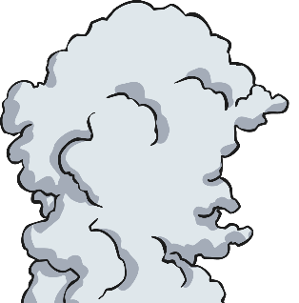
Exploring the Processes
melting
evaporation
freezing
condensation
ice
water
water
vapour
Water changes state as a result of these processes.

Slide 9
Activity
Some children make ice lollies of different sizes. They time how long the lollies take to melt.
Here are their results:
Describe the link between the volume of the lolly and the time it takes to melt.
Challenge: do you think this will be true for all melting solids? Why?
Volume of lolly (cm³) | Time taken to melt (minutes)
30 | 200
40 | 230
50 | 255
60 | 275
70 | 295

Slide 10
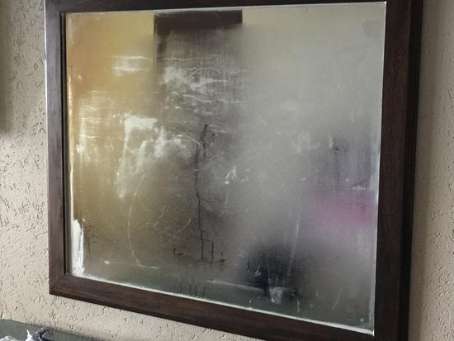
Red Pen
Why does condensation form on a bathroom mirror after the shower has been on?

