Slide 1
Tuesday 13th July 2021
LO: to understand beliefs and teachings
to understand lifestyles and practices
to understand values
C: Buddhism

Slide 2
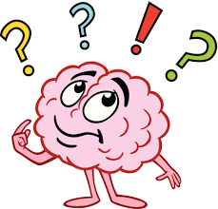
What have you done so far today?
Make a list of all the things you have done today.

Slide 3

Have you led a ‘good’ life today?
What made it ‘good’?
How would you define a ‘good’ life?

Slide 4

What definition would Buddhists give for leading a ‘good’ life?
How would they know they had been ‘good’?
They would have lived their lives without harming any living thing.

Slide 5
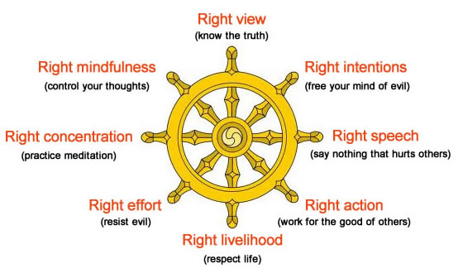
Did you follow the Eight-Fold Path today?
Which folds did you follow?
How do you know?
Did any of the things you did today go against any of the folds?
How do you know?

Slide 6
Look back at the things you have done today – if you were a Buddhist, is there anything you would have done differently to make sure you were following the Eight-Fold Path?
Is there anything you would have had to think carefully about before you did it?

Slide 7
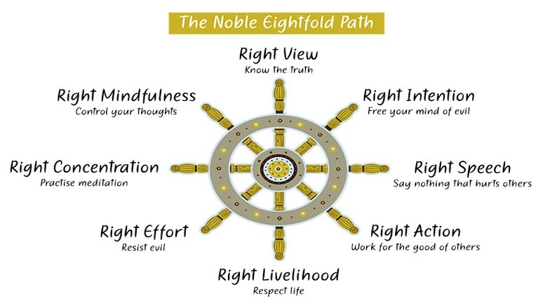
What would your day have looked like if you followed the Eight-Fold Path?
Would following the Eight-Fold Path help you to lead a ‘good’ lead?
How would the Eight-Fold Path help you to be ‘good’?
If you followed the Eight-Fold Path yesterday, would you be leading a ‘good’ life?
How do you know?
What would make it ‘good’?

Slide 8
Activity
Imagine you are a Buddhist.
Write a diary entry explaining how following the Eight-Fold Path affects your life.
Let’s look at the example on the next slide.
Diving: try to include how easy you think it is to follow these principles.

Slide 9
Example
Dear diary,
Today at school, people were talking about one of our friends. I stayed out of it and didn’t get involved. This is because I am a Buddhist and the Eight-Fold Path teaches me that I should practice Right Speech. In other words, I should not lie, be rude or abusive and should not gossip. Because of this, I make sure that in life, I take care to respect everyone I can. I try not to get involved in it when people are being mean about others.

Slide 10
Red Pen
Do you think there is a ‘best’ way for a Buddhist to lead a good life?
Why/why not?

