Slide 1


Present Perfect Tense
We use the present perfect tense to talk about actions that started in the past and still continue in the present.

Slide 2
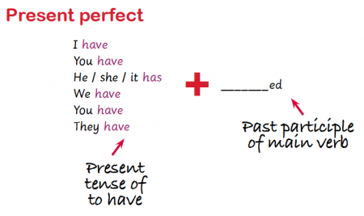

Slide 3
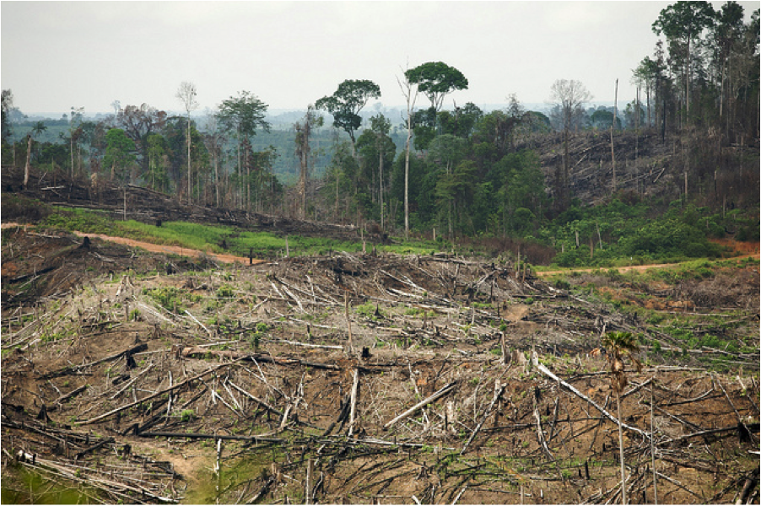
The rainforest destruction started in the past, but it continues in the present.

Slide 4
For example:
I have watched the skyscrapers of the rainforest topple heavily to the floor like dominoes. With tears in my eyes, I have heard innocent animals crying as their homes are cruelly destroyed. Unbelievably, I have seen blazing fires, with blinding light, tear through the towering trees, incinerating everything they touch. I have walked along the black, charred soil as toxic smoke fills the air around me. I have watched thriving, lush rainforests burn until there is nothing left. Despite the damage and destruction, I have seen ignorant men raise their deadly axes again and again and again. Singlehandedly, mankind has destroyed the lungs of the earth.

Slide 5

Paddling | Snorkelling | Diving
Write a paragraph describing the rainforest destruction that you have seen and that continues to take place using the present perfect tense. Make sure you are using adjectives to describe. Red Pen: underline the present tense of have and the past tense verb in your writing to show you have written in the present perfect tense. Have you written in the present perfect tense consistently? | Write a paragraph describing the rainforest destruction that you have seen and that continues to take place using the present perfect tense. Make sure you are using expanded noun phrases, similes and metaphors to describe. Red Pen: underline the present tense of have and the past tense verb in your writing to show you have written in the present perfect tense. Have you written in the present perfect tense consistently? | Write a paragraph describing the rainforest destruction that you have seen and that continues to take place using the present perfect tense. Think about the different types of sentence you could use. Red Pen: underline the present tense of have and the past tense verb in your writing to show you have written in the present perfect tense. Have you written in the present perfect tense consistently?

