Slide 1


Think about your stories.
Where are they set?
Do they take place in the same settings? Different settings?

Slide 2
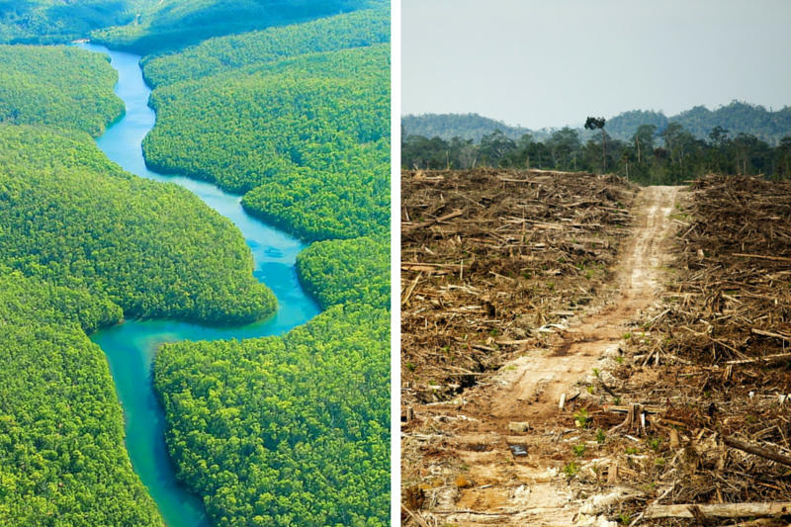
An office
The rainforest
The destroyed rainforest
The rescued rainforest
Any other settings?

Slide 3
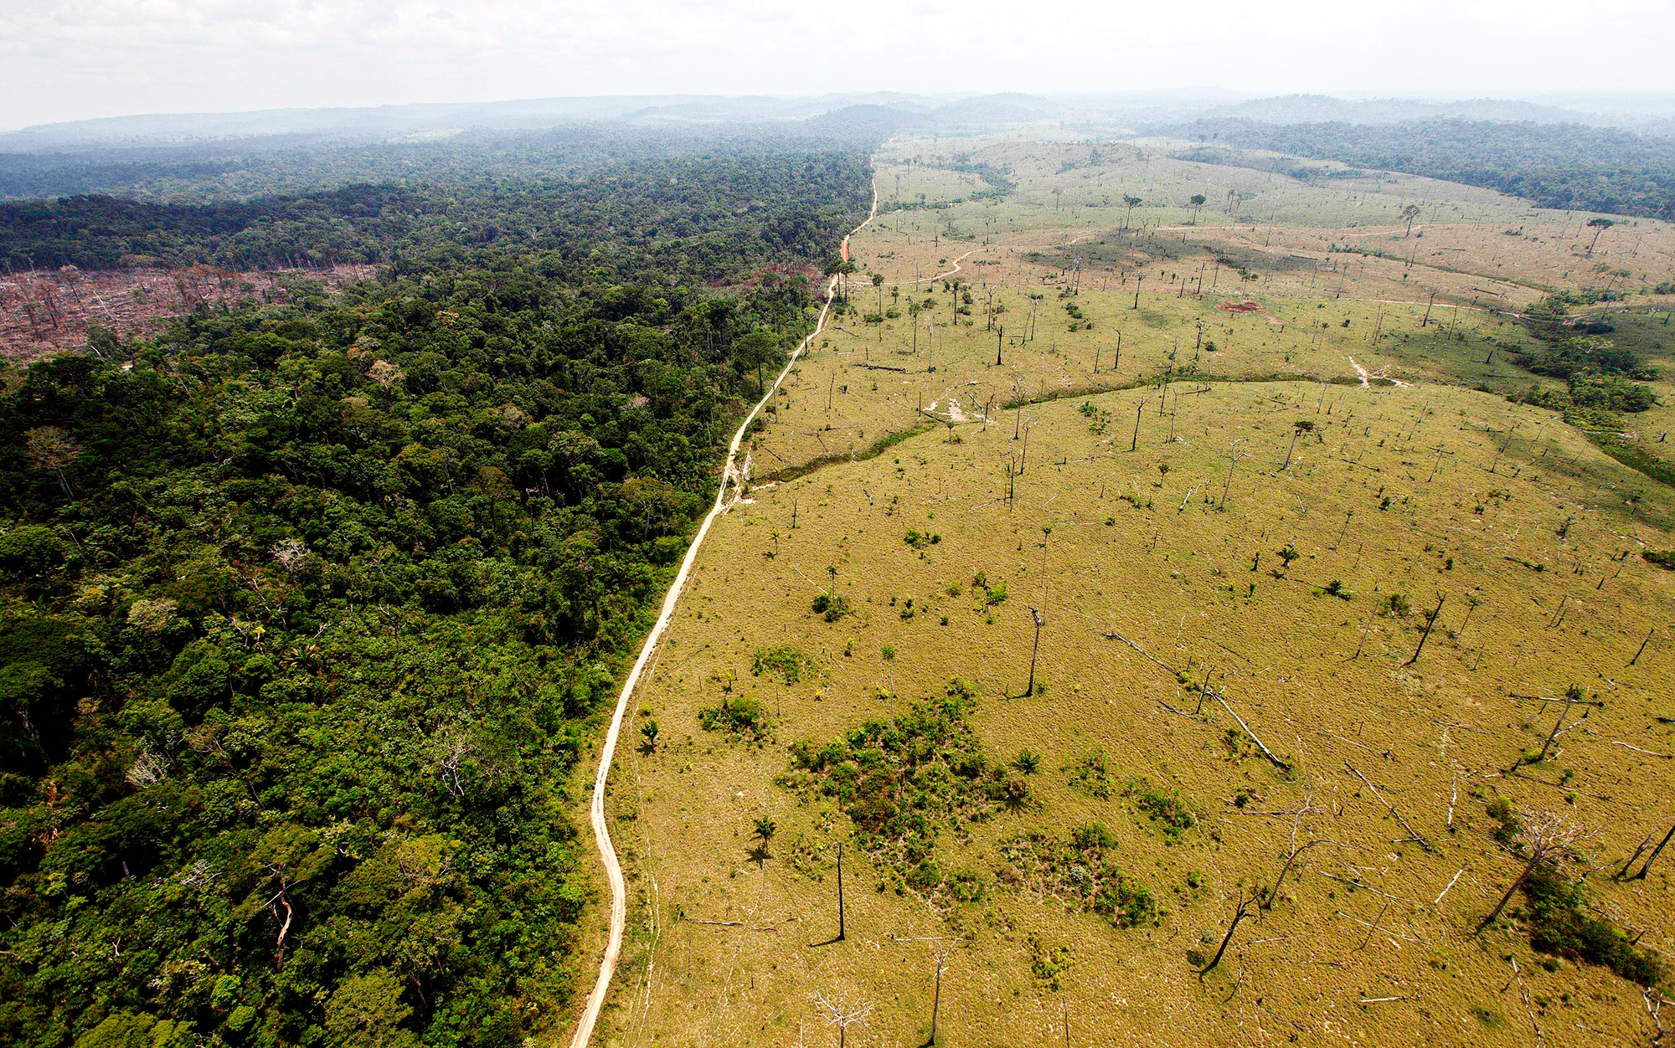

Slide 4
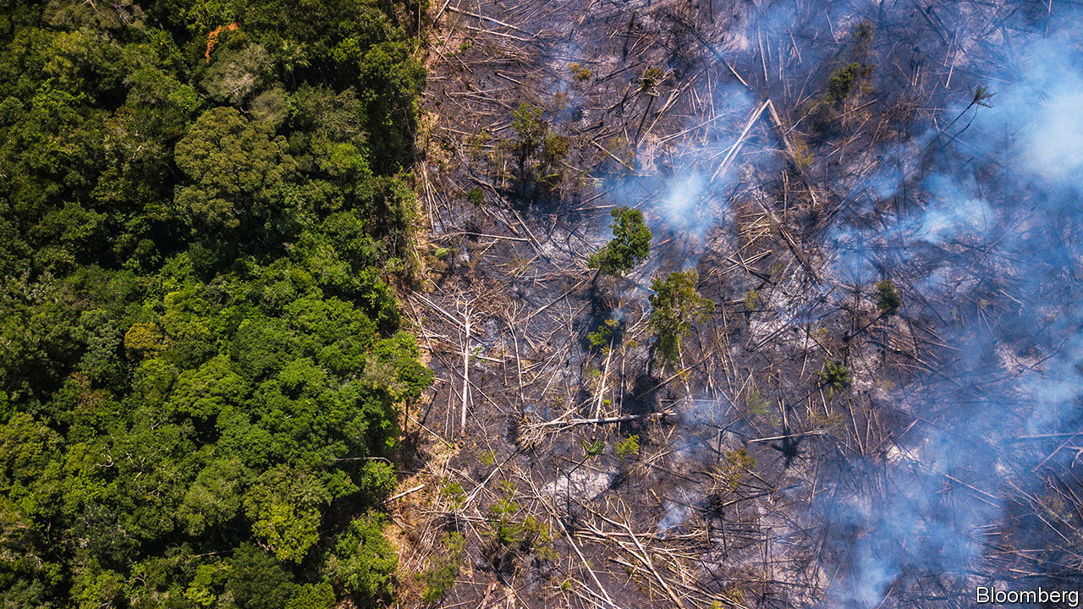

Slide 5
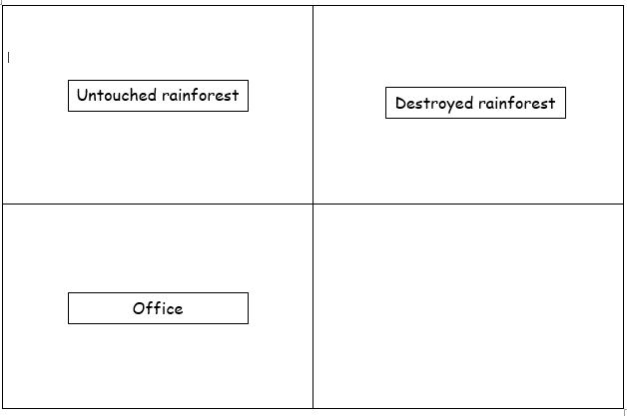
Which do you think is better? Why?
tall trees, green leaves, wet
black soil, no trees, fire
skyscrapers of the forest, lush, green leaves
fallen trees lay like sleeping children, toxic smoke fills the air
rainy, green, noisy, loud
smoky, smelly, scary
hot, humid air, damp, murky water
black, charred soil, blazing fires raging
cluttered, wooden desk, towering piles of crumpled paperwork
desk, lots of paper, wood
ancient, dinosaur computer, snake-like cables slithering across the floor
old computer, messy, smelly

Slide 6
Activity
Write the name of each different setting from your story in the boxes.
Write descriptive words and phrases (expanded noun phrases, metaphors and similes) which describe the different settings.
You should be using powerful vocabulary to ensure the reader can imagine each setting.
Red Pen: thesaurus any words you have repeated or have used in your writing before!

