Slide 1

Starter
Now Mitch, don’t go playing up by the pylon my Mum had warned me often enough. It’s dangerous. You’ll get yourself electrocuted. Did I listen? Of course I didn’t. Most days after school that was exactly where I went.
Of course, Mum was furious. I’m not made of money she said, eyeing the state of my school clothes. Still, maybe a good wash will sort them out She glared at me suspiciously. So, a tree nearly hit you I nodded, avoiding her icy stare. You could have been killed Shamefaced, I nodded. She was right. She’d been right from the start.
What do you notice about these extracts?

Slide 2
Steps to Success!
1. Start by writing a 66 at the top of the line.
“
2. Use a capital letter for your first word.
“We
3. Write what is being said.
“We are writing speech today
4. finish the sentence with the correct punctuation.
“We are writing speech today!
5. Close the speech by writing a 99 at the top of the line.
“We are writing speech today!”
6. Write who said it and how they said it.
“We are writing speech today!” exclaimed Mrs Fenner excitedly.

Slide 3

Has the direct speech been correctly punctuated?
How do you know?
Can you explain why the sentence is correct or incorrect?
“Hello smiled Greg.”
You look tired “stated Martin.”
“Can I come in” asked the man?
“No screamed” the man
“Come here,” demanded Grandma.
“Is that my bag? asked Daniel
“I know what I want for my birthday!” exclaimed Tina

Slide 4

“Hello,” smiled Greg.
“You look tired,” stated Martin.
“Can I come in?” asked the man.
“No!” screamed the man.
“Come here,” demanded Grandma.
“Is that my bag?” asked Daniel.
“I know what I want for my birthday!” exclaimed Tina.

Slide 5

“We are writing speech today!” exclaimed Mrs Fenner excitedly.
Mrs Fenner exclaimed excitedly, “We are writing speech today!”
If who is speaking goes before the direct speech, use a comma before your 66.

Slide 6

You are banned from using said today!

Slide 7
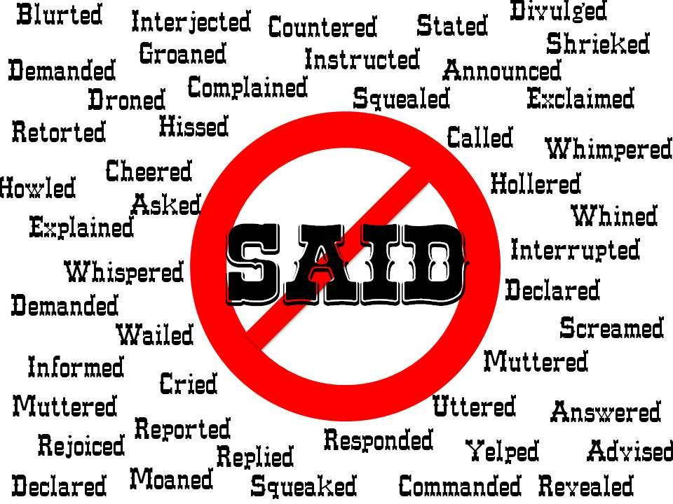

Slide 9
Activity:
Write the warning given in your story using direct speech.
Then practice writing other speech you could use in your story, e.g. the main characters telling each other to chop down trees, the main character speaking in shock at the destroyed rainforest etc.
Red Pen: Write the steps for punctuating speech correctly to use when you are writing your stories next week.

