Slide 1

Read Write Inc. Phonics
Parents’ Meeting
Notes:
Notes are provided to help you lead the presentation.
Notes in italics are for your attention only.

Slide 2
Sound Pronunciation
It is important that we use pure sounds, such as ‘s’ not ‘suh’, so that your child will be able to blend the sounds into words. https://youtu.be/UCI2mu7URBc
Notes:
We teach using pure sounds.
We use pure sounds (‘m’ not’ muh’, ’s’ not ‘suh’, etc.) so that your child will be able to blend the sounds into words more easily.
Children need to know sounds – not letter names – to read words.
Demo

Slide 3
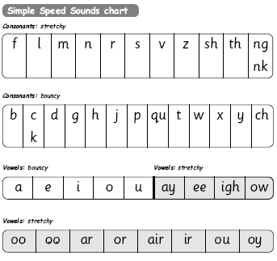
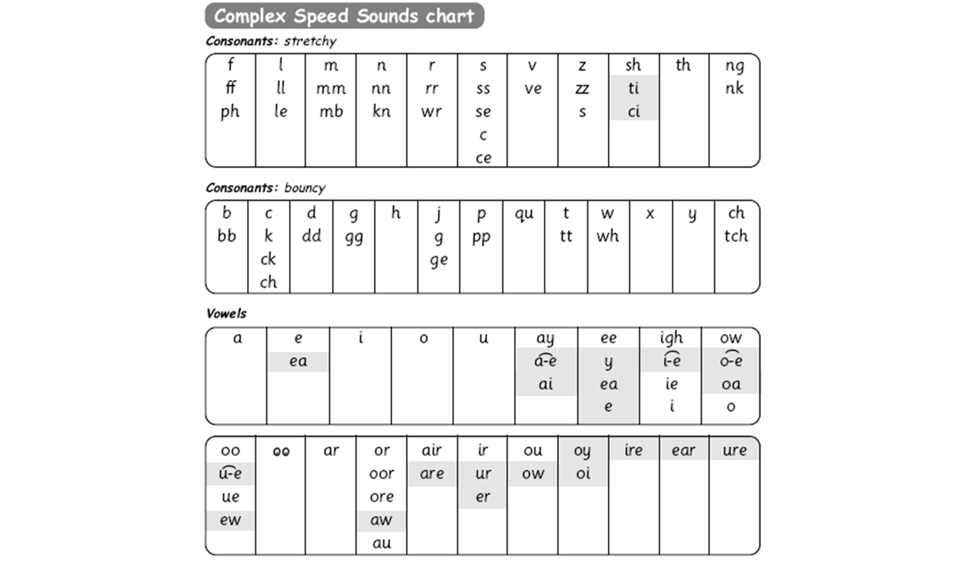

Simple Speed Sounds

Slide 4

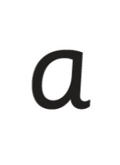


Systematic Approach
sat
mat
p
d
sad
i
t
n
Notes:
Read Write Inc. Phonics is a programme that uses systematic phonics to teach all children to read.
It lasts two years for most children - if they start to learn to read in the Reception class.
(There are some children with learning difficulties who spend longer on the programme.)
Click – We teach the sounds first – in a specific order.
Click – We then teach your children to blend those sounds together in order to read words, green words example
Click – The children will be regualrly assessed and be provided with coloured books appropriate for their ability

Slide 5
Initial Sounds Lesson Demonstration
Games to engage the children
Pictures and rhymes to support the letter recognition and formation
Speed write
Fast paced
Lots of praise!
Notes:
We use this Speed Sounds chart in Phonics lessons.
It shows the most common graphemes for each sound.
Each box is a sound box showing different ways to read and write the sound. Demo the ‘f’ sound box with examples of words ‘fun’, ‘huff’, ‘photo’ and the ‘or’ sound box with examples of words ‘or’, ‘door’, ‘more’, ‘dawn’, ‘author’.

Slide 6
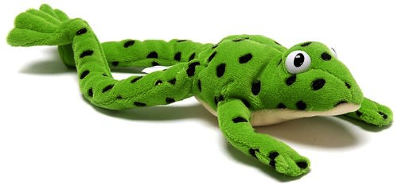
Fred Talk
Notes:
This is Fred.
He is a frog who can only speak in sounds, and we call this Fred Talk. For example ‘m’ ‘a’ ‘t’, ‘l’ ‘u’ ‘n’ ‘c’ ‘h’.
He helps children sound out words so they can read and spell.
MTYT some examples with the parents. For example ‘m’ ‘a’ ‘t’ mat, ‘s’ ‘a’ ‘t’ sat.
Click. Fred is our friend!

Slide 7

Fred Fingers
Notes:
We use Fred Fingers to help children sound out words to spell easily.
It means they do not have to memorise lists of spelling words.
It is a tool so they will be able to spell any word.
Demonstrate how to use Fred Fingers.

Slide 8

Ditties
Notes:
We use Fred Fingers to help children sound out words to spell easily.
It means they do not have to memorise lists of spelling words.
It is a tool so they will be able to spell any word.
Demonstrate how to use Fred Fingers.

Slide 9
How can I help at home?
Notes:
Read question.

Slide 10




Picture Books And Anything That Interests Them!
Notes:
Children will bring home a ‘reading’ phonics book. They will also bring home a reading book, like they have had previously, if they were on turquoise or above before our new scheme.

Slide 11
Storytime
Read to your children as well as hearing them read
Ask lots of questions and share opinions
‘You're never too old, too wacky, too wild, to pick up a book and read to a child.’
Dr Seuss
Notes:
One of the most important things you can do as a parent at home is read higher level texts to your child.
This helps develop an enjoyment for stories and the motivation for learning to read themselves.
Ask questions and share opinions about what you read to engage them in discussion, get them thinking about what they read and develop vocabulary.
Click and read.

Slide 12
Journey through Read Write Inc
A child’s reading journey through the Read Write Inc programme…
Read Write Inc. Phonics: Kalim's reading journey - YouTube
Notes:
It really helps to be aware of how your child is learning in the classroom – pure sounds not letter names; Fred Talk when they are reading words and Fred Fingers when they are spelling words.
Encourage your child to discuss their Phonics lessons with you and to read and discuss their storybook with you at home.
We have shared the basics of Read Write Inc. Phonics and how you can help.
There are also some online resources that you can access for free. Click through to next slide.

Slide 13
Online resources available
Ruth Miskin Parents’ Page:
http://www.ruthmiskin.com/en/parents/
Free e-books for home reading:
http://www.oxfordowl.co.uk/Reading/

Slide 14

Any other questions

