Slide 1


Slide 2

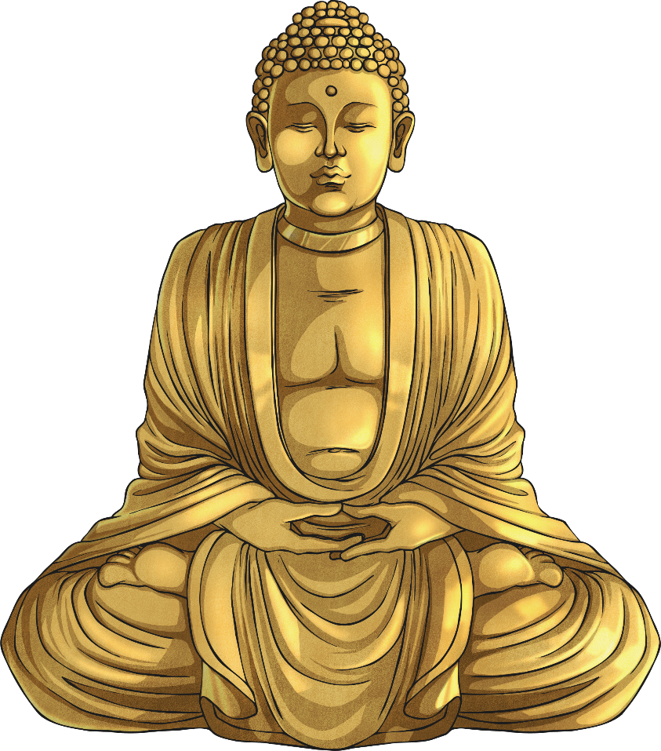
What is the Eightfold Path?
The Eightfold Path consists of eight areas of life that people focus on towards the path of Buddhism. They can be worked on in any order and some are more difficult to achieve than others depending on the situation or the person.
It is designed to relieve suffering.

Slide 3
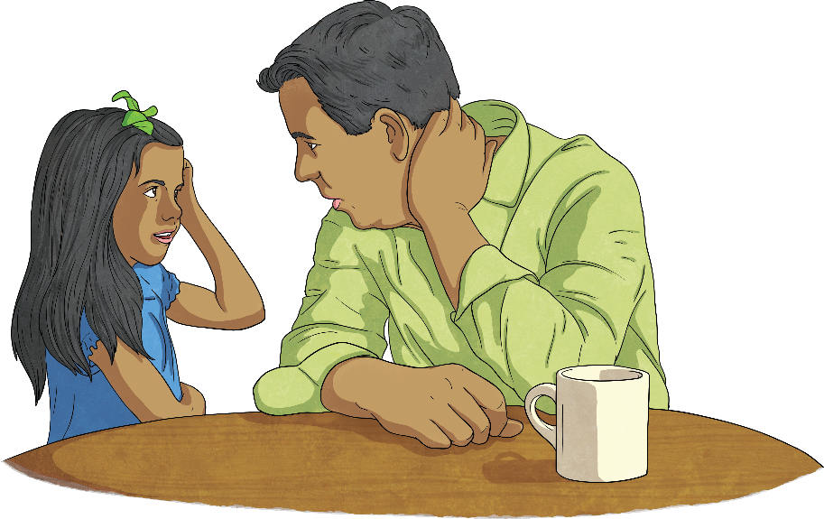

Right Speech
Often things we say in anger or behind people’s backs can cause upset and hurt, and take
a long time to sort out. Having Right Speech is deciding never to speak unkindly or in anger.
Have you hurt someone’s feelings by something you have said to them or about them?
Reflect on a time you could have said something differently or not at all.

Slide 4

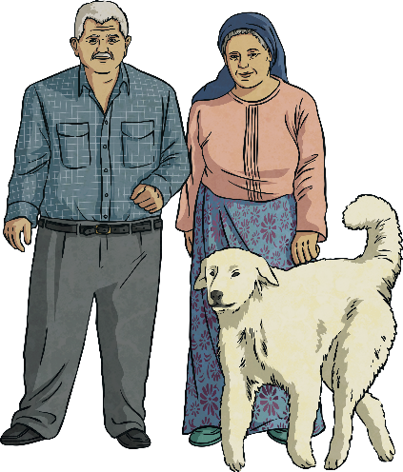
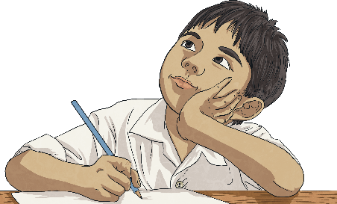
Right Action
Right action means behaving in a thoughtful way, considering others and the world we live in. Through our actions, it is a chance to keep the world safe for future generations to live in.
Has there been a time that you have done something that has affected someone else?

