Slide 1


20.1.2021 & 21.1.2021
L.O: Multiplication and Division
C: Making equal groups- grouping.

Slide 3




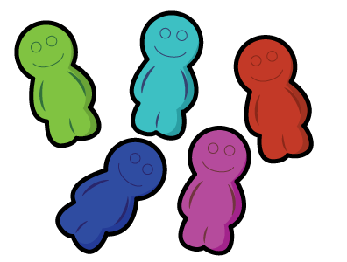
Complete the sentences below.
1) There are ____ groups of ____ apples.
2) There are ____ groups of ____ flowers.
3) There are ____ groups of ____ sweets.

Slide 4
Complete the sentences below.
1) There are ____ groups of ____ apples.
2) There are ____ groups of ____ flowers.
3) There are ____ groups of ____ sweets.
3
3
4
2
3
5

Slide 6
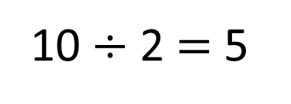
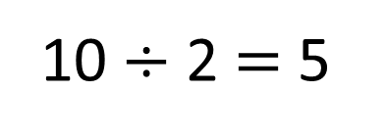
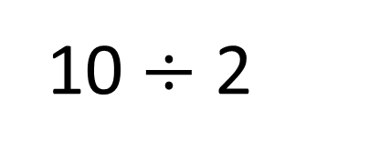
10 $÷$ 2
Sharing
10 $÷$ 2 $=$ 5
Grouping
10 $÷$ 2 $=$ 5

Slide 7

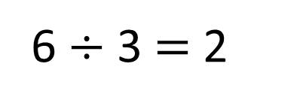
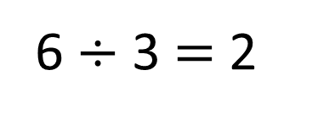
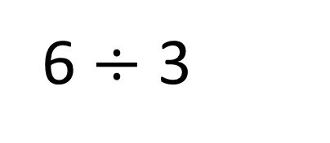
6 $÷$ 3
Have a think
Sharing
6 $÷$ 3 $=$ 2
Grouping
6 $÷$ 3 $=$ 2

Slide 8
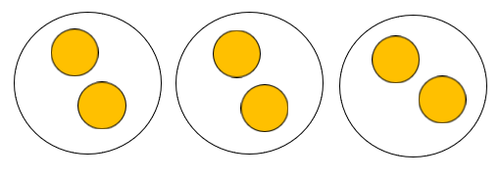
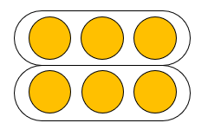
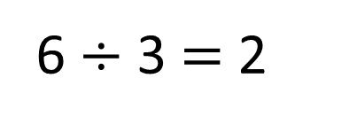
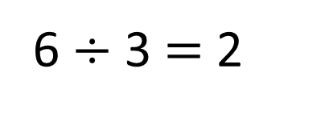
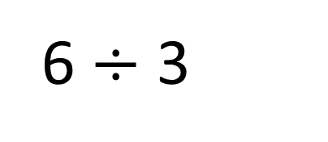
6 $÷$ 3
Sharing
Grouping
6 $÷$ 3 $=$ 2
6 $÷$ 3 $=$ 2
How many groups we are sharing between
How many in each group

Slide 9
6 $÷$ 3
Sharing
Grouping
6 $÷$ 3 $=$ 2
6 $÷$ 3 $=$ 2
How many are in each group
How many groups we can make

Slide 10




How many groups of 10 can you make?
How many groups of 5?
How many groups of 4?
How many groups of 2?
How many groups of 1?
Have a think

Slide 11

2 groups of 10 20 $÷$ 10 $=$ 2

Slide 12

4 groups of 5 20 $÷$ 5 $=$ 4

Slide 13




5 groups of 4 20 $÷$ 4 $=$ 5
10 groups of 2 20 $÷$ 2 $=$ 10
20 groups of 1 20 $÷$ 1 $=$ 20

Slide 14

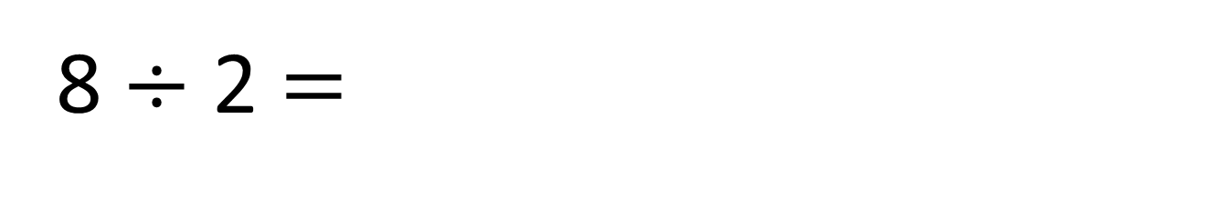
8 $÷$ 2 $=$
4
0 2 4 6 8 10 12 14
4 jumps of 2 are equal to 8

Slide 15
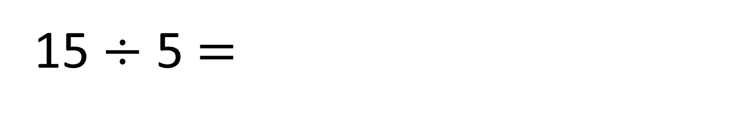
15 $÷$ 5 $=$
3
Have a think
0 5 10 15 20 25 30 35
3 jumps of 5 are equal to 15

Slide 16

60 $÷$ 10 $=$
6
Have a think
0 10 20 30 40 50 60
6 jumps of 10 are equal to 60

Slide 17
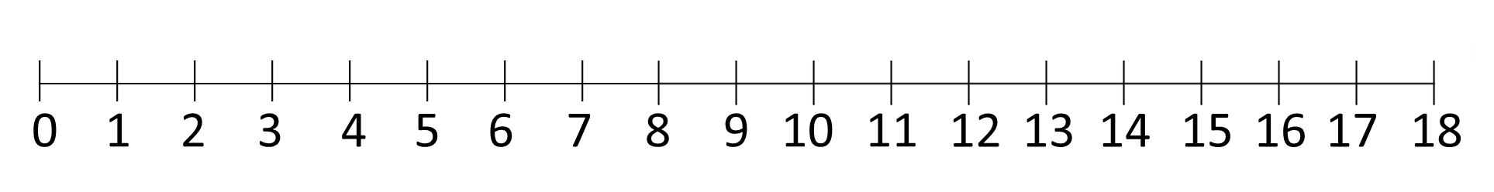
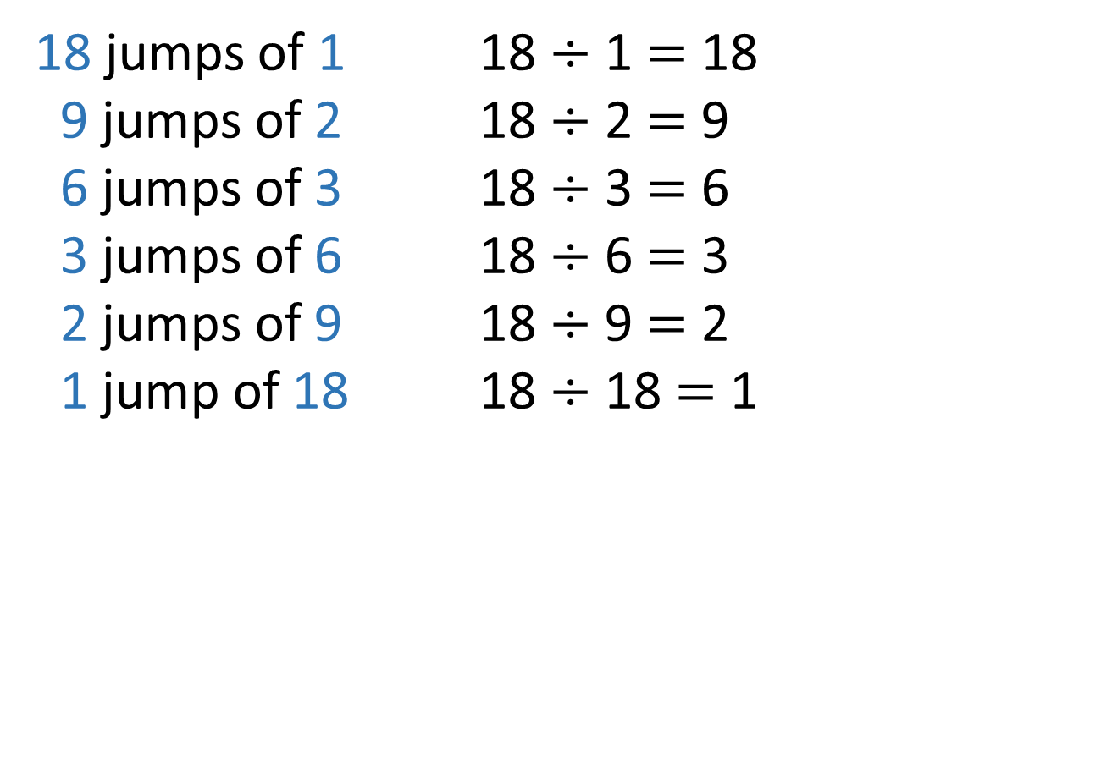
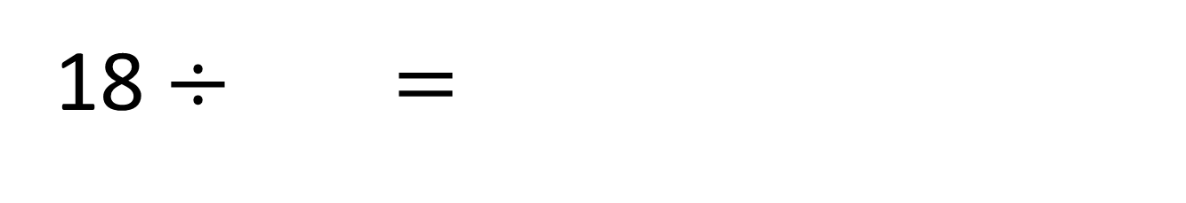
18 $÷$ $=$
Have a think
18 jumps of 1 18 $÷$ 1 $=$ 18
9 jumps of 2 18 $÷$ 2 $=$ 9
6 jumps of 3 18 $÷$ 3 $=$ 6
3 jumps of 6 18 $÷$ 6 $=$ 3
2 jumps of 9 18 $÷$ 9 $=$ 2
1 jump of 18 18 $÷$ 18 $=$ 1

Slide 18


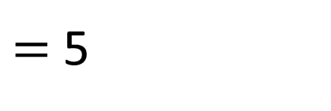

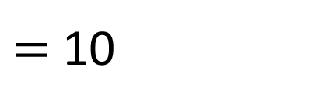
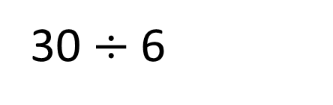
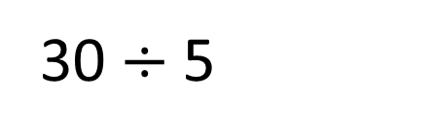

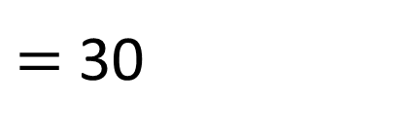



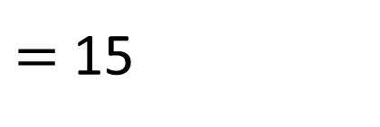
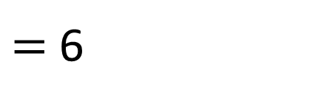
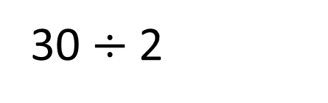

30$\text{÷}$1
$=$ 30
30$\text{÷}$5
$=$ 6
30$\text{÷}$2
$=$ 15
30$\text{÷}$6
$=$ 5
30$\text{÷}$3
30$\text{÷}$7
$=$ 10
$=$
30$\text{÷}$4
$=$
Have a go

Slide 19
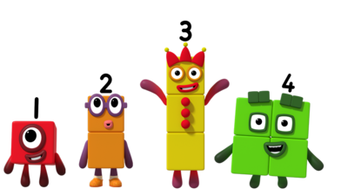
Your Task
You are going to create your own episode of number blocks! You can make a video, story or comic strip!

