Slide 1

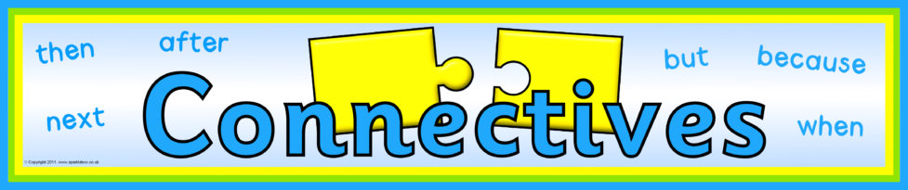
What does this word mean?

Slide 2
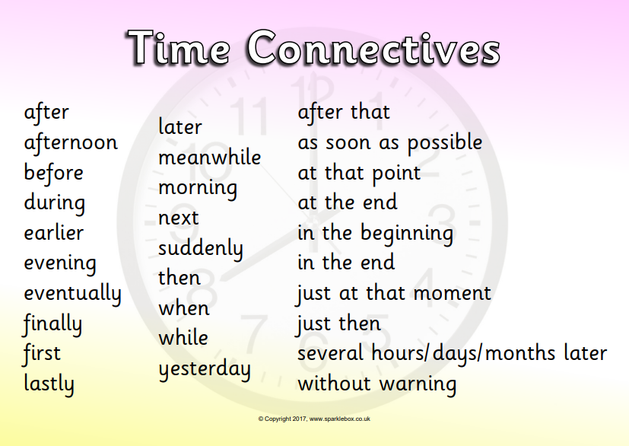

Slide 3
Connectives to shift attention
Meanwhile
At that very moment
Whereas
While this was happening
In the meantime
At the same time
Before long
On the other hand
While
However

Slide 4
Connectives to add suspense
Suddenly
Without warning
At that moment
Unfortunately
In an instant
Out of the blue
In a flash
Out of nowhere
Unexpectedly
All of a sudden
Out of the corner of his eye

Slide 5
Connectives to change the setting
On the other side of…
Back at…
In the middle of the…
In the distance…
Nearby…
Beyond the…
Next to…
Under the…

Slide 6
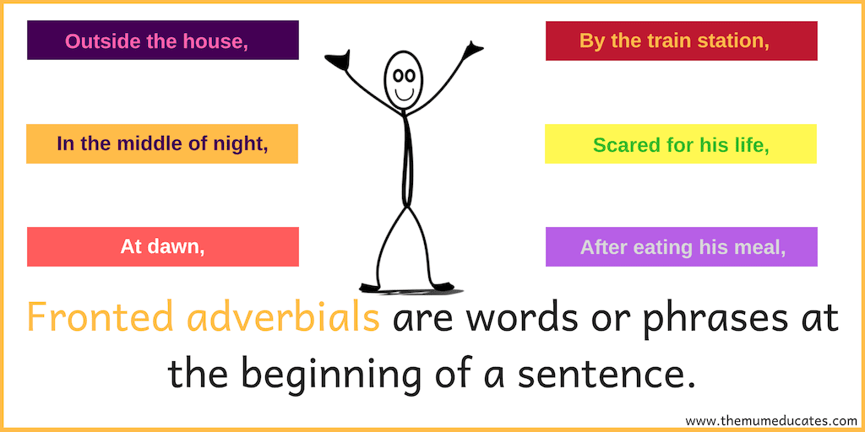

Slide 7
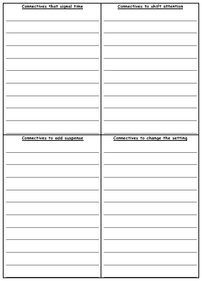
Activity
On the sheet saved underneath the PowerPoint on our class page:
Write at least 2 sentences in each column for your story which use the connectives we have learned about today.
Red Pen: Add any more connectives you have learned to your columns that you could use in your writing next week.

