Slide 1



Reception Milestones Meeting
There are seven areas of learning and development that set out what providers must teach.
All areas of learning and development are important and inter-connected
DfE guidance - sets out the pathways of children’s development in broad ages and stages
Birth to 3,
3 and 4 yr olds,
Reception age
Statutory Framework

Slide 2
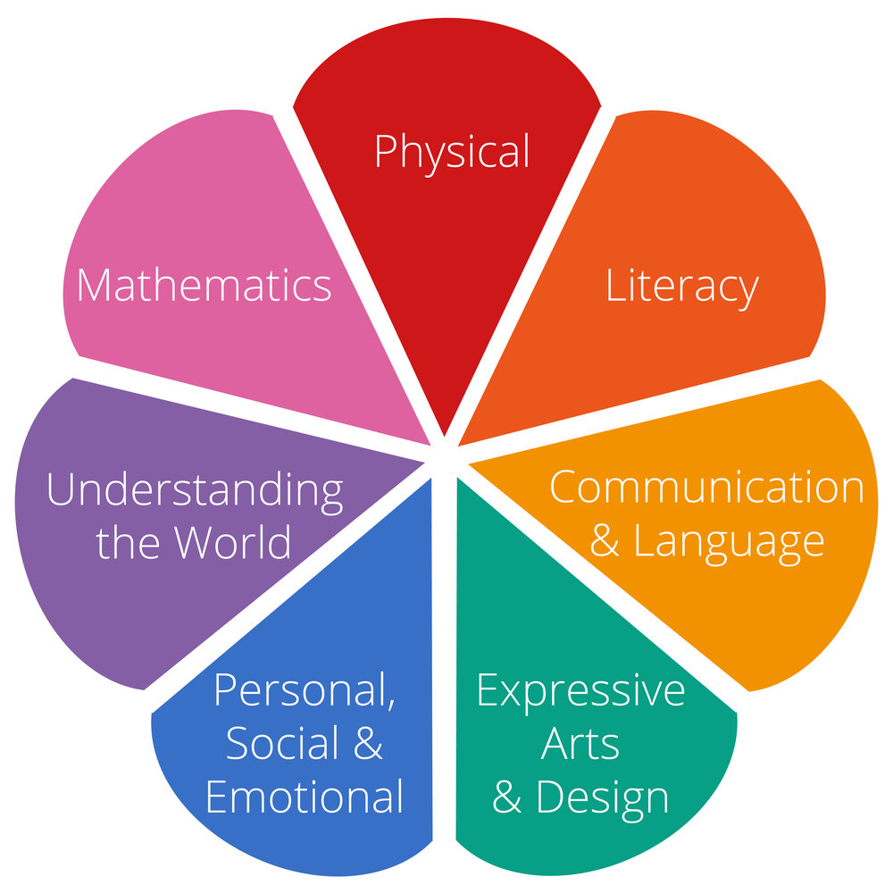
Three prime areas - build a foundation for children to thrive and provide the basis for learning in all areas.
• Communication and language
• Physical development
• Personal, social and emotional development
Support in the four other areas help strengthen and develop the three prime areas and ignite children’s curiosity and enthusiasm.
• Literacy
• Mathematics
• Understanding the world
• Expressive arts and design

Slide 3
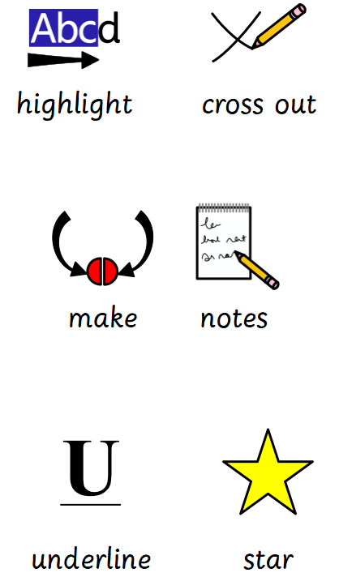

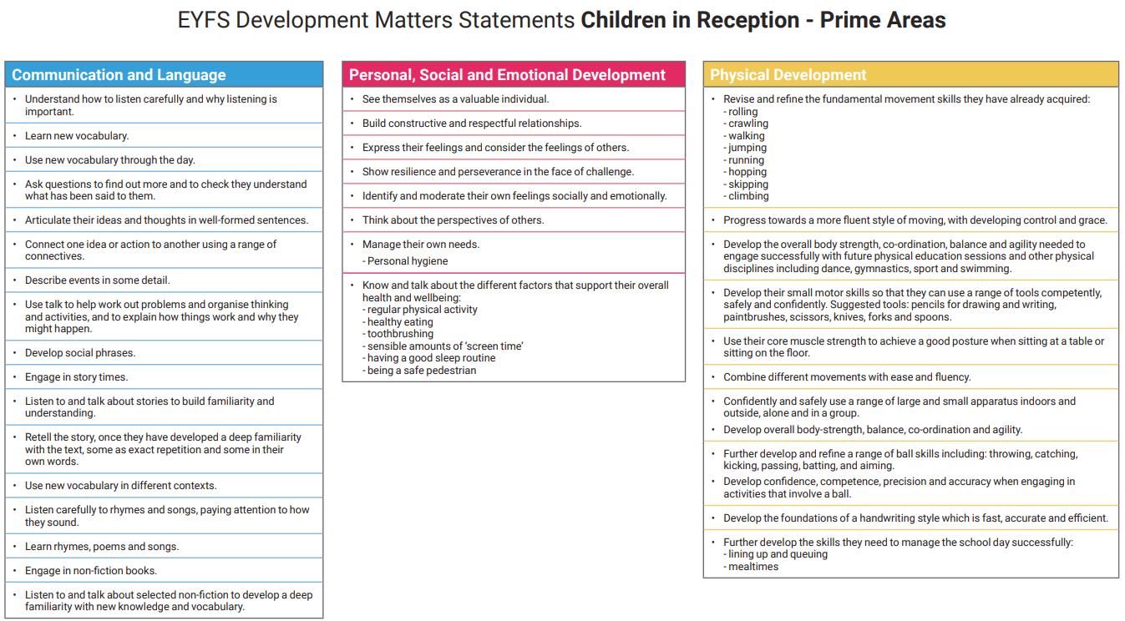
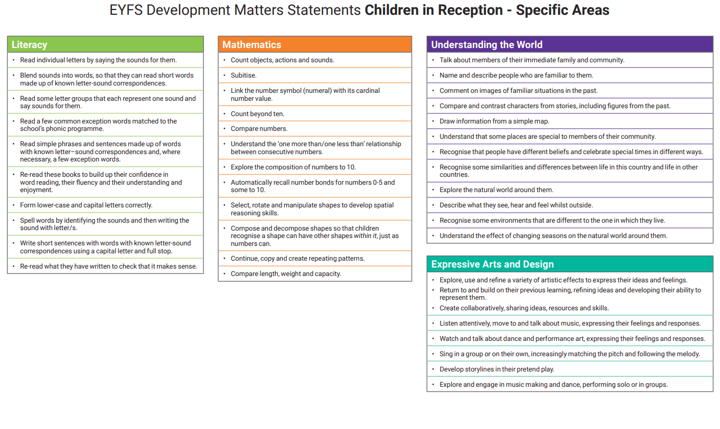

As we look closer into the Development Matters Framework….
…what can my child do now?
…what can I do to support their learning at home?
Less screen time?

Slide 4
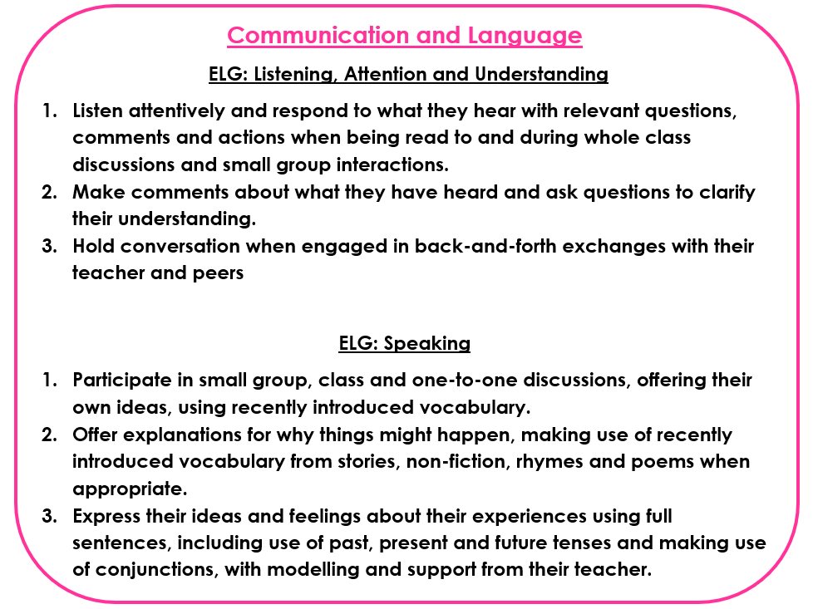

Understand how to listen carefully and why listening is important.
Learn new vocabulary.
Use new vocabulary through the day.
Ask questions to find out more and to check they understand what has been said to them
Articulate their ideas and thoughts in well-formed sentences.
Connect one idea or action to another using a range of connectives.
Describe events in some detail.
Use talk to help work out problems and organise thinking and activities and to explain how things work and why they might happen.
Develop social phrases.
Engage in story time.
Listen to and talk about stories to build familiarity and understanding.
Use new vocabulary in different contexts.
Listen carefully to rhymes and songs, paying attention to how they sound.
Learn rhymes, poems and songs.
Engage in non-fiction books.
Listen to and talk about selected non-fiction to develop a deep familiarity with new knowledge and vocabulary.

Slide 5
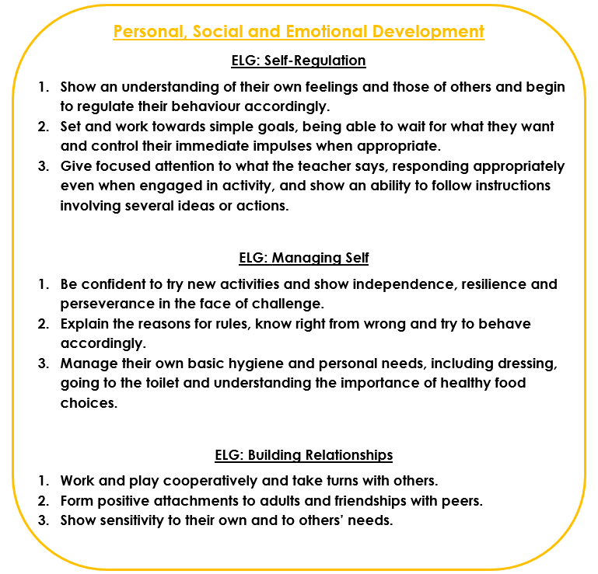

See themselves as a valuable individual
Build constructive and respectful relationships
Express their feelings and consider the feelings of others.
Show resilience and perseverance in the face of challenge
Identify and moderate their own feelings socially and emotionally.
Think about the perspectives of others.
Manage their own needs – personal hygiene
Know and talk about the different factors that support their overall health and wellbeing:
Regular physical activity
Healthy eating
Toothbrushing
Sensible amounts of ‘screen time’
Having a good sleep routine
Being a safe pedestrian

Slide 6
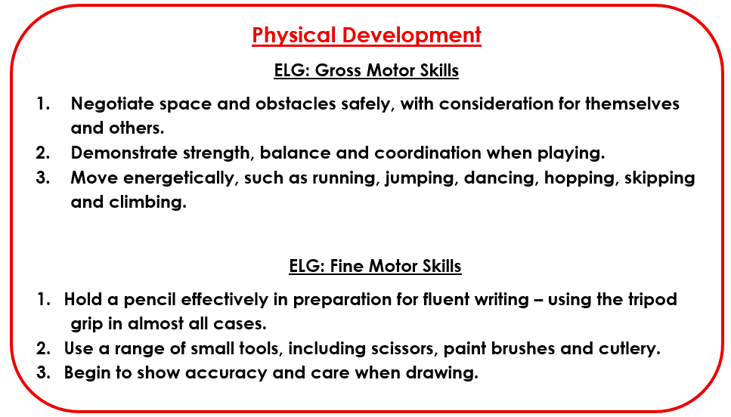

Revise and refine the fundamental movement skills they have already acquired: Rolling, Crawling, Walking, Jumping, Running, Hopping,
Skipping, Climbing
Progress towards a more fluent style of moving, with developing control and grace
Develop the overall body strength, co-ordination, balance and agility needed to engage successfully with future physical education sessions and other physical disciplines including dance, gymnastics, sport and swimming
Develop their small motor skills so that they can use a range of tools competently, safely and confidently. Suggested tools: pencils for drawing and writing, paintbrushes, scissors, knives, forks and spoons.
Use their core muscle strength to achieve a good posture when sitting at a table or sitting on the floor.
Combine different movements with ease and fluency.
Confidently and safely use a range of large and small apparatus indoors and outside, alone and in a group.
Develop overall body-strength, balance, co-ordination and agility.
Further develop and refine a range of ball skills including: throwing, catching, kicking, passing, batting, and aiming.
Develop confidence, competence, precision and accuracy when engaging in activities that involve a ball.
Develop the foundations of a handwriting style which is fast, accurate and efficient.
Further develop the skills they need to manage the school day successfully:
lining up and queuing
mealtimes

Slide 7
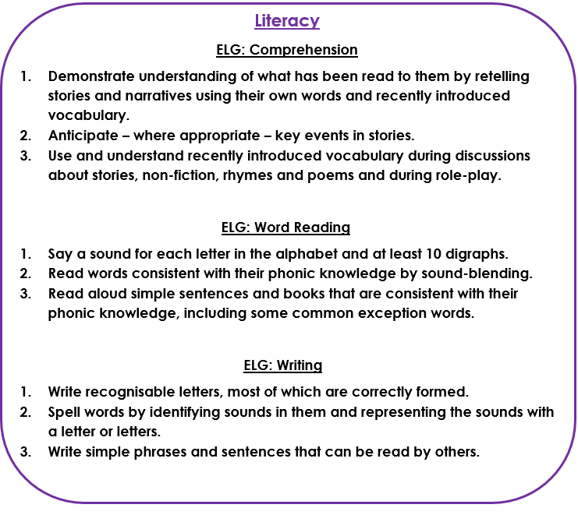

Read individual letters by saying the sounds for them.
Blend sounds into words, so that they can read short words made up of known letter-sound correspondences.
Read some letter groups that each represent one sound and say sounds for them.
Read a few common exception words matched to the school’s phonics programme.
Read simple phrases and sentences made up of words with known letter-sound correspondences and, where necessary, a few exception words.
Re-read these books to build up their confidence in word reading, their fluency and their understanding and enjoyment.
Form lower case and capital letters correctly.
Spell words by identifying the sounds and then writing the sound with letter/s.
Write short sentences with words with known sound-letter correspondences using a capital letter and full stop.
Re-read what they have written to check that it makes sense
.

Slide 8
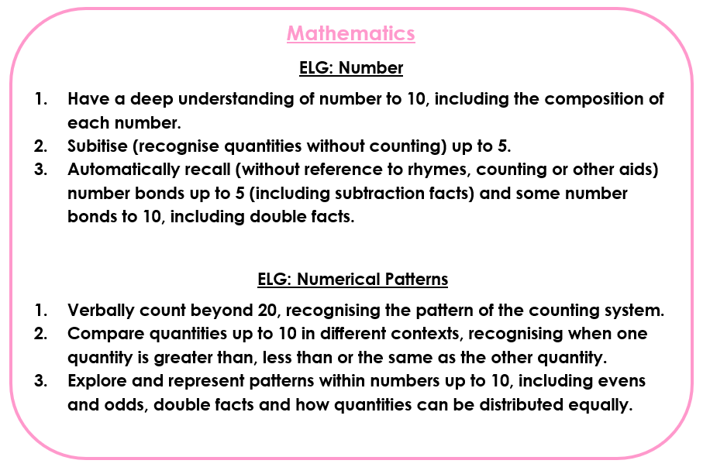

Count objects, actions and sounds
Subitise
Link the number symbol (numeral) with its cardinal number value.
Count beyond 10.
Compare numbers.
Understand the ‘one more than/one less than’ relationship between consecutive numbers.
Explore the composition of numbers to 10.
Automatically recall number bonds for numbers 0-5 and some to 10.
Select, rotate and manipulate shapes to develop spatial reasoning skills.
Compose and decompose shapes so that children recognise a shape can have other shapes within it, just as numbers can.
Continue, copy and create repeating patterns
Compare length, weight and capacity.

Slide 9
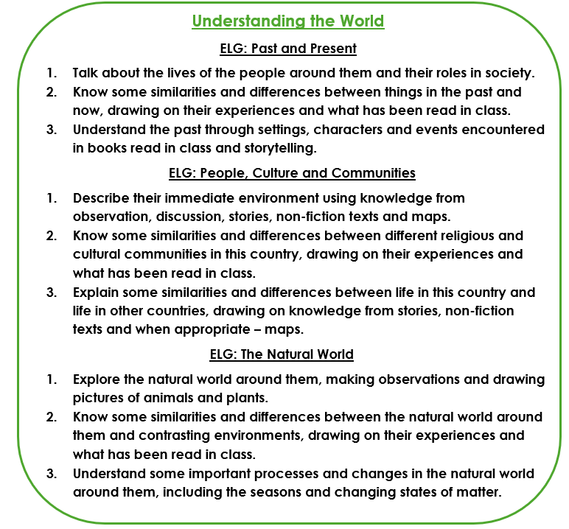

Talk about members of their immediate family and community.
Name and describe people who are familiar to them.
Comment on images of familiar situations in the past.
Compare and contrast characters from stories, including figures from the past.
Draw information from a simple map.
Understand that some places are special to members of their community.
Recognise that people have different beliefs and celebrate special times in different ways.
Recognise some similarities and difference between life in this country and life in other countries.
Explore the natural world around them.
Describe what they see, hear and feel whilst outside.
Recognise some environments that are different from the one in which they live.
Understand the effect of changing seasons on the natural world around them.

Slide 10
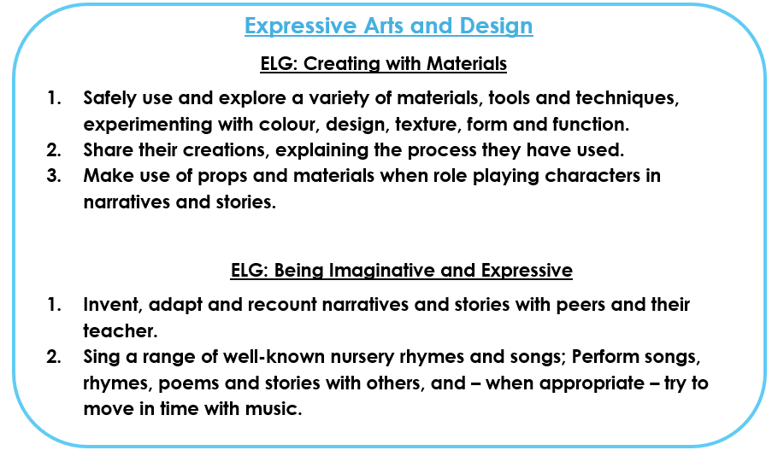

Explore, use and refine a variety of artistic effects to express their ideas and feelings.
Return to and build on their previous learning, refining ideas and developing their ability to represent them.
Create collaboratively, sharing ideas, resources and skills.
Listen attentively, move to and talk about music, expressing their feelings and responses.
Watch and talk about dance and performance art, expressing their feelings and responses.
Sing in a group or on their own, increasingly matching the pitch and following the melody.
Develop storylines in their pretend play.
Explore and engage in music making and dance, performing solo or in groups

Slide 11

Any further questions?

