Slide 1
Tuesday 20th April 2021
LO: to understand beliefs
to reflect
C: Buddhism

Slide 2

https://www.youtube.com/watch?v=p-T6aaRV9HY
What do you learn from the lyrics?

Slide 3

How is the world a wonderful place to you in your lives?
When is the world a wonderful place to you in your lives?

Slide 4

Do humans have the ability to see and experience wonderful aspects of the world?
What makes these aspects wonderful?

Slide 5

Does everyone experience the world/life as wonderful?
Can you think of any people who may not be in this situation right now?
Make a list.
What might be causing the suffering, unpleasant or life threatening experiences?
Have these people ever seen the wonderful side of the world/of life?
What may have made this change?
How could compassion help?

Slide 6
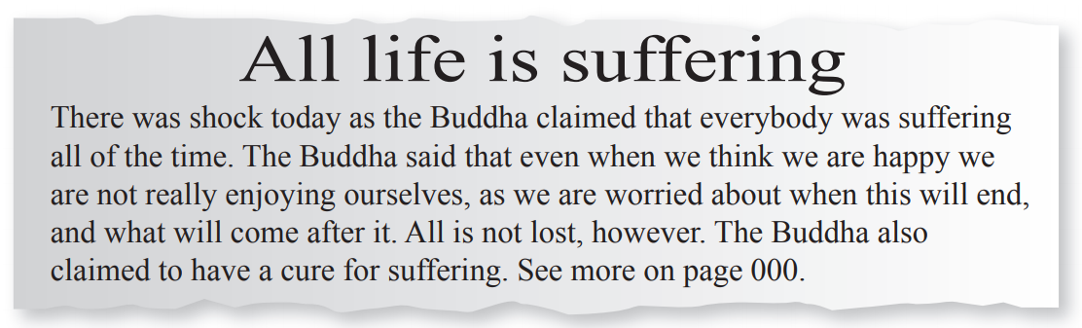
The Buddha was a human being – he did not claim to be a god or a prophet – who became ‘enlightened,’ which means that, through his own efforts, he came to understand what life was all about.
He taught four statements called the Four Noble Truths.
The first of these is ‘life involves suffering.’

Slide 7

Think of…
As many reasons as you can why the Buddha could be right to claim that all life is suffering.
As many reasons as you can why the Buddha might be wrong.

Slide 8
Activity
Create 2 bubble maps.
1. A bubble map which supports the Buddha’s claim; a bubble map of the suffering in the world.
2. A bubble map which refutes the Buddha’s claim; a bubble map of the pleasures/joys in the world.
Answer this question underneath: Overall, do you think the Buddha was right or wrong? Why? Explain the reasoning behind your answer.
Red Pen: The Buddha claimed to have a cure for suffering. If you lived in the same time as the Buddha, would you be curious enough to go and find out what this cure was? Why/why not?

