Slide 1
Year 1 PSHE
Transition to Year 2!

Slide 2
Ask an adult to read this story with you while you look at the pictures.
How is Jigsaw Jack feeling about all the changes that are happening?
What is he worrying about?

Slide 3
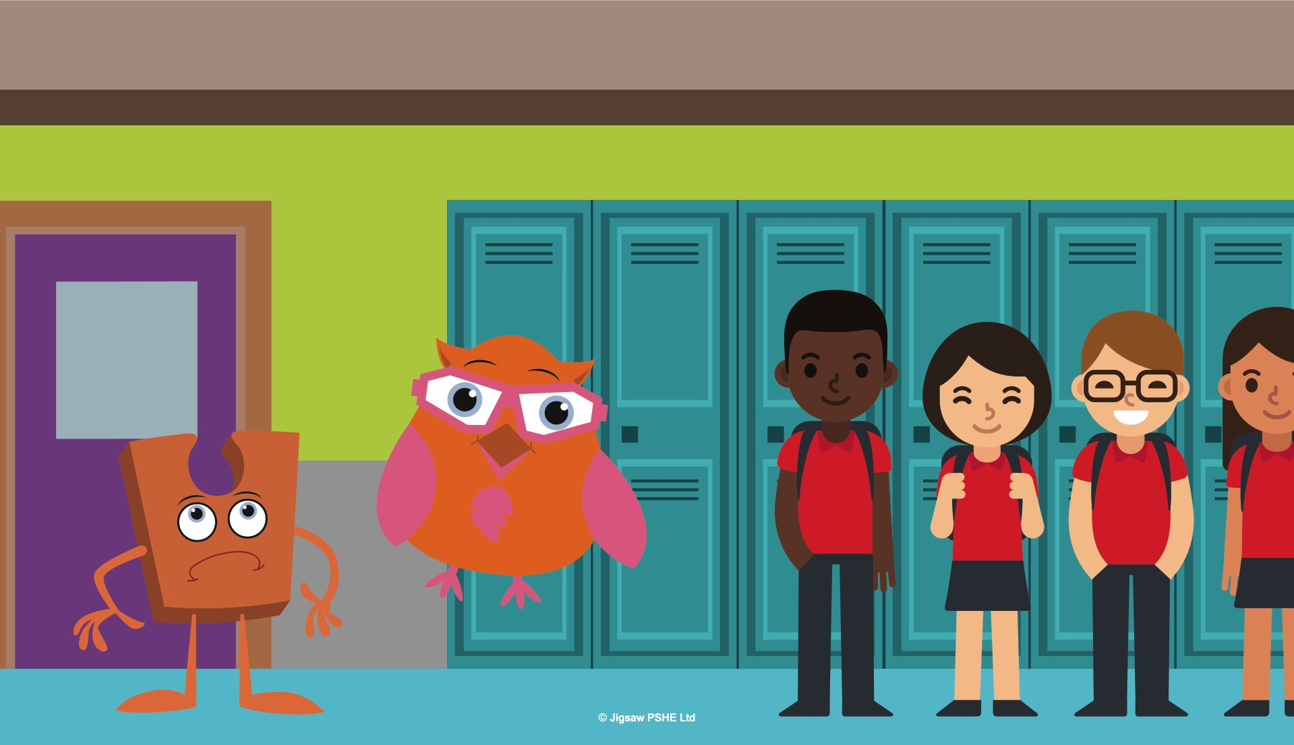

Notes:
It was the end of the school year and it seemed to Jack that everything was changing.
Two of the children in the class were moving away to go to a different school. Most of the other children were going to be moving up to the next class after the holidays. Jack was staying where he was. This made Jack feel sad. He felt left behind.
As the end of term approached, Jack seemed to get more and more upset, and even his friend Abbey Owl wasn’t able to cheer him up. “Try not to be sad Jack, things change all the time, some of these changes we might like, and others might not feel so good. There are things we can do to help with the not so good ones.” She said. Abbey Owl was clever and usually always said the right things, but even this didn’t make Jack feel any better.

Slide 4
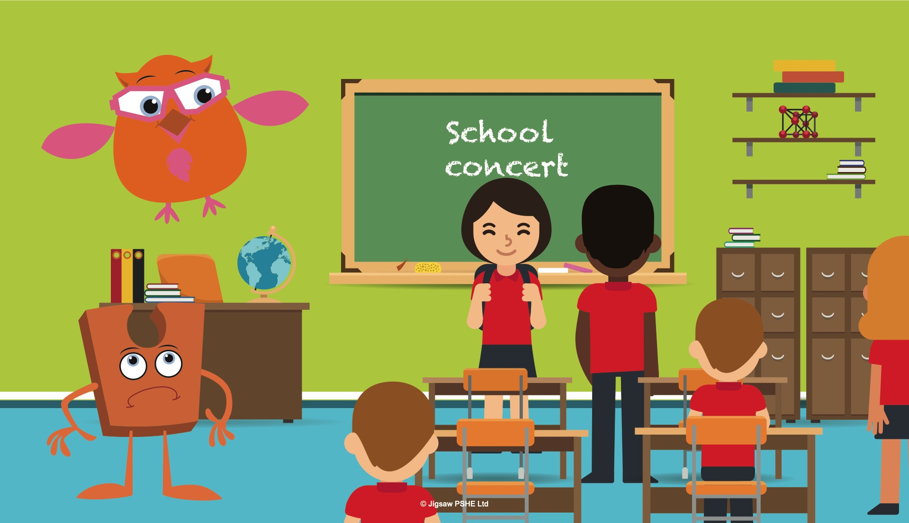
Notes:
It was soon the last week of the school term and the classroom seemed busier than usual. There were special assemblies, end of year concerts and performances and all the classwork had to be finished off. Jack watched everything going on and it just made him feel miserable.
It was soon time for the children’s last Jigsaw lesson of the year. The teacher said that everyone was going to be learning about change. “You see,” hooted Abbey Owl excitedly, “this lesson is going to really help Jack. Some of the children are feeling a little bit worried and sad about not being in this class anymore, so it’s not just you feeling like this.”

Slide 5
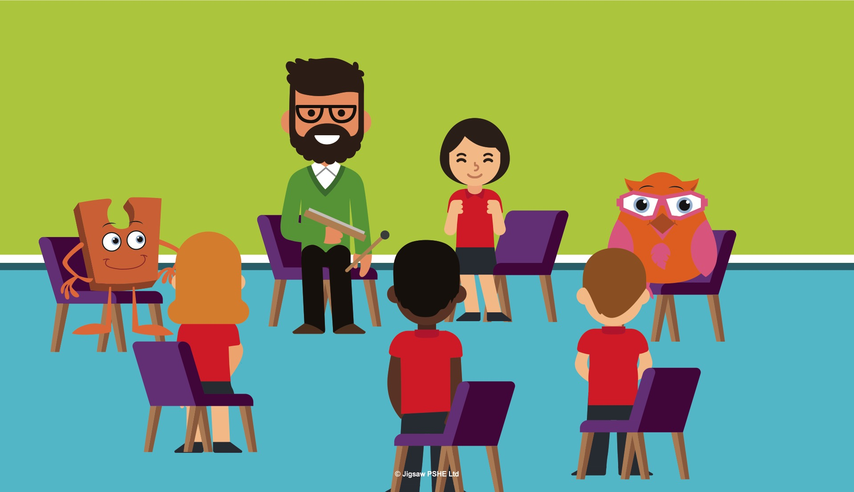
Notes:
Jack hadn’t really noticed how some of the children were feeling. He had only really been thinking about himself and how things were going to change. Jack listened to the lesson carefully hoping it was going to help. Jack practised the Calm me time with the children. It was so relaxing listening to the chime and the teacher’s voice, and when everyone opened their eyes Jack thought he felt a little better.
Have you just had your Calm me time? How do you feel?

Slide 6
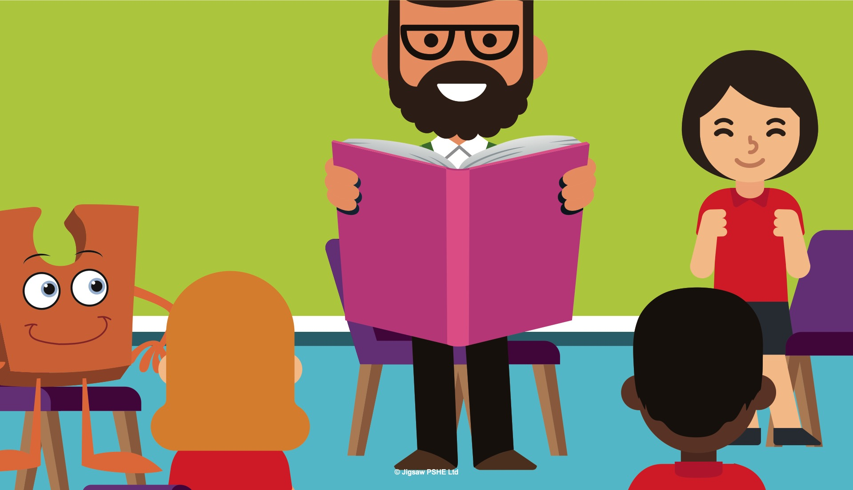
Notes:
The teacher then read a story all about Jack and how he was worried about things changing? Jack thought this was AMAZING!
The children talked about some of the things they were looking forward to about the next school year and some of the things that made them feel anxious. The teacher said that when things change people often can feel worried or scared and that it was perfectly normal. Jack felt better hearing that, because up to this point he thought that it was only him feeling this way.
In the next part of the lesson the teacher had some special objects in a bag, and when the children took them out, the teacher played a game, asking the children to guess what sort of ‘change’ the object might link to. The children were very good at guessing, much better than Jack.

Slide 7
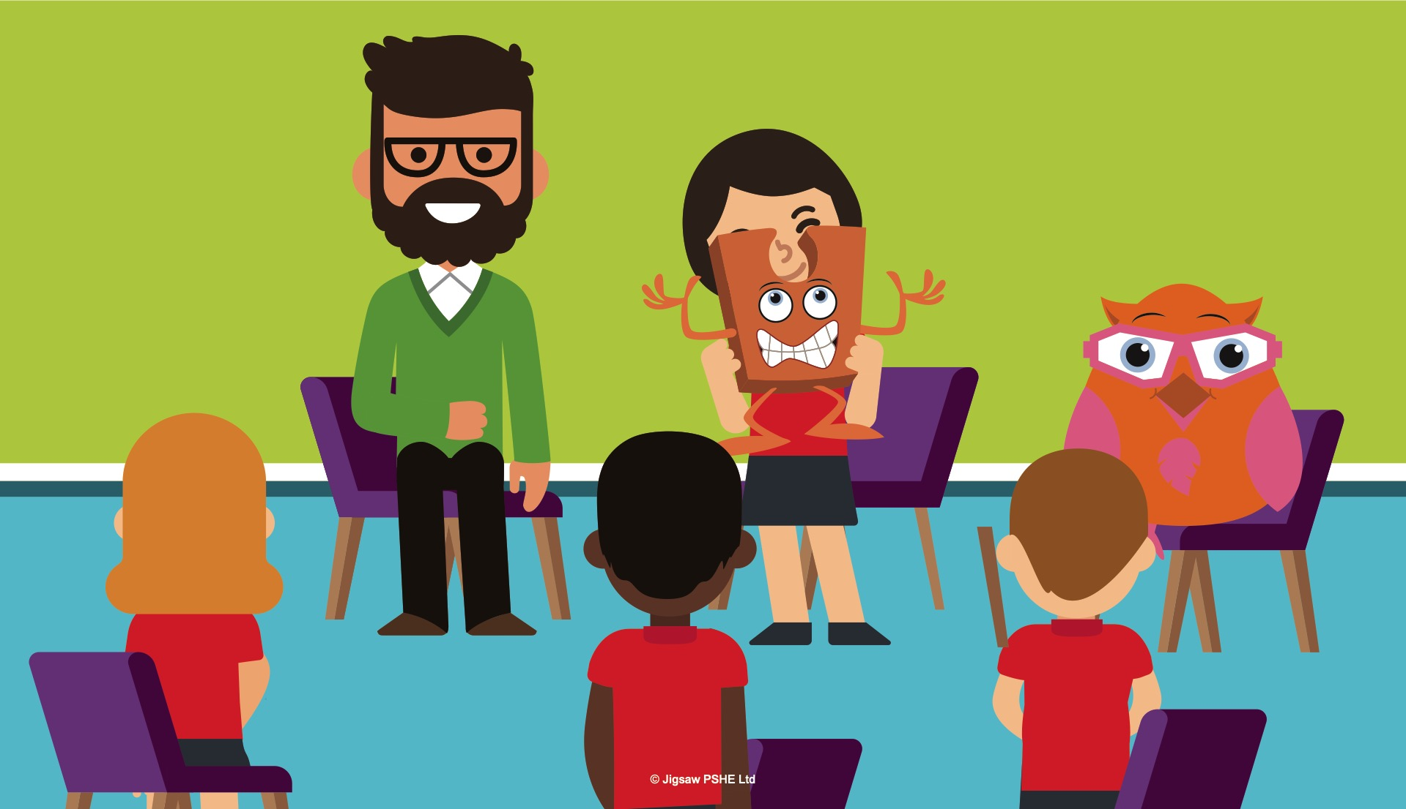
Notes:
Abbey Owl smiled, she knew what was coming next, because she had seen the teacher do the lesson with a different group of children.
For each change, the teacher asked the children how they might be able to manage their feelings through the change. At first everyone found this a little bit difficult, but with the teacher’s help they soon had a huge list of ideas they could use. Jack felt much better now.
At the end of the lesson Jack was passed around the children, he always liked this bit the best, and they each told him one thing they were really looking forward to about changing class. At the end the teacher asked Jack to whisper something that he was looking forward to, and he said, “I will have some new children to meet next year and make friends with and that will be exciting. I won’t be sad because the children this year will meet Jigsaw Jo in their next class, so they will still have a very special Jigsaw Friend.”

Slide 8
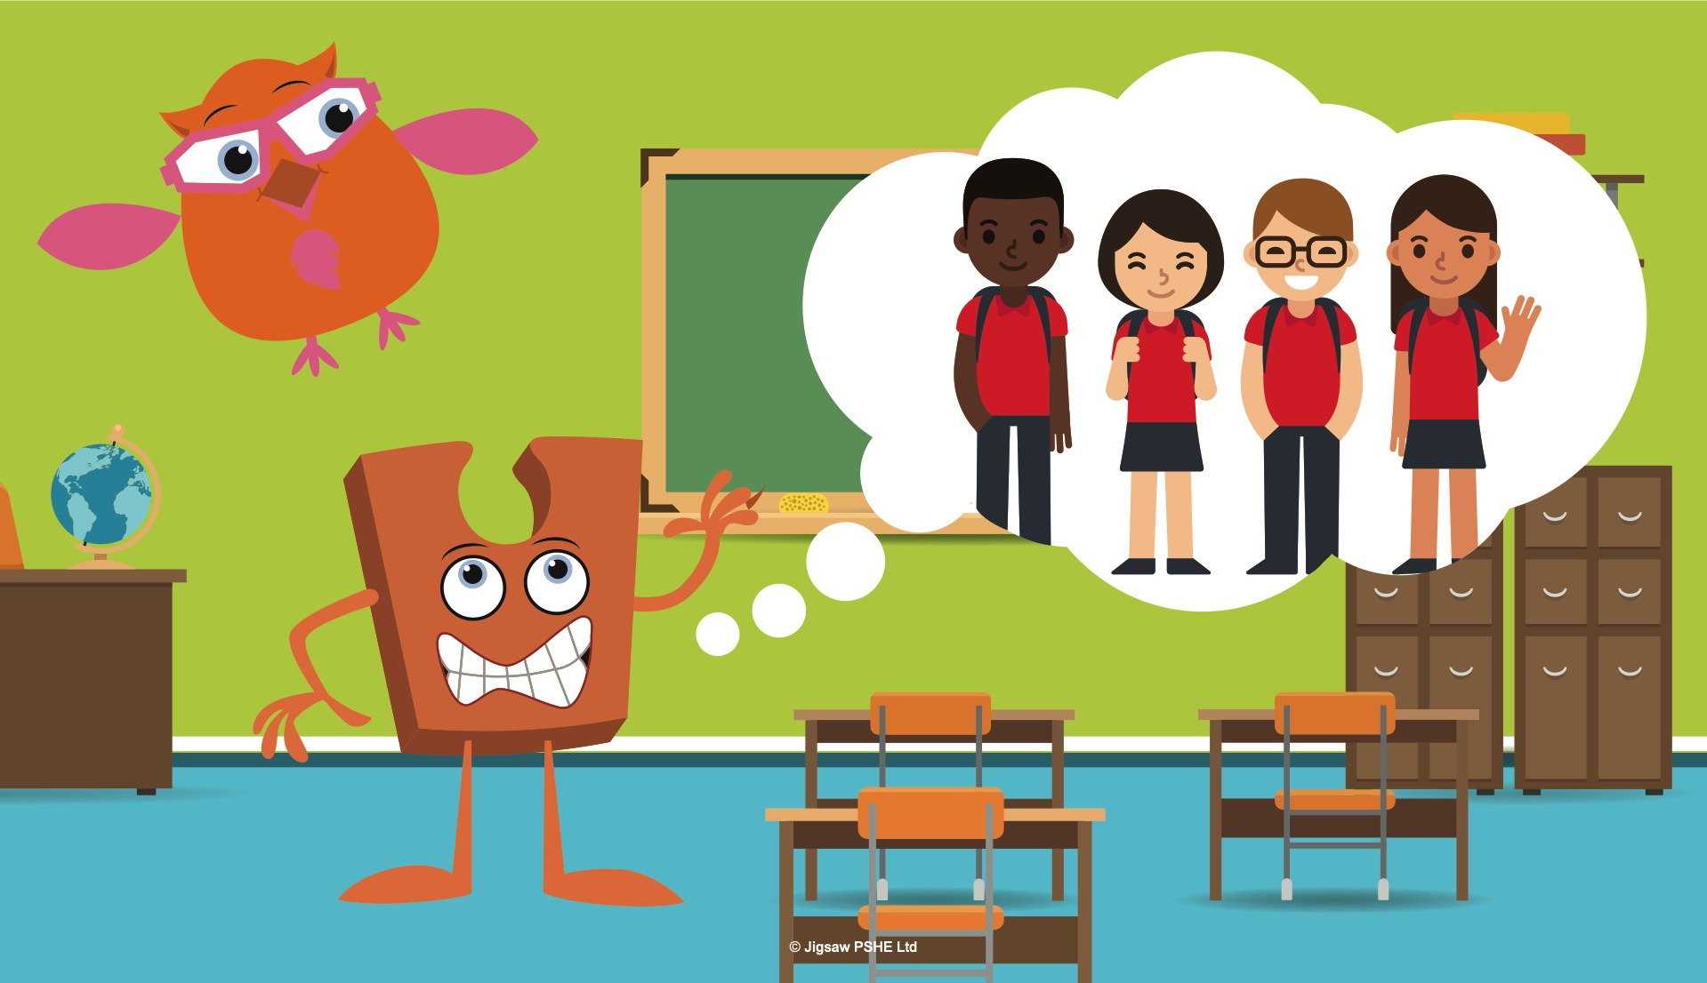
Notes:
The teacher thanked Jack and said to everyone, “Jack is right, it can really help to look at the good things about a change. Sometimes we do leave friends behind but they are in our thoughts, memories and hearts, and that will NEVER change! If we look at a change as a new adventure it doesn’t seem so bad does it? Not all changes are bad, some are very exciting!”
Everyone, including Jack felt excited about the new adventures and experiences they were going to have in the next school year. Jack felt less worried now and much happier.
Abbey owl hooted proudly, she was always right! What a clever owl!

Slide 9
Talk to your adult about what happened in the story.
What things about changing class worry you?
What things about changing class are you looking forward to?
What would you say to Jack to reassure him and help him feel better?

