Slide 1
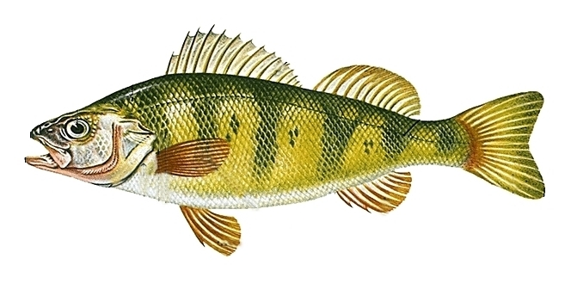
LO: To describe the structure of a fish.

Slide 2
The eyes
The eyes of a fish are always open;
they have no eyelids.
Notes:
Fish use their eyes to look for predators. A lot of fish are nocturnal so have large eyes to help them feed at night.

Slide 3
The mouth
The mouth is used to catch food.
Only some fish have teeth.
Notes:
The size of the mouth is a big clue to its’ diet. Fish with large mouths eat whole or large chunks of fish. Fish with smaller mouths nibble on plants and small animals.

Slide 4
The body
The body of the fish is protected by a thin but hard coat of overlapping scales and a coating of slime!

Slide 5
The gills
Fish use their gills to breathe. They suck in water through their mouth and breathe out through the gills.

Slide 6
The tail
The tail swings from side to side to move forwards, left and right in the water.

Slide 7
The fins
Fins are used for swimming and sometimes for protection. Fins come in lots of shapes and sizes.
Notes:
Fins come in lots of shapes and sizes.

Slide 8
LO: To describe the structure of a fish.
Notes:
Fins come in lots of shapes and sizes.

Slide 9
LO: To describe the structure of a fish.
1* = Label the parts of a fish.
2* = Label and describe the function of the parts of a fish.
3* = Draw and label a fish. Summarise the function of the different parts.
Notes:
Fins come in lots of shapes and sizes.

