Slide 1
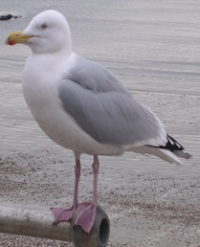
LO: To describe the structure of a bird.

Slide 2
The eyes
The eyes of a bird help spot its food.
Notes:
Fish use their eyes to look for predators. A lot of fish are nocturnal so have large eyes to help them feed at night.

Slide 3
The beak
The beak is often long and thin to grip its food.
Notes:
The size of the mouth is a big clue to its’ diet. Fish with large mouths eat whole or large chunks of fish. Fish with smaller mouths nibble on plants and small animals.

Slide 4
The body
The wing of a bird helps it glide through the air.

Slide 5
The gills
Feet on a bird are sometimes webbed to help them swim well. Some birds have claws to help them grip onto things like branches.

Slide 6
The tail
The tail can be long and pointed to help the bird twist and turn quickly.

Slide 7
LO: To describe the structure of a bird.
1* = Label the parts of a bird.
2* = Label and describe the function of the parts of a bird.
3* = Draw and label a bird. Summarise the function of the different parts.
Notes:
Fins come in lots of shapes and sizes.

