Slide 1

Lesson 4 – Counting in coins (2)
Problem solving.

Slide 2
Today we will be doing some problem solving.
You will need to use coins to help you with the questions today.
You can either:
Use real coins, if you have them.
Use the coins on
Or cut out the coins provided at the end of the slides.
  Whatever is easiest for you!
  There are only two questions today. This is because they require some investigating, so they should take longer to complete.
https://mathsbot.com/manipulatives/coins

Slide 3
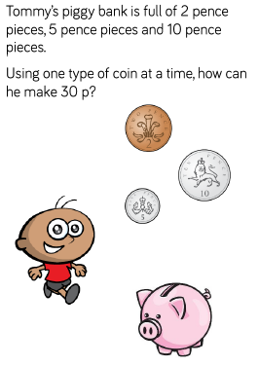

Slide 4
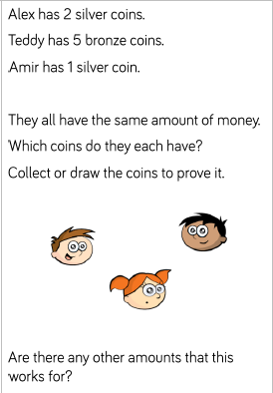

Slide 5
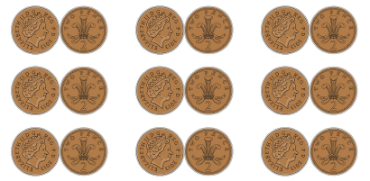

Slide 6
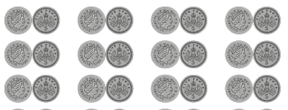

Slide 7


