Slide 1

Lesson 3 Counting in coins

Slide 2
Before starting your questions today, you might like to explore adding or counting with real coins at home. If you don’t have any coins at home, you could use the ones on this website.
https://mathsbot.com/manipulatives/coins

Slide 3
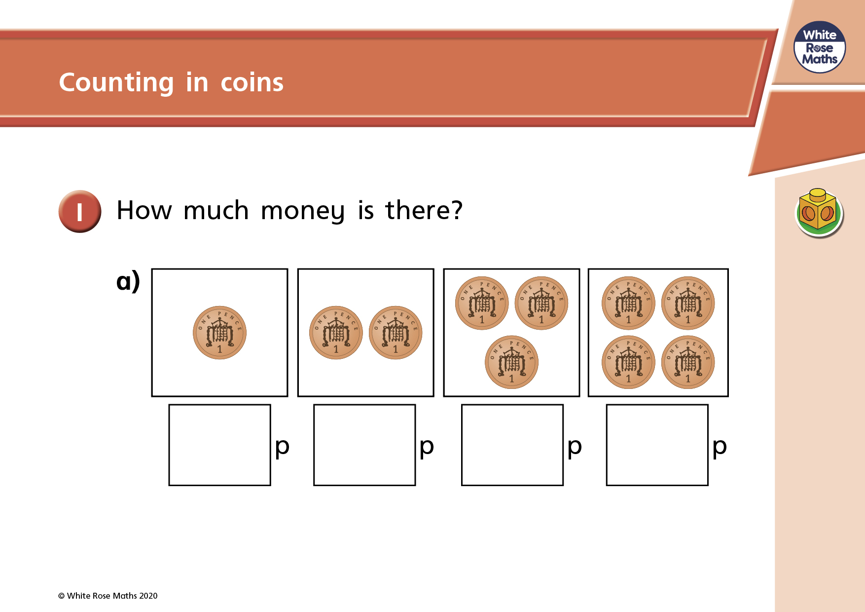

Slide 4
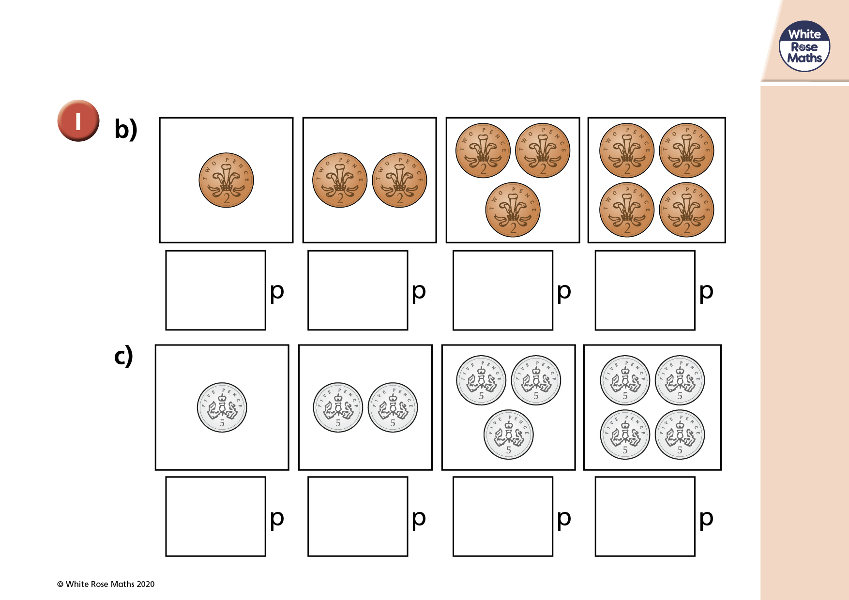

Slide 5
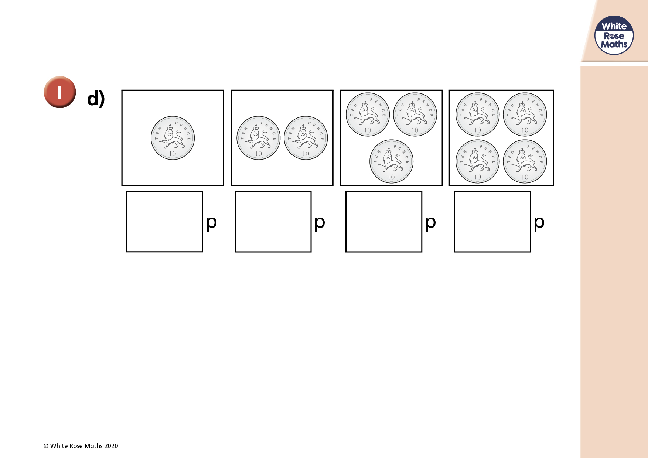

Slide 6
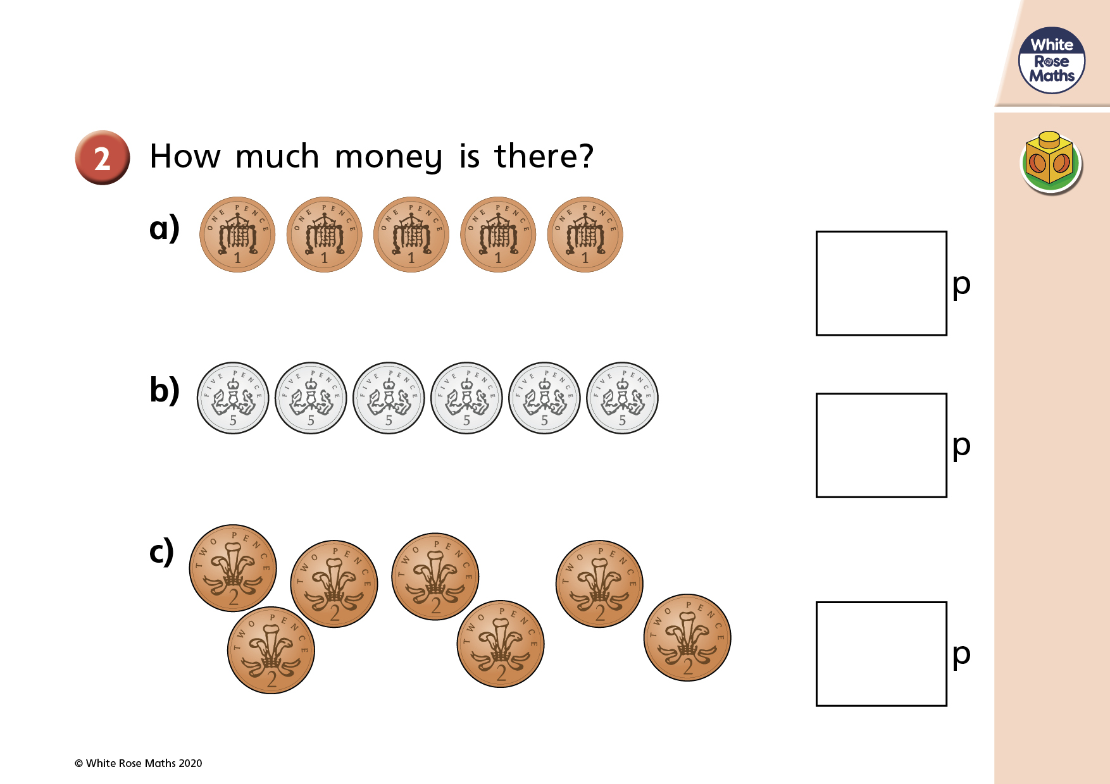

Slide 7
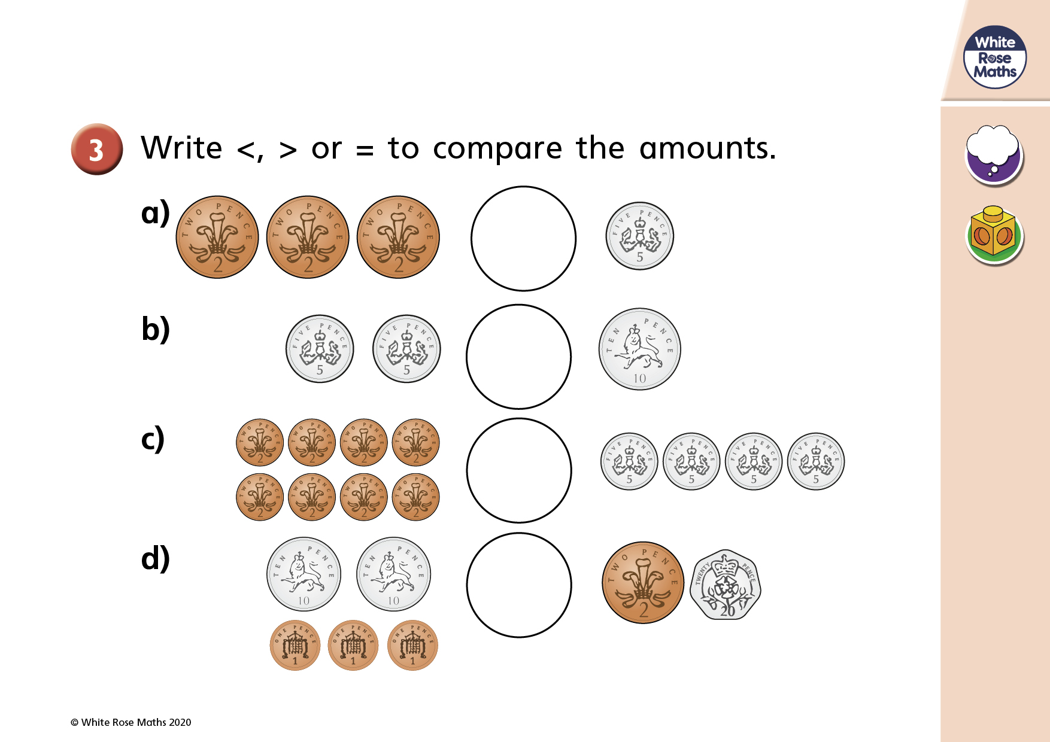


Slide 8
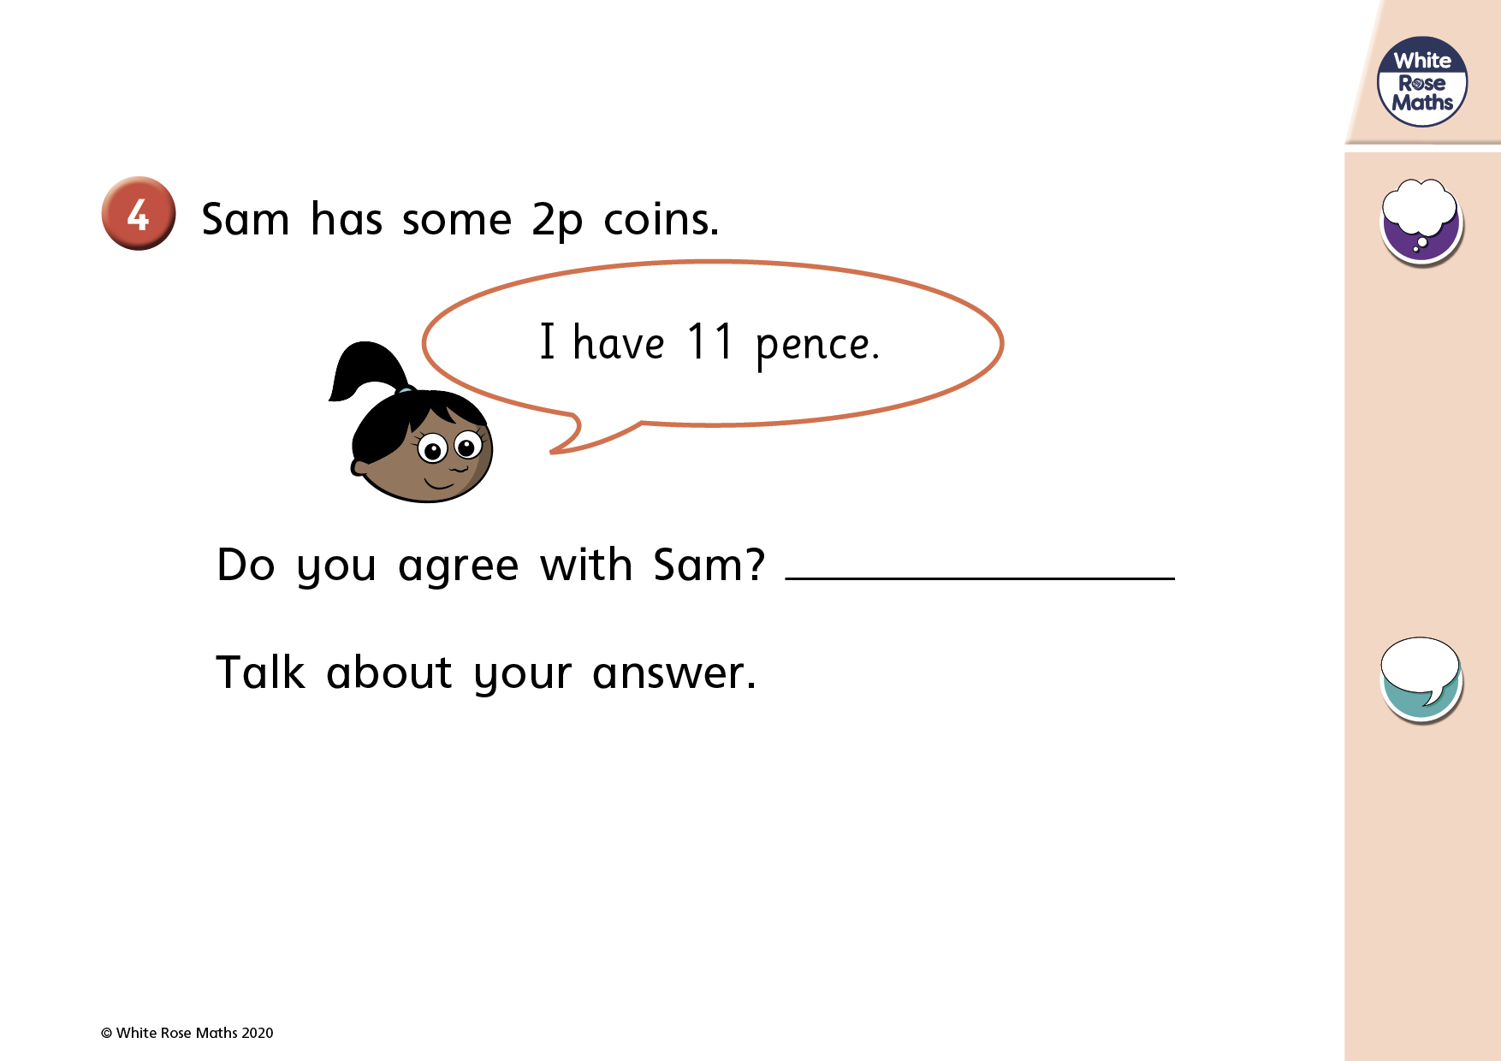
https://mathsbot.com/manipulatives/coins

Slide 9
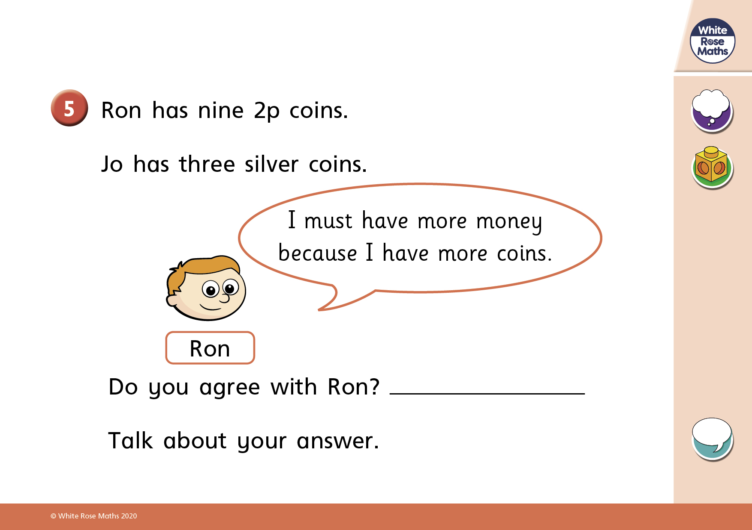
https://mathsbot.com/manipulatives/coins

