Slide 1

Welcome to the last week of Year 1 Maths!

Slide 2
This week:
There are some Maths activity mats on the following slides which have a variety of different questions on them, based on the different concepts you have learned across the year.
There are two different activity mats that you can try each day.
The mats will also be available in PDF form along with the answer sheets on our school class pages.
Enjoy!

Slide 3
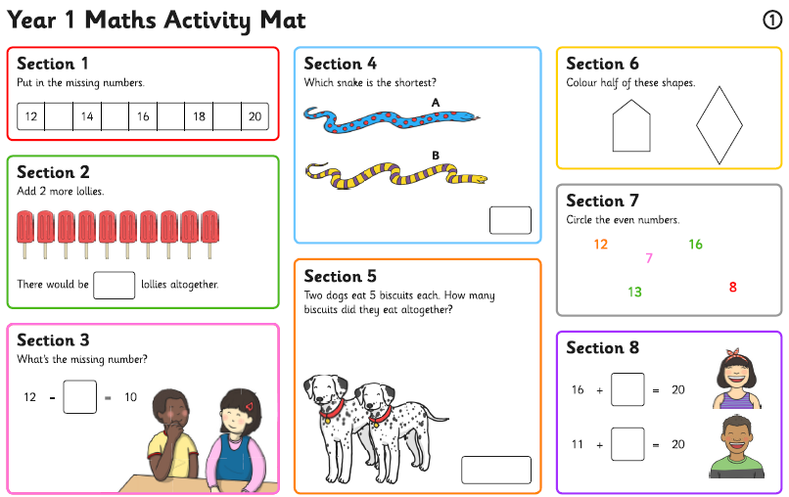
Monday

Slide 4
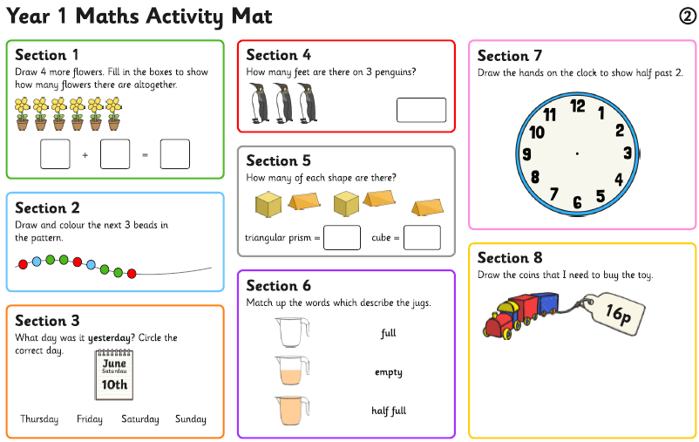
Monday

Slide 5
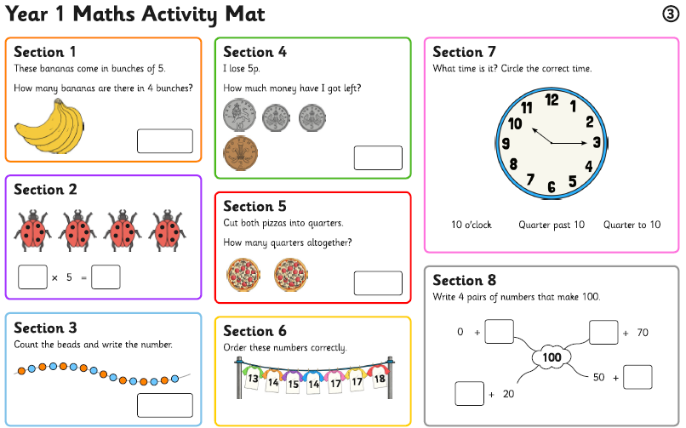
Tuesday

Slide 6
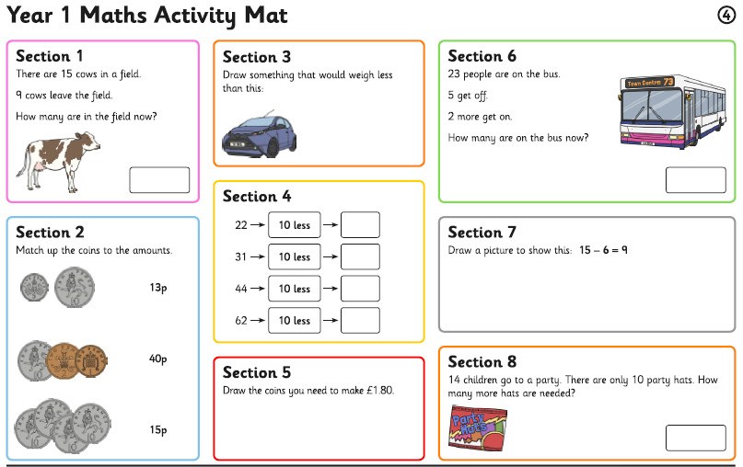
Tuesday

Slide 7
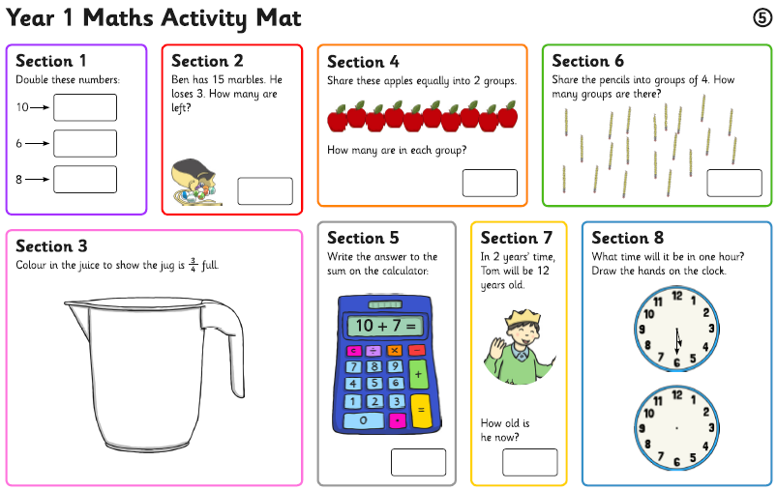
Wednesday

Slide 8
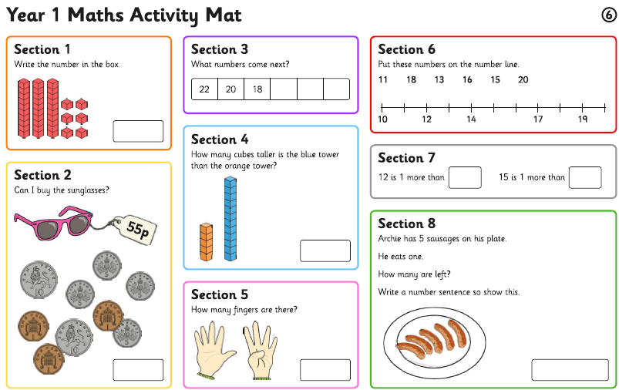
Wednesday

