Slide 1
Lesson 4 – Comparing the time

Slide 2
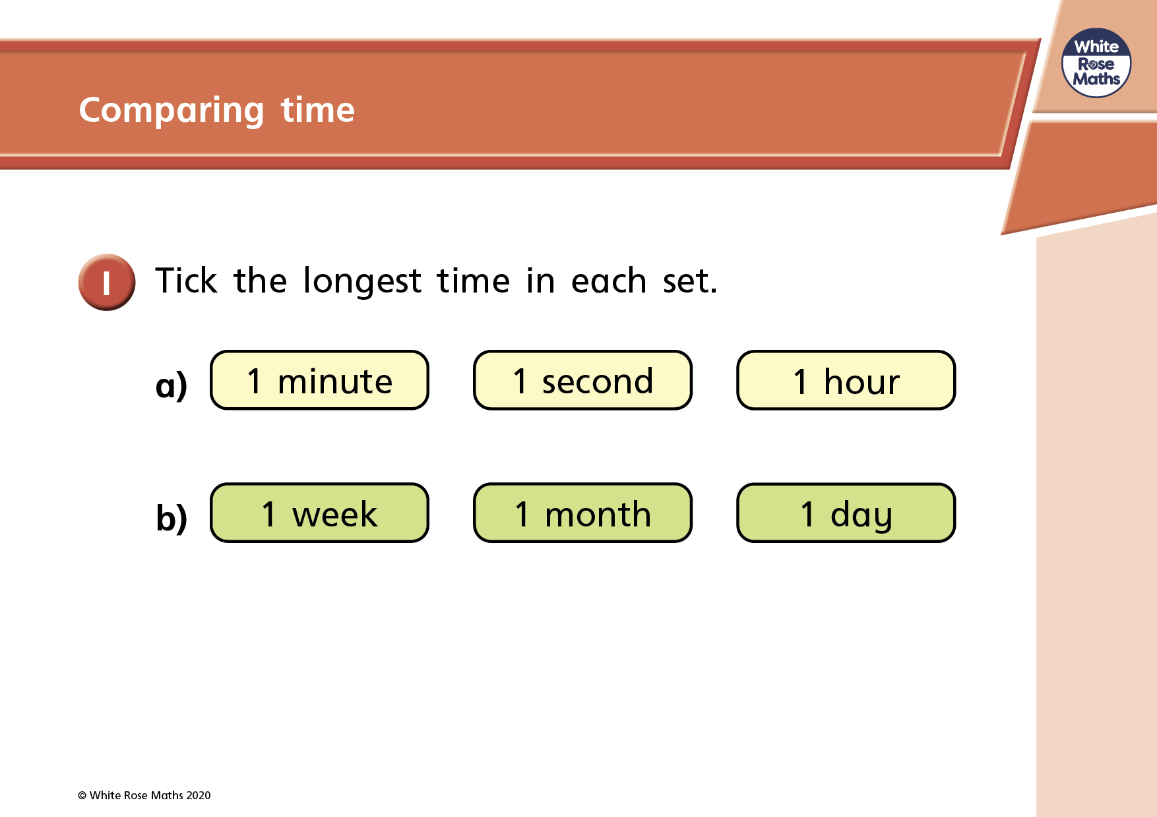

Slide 3
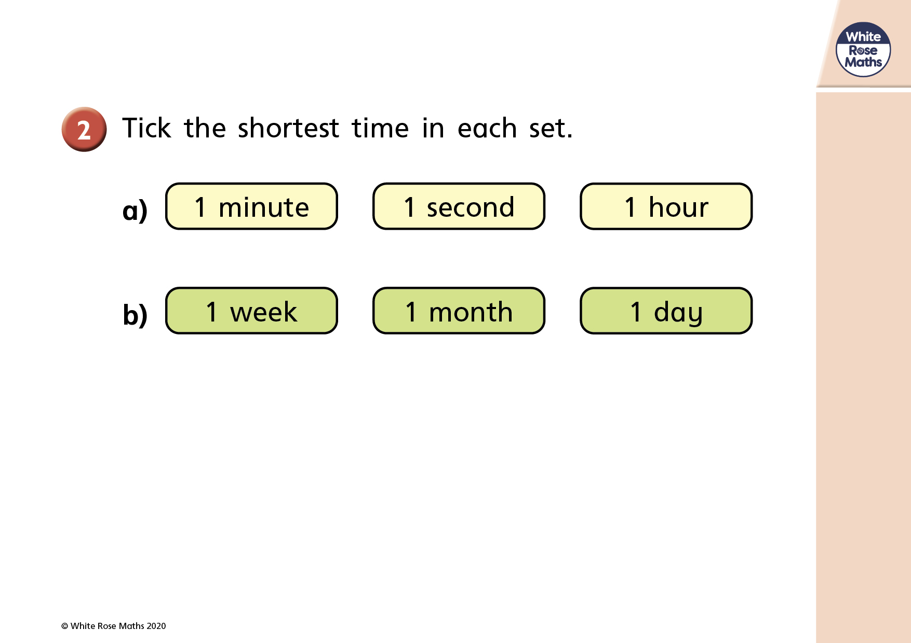

Slide 4
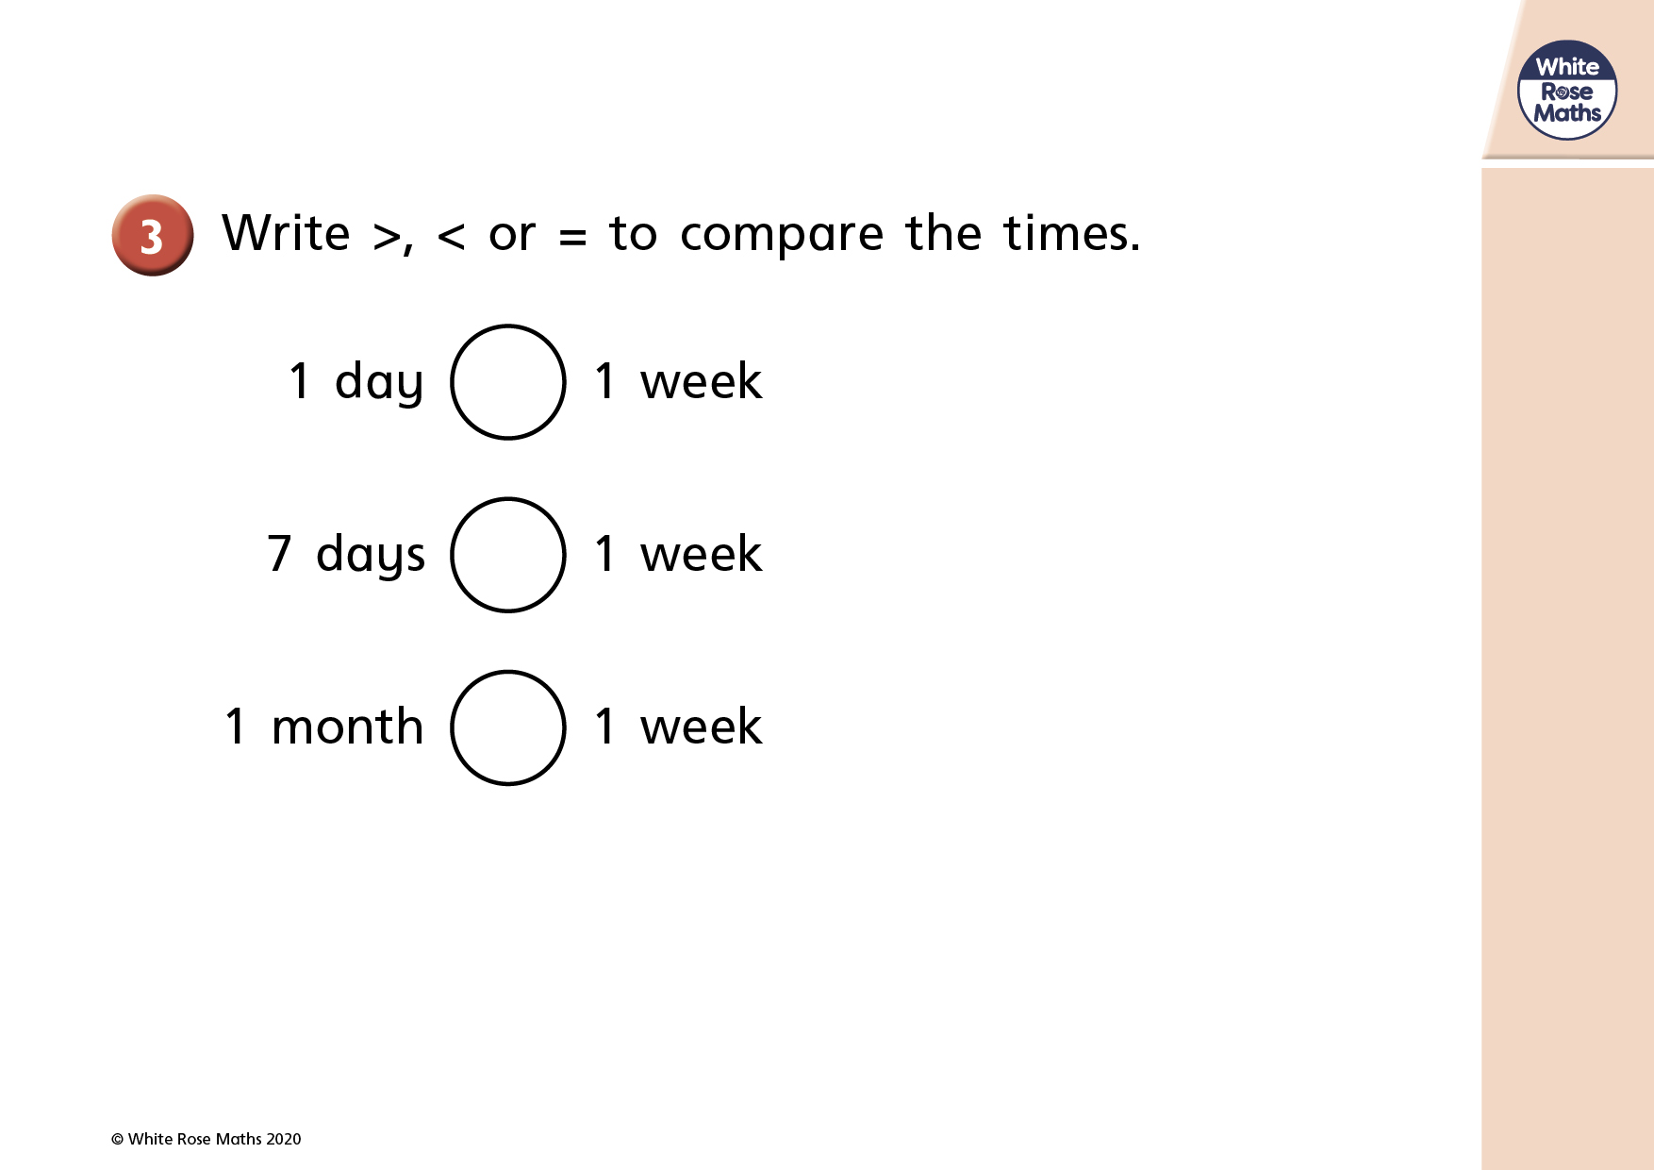


Slide 5
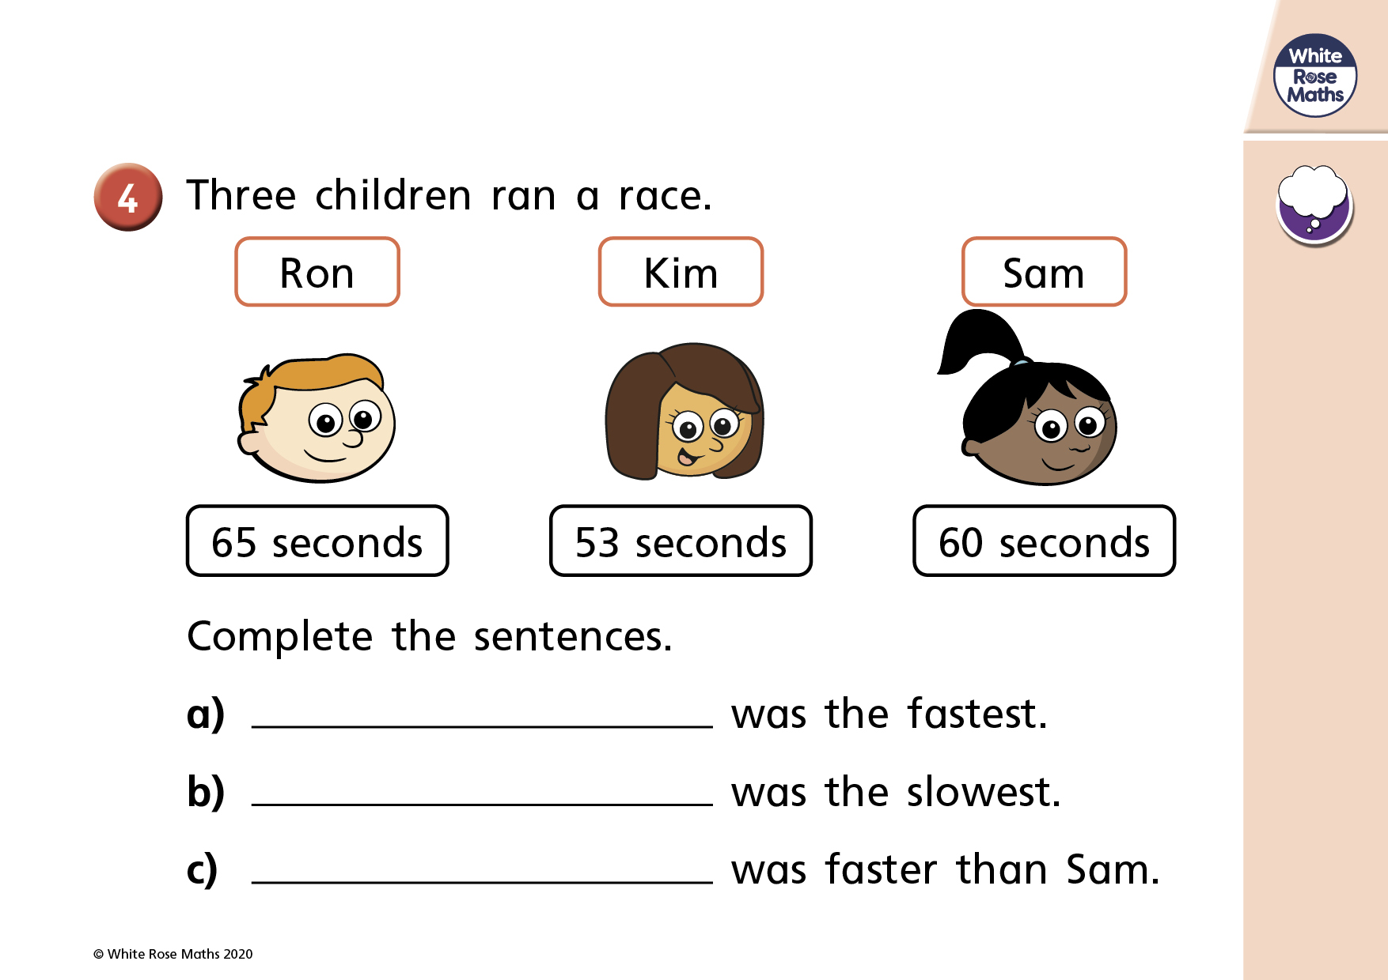

Slide 6
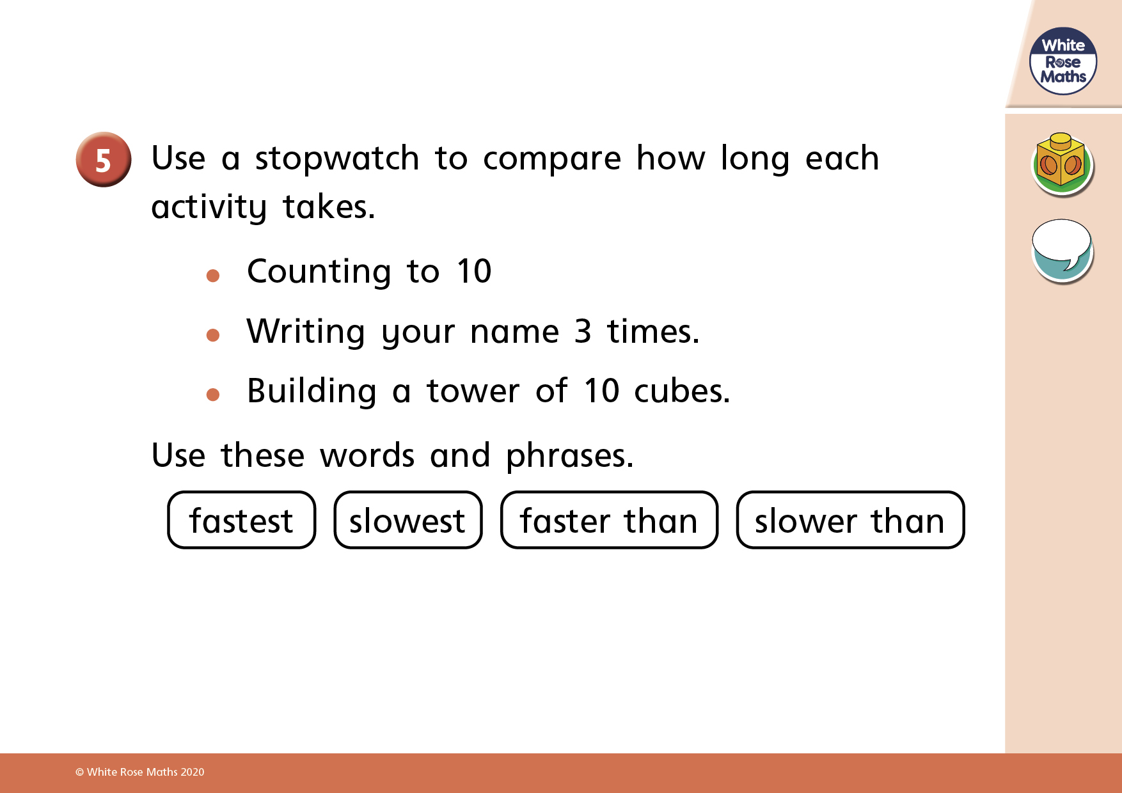
https://www.online-stopwatch.com/countdown/

