Slide 1

Lesson 3 – Writing the time (2)
Today you will continue to practice writing the time.

Slide 2
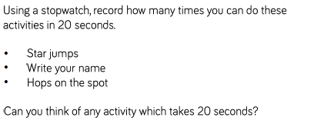
https://www.online-stopwatch.com/countdown/

Slide 3
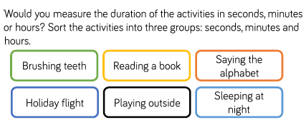

Slide 4

Could you write some time sentences like this of your own?

Slide 5
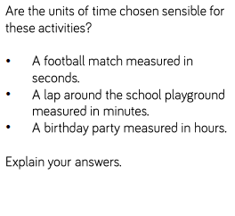
Discuss this question with an adult.

