Slide 1
Lesson 2 - Writing the time.

Slide 2
Which measure of time is most useful?
Different activities take different amounts of time to complete. Which is why we have different units of measure such as; seconds, minutes and hours.
For example: How would you measure how long it takes to…
Brush your teeth?
Blink 5 times?
Watch a film?

Slide 3
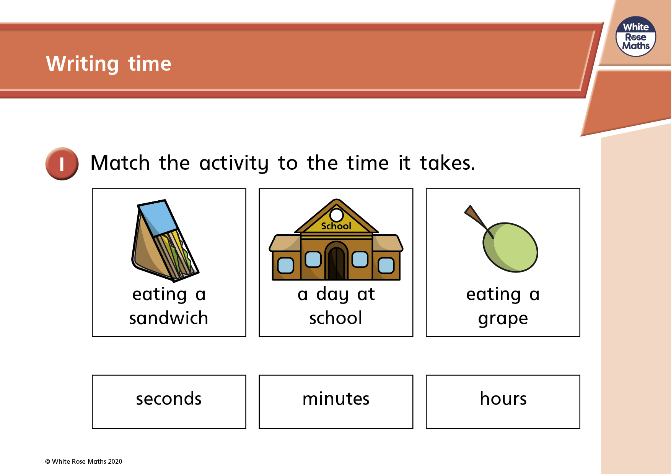

Slide 4
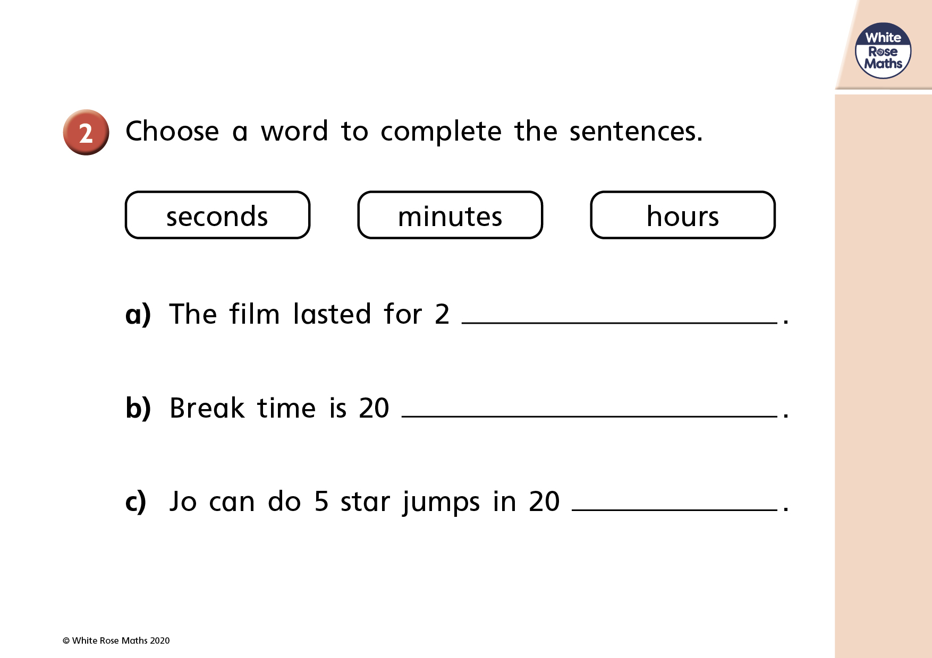

Slide 5
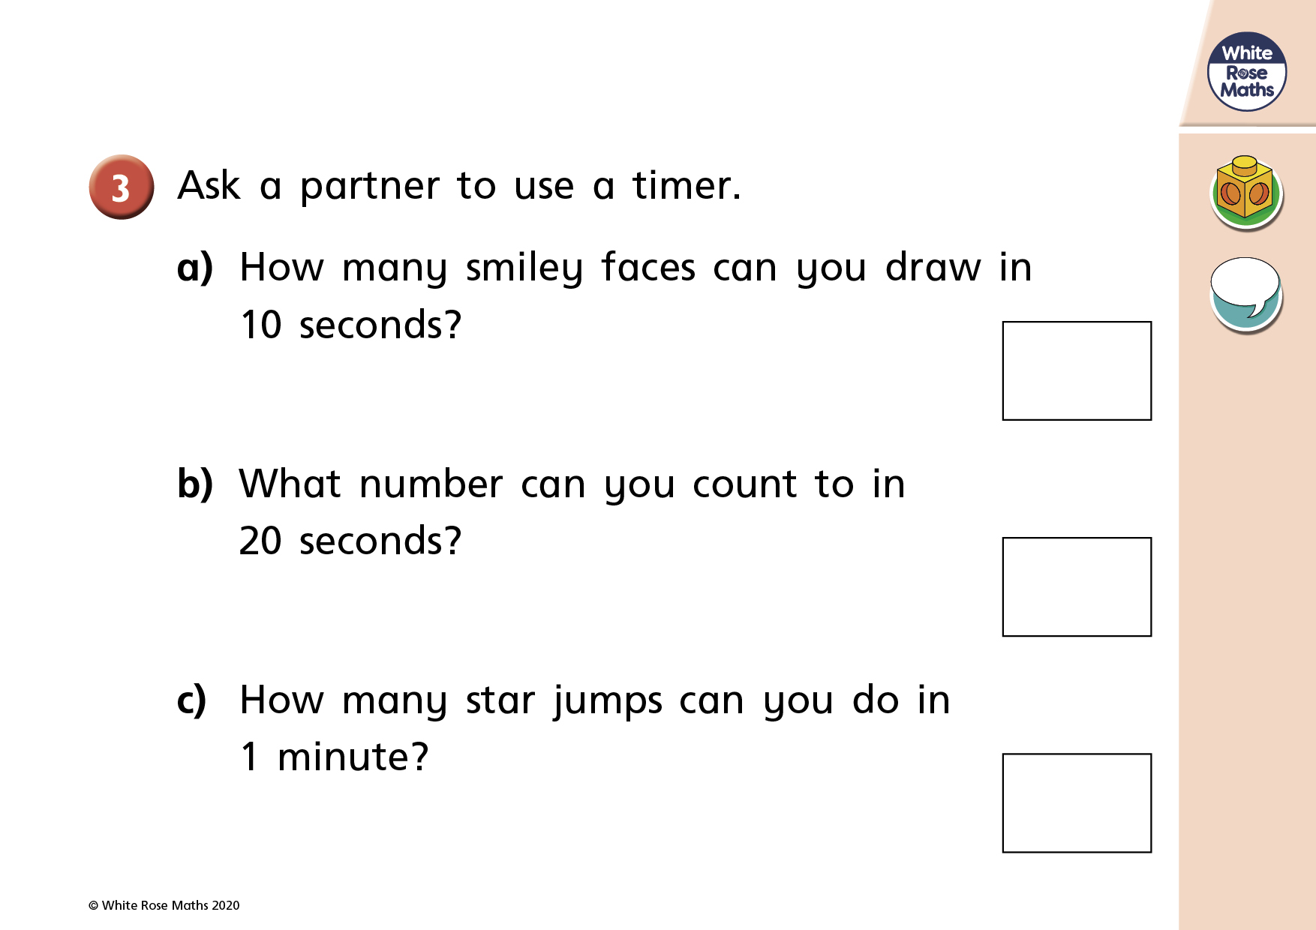

Slide 6


