Slide 1

Lesson 1 – Telling the time.
Telling the time to the hour and half hour.

Slide 2
Use your learning from last week about telling the time to help you answer today’s questions.

Slide 3
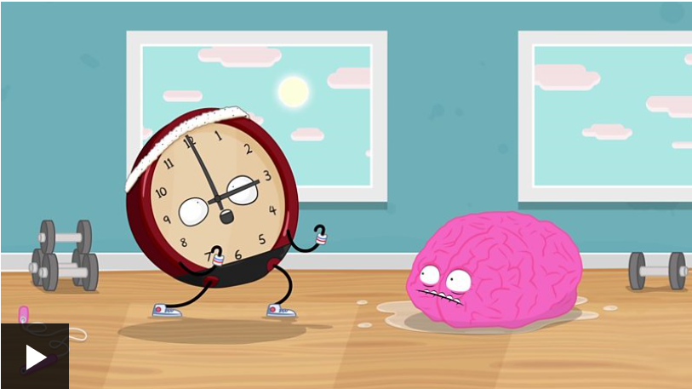
You can watch the Bitesize clip again to remind you about how to tell the time.
https://www.bbc.co.uk/bitesize/topics/zhk82hv/articles/zcmdwxs

Slide 4
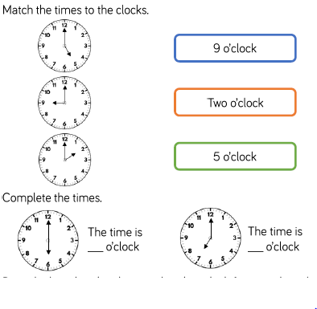

Slide 5

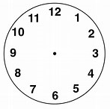

Slide 6
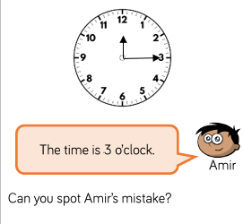
Discuss this question with an adult

Slide 7
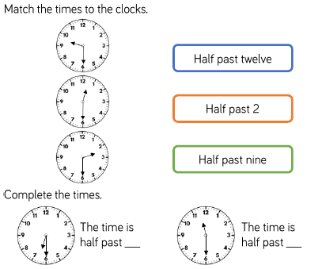

Slide 8


Slide 9


