Slide 1
Tuesday 20th April 2021
LO: To write with purpose
To organise writing appropriately
C: Formal Recount

Slide 2
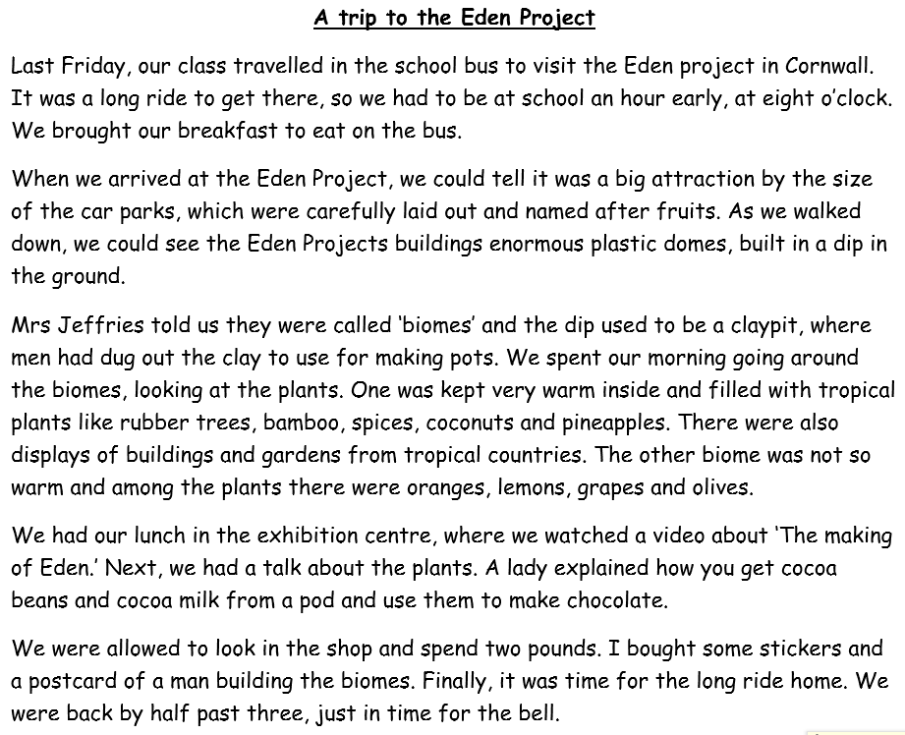
Starter
What features of writing can you identify in this text?
Create a bubble map!
What type of writing do you think this is?

Slide 3
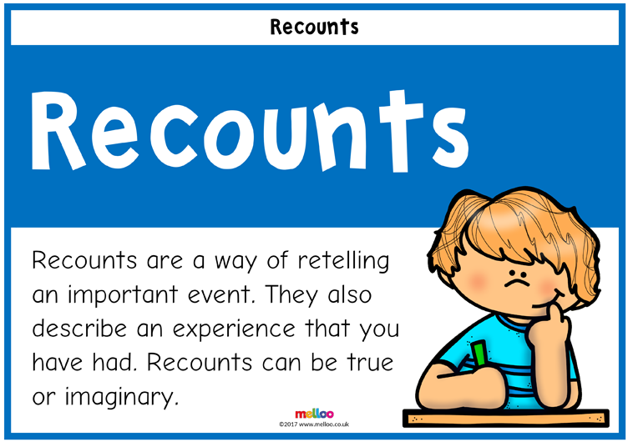
It is a formal recount!
A recount retells an experience or an event that happened in the past.
The purpose of a recount can be to inform, entertain or to reflect an evaluate.
A recount can focus on a specific section of an event or retell the entire story.

Slide 4
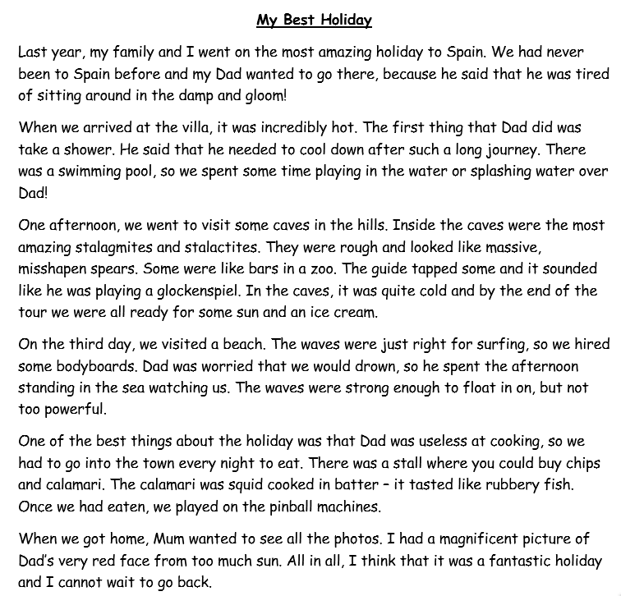
Can you identify any additional features of formal recounts?
Add them to your bubble map!

Slide 5
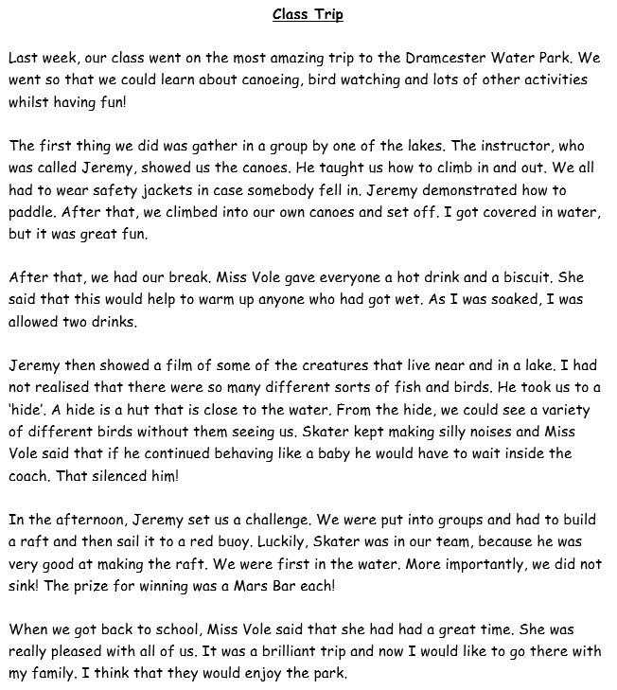
Can you identify any additional features of formal recounts?
Add them to your bubble map!

Slide 6
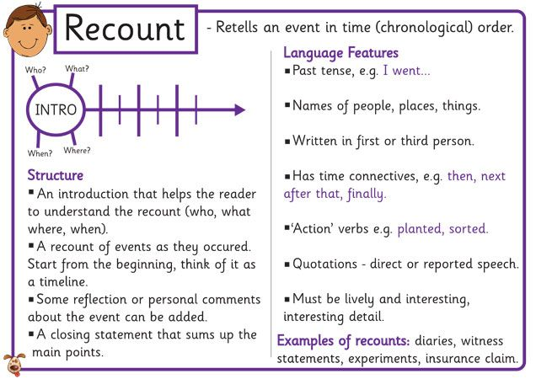

Slide 7
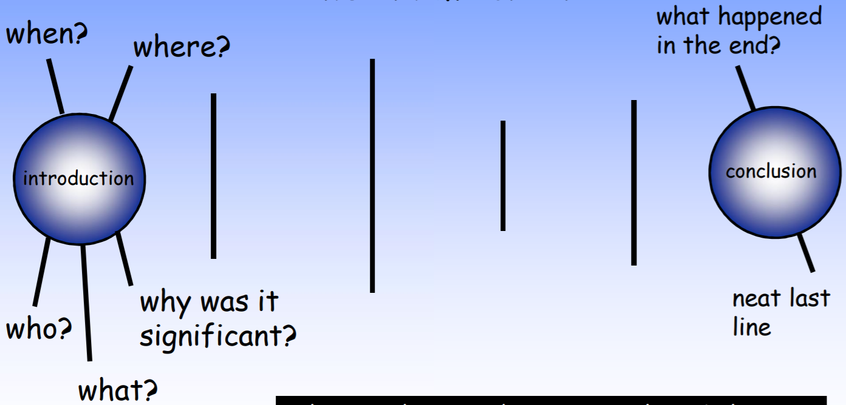
Structure of Formal Recounts

Slide 8


What is Formal and Informal Language?
Do you know what the difference between formal and informal
language is?
Formal Language
Formal language is used for more official and serious purposes.
The correct grammar and standard English should always
be used.
Informal Language
Informal language is used for more casual and less
serious purposes. Slang words and chatty language
can be used.

Slide 9

What is Formal and Informal Language?
formal
informal
uses a serious tone
uses a ‘chatty’ tone
uses correct grammar
and punctuation
can use ‘text’
language and slang
uses correct vocabulary
can use contractions and
abbreviations e.g. ‘it’s’ or ‘TV’

Slide 10
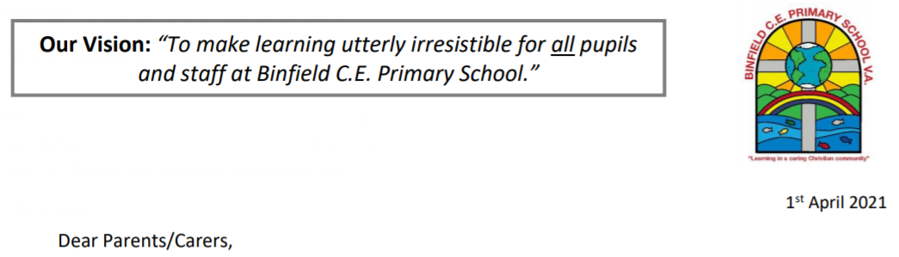
Mrs Featherstone-Wright has asked Year 4 to write some formal recounts of their Easter Holiday for our school newsletter!
Before we can start writing our recounts, we need to learn some more about their features.

Slide 11
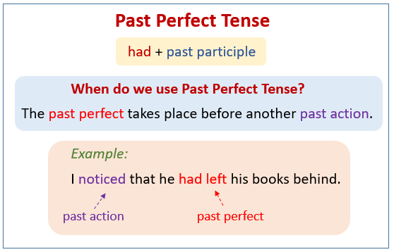
One of the features of formal recounts is past perfect tense.
The past perfect tense describes a completed activity in the past.
It is used to talk about an event that was completed in the past before something else happened.
For example:
I had just finished cooking the meal, when my guests arrived.
I didn’t want to watch the film, as I had seen it already.

Slide 12
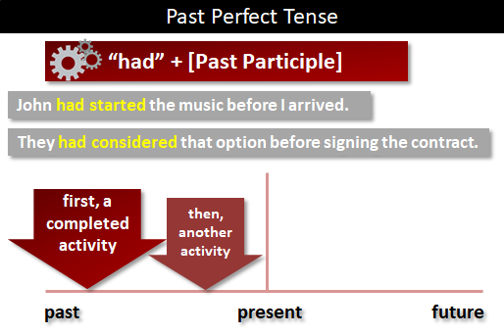

Slide 13
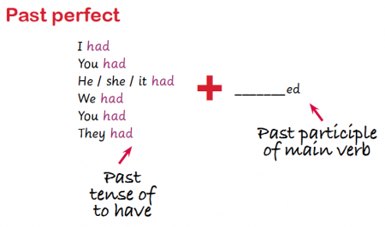

Slide 14
My example:
On Easter Sunday, I finally got to spend time with my family, as some of the Covid restrictions were lifted. As part of our family tradition, my mum prepared an Easter Egg hunt to celebrate Easter. Before I arrived, she had hidden all of the delicious, chocolate eggs. Unfortunately, I was not allowed to hunt for the hidden eggs, until everyone had finished their dinner. The wait for the barbeque seemed endless, but it definitely worth it! The wooden, outdoor table was completely covered in flavoursome food! In my excitement for the Easter egg hunt to begin, I had cleared my plate, before the last of the food was even cooked! One thing that made our Easter egg hunt unique this year, was that my mum wrote clues and riddles to help us in our quest for eggs. This meant that I could not search for more eggs, until I had solved each riddle. Fortunately, I had a head start, because I had hunted surreptitiously for eggs, before the hunt officially began. My brother was not impressed, as I successfully solved all of the clues in record time! I sat and consumed nearly all of my chocolate eggs, before he had answered his first clue!

Slide 15
On Easter Sunday, I finally got to spend time with my family, as some of the Covid restrictions were lifted. As part of our family tradition, my mum prepared an Easter Egg hunt to celebrate Easter. Before I arrived, she had hidden all of the delicious, chocolate eggs. Unfortunately, I was not allowed to hunt for the hidden eggs, until everyone had finished their dinner. The wait for the barbeque seemed endless, but it definitely worth it! The wooden, outdoor table was completely covered in flavoursome food! In my excitement for the Easter egg hunt to begin, I had cleared my plate, before the last of the food was even cooked! One thing that made our Easter egg hunt unique this year, was that my mum wrote clues and riddles to help us in our quest for eggs. This meant that I could not search for more eggs, until I had solved each riddle. Fortunately, I had a head start, because I had hunted surreptitiously for eggs, before the hunt officially began. My brother was not impressed, as I successfully solved all of the clues in record time! I sat and consumed nearly all of my chocolate eggs, before he had answered his first clue!
Have a look at the words/phrases I have highlighted – try to magpie some of them in your writing today!
I am expecting to see at least 3 of these highlighted examples in your work.
You might like to write them in red pen or underline them in your work to show that you have used them.

Slide 16
Activity:
Choose a single day/event from your Easter Holidays and write about it using the past perfect tense.
You should also make sure you are using formal language, e.g. no abbreviations or contractions.
You can use my example to help you write your own paragraph.
Red Pen: use conjunctions to add detail and information to your writing.

Slide 17
Wednesday 21st April 2021
LO: To write with purpose
To organise writing appropriately
To use sentences appropriately
C: Formal Recount

Slide 18
Starter
Conjunctions are used in formal recounts to signal time and shift attention.
Focus conjunctions for today:
after, before, while, when, until, since, although, but, yet
Can you create some formal sentences using these conjunctions that you could use in your formal recounts?

Slide 19
You are going to plan your formal recount today.
Remember that you are writing these recounts for our school newsletter.

Slide 20
What are the features of formal recounts?

Slide 21
You are not going to write about every single thing you did over the Easter Holidays!
You should choose a certain event or day that you would like to write about.
Remember that you should be writing about important/significant details – you don’t need to tell us what you ate for breakfast!

Slide 22

What event or day of the Easter Holidays are you going to write about?
Jot down any ideas on your whiteboards to help you!

Slide 23
Consider the following questions:
- What are you going to tell your reader? What are you recounting?
- What information will the reader need early in the text?
- What are the important events or parts of the recount you want to describe? And what order will they occur in?
- How will you let your readers know the order of events? And what language will we use to link them?
- What other information may be useful to include?
- How will you conclude your recount?

Slide 24
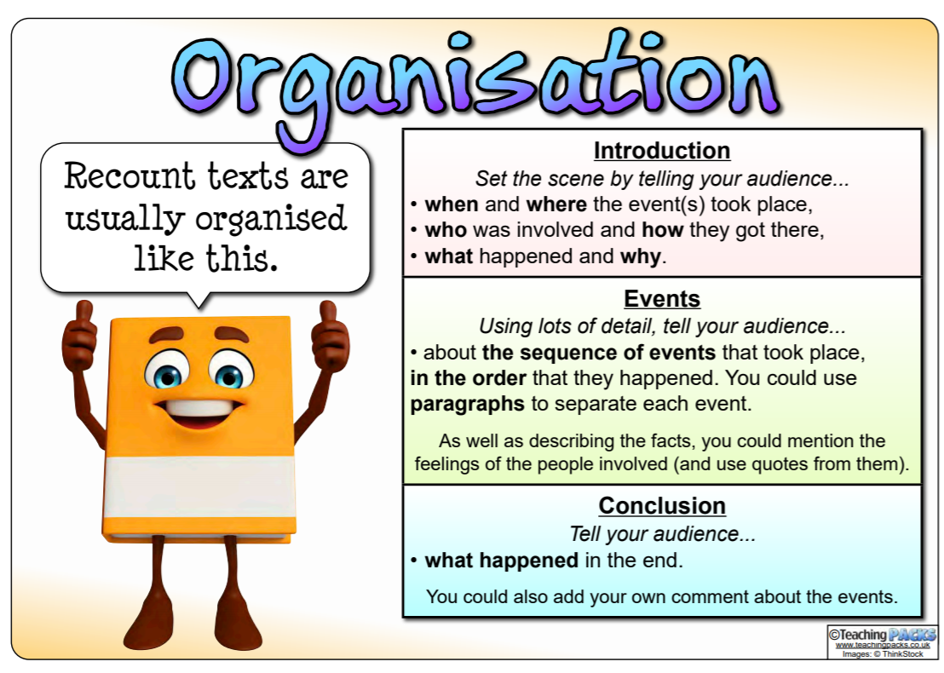

Slide 25
What?
What did they do?
Who?
Who did the activity?
Where?
Where did this take place?
Introduction
When?
When did this happen?
Why?
What was the purpose of the activity?

Slide 26
Use time connectives
Write in paragraphs
Write about what
happened during
the activity
Main Body
Use conjunctions to
signal time and
shift attention
Write in chronological
order

Slide 27
Sum up the visit
Say what you
enjoyed
Concluding
Paragraph
Say what you
learnt
Recommend others
who may
enjoy it

Slide 28
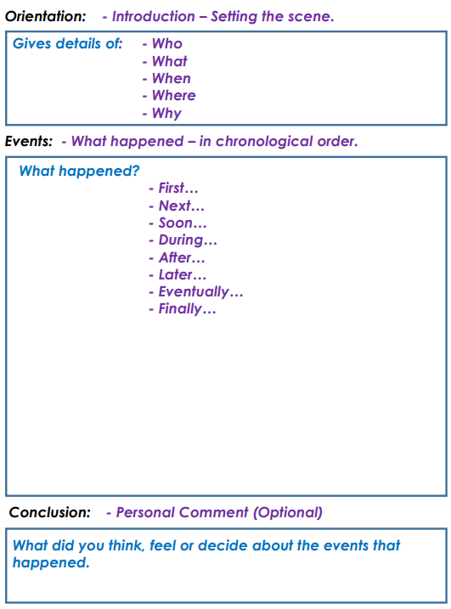
Activity:
Plan your formal recount using the template.
Red Pen: write some sentences with conjunctions that you could use in your formal recount tomorrow.

Slide 29
Thursday 22nd April 2021
LO: To write with purpose
To organise writing appropriately
To use sentences appropriately
C: Formal Recount

Slide 30
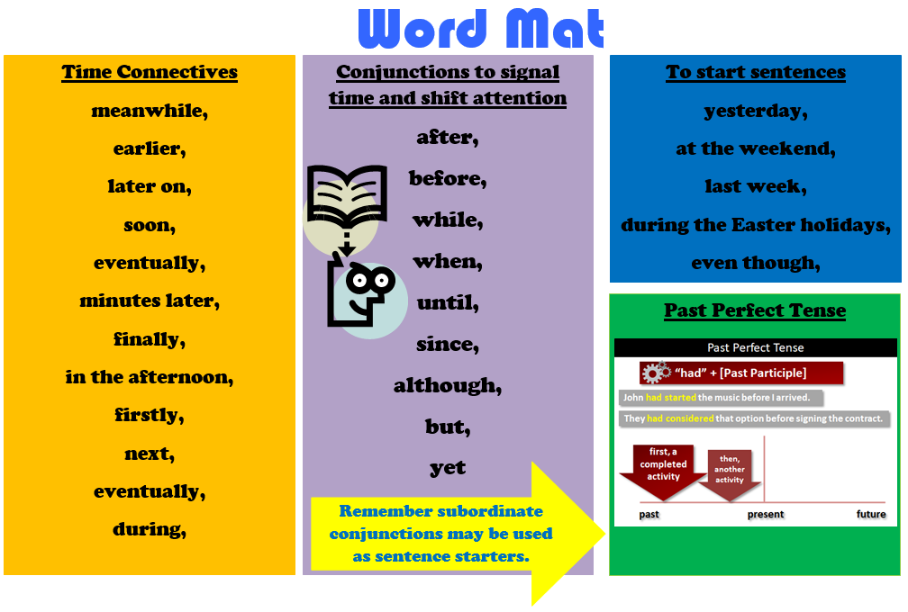
Starter
What sentences can you think of using the vocabulary from the word mat that you could use in your writing today?

Slide 31
You are going to be writing your formal recounts today for the school newsletter!
Spend some time verbally sharing your formal recount with someone in your house.
Ask your partner to help you improve your retelling, e.g. correcting you if you use contractions, encouraging you to use conjunctions to signal time or shift attention, speaking in the past perfect tense etc.
Remember to look back over your plan to help you!

Slide 32

In your writing today, I am looking for:
- conjunctions to signal time and shift attention (after, before, while, when, until, since, although, but, yet)
- past tense (past perfect tense)
- time connectives (next, later, finally)
- first person
- formal language
- paragraphs (introduction, main body, conclusion)

Slide 33
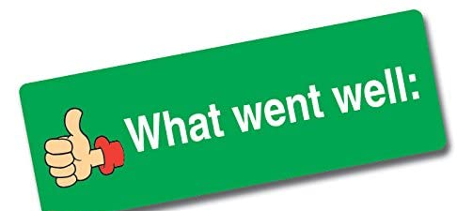

What features of formal recounts can you identify?
What words/phrases could you magpie in your writing today?
On Easter Sunday, I finally got to spend time with my family, as some of the Covid restrictions were lifted. I was able to spend an unusually, warm sunny April afternoon in my parent's garden celebrating the Easter weekend and enjoying a delicious barbeque in the company of my immediate family.
I awoke bright and early, since I was unbelievably excited to see my family after six, long months. In fact, I had got up and dressed, before the sun rose. Although the weather had been cold and cloudy in previous days, the sunlight streaming through my bright, white blinds hinted that there may be some unseasonably, warm weather on the way.
After what seemed like hours, it was finally time to leave my house in Bracknell and begin the journey to my parent’s small, welcoming home. We had just arrived, when the delightful smell of dinner filled the air and made my mouth water.
Before I arrived, my mum had hidden all of the delicious, chocolate eggs as part of an Easter Egg hunt to celebrate Easter. Unfortunately, I was not allowed to hunt for the hidden eggs, until everyone had finished their dinner. The wait for the barbeque seemed endless, but it definitely worth it! The wooden, outdoor table was completely covered in flavoursome food! In my excitement for the Easter egg hunt to begin, I had cleared my plate, before the last of the food was even cooked!
Eventually, the quest for eggs began! This year, my mum wrote clues and riddles for us, since she wanted to make it more challenging. This meant that I could not search for more eggs, until I had solved each riddle. Fortunately, I had a head start, because I had hunted surreptitiously for eggs, before the hunt officially began. My brother was not impressed, as I successfully solved all of the clues in record time! I sat and consumed nearly all of my chocolate eggs, before he had answered his first clue!
While I drove home later that evening, I could not help but smile. After six long months, I had been reunited with my family. It reminded me how important spending time with loved ones really is.

Slide 34
On Easter Sunday, I finally got to spend time with my family, as some of the Covid restrictions were lifted. I was able to spend an unusually, warm sunny April afternoon in my parent's garden celebrating the Easter weekend and enjoying a delicious barbeque in the company of my immediate family.
I awoke bright and early, since I was unbelievably excited to see my family after six, long months. In fact, I had got up and dressed, before the sun rose. Although the weather had been cold and cloudy in previous days, the sunlight streaming through my bright, white blinds hinted that there may be some unseasonably, warm weather on the way.
After what seemed like hours, it was finally time to leave my house in Bracknell and begin the journey to my parent’s small, welcoming home. We had just arrived, when the delightful smell of dinner filled the air and made my mouth water.
Before I arrived, my mum had hidden all of the delicious, chocolate eggs as part of an Easter Egg hunt to celebrate Easter. Unfortunately, I was not allowed to hunt for the hidden eggs, until everyone had finished their dinner. The wait for the barbeque seemed endless, but it definitely worth it! The wooden, outdoor table was completely covered in flavoursome food! In my excitement for the Easter egg hunt to begin, I had cleared my plate, before the last of the food was even cooked!
Eventually, the quest for eggs began! This year, my mum wrote clues and riddles for us, since she wanted to make it more challenging. This meant that I could not search for more eggs, until I had solved each riddle. Fortunately, I had a head start, because I had hunted surreptitiously for eggs, before the hunt officially began. My brother was not impressed, as I successfully solved all of the clues in record time! I sat and consumed nearly all of my chocolate eggs, before he had answered his first clue!
While I drove home later that evening, I could not help but smile. After six long months, I had been reunited with my family. It reminded me how important spending time with loved ones really is.

Slide 35
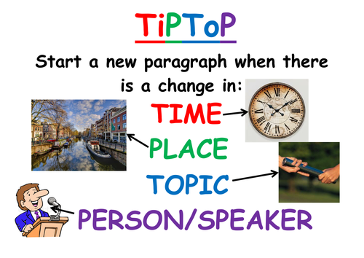
I have written my recount in paragraphs!
I have used the planning template from last lesson to help me.
See if you can write in paragraphs today!

Slide 36
Activity:
Start to write your formal recount for the newsletter.
After 15 minutes, stop and reread your work. You should red pen edit any corrections and check your work against the success criteria. Is there anything you need to improve/add when you start writing again?
Then, continue writing for another 10 minutes.
Spend 5 more minutes red pen editing your formal recount at the end of the lesson.
Red Pen: look at the formal recount success criteria. Have you included everything you need to? Is there anything you have missed that you need to include? Write a sentence or two to meet any missing points from the success criteria.

