Slide 1
Lesson 4 – Time to the half hour

Slide 2
Watch the video again to remind yourselves about how to tell the time.
https://www.bbc.co.uk/bitesize/topics/zhk82hv/articles/zcmdwxs

Slide 3
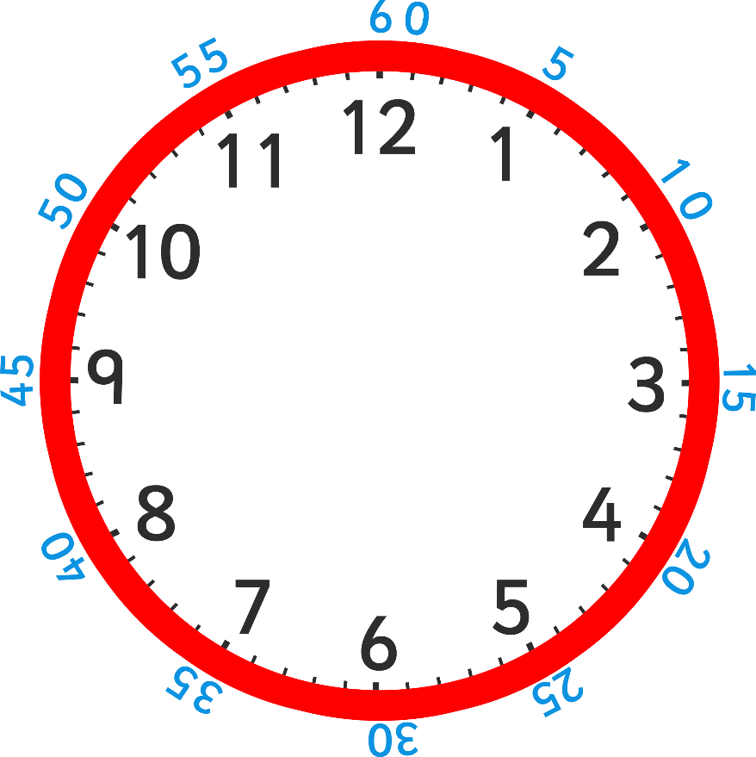
A clock face is a full circle which is made up of 2 halves.
How many minutes make up half of an hour?

Slide 4
There are 30 minutes in half of an hour.

Slide 5
When it is 30 minutes past the hour we say ‘half past’ the hour.
o’clock
half past

Slide 6
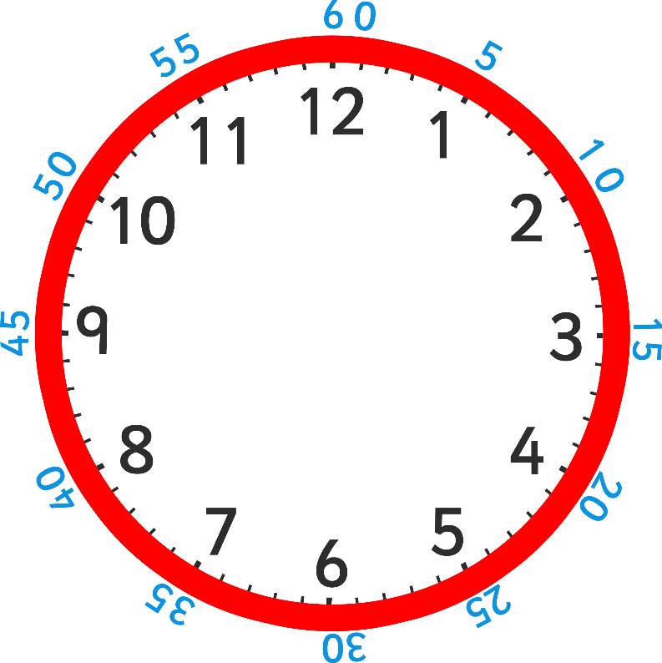
Look at this time.
The big hand is pointing at 6, which is halfway around the clock.
Where is the small hand pointing? Is it on the number?
It’s half way between 1 and 2.
half past

Slide 7
What time is this clock showing?
Where is the big hand pointing?
6
half past 11
Where is the little hand pointing?
halfway between 11 and 12
half past

Slide 8
What do you notice about the small hand?
It is halfway between 3 and 4.
What time is this clock showing?
Half past three.
half past

Slide 9
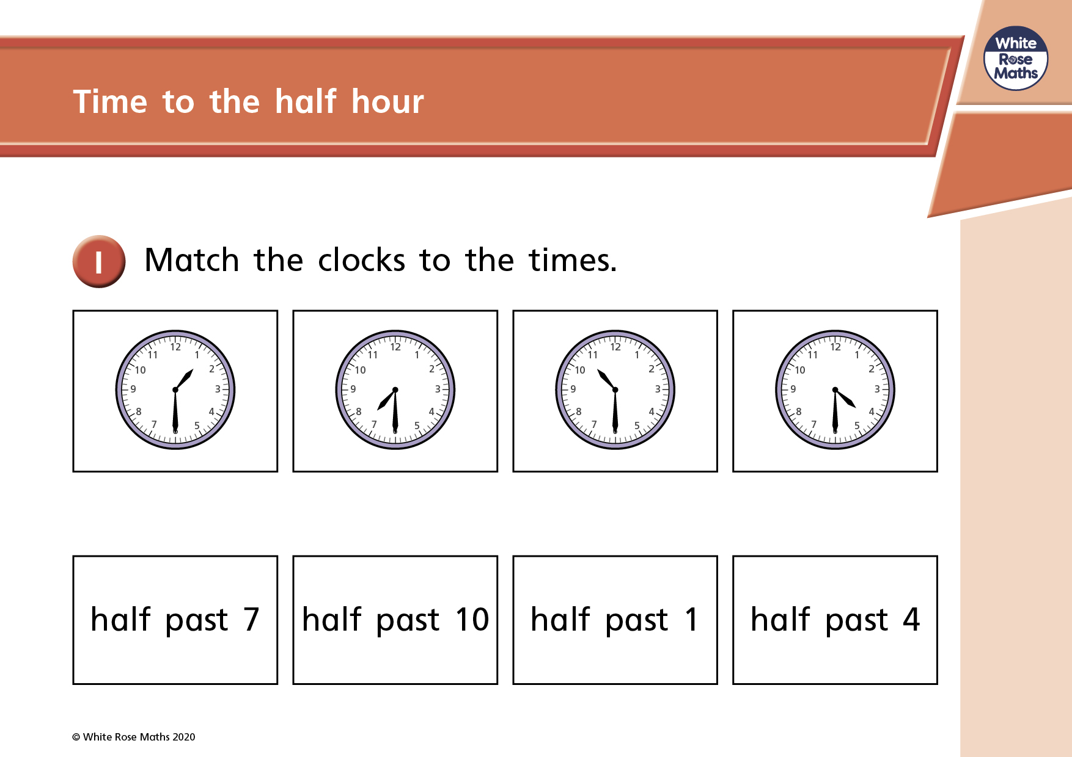

Slide 10
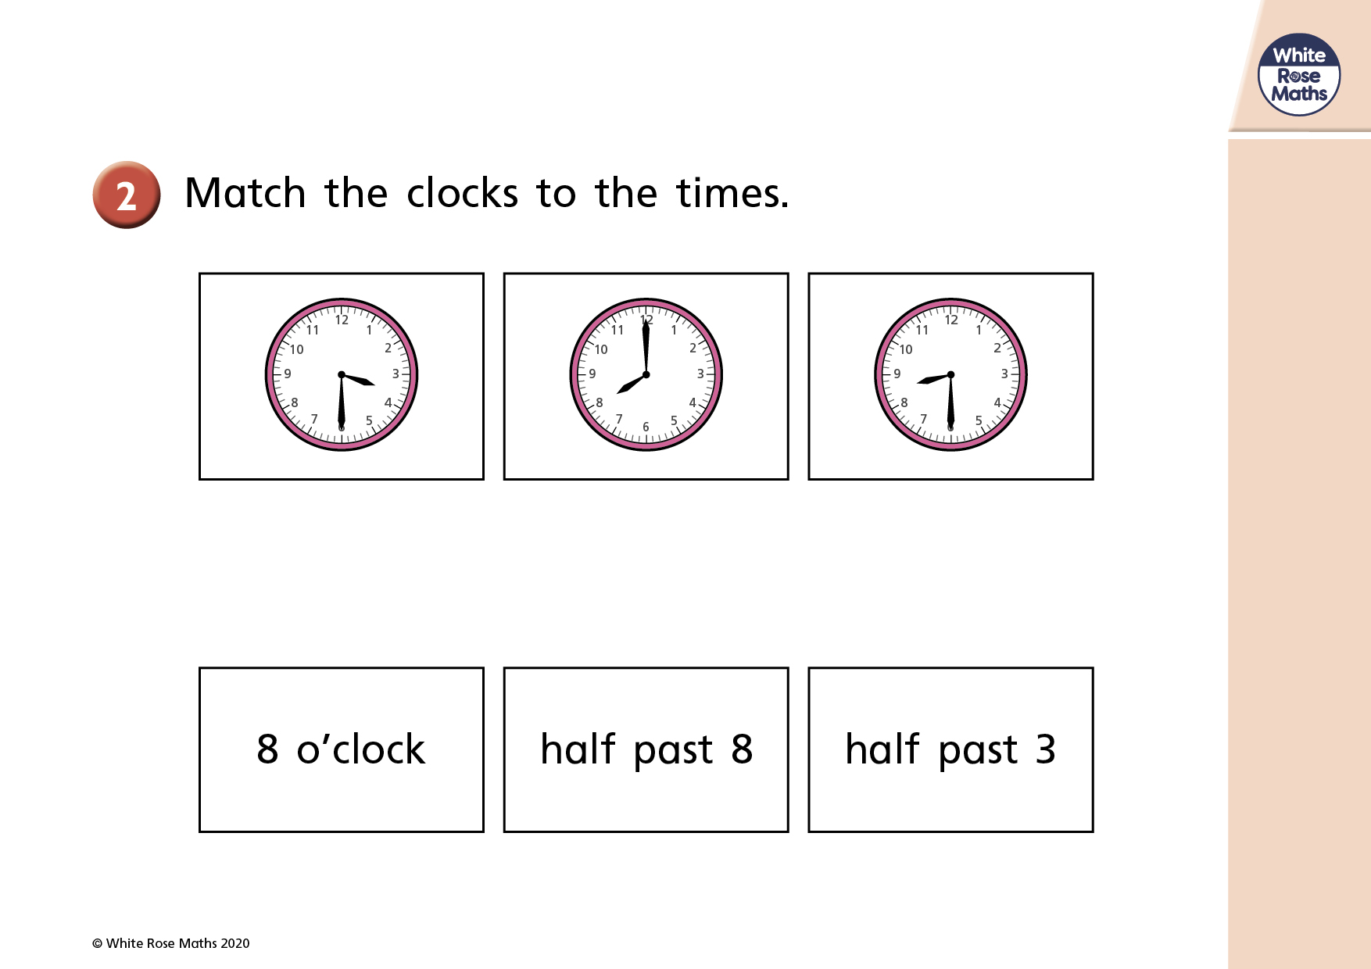

Slide 11
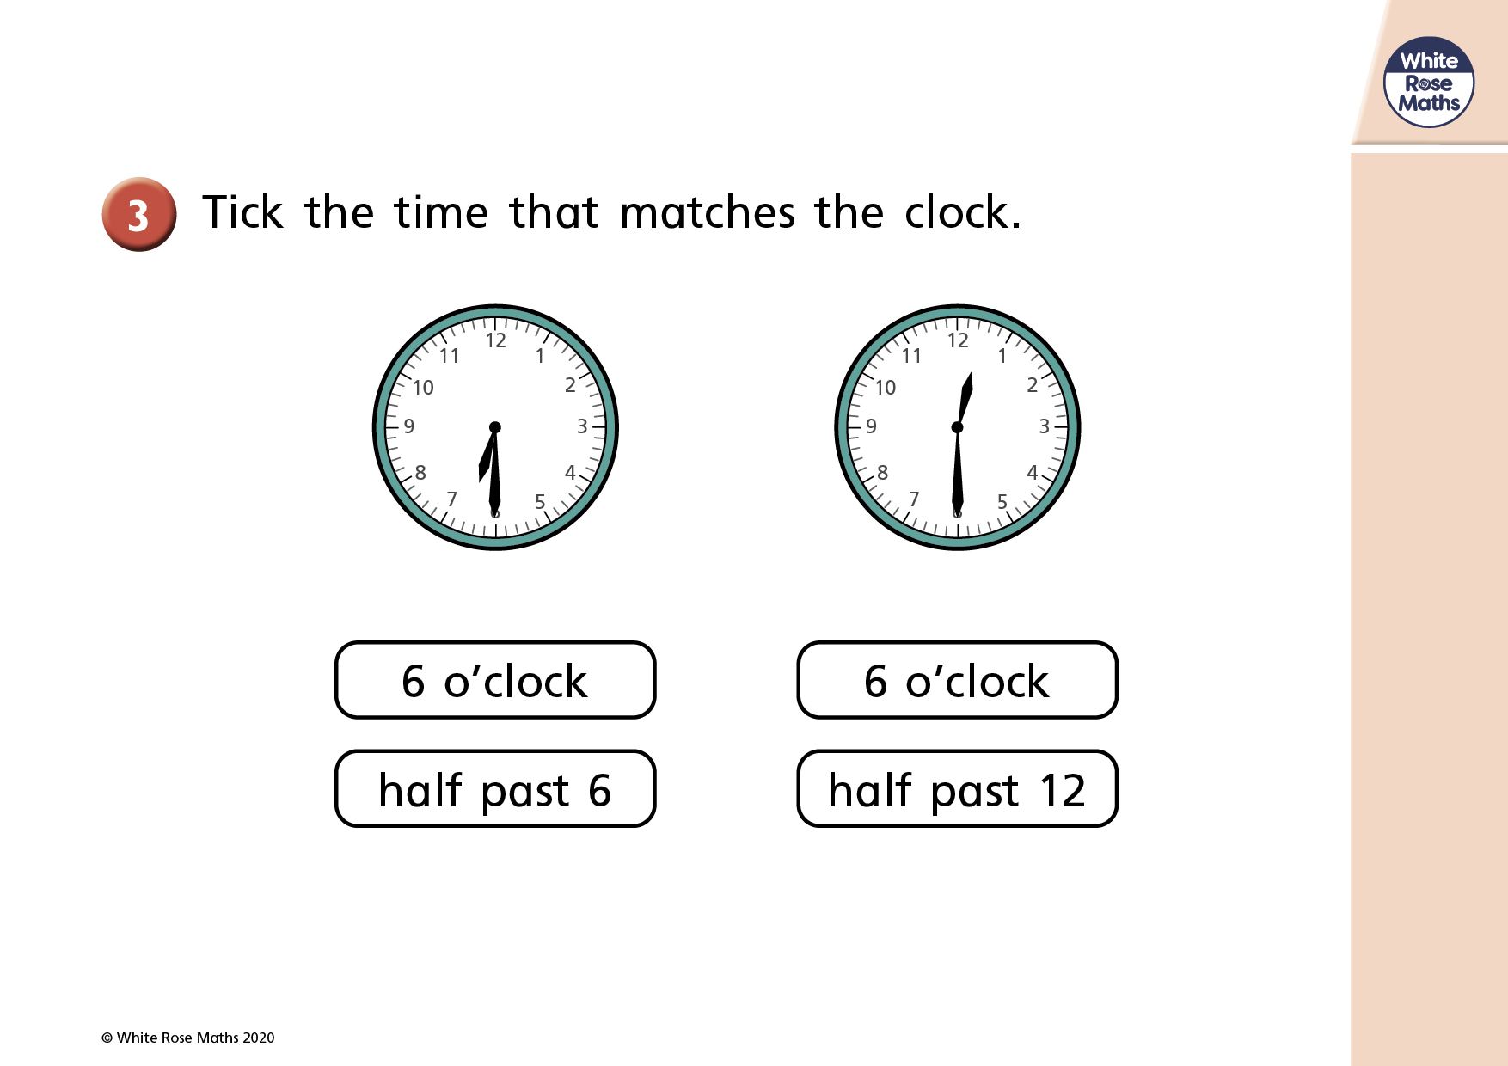

Slide 12


