Slide 1
Lesson 2 - Dates

Slide 2
Today we are looking at calendars.
Calendars are a good way to record and organise your activities!
They remind you what and when you need to do things.

Slide 3
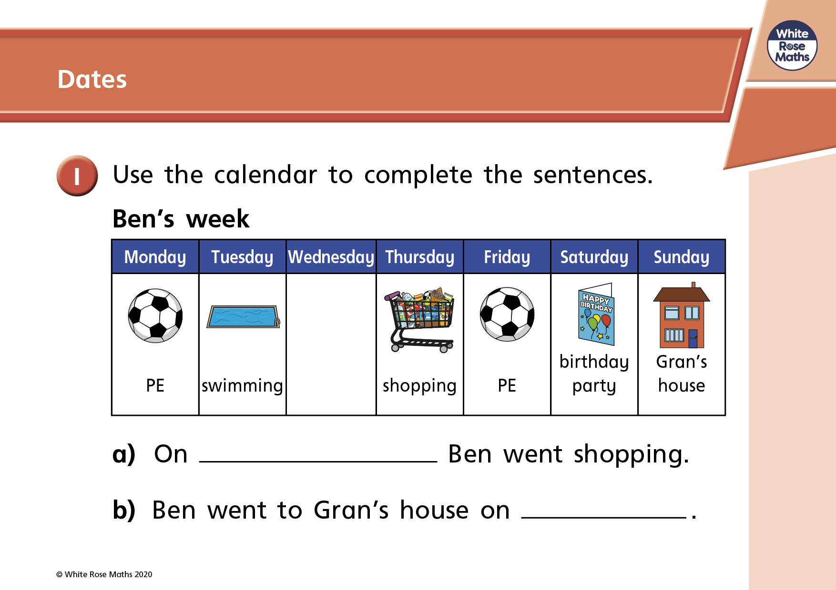

Slide 4
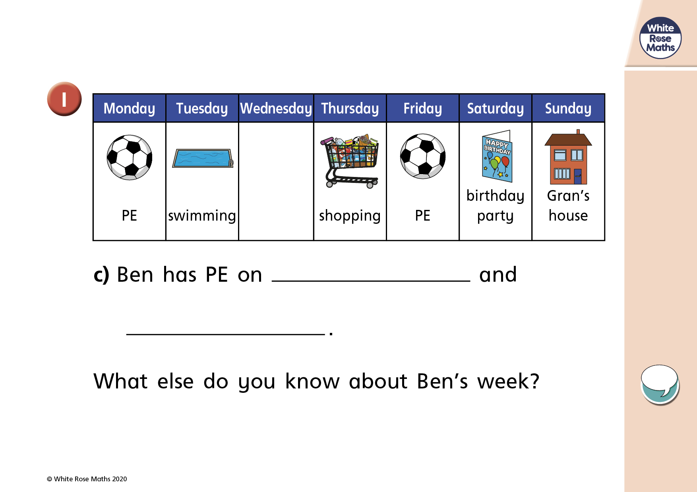

Slide 5
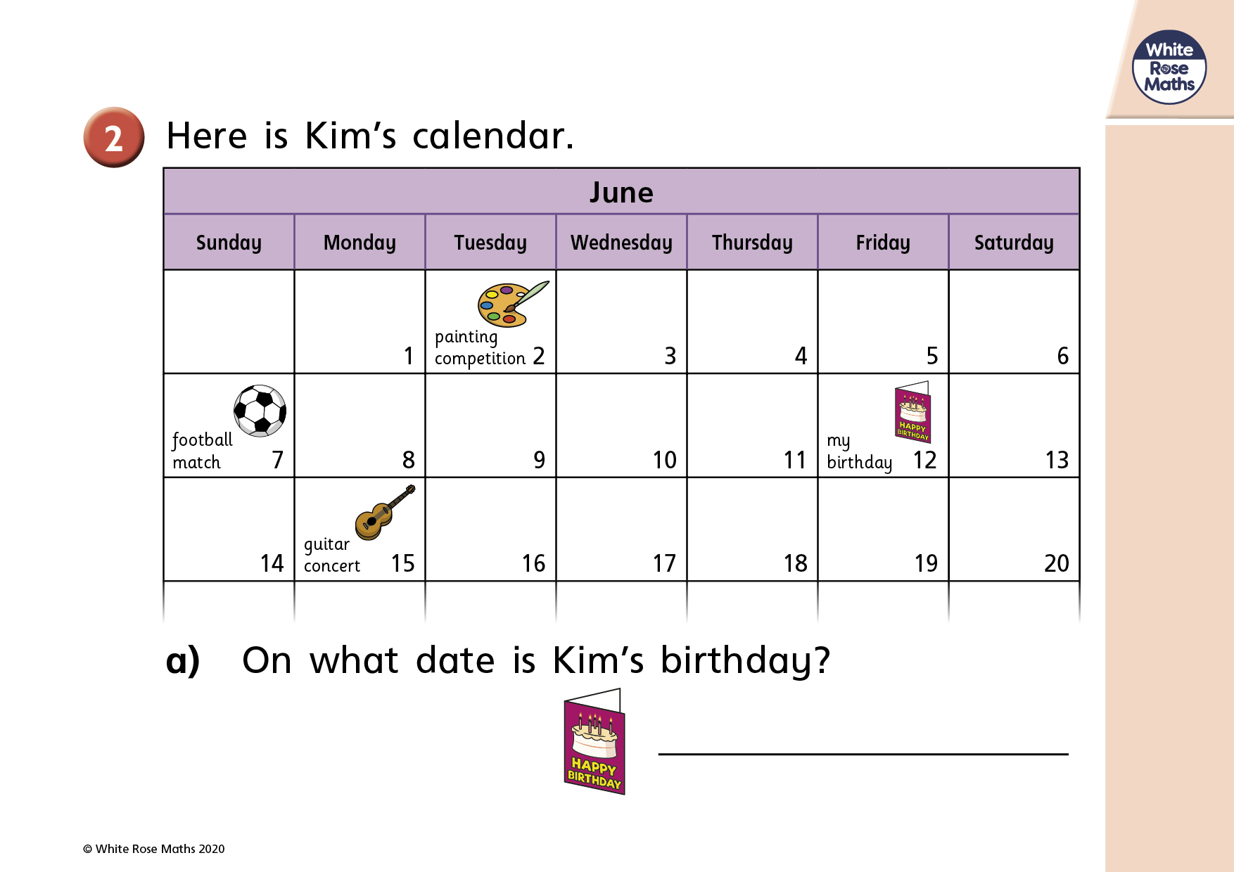

Slide 6
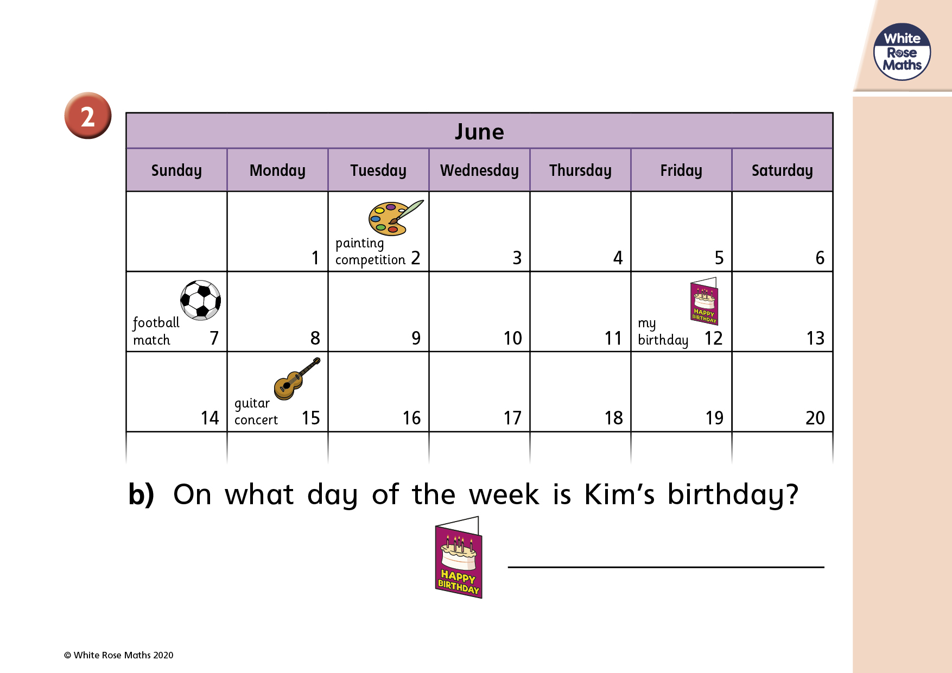

Slide 7
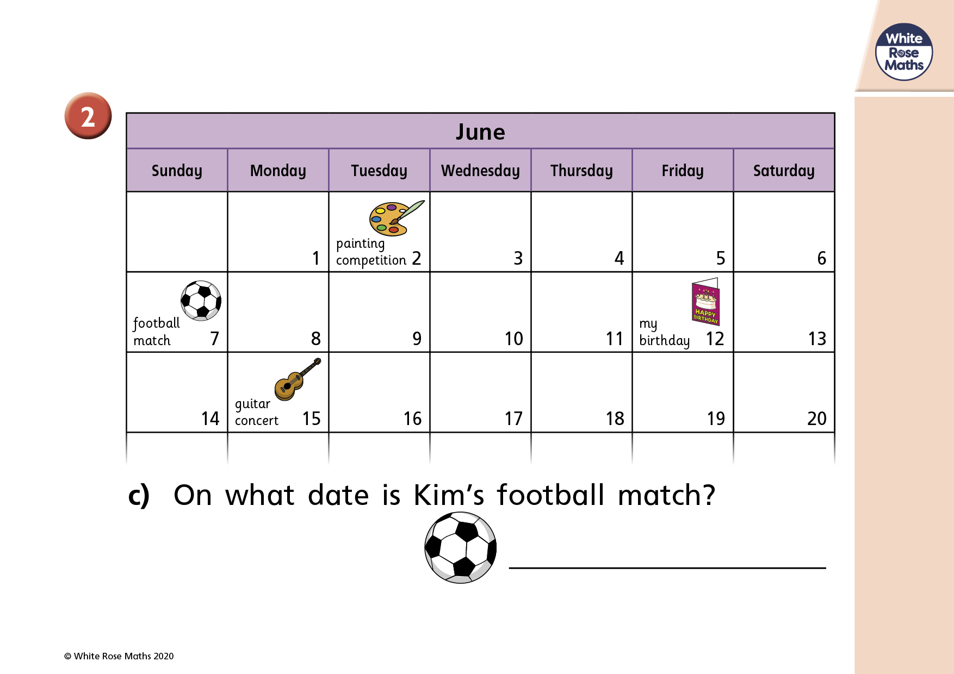

Slide 8
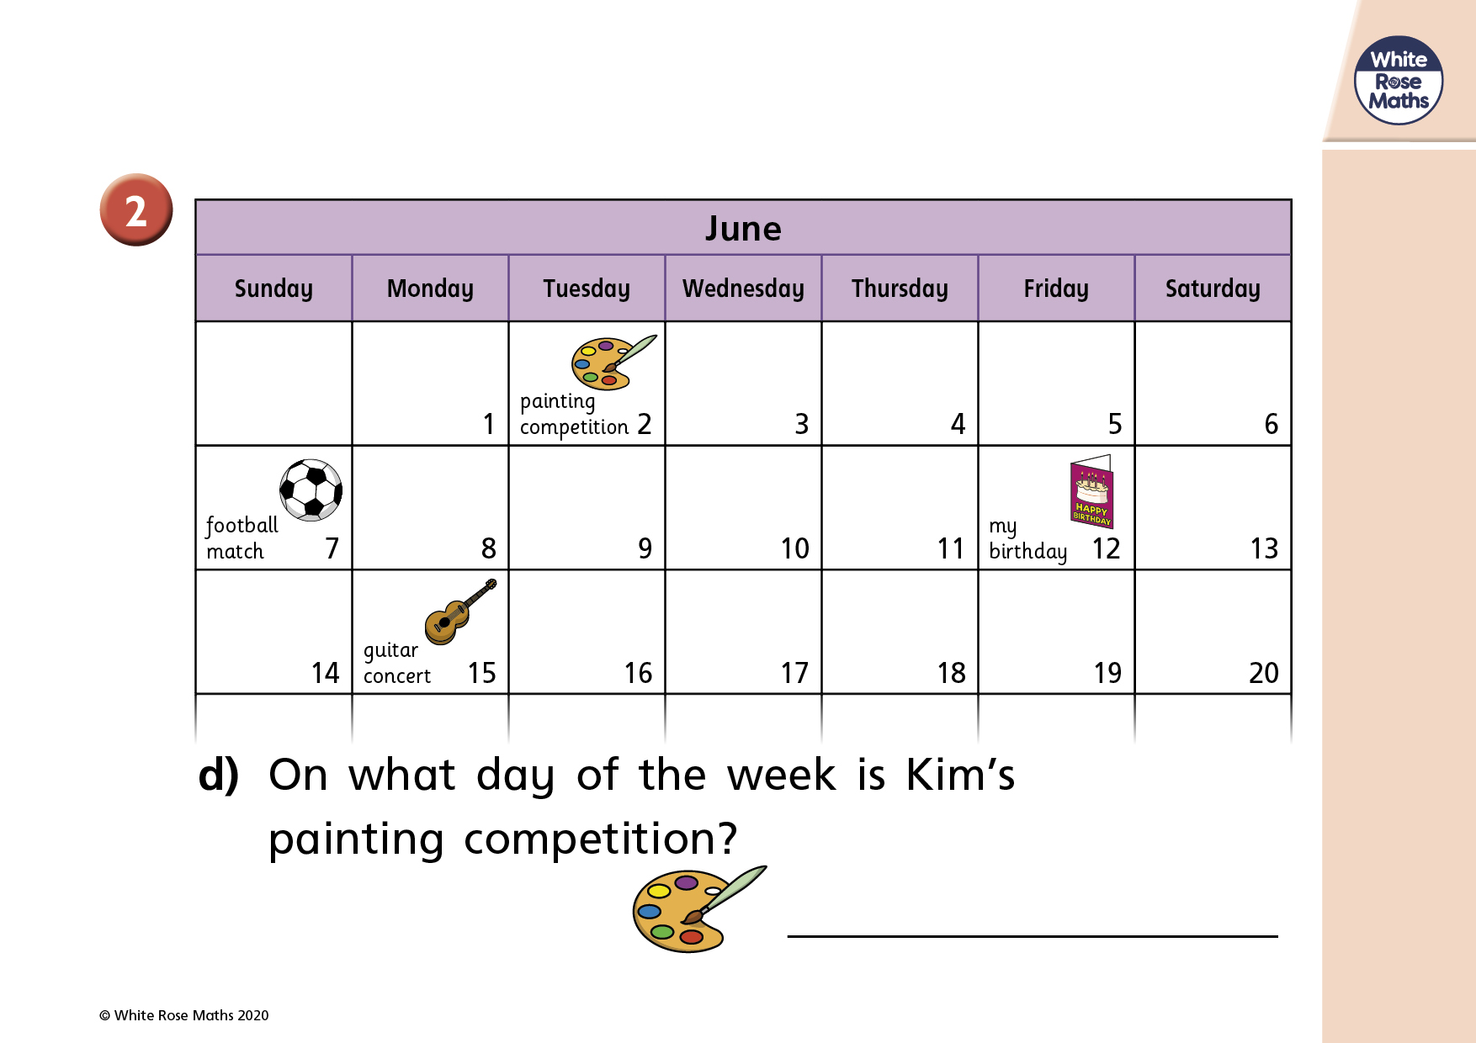

Slide 9
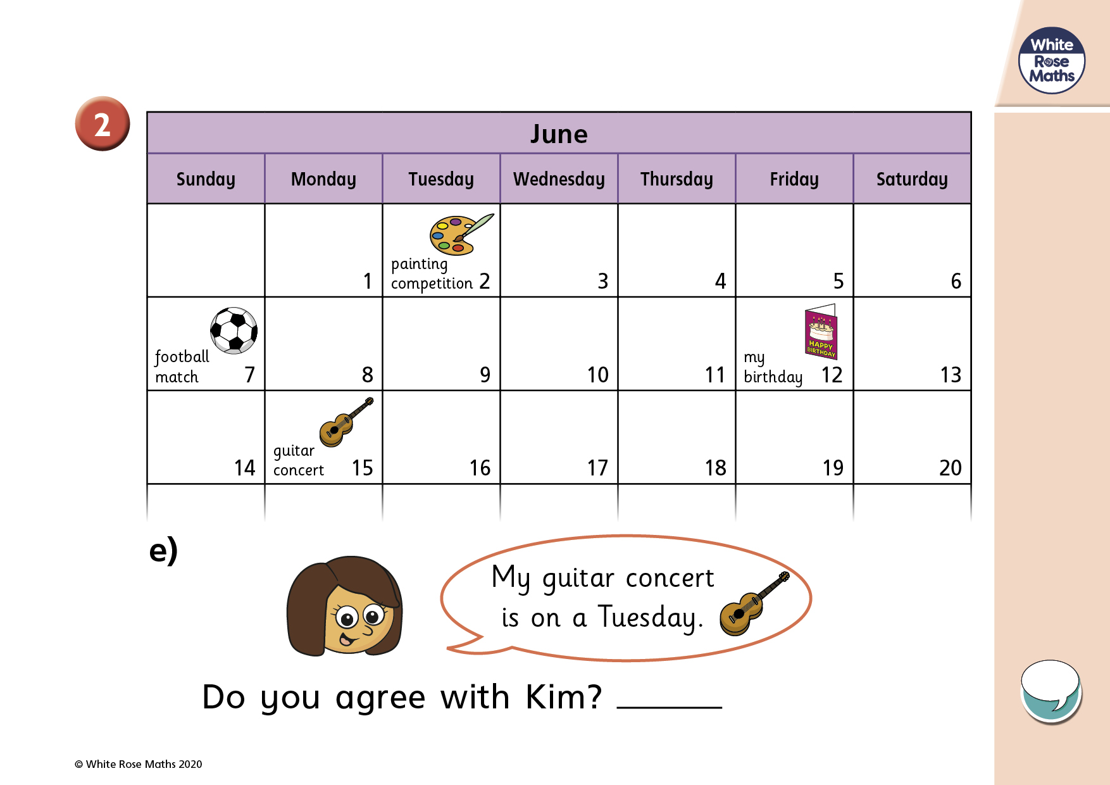

Slide 10


