Slide 1

Lesson 3 – Time to the hour

Slide 2
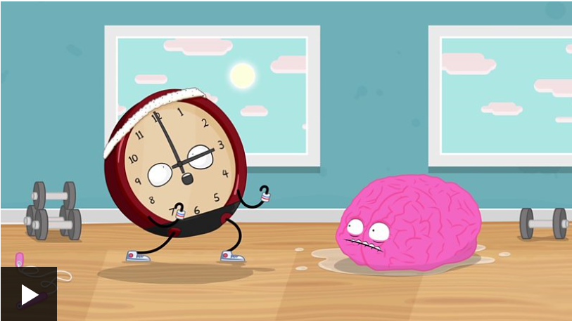
Watch the BBC bitesize clip about telling the time and then try the activity underneath.
https://www.bbc.co.uk/bitesize/topics/zhk82hv/articles/zcmdwxs

Slide 3
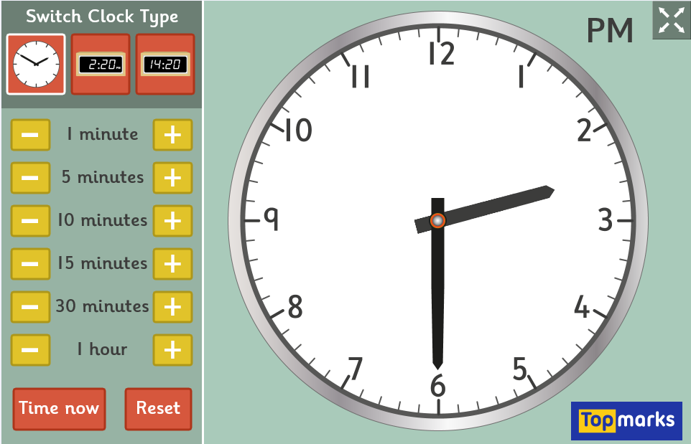
You make also like to spend some time this week exploring the interactive clock on Top Marks Maths.
https://www.topmarks.co.uk/time/teaching-clock

Slide 4
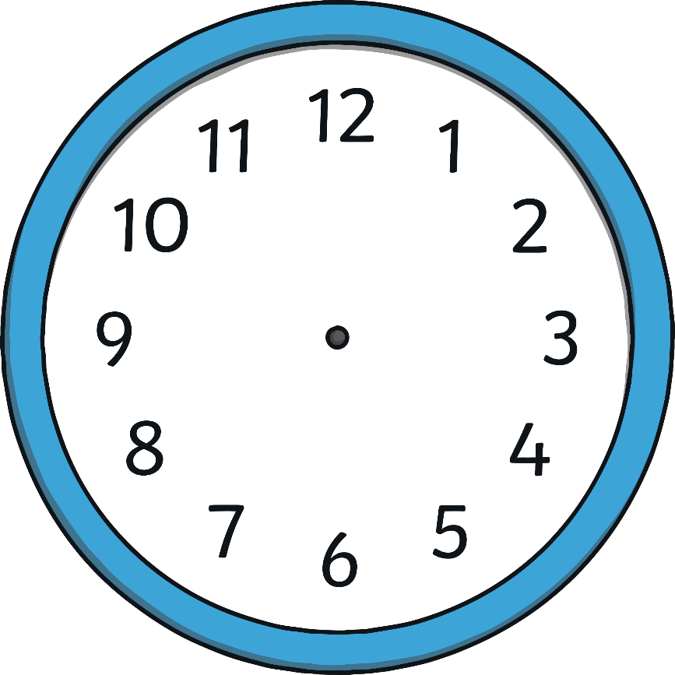
Hours and Minutes
This is the hour hand.
It is the shortest hand on the clock.
This is the minute hand.
It is longer than the hour hand.

Slide 5
Hours and Minutes
When the minute hand is pointing to 12, it is showing a full hour.
We call this time ‘o’clock’.
On this clock, the hour hand is pointing at the 8 and the minute hand is pointing to the 12.
This clock is showing that the time is 8 o’clock.

Slide 6
What Time Is It?
It is 7 o’clock.

Slide 7
What Time Is It?
It is 3 o’clock.

Slide 8
What Time Is It?
It is 11 o’clock.

Slide 9
What Time Is It?
It is 6 o’clock.

Slide 10
What Time Is It?
It is 9 o’clock.

Slide 11
What Time Is It?
It is 12 o’clock.

Slide 12
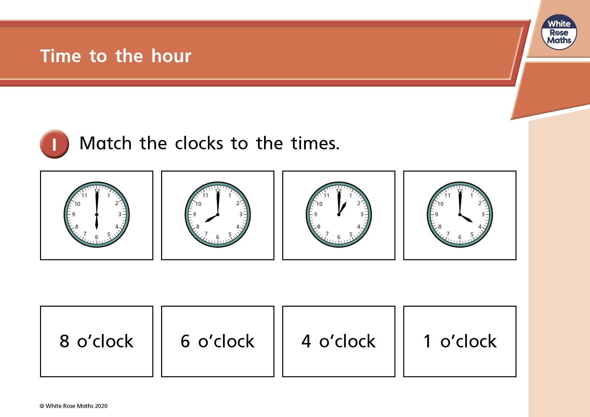

Slide 13
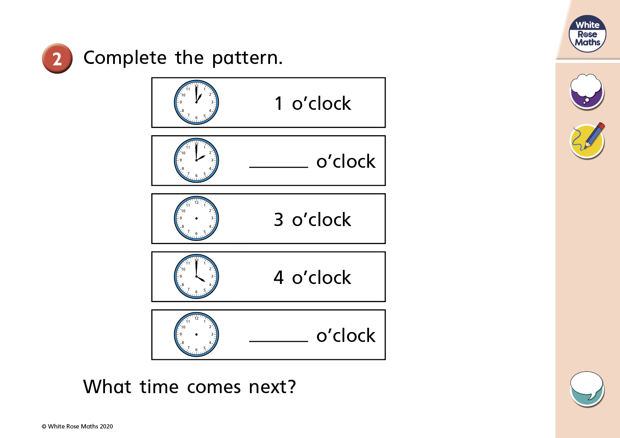

Slide 14
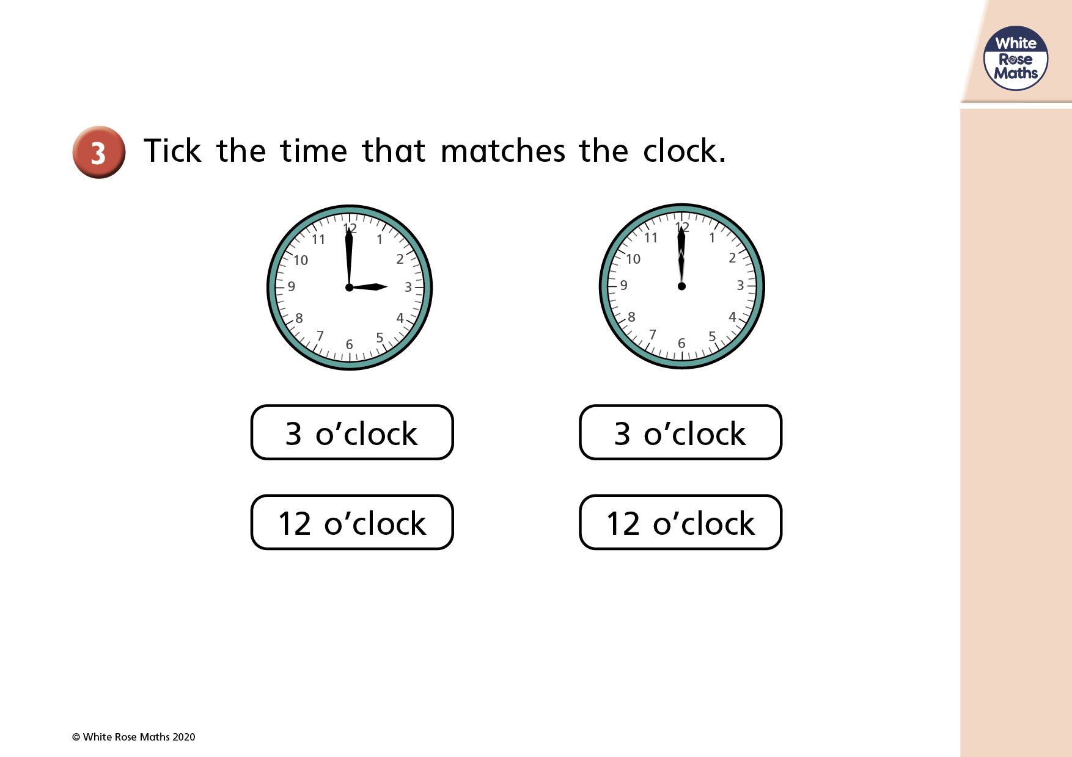

Slide 15
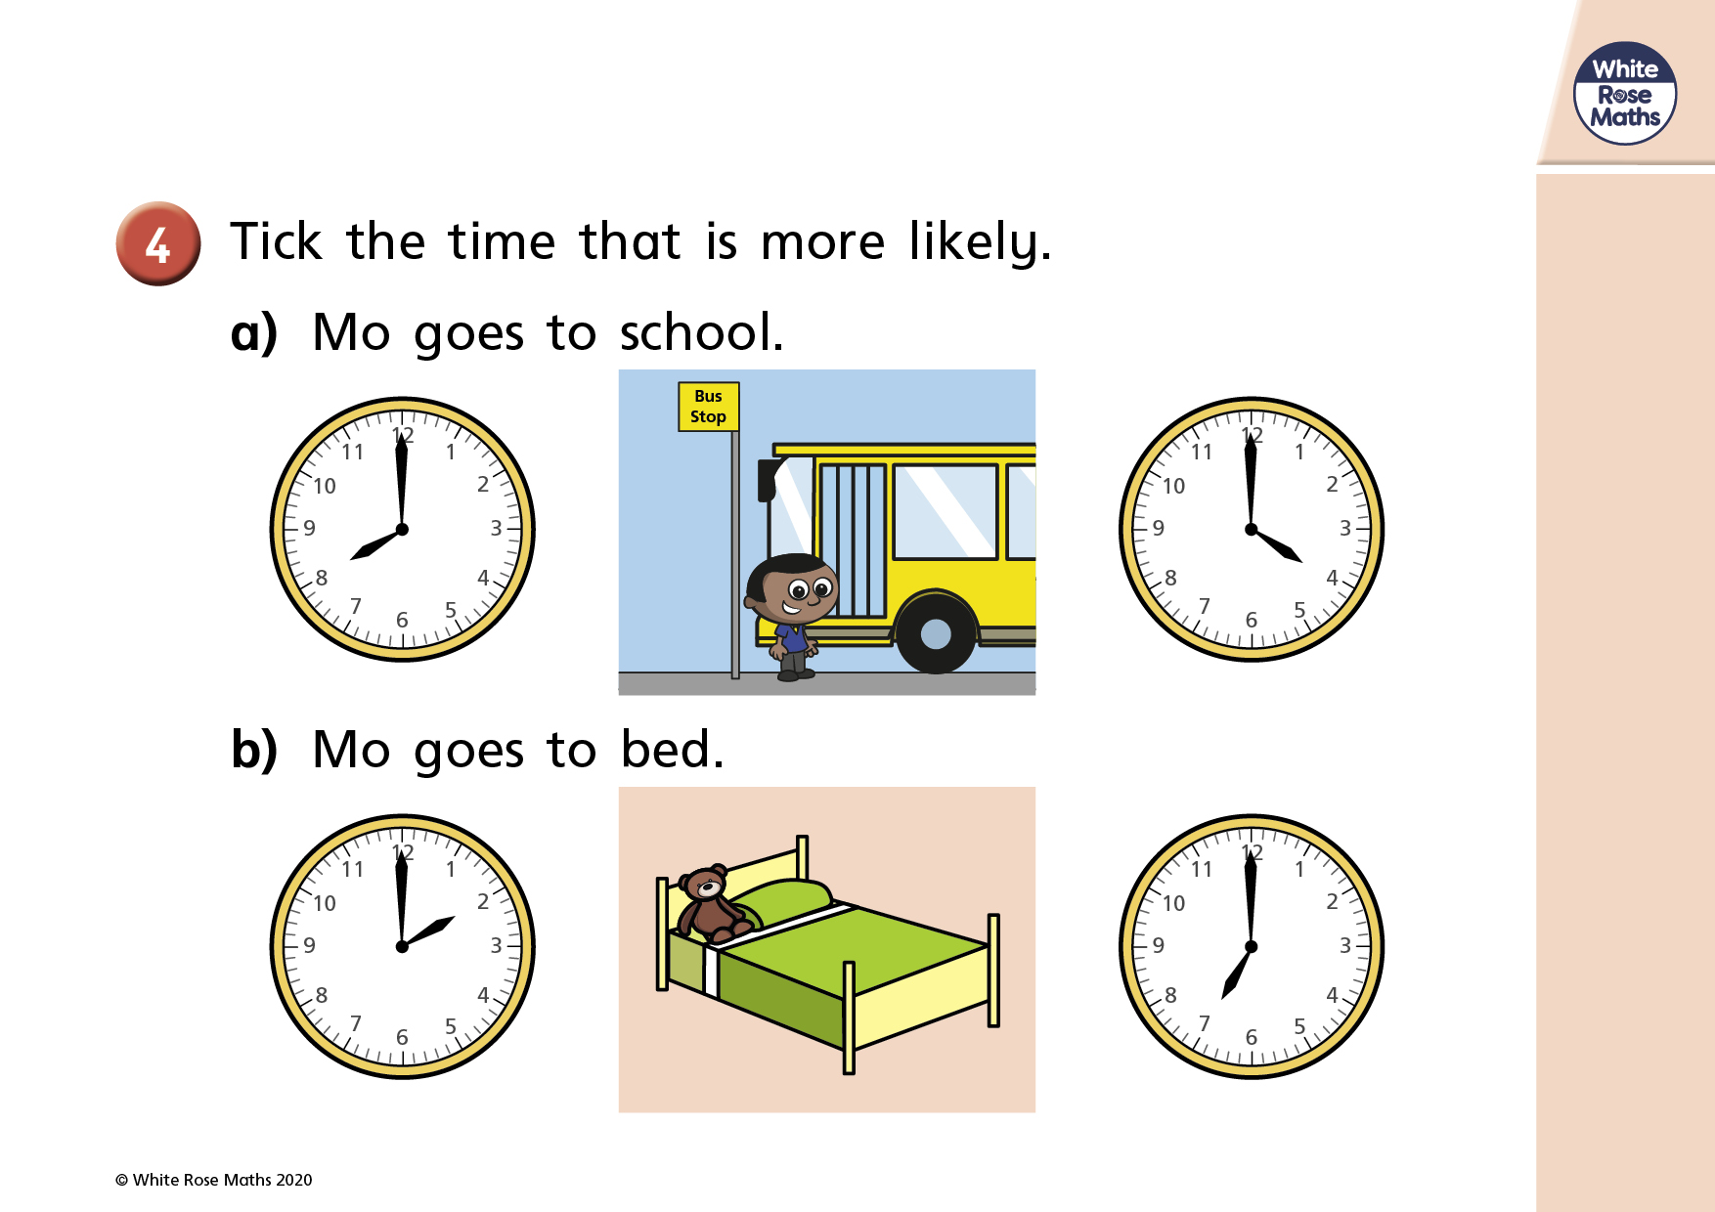

Slide 16


