Slide 1

Lesson 1 – Before and After.

Slide 2
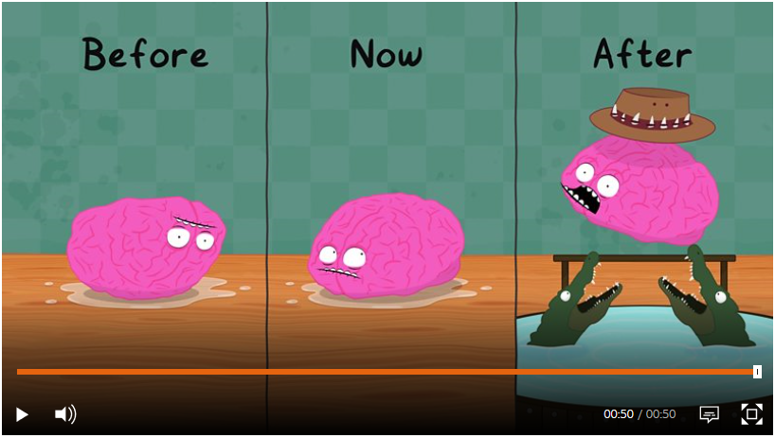
Watch the video on chronological order on BBC bitesize and then try the activity underneath it.
https://www.bbc.co.uk/bitesize/topics/zhk82hv/articles/zydsb82

Slide 3
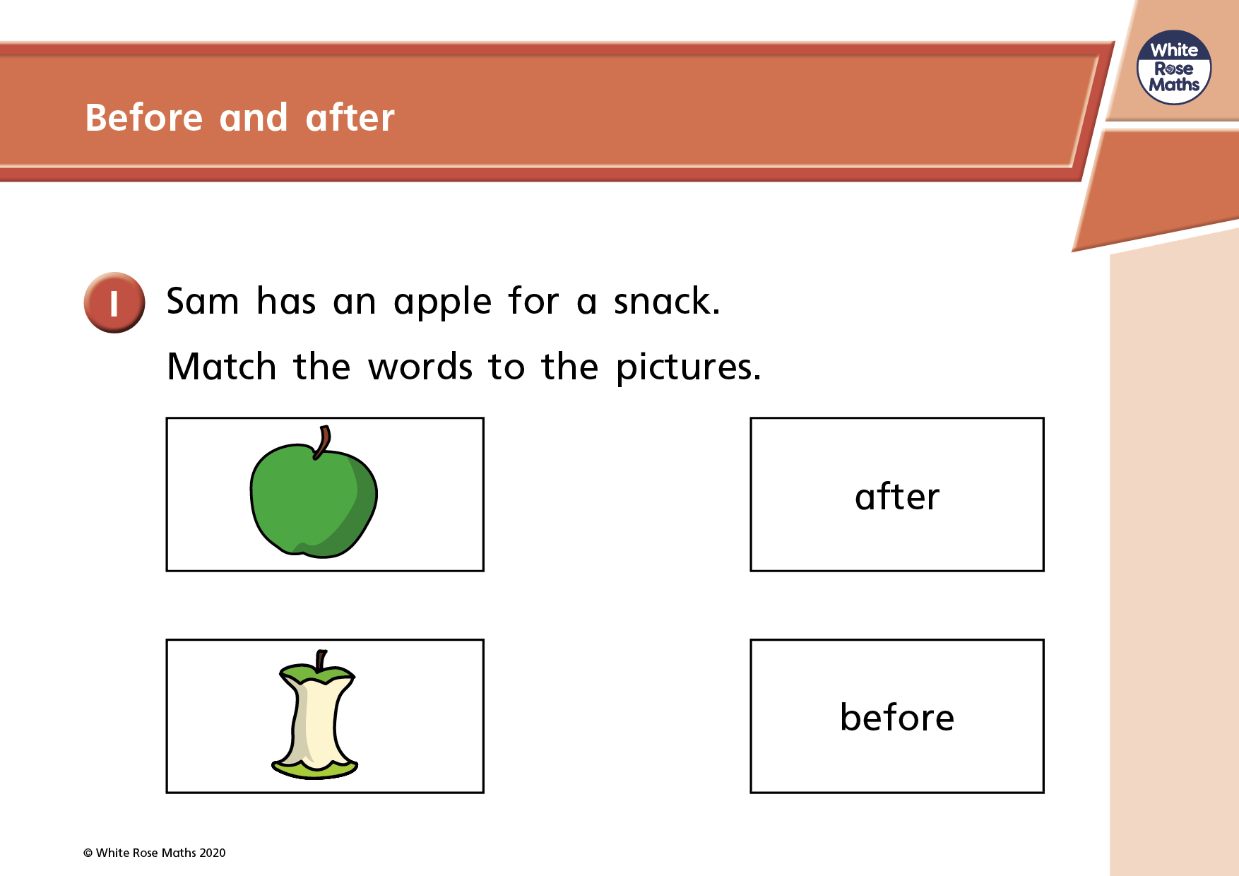

Slide 4
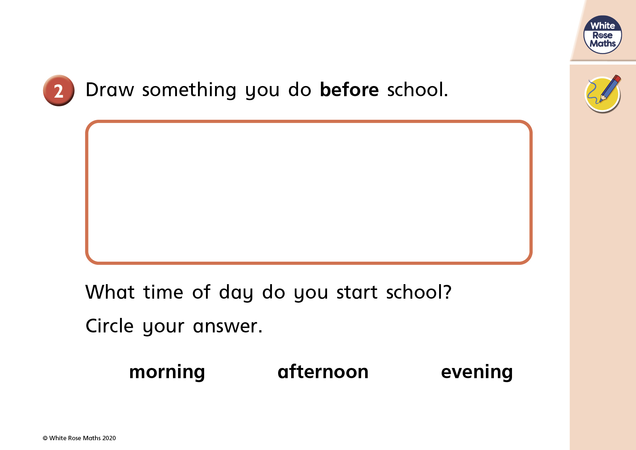

Slide 5
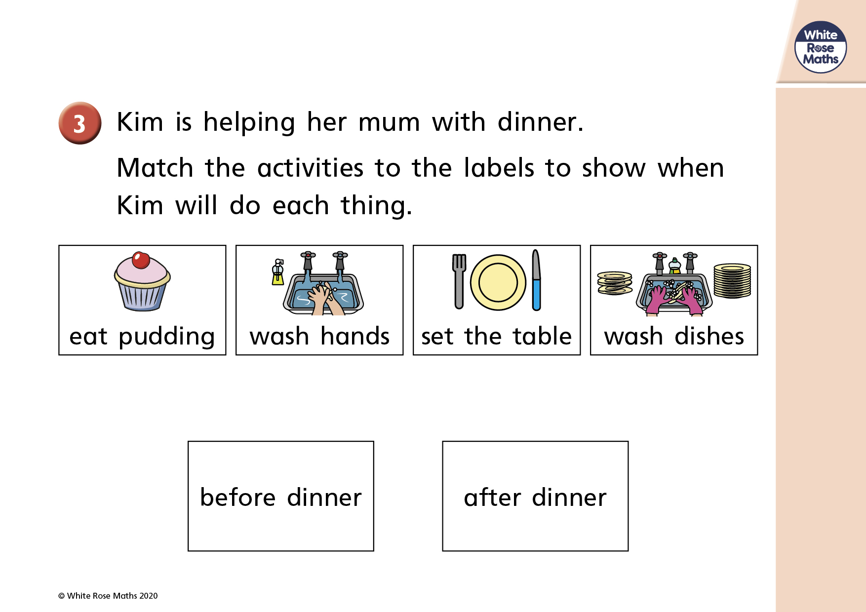

Slide 6
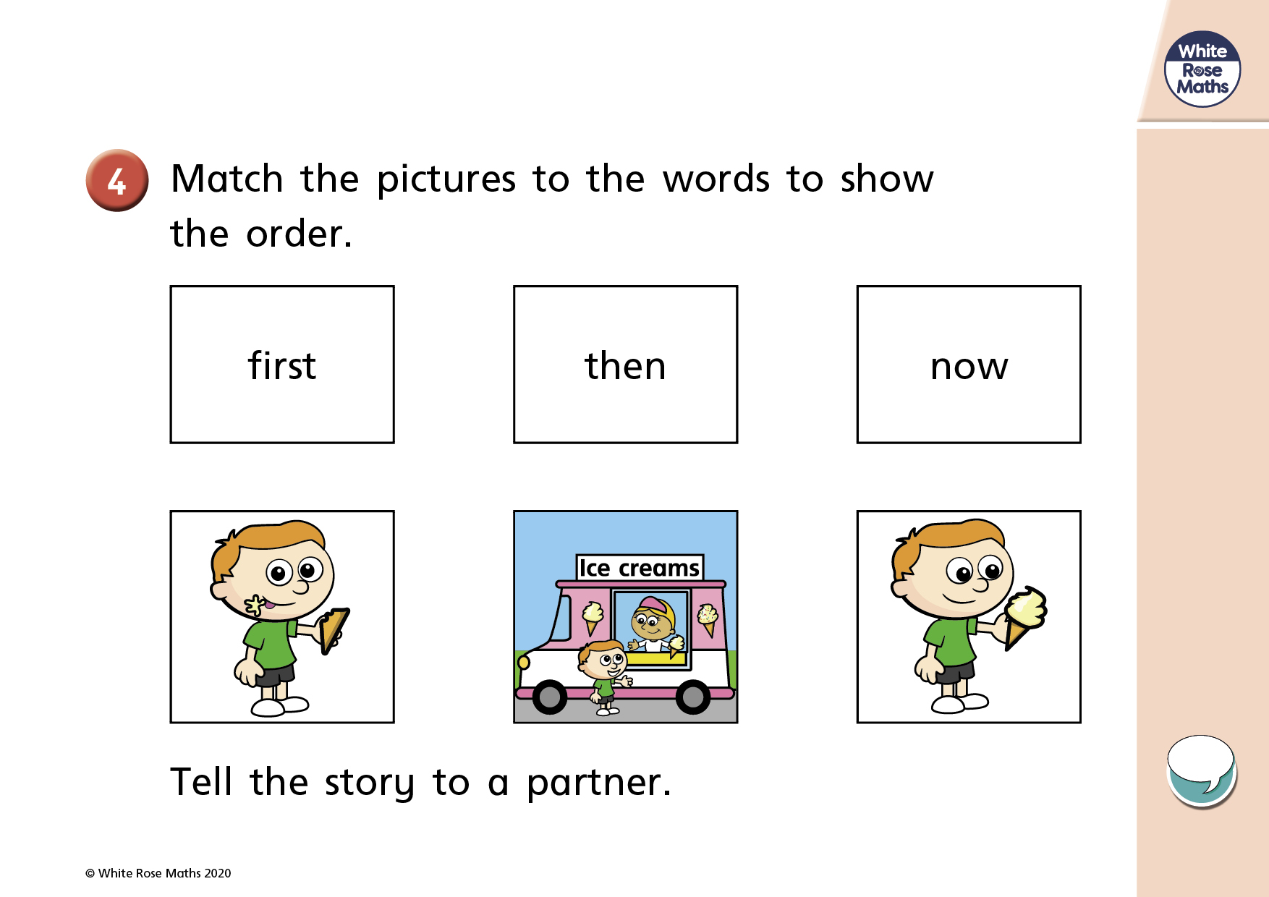

Slide 7


