Slide 1

Year 1 PSHE
Who can help me in my school community?

Slide 2
Talk with someone in your household/class about something that somebody has helped you with this week that you couldn’t have done by yourself.
Who are the people who have special jobs that help us in our school community?
Can we think of anyone else that helps us?
Does everyone help us in the same way?

Slide 3
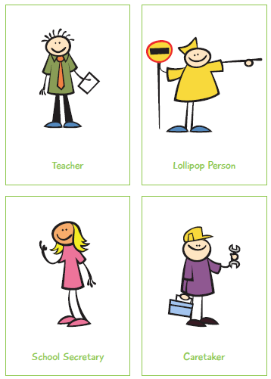
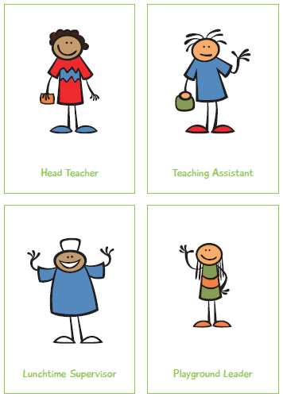
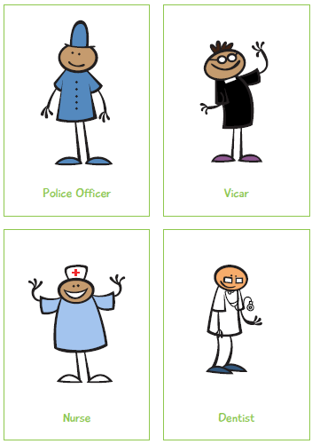
Task 1: Sort the people in the cards into two groups. People who might help you in school and people who might help you outside of school.

Slide 4
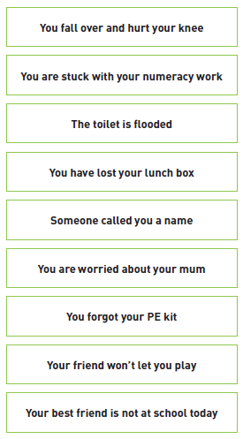
Task 2: Look at these different scenario cards.
Which people in your school community might help you with these problems?
How would you ask them for help?
Discuss each scenario and who would help you OR role play each scenario with a partner.

