Slide 1

Thursday 18th June 2020
One more, one less.

Slide 2
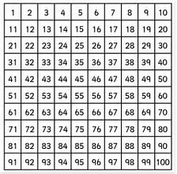

Look carefully at the number line and the 100 square.
What is one more than 5?
One less than 10?
One more than 19?
One less that 25?

Slide 3
Look carefully at the 100 square.
What is one more than 56?
One less than 100?
One more than 89?
One less that 44?

Slide 4
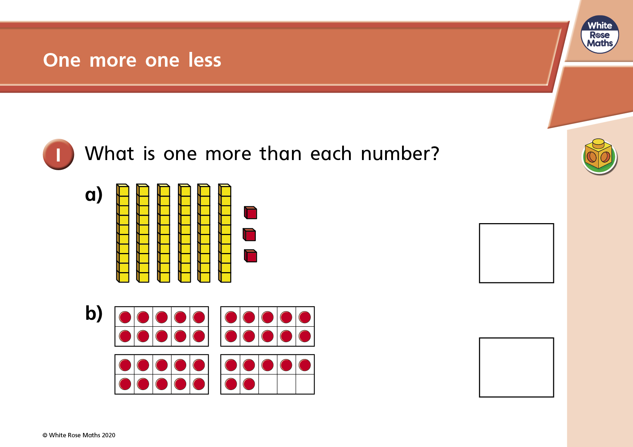

Slide 5
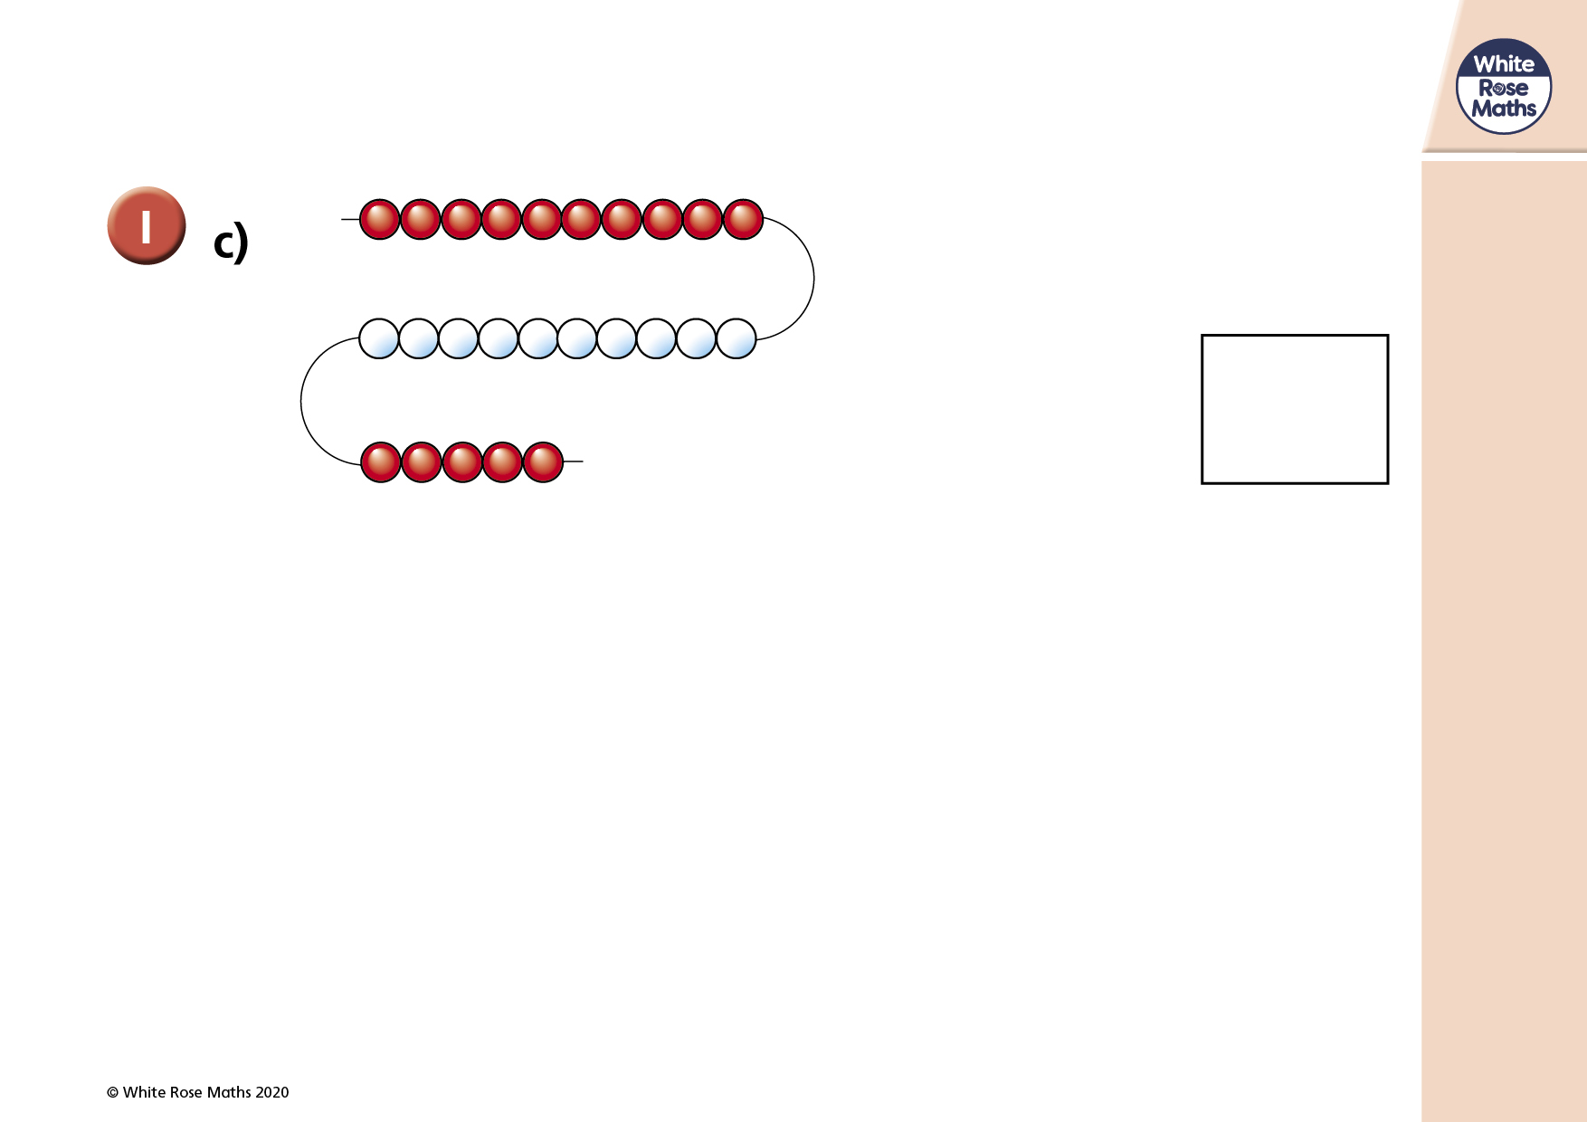

Slide 6
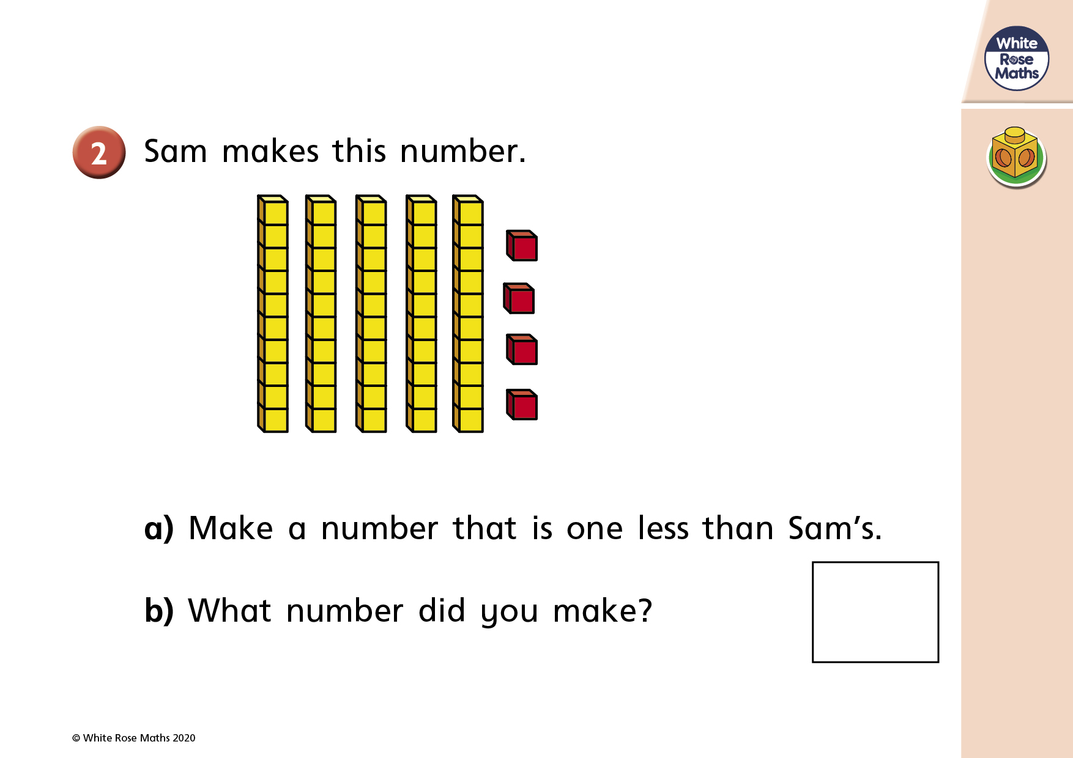

Slide 7
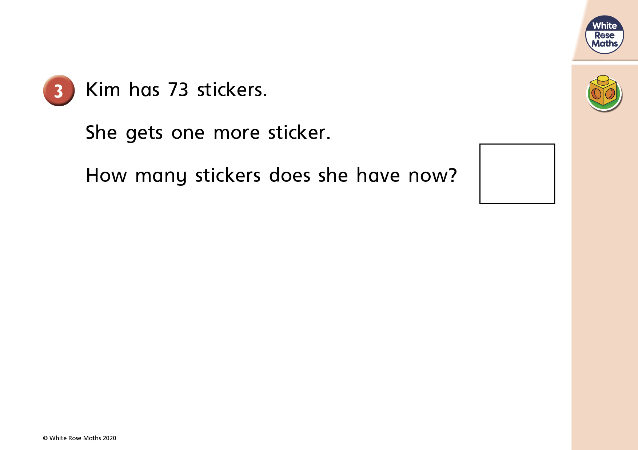

Slide 8
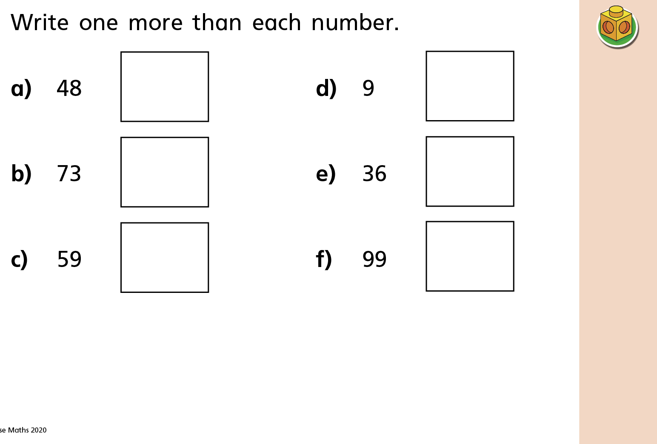

Slide 9
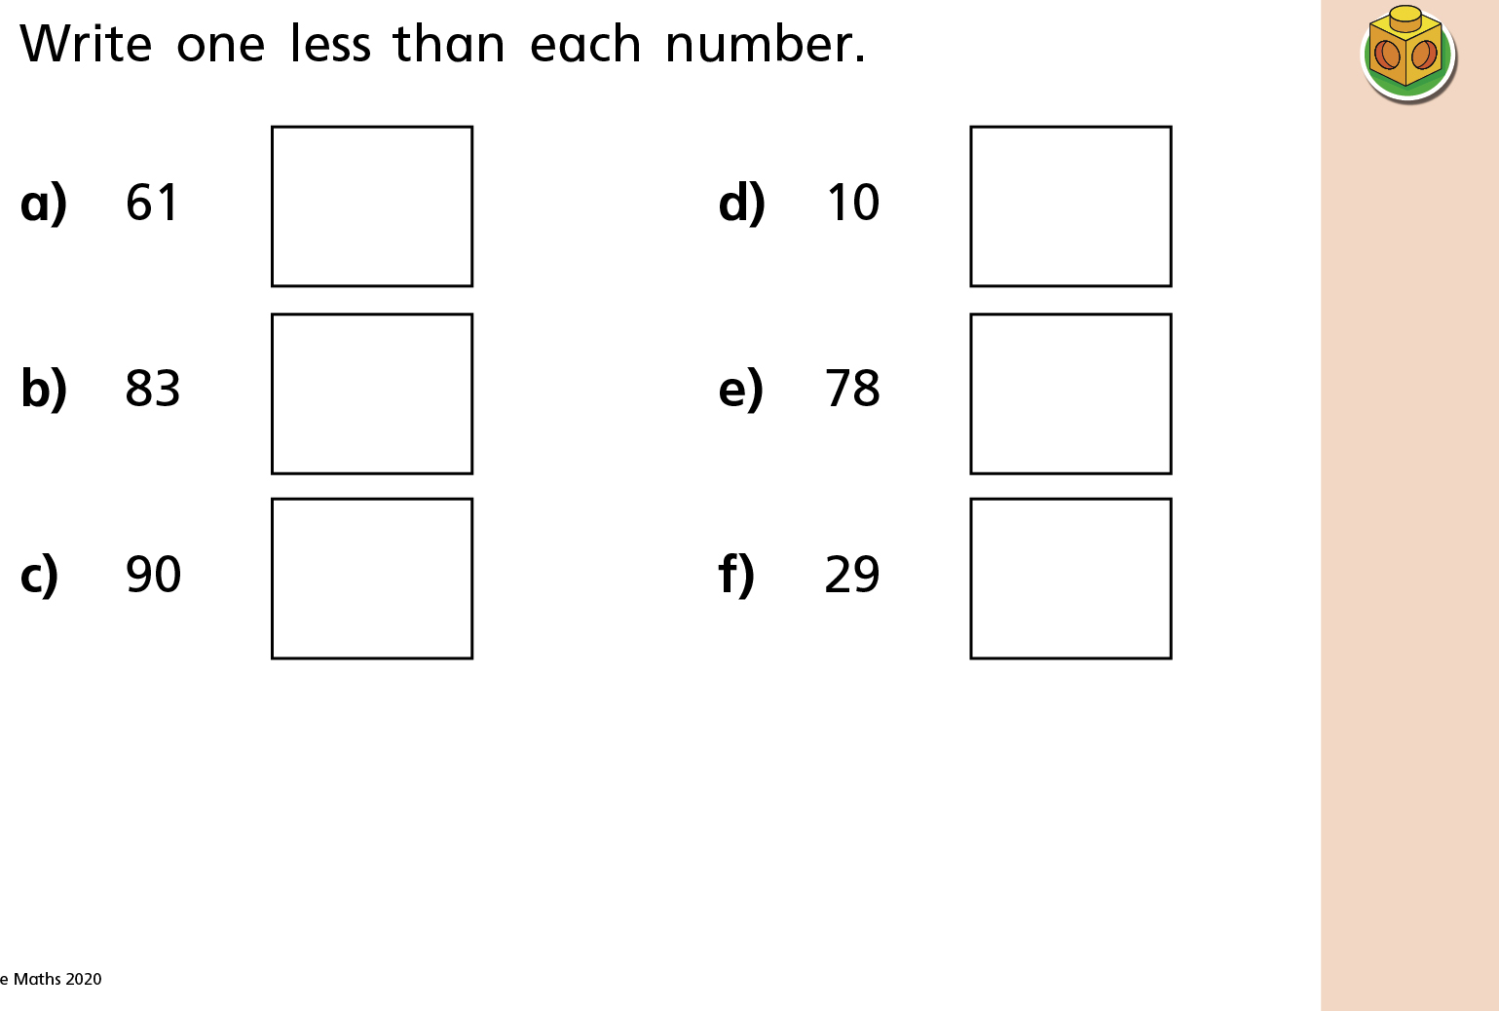

Slide 10


