Slide 1

Tuesday 16th June 2020

Slide 2
Warm up: Hollabaloo!
Comparing numbers up to 100 using less than, greater than and equal to symbols.
Re-cap with Blazer Fresh (and Hot Dog ☺) to remind yourselves about greater than and less than.
Follow the link below:
https://www.youtube.com/watch?v=-Ldz0POzBoU

Slide 3

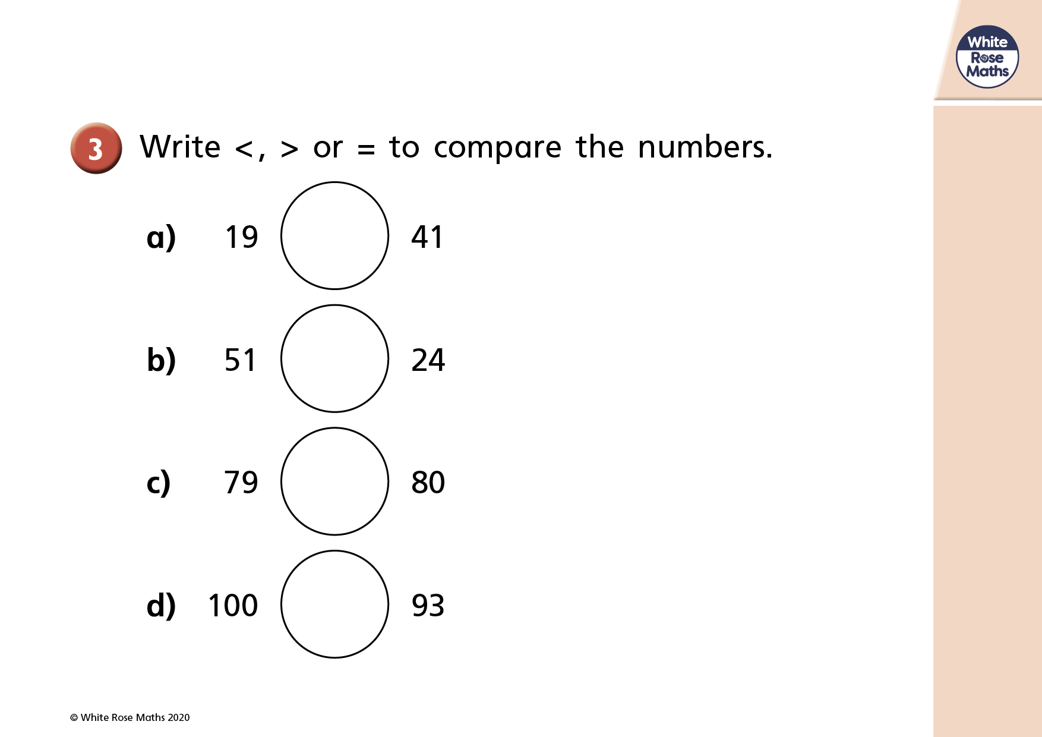
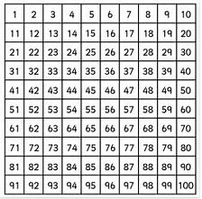
Base 10 resources have been provided on the bottom slide if you would like to use them to help you work out the answers to these questions. You can also use the 100 square.

Slide 4
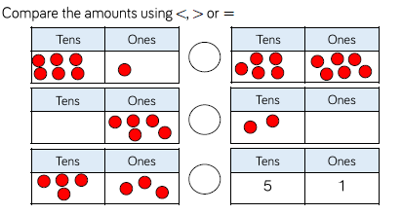
What numbers are being represented by the counters?
Write the numbers in numerals, then compare them using the <> or = symbols.
>
61
56

Slide 5
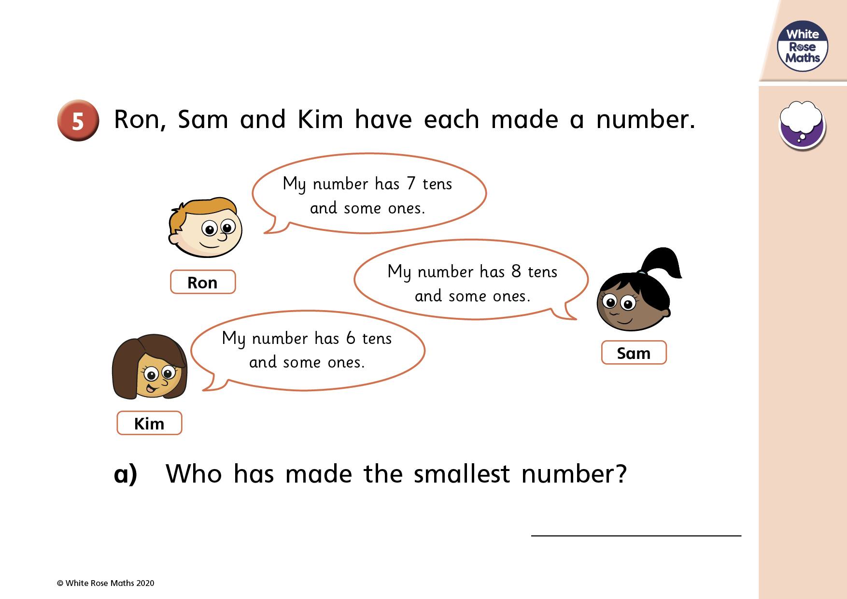


Slide 6
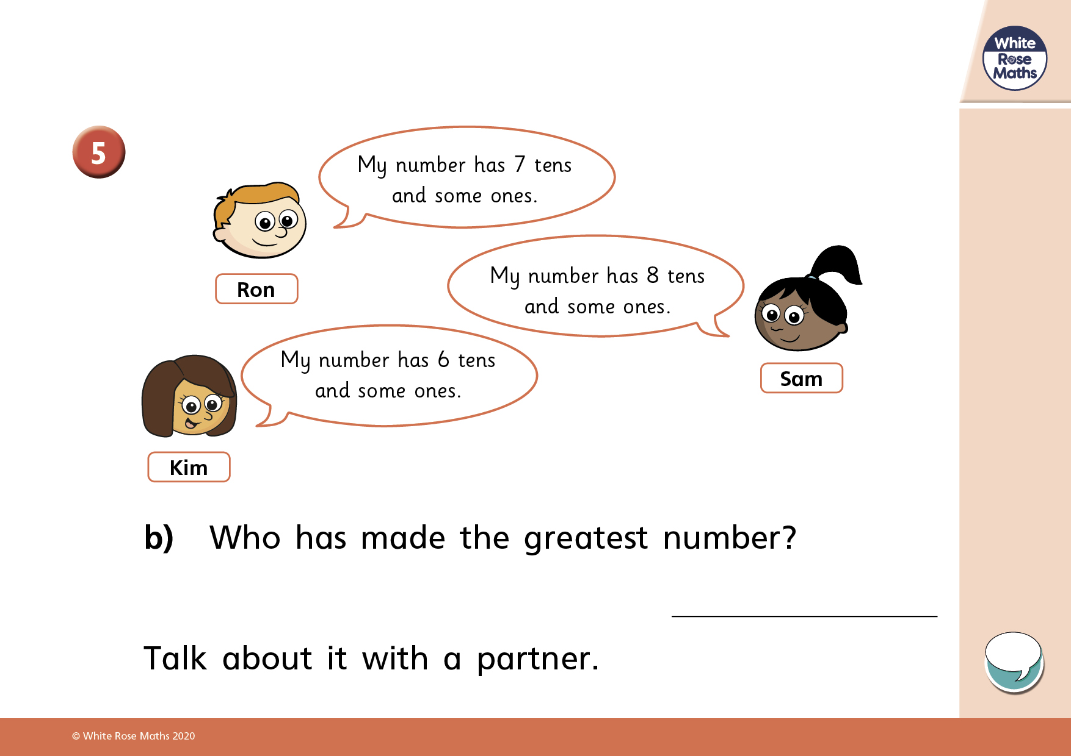

Slide 7


