Slide 1

Monday 15th June 2020
Comparing numbers to 100

Slide 2



Slide 3
Lets use the base 10 to help us work out which of these numbers is greater
Tens | Ones
1 | 5
Tens | Ones
2 | 1

Slide 4
Lets use the base 10 to help us work out which of these numbers is greater
Tens | Ones
3 | 7
Tens | Ones
4 | 2

Slide 5
Lets use the base 10 to help us work out which of these numbers is greater
Tens | Ones
5 | 4
Tens | Ones
4 | 5

Slide 6
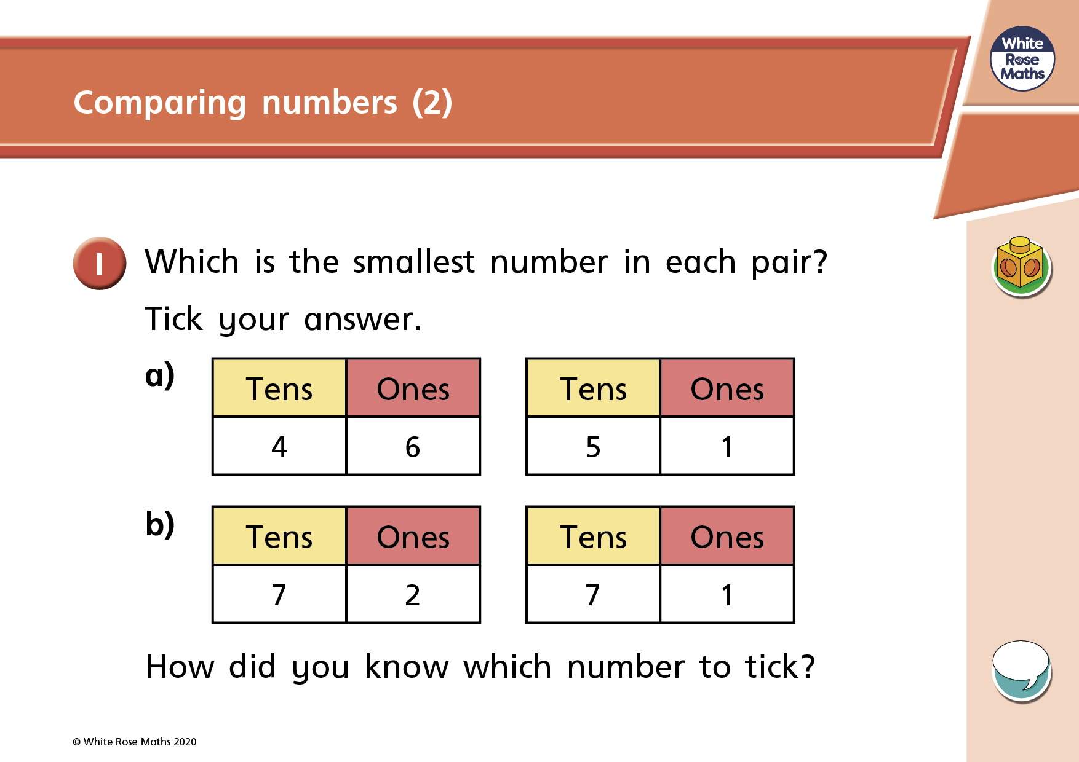
Remember you can use Base 10 to help you.

Slide 7
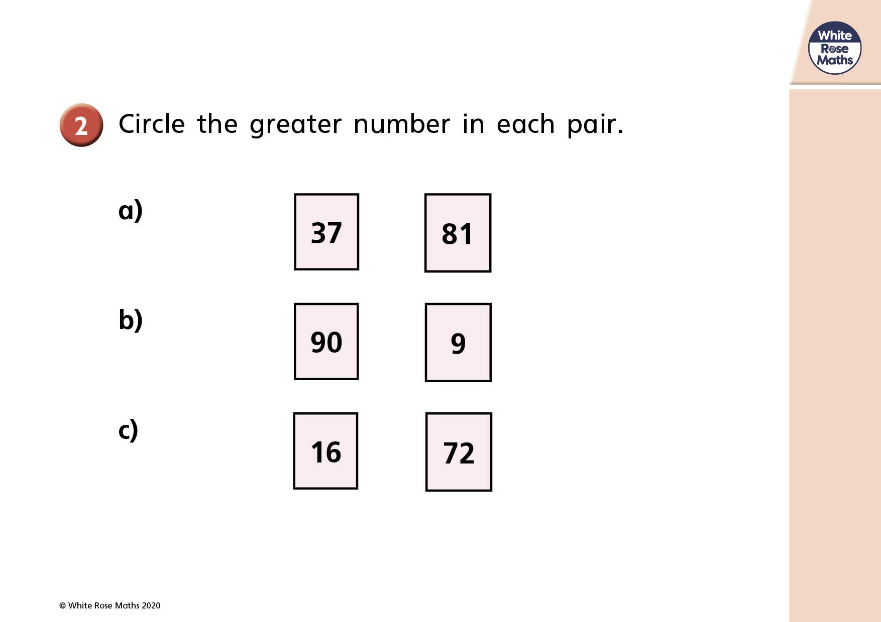
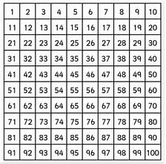
Use Base 10 or a 100 square to help you.

Slide 8


