Slide 1


Geography
Beside the Seaside
Year One
Geography | Year 2 | Beside the Seaside | Features of the Seaside | Lesson 2

Slide 2


Slide 3
Aim
I can use key words to describe seaside locations.
I can observe aerial photographs of seaside locations.
Success Criteria
I can use key words to talk about the key features of the seaside.
I can begin to say which features are ‘human’ and which are ‘physical’.
I can spot key features of seaside locations using aerial photographs.
I can use my senses to say describing words about what I can see in aerial photographs.

Slide 4

Key Words
seaside
coastline
beach
human
physical
aerial view
bird’s-eye
view
observe
sand
sea
promenade
cliffs
coast
pier
vegetation
harbour
shop
sand dunes
bay
lighthouse

Slide 5

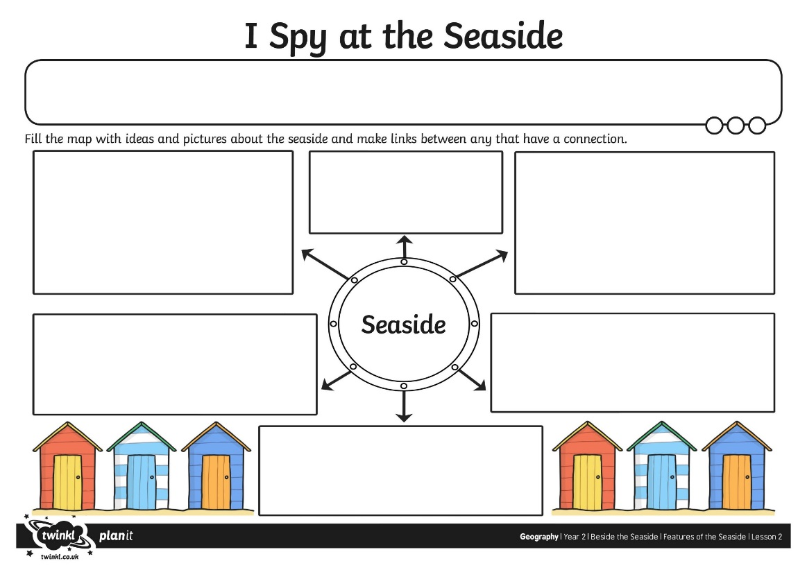

I Spy at the Seaside
What things can you see at the seaside?
What things can you do?

Slide 6

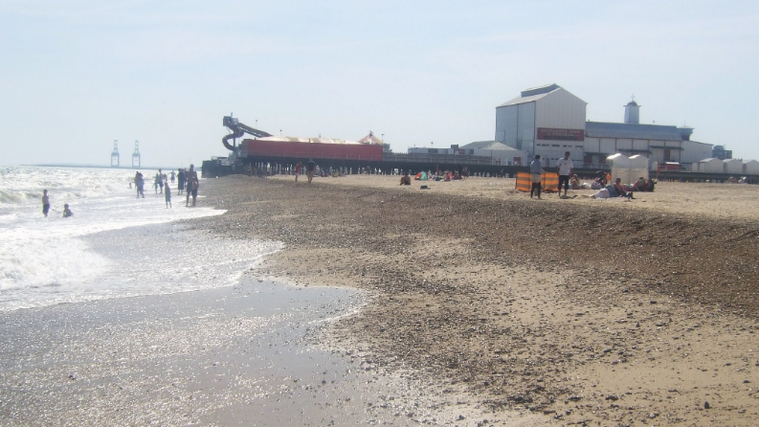
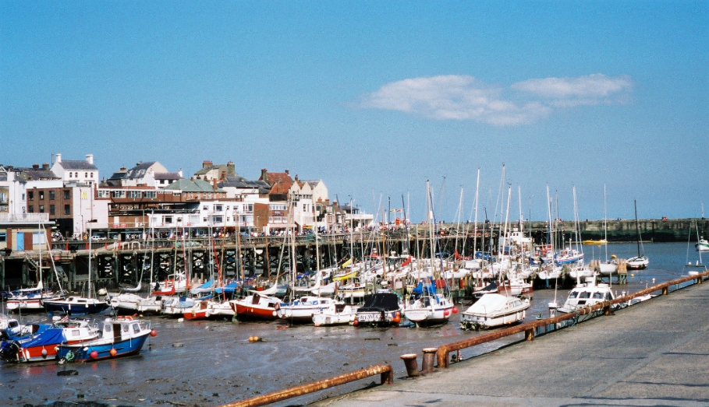
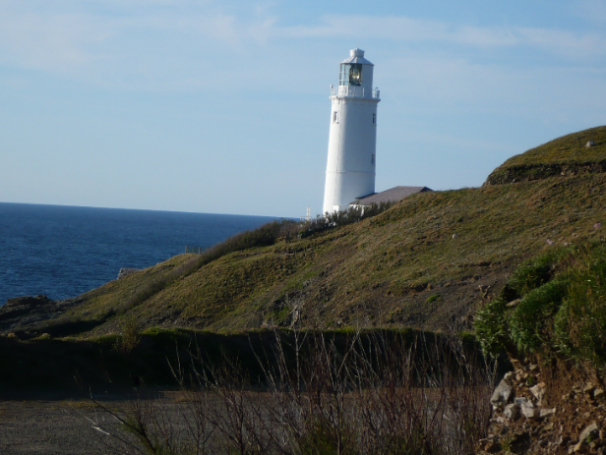
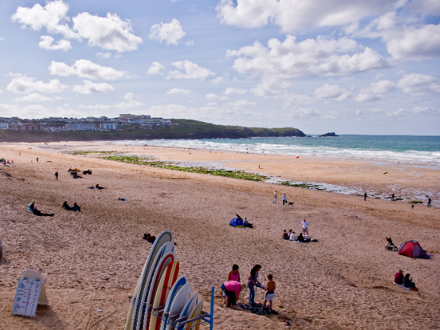
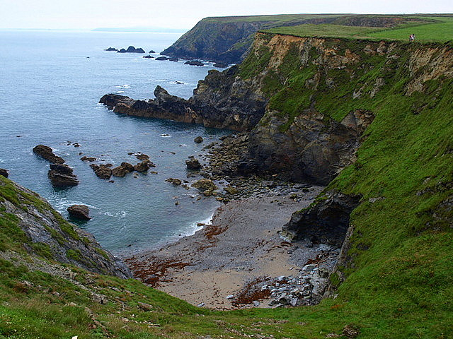
Features of the Seaside
What features can you see? What things are natural/physical? What things are human/man-made?

Slide 7
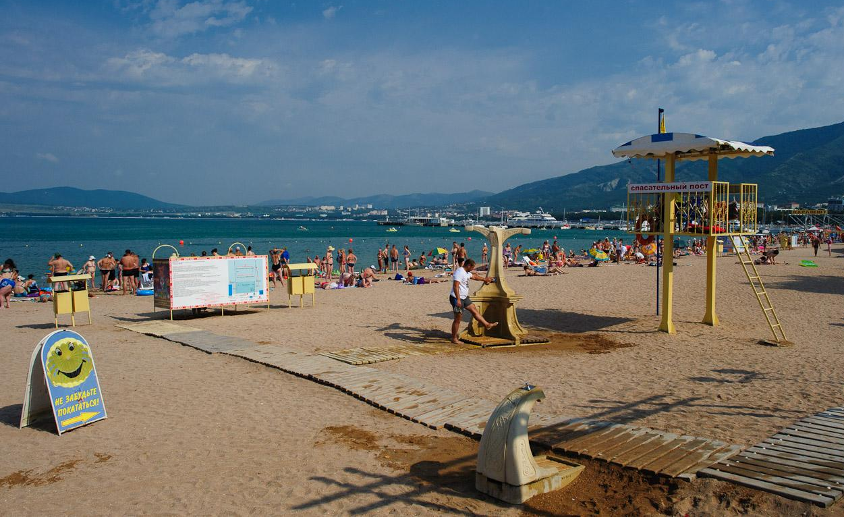
Features of the Seaside
Beach
Photo courtesy of Evgeniy Isaev @flickr.com - granted under creative commons licence - attribution

Slide 8
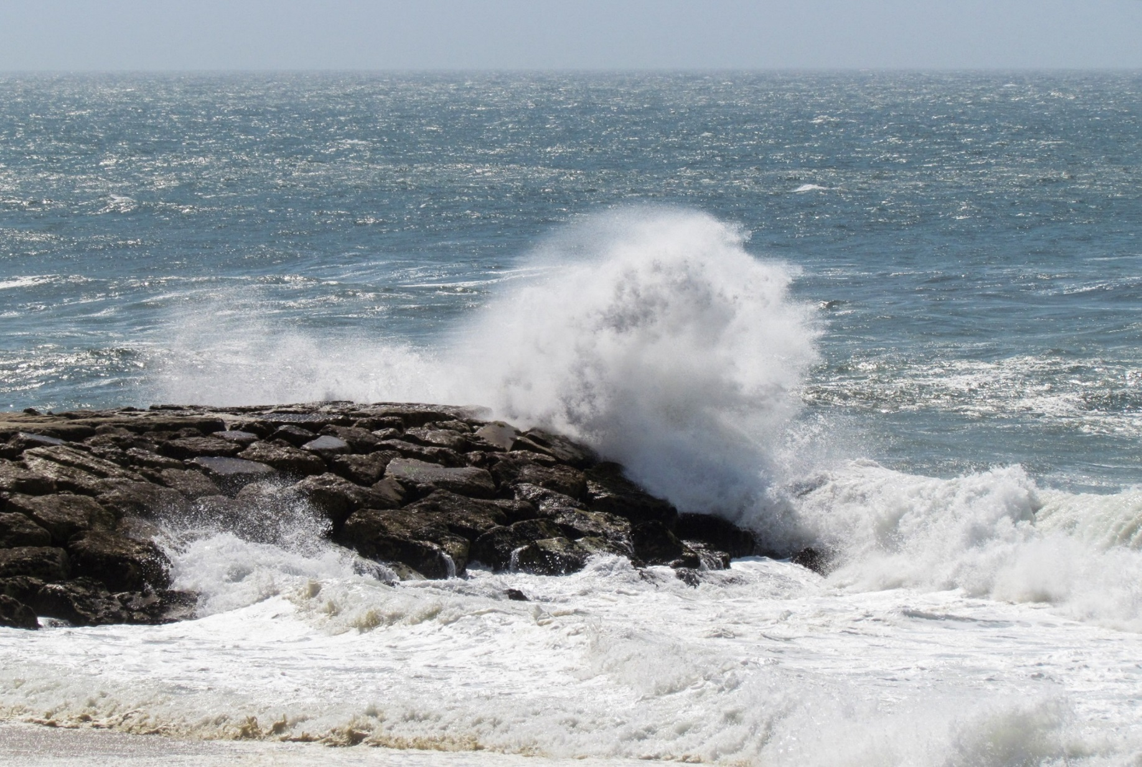
Features of the Seaside
Sea
Photo courtesy of daniela_naturephotography @flickr.com - granted under creative commons licence - attribution

Slide 9
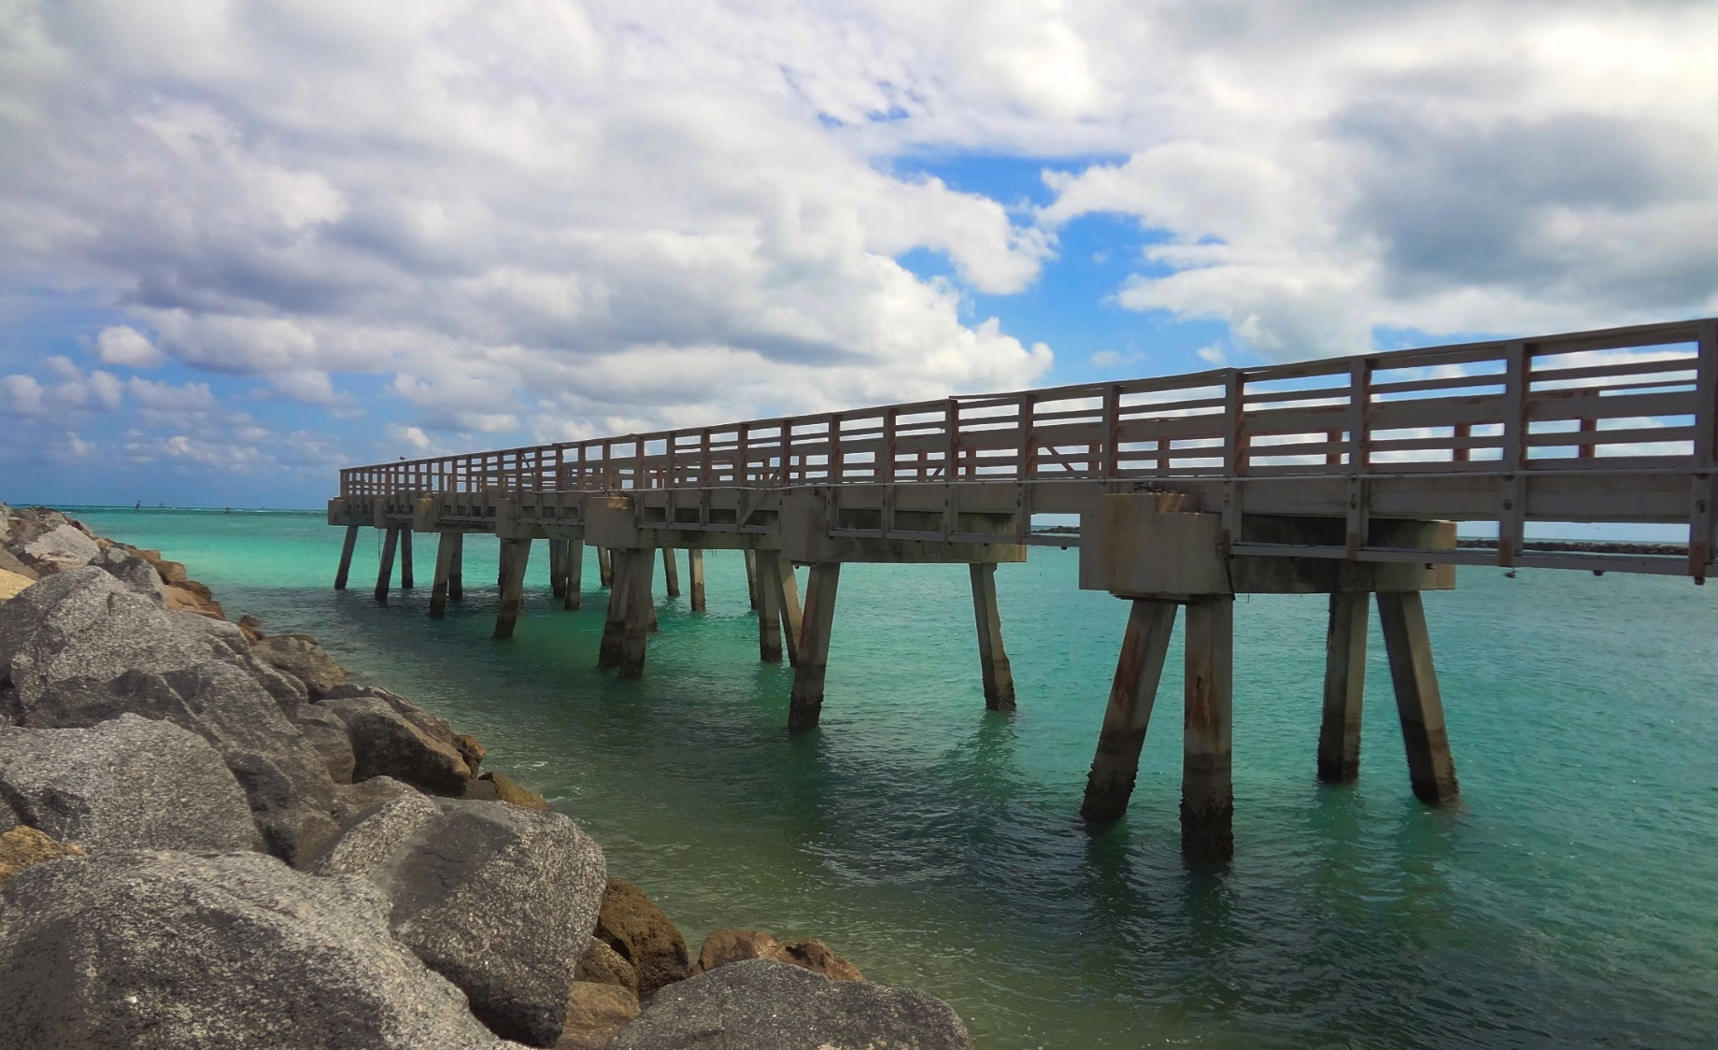
Features of the Seaside
Pier
Photo courtesy of chadcooperphotos @flickr.com - granted under creative commons licence - attribution

Slide 10
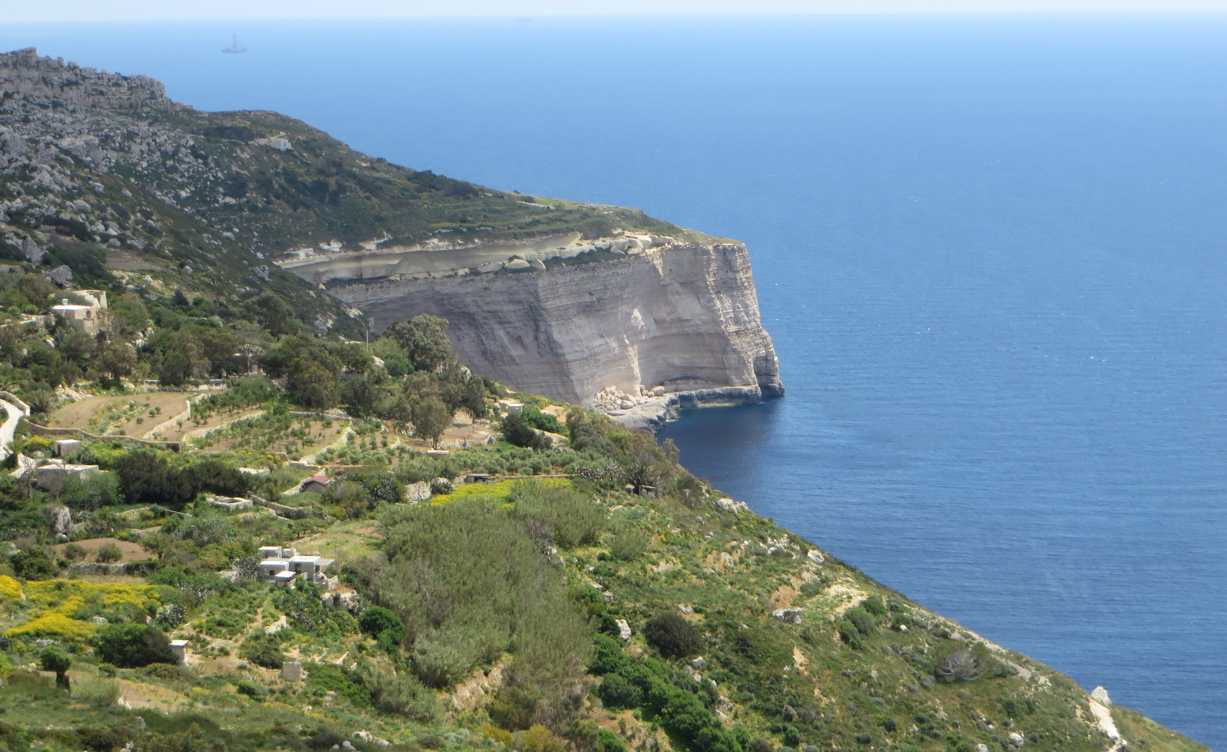
Features of the Seaside
Cliffs
Photo courtesy of brostad @flickr.com - granted under creative commons licence - attribution

Slide 11
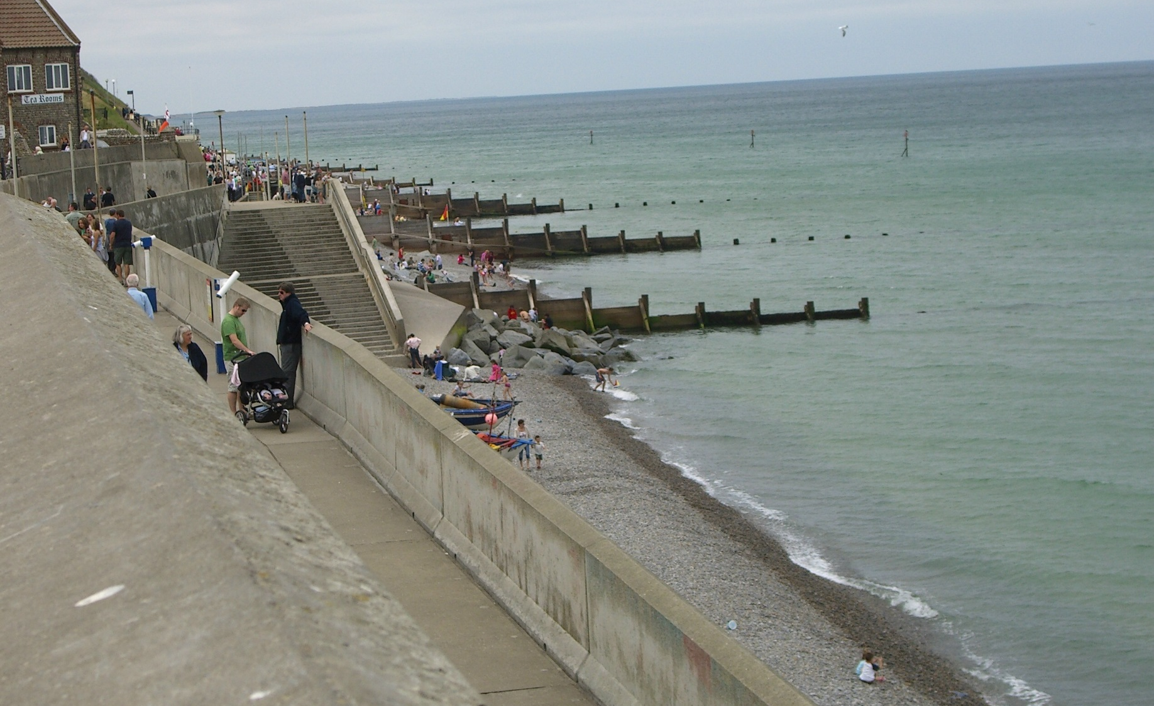
Features of the Seaside
Promenade
Photo courtesy of wikidave @flickr.com - granted under creative commons licence - attribution

Slide 12
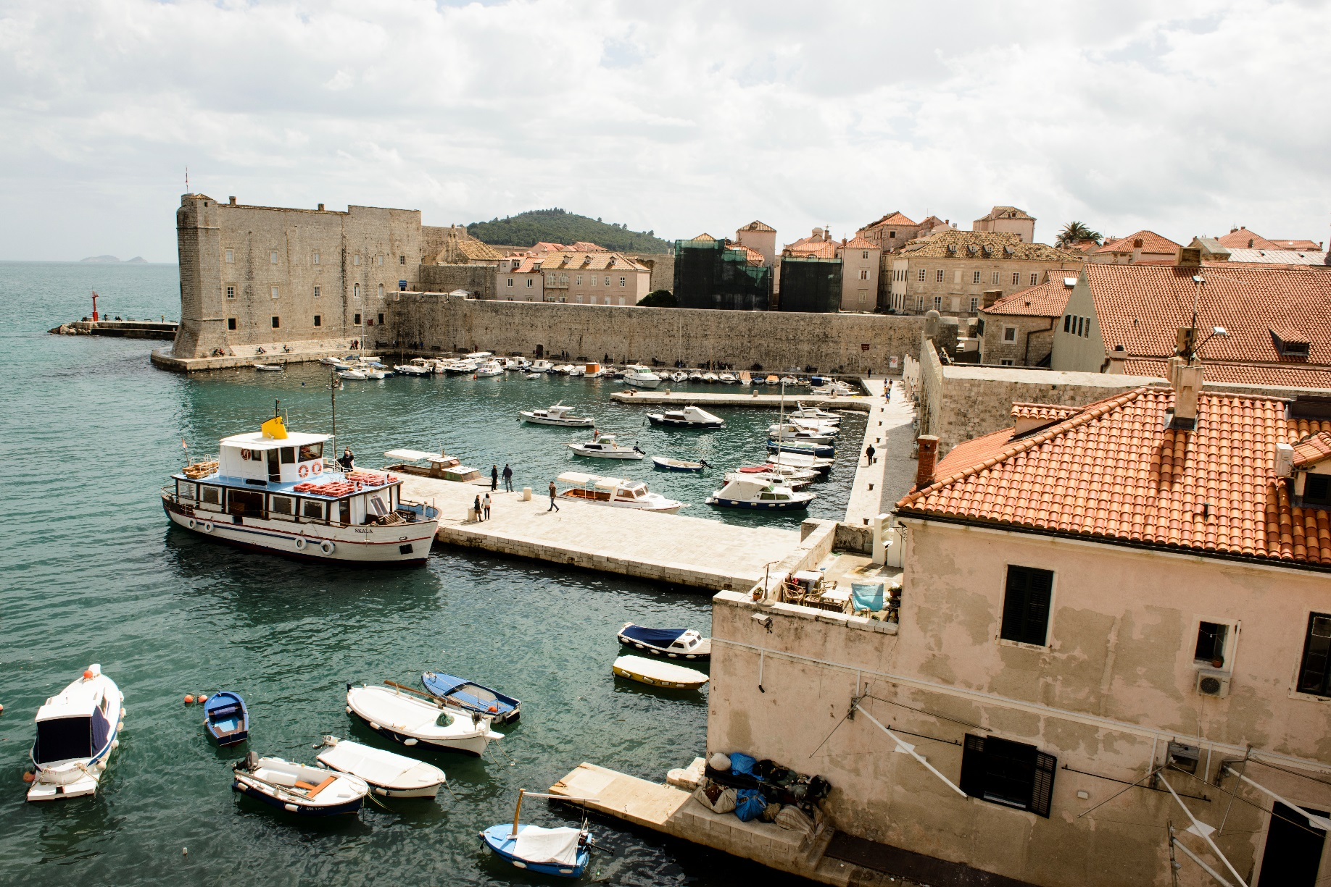
Features of the Seaside
Harbour
Photo courtesy of sonofgroucho @flickr.com - granted under creative commons licence - attribution

Slide 13
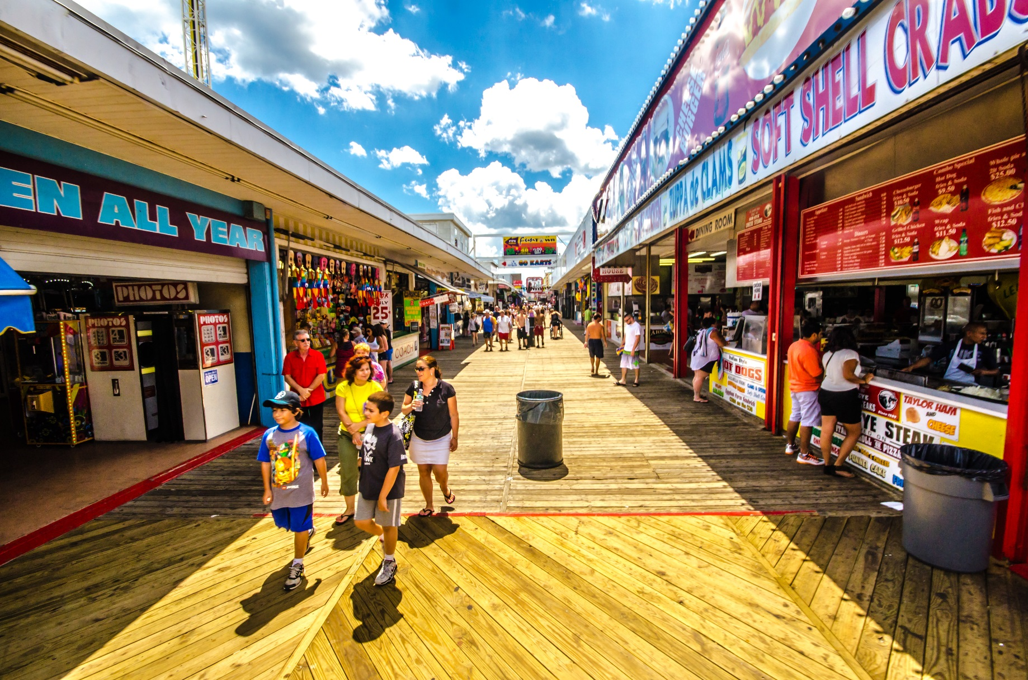
Features of the Seaside
Shops
Photo courtesy of kjarrett @flickr.com - granted under creative commons licence - attribution

Slide 14
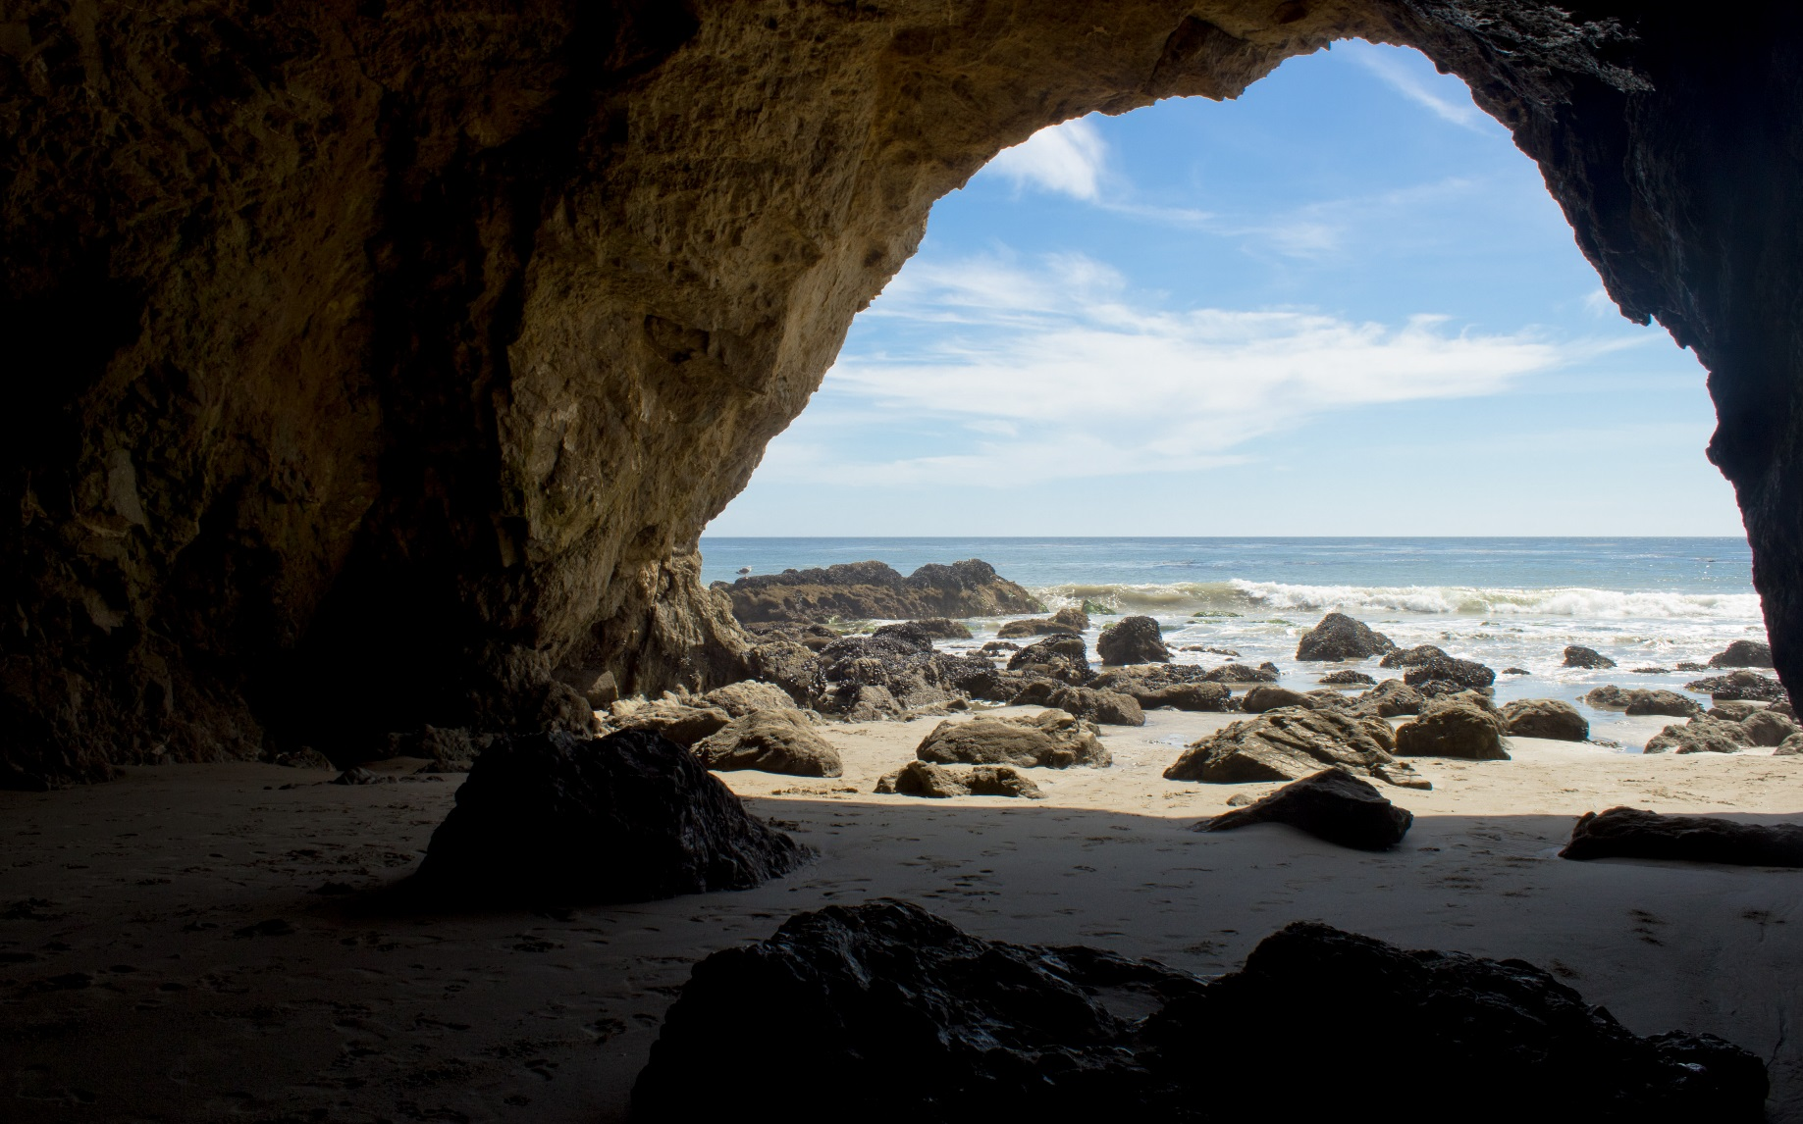
Features of the Seaside
Cave
Photo courtesy of brostad @flickr.com - granted under creative commons licence - attribution

Slide 15
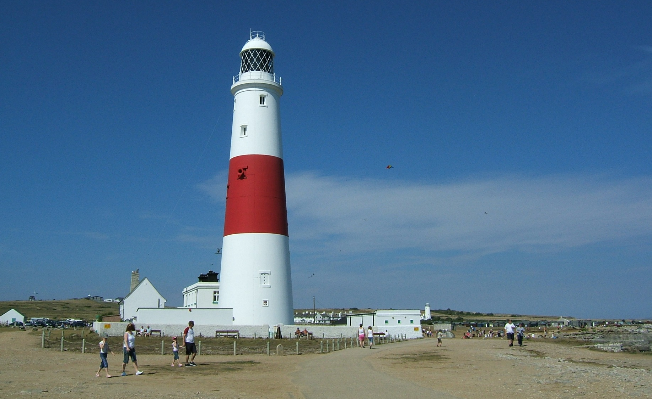
Features of the Seaside
Lighthouse
Photo courtesy of wikidave @flickr.com - granted under creative commons licence - attribution

Slide 16
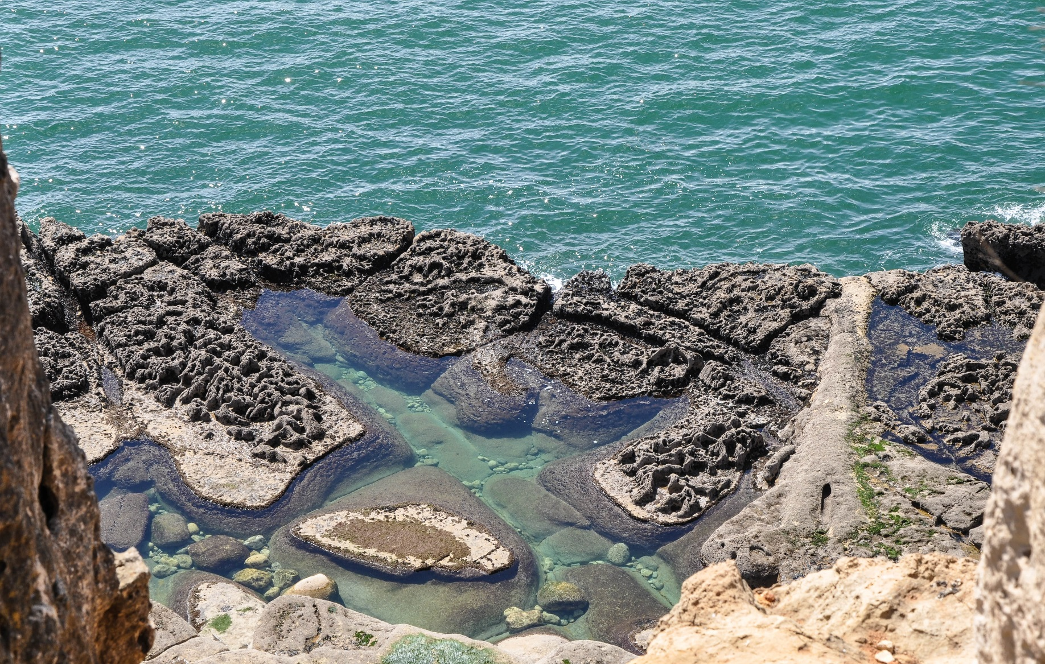
Features of the Seaside
Rockpools
Photo courtesy of sonofgroucho @flickr.com - granted under creative commons licence - attribution

Slide 17
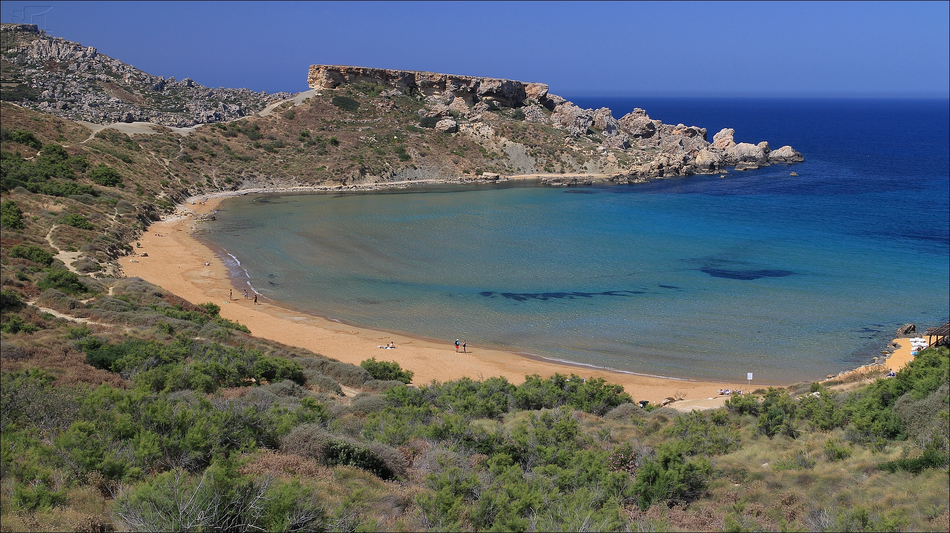
Features of the Seaside
Bay
Photo courtesy of imagea @flickr.com - granted under creative commons licence - attribution

Slide 18
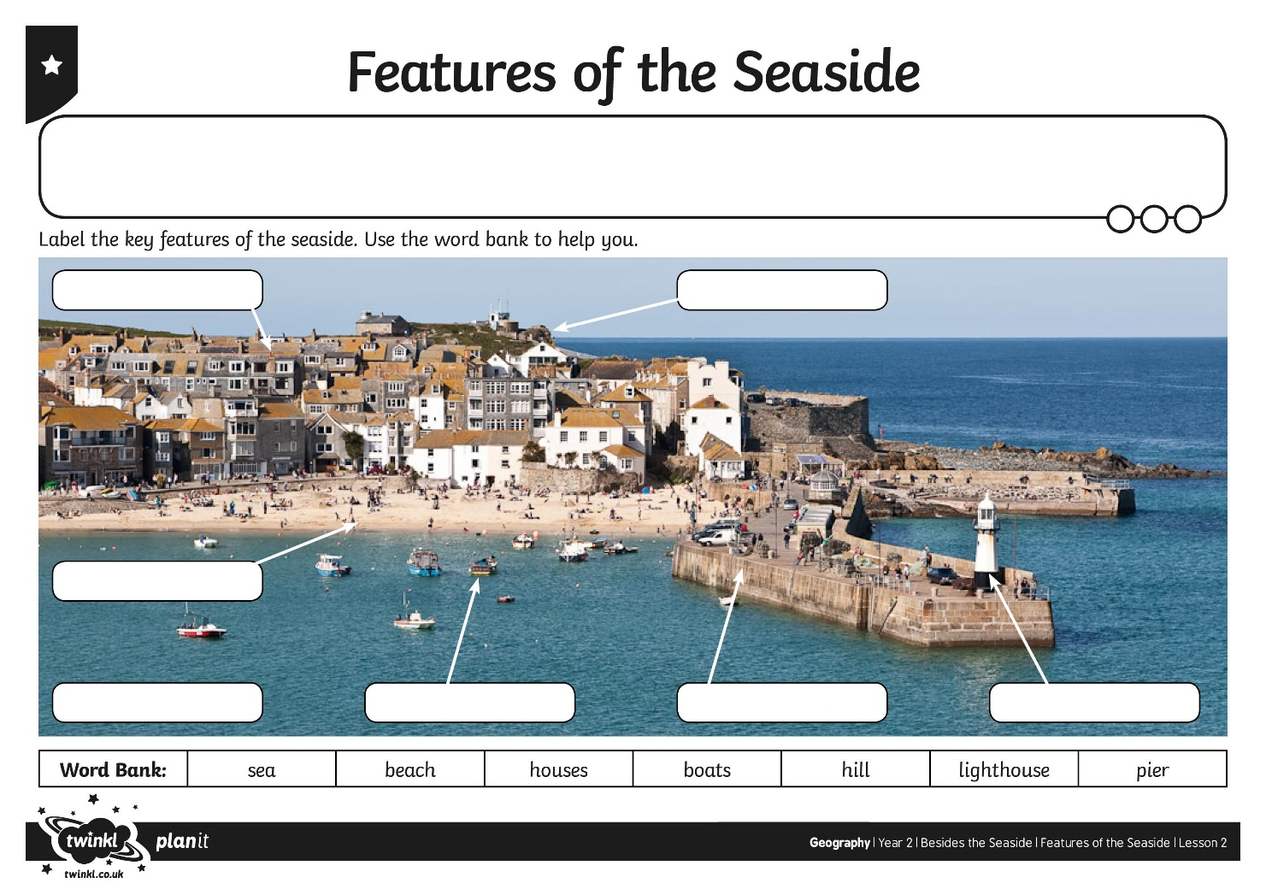
Features of the Seaside

Slide 19
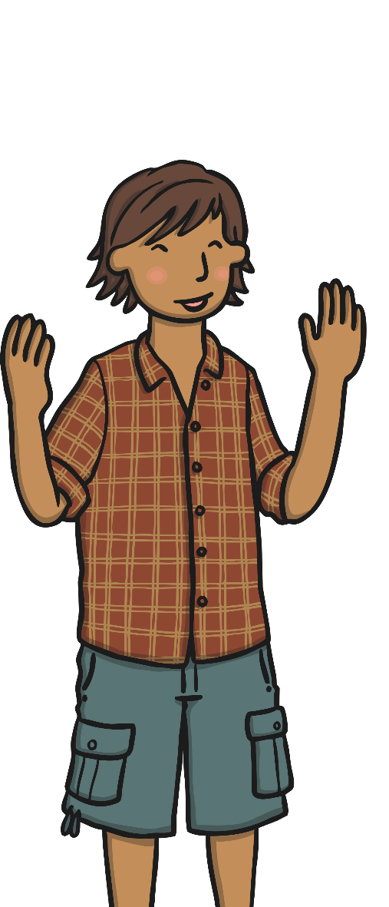
Seaside Sort
Can you sort these key words into ‘human’ and ‘physical’?
sand
sea
promenade
cliffs
coast
pier
vegetation
harbour
shop
beach
fairground
lighthouse

Slide 20
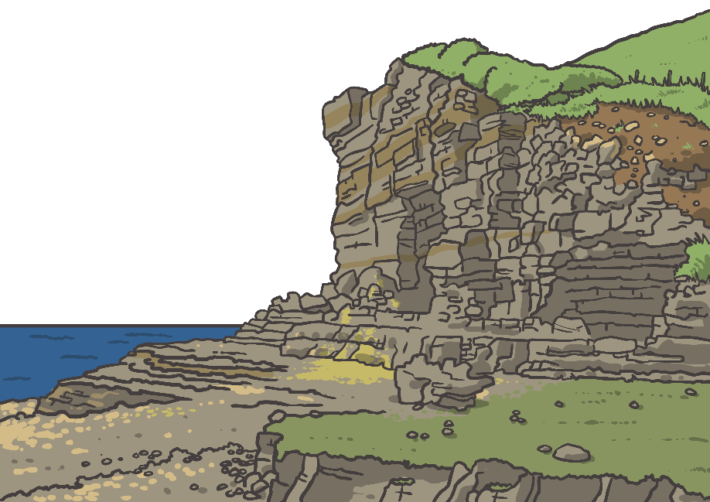

Seaside Sort
Draw a table like this to help you sort the key words:
Human | Physical

Slide 21
Seaside Sort
Draw a table like this to help you sort the key words:
Human | Physical
sand
sea
promenade
vegetation
harbour
shop
cliffs
coast
pier
beach
fairground
lighthouse

Slide 22

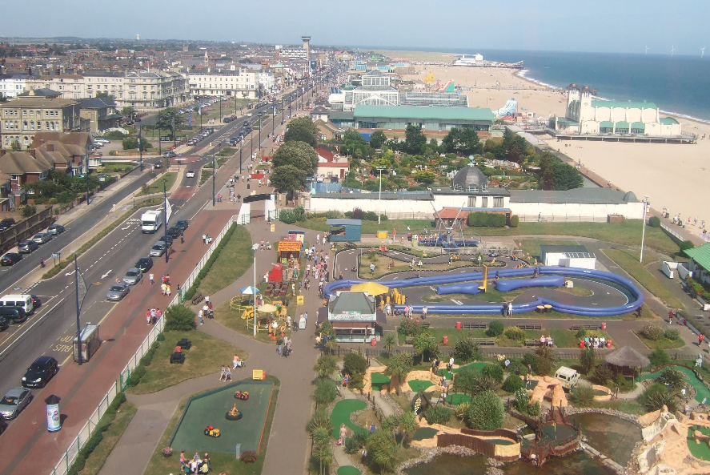
In the Picture

Slide 23
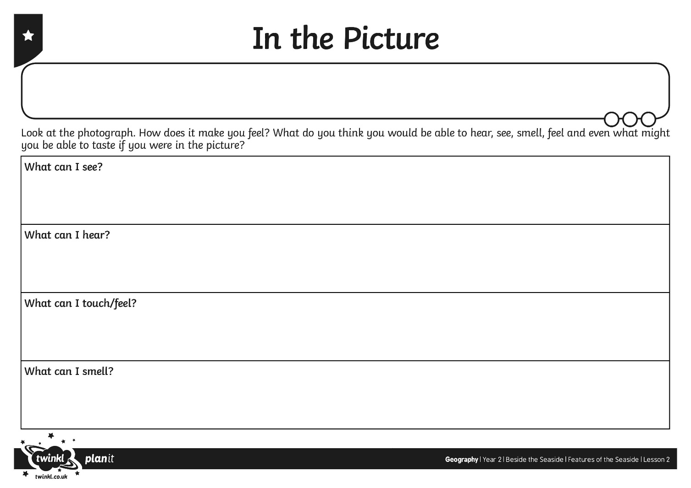
In the Picture

Slide 24
Let’s Ask!
Look at the photograph again.
What questions would you like to ask to find out more about what is happening in the picture?

Slide 25
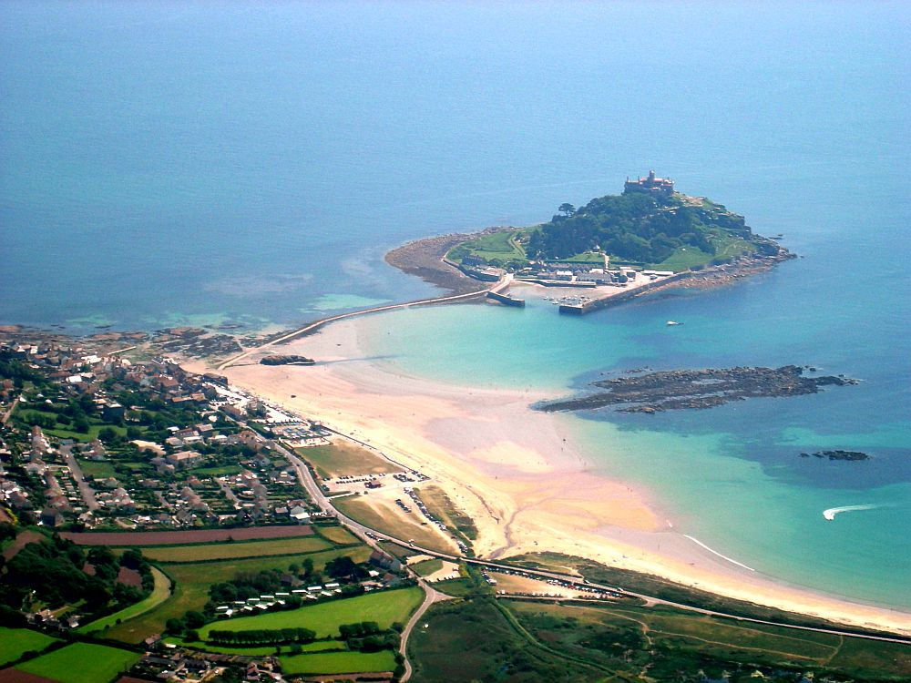
Let’s Ask!
Photo courtesy of 50144889@N08 @flickr.com - granted under creative commons licence - attribution

Slide 26
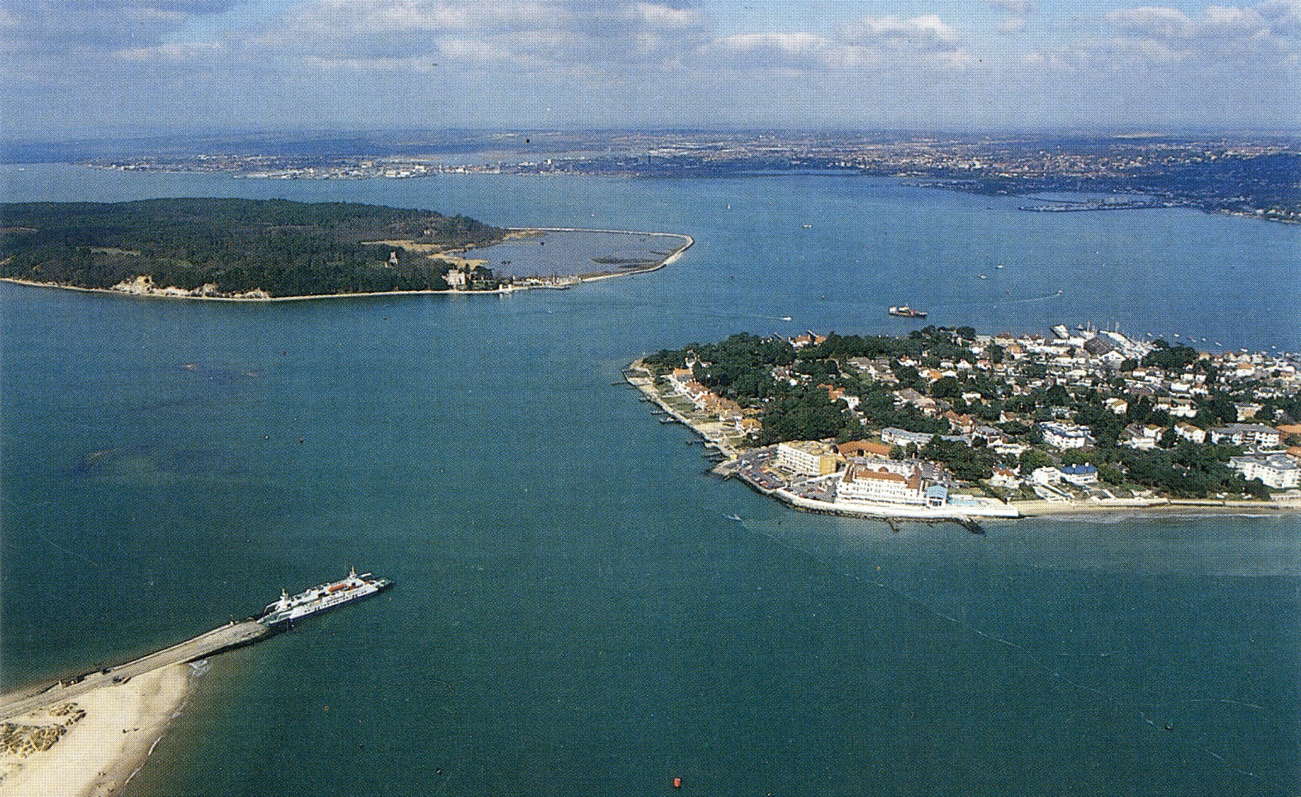
Let’s Ask!
Photo courtesy of alwyn_ladell @flickr.com - granted under creative commons licence - attribution

Slide 27

Aim
I can use key words to describe seaside locations.
I can observe aerial photographs of seaside locations.
Success Criteria
I can use key words to talk about the key features of the seaside.
I can begin to say which features are ‘human’ and which are ‘physical’.
I can spot key features of seaside locations using aerial photographs.
I can use my senses to say describing words about what I can see in aerial photographs.

Slide 28


