Slide 1
Monday 5th October 2020
LO: To build an overview of world history.
C: beliefs and seasons

Slide 2
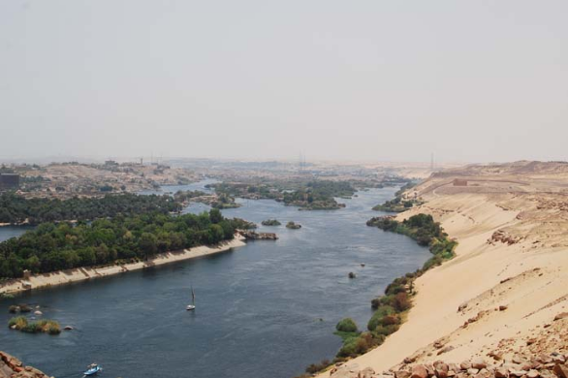
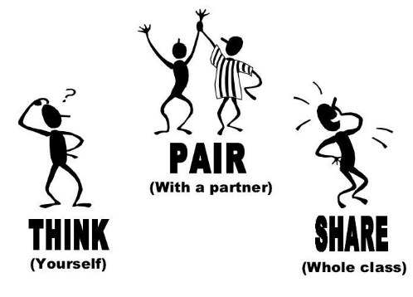
"Why might the Ancient Egyptians have thought the yearly flooding of The Nile was a gift from God?"

Slide 3
The Egyptians believed in many different God’s. Lets look at the story of Isis and her gift of The Nile.

Slide 4
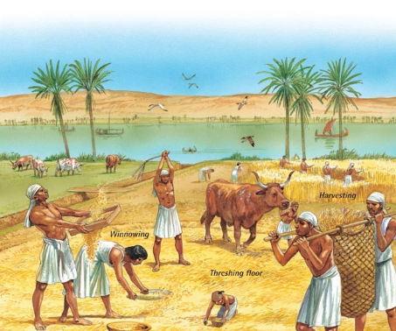
So how did the flooding influence Seasons?
There were three main seasons:
The growing season
The farming season
The flooding season

Slide 5
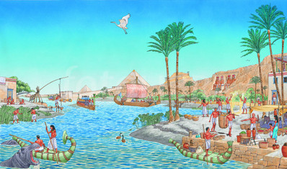
Akhet - the inundation (June-September): The Flooding Season.
No farming was done at this time, as all the fields were flooded. Instead, many farmers worked for the Pharaoh (King), building pyramids or temples. Some of the time was spent mending their tools and looking after animals.

Slide 6
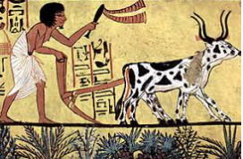
Peret (October-February): The Growing Season.
In October the floodwaters receded, leaving behind a layer of rich, black soil. This fertile soil was then ploughed and seeded.

Slide 7
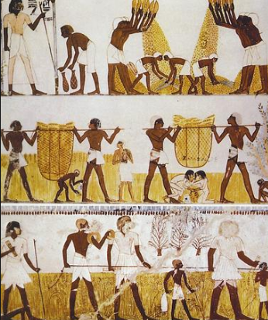
Shemu (March-May): The Harvesting Season.
The fully grown crops had to be cut down (harvested) and removed before the Nile flooded again. It was also the time to repair the canals ready for the next flood.

Slide 8
Paddling: Draw seasons and use key words from the handout to write bullet points about the seasons.
Snorkeling: Draw seasons and use key words from the handout to write facts about the seasons.
Diving: Draw and use technical language to describe the three seasons.

